Slide 1
CASAS Website Account
Please indicate in the Chat box if you can successfully Login to the CASAS website at www.casas.org.
✓ Yes! I can log on.
∅ No, I cannot log on.
Notes:
Display this slide while admitting participants from the Waiting Room.

Slide 2
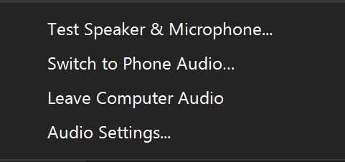
Switch to Phone Audio
Click the Mute icon UP Arrow
Click Switch to Phone Audio
########
########
Notes:
This is an ANIMATED slide with 2 clicks for each point.

Slide 3
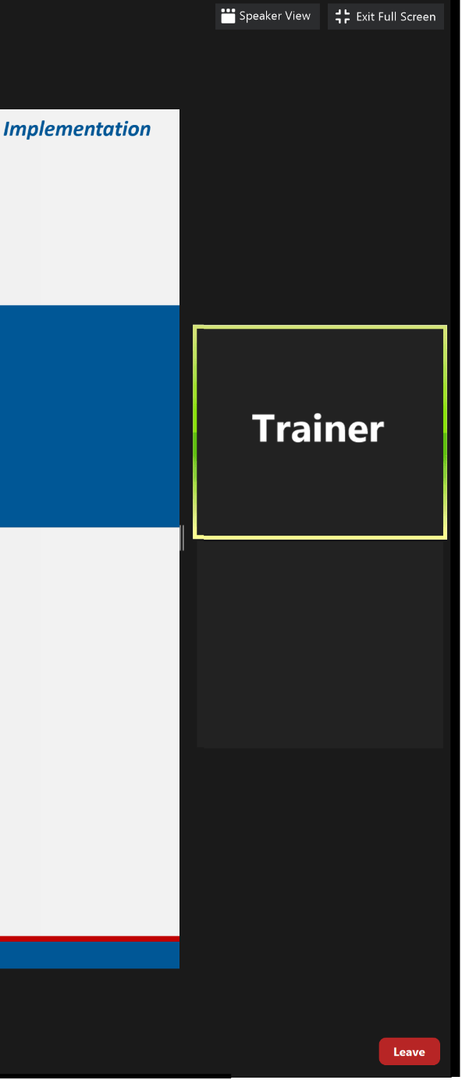
Meeting Controls & Screen Display
Mute and unmute your microphone
Start a screen share
See who's currently in the meeting
Drag vertical bar right to increase the display
Turns your camera on or off
Access the window to chat with trainers
Notes:
This is an ANIMATED slide with 7 clicks for each point.

Slide 5
Welcome!
We are so glad you are here.
Please introduce yourself in the Chat box by entering:
Your Name
Your Organization

Slide 6
Module 1 CASAS Implementation Basics
Presented by
Chrissy Palumbo, National Program Specialist
Dawn Montgomery, Technical Implementation Specialist
www.casas.org
casas@casas.org
1-800-255-1036
© 2020 CASAS — Comprehensive Adult Student Assessment Systems.

Slide 7
Agenda
About this Training
Unit 1. About CASAS
Unit 2. Tests Overview
Unit 3. Intake, Locators, Appraisals
Unit 4. Progress Tests
Unit 5. Results, Reports, Instruction
Unit 6. What’s Next?
Training Completion

Slide 8
Polls
Answer the poll.
Submit your answer.

Slide 9
Polls
Close the poll
Answer the poll
Scroll the poll
Submit the poll
Notes:
This is an ANIMATED slide with 4 clicks for each point.

Slide 10
We would like to get to know you.
Role at your agency
Agency size and population served
Testing method and environment
How often testing occurs

Slide 11
Training Content
Content is presented in Books on the training site.
Navigate the content with the RIGHT arrow.
Notes:
This is an ANIMATED slide with 1 click for the arrows.

Slide 12
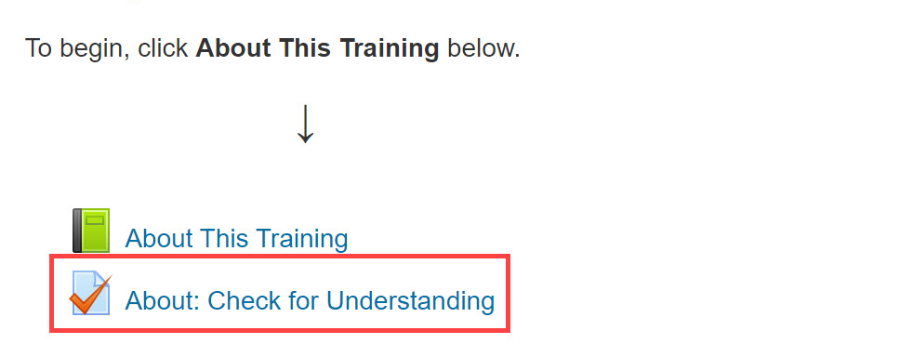
Check for Understanding
Notes:
This is an ANIMATED slide with 2 clicks for “Attempt activity now” and getting 100%.

Slide 13
Return to the Meeting Room
Click the blue video icon in the Taskbar at the bottom of your computer monitor.
Notes:
This is an ANIMATED slide without any clicks.

Slide 14
Question Time!
Where do the ONLINE Modules live?
training.casas.org
What is the cost of the CASAS training?
Free!
Notes:
This is an ANIMATED slide with 2 clicks for each question AND 2 clicks for each answer.

Slide 15
Connecting to the Training Site
Go To
Click training.casas.org in the Chat box.
Your web browser will open to the Training site.
Log In
Scroll down and click the Module 1 training title.
Enter your log in credentials and click Login.
Enroll
When you are returned to the Training website,
Click Enter Here to enroll in Module 1.
Notes:
This is an ANIMATED slide with 3 clicks for each Chevron.

Slide 16
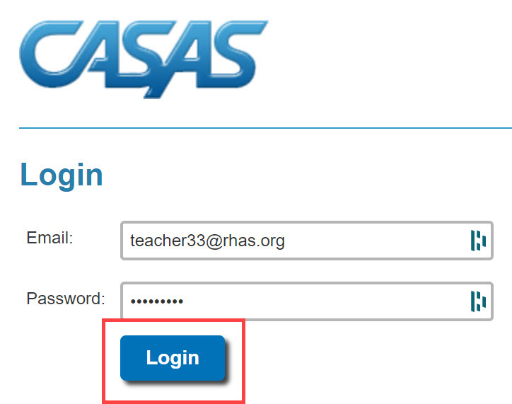
Connecting to the Training Site
Training.casas.org
Enroll in Module 1
Module 1: CASAS Implementation Basics
Notes:
This is an ANIMATED slide with 4 clicks for each highlighted text.

Slide 17
Welcome Back!

Slide 18
Polls
Answer the poll.
Submit your answer.

Slide 19
Welcome Back!

Slide 20
Unit 2. Check for Understanding
1. CASAS ____________ tests (pretests and post-tests) have four principal uses:
Fill in the Blanks
accountability
instruction
measure
progress
skill
to identify a student’s ____________ level
to guide ____________
to ____________ learning progress
for ____________ reporting
Notes:
This is an ANIMATED slide with 5 clicks to fill in each blank.

Slide 21
Unit 2. Check for Understanding
2. Which test delivery method requires a Test Administration Manual (TAM)?
Paper tests only
CASAS eTests only
Both paper tests and eTests
A TAM is not required for paper tests or eTests.
3. CASAS eTests works with iPads & Chromebooks.
True
False
Notes:
This is an ANIMATED slide with 2 clicks for correct answers.

Slide 22
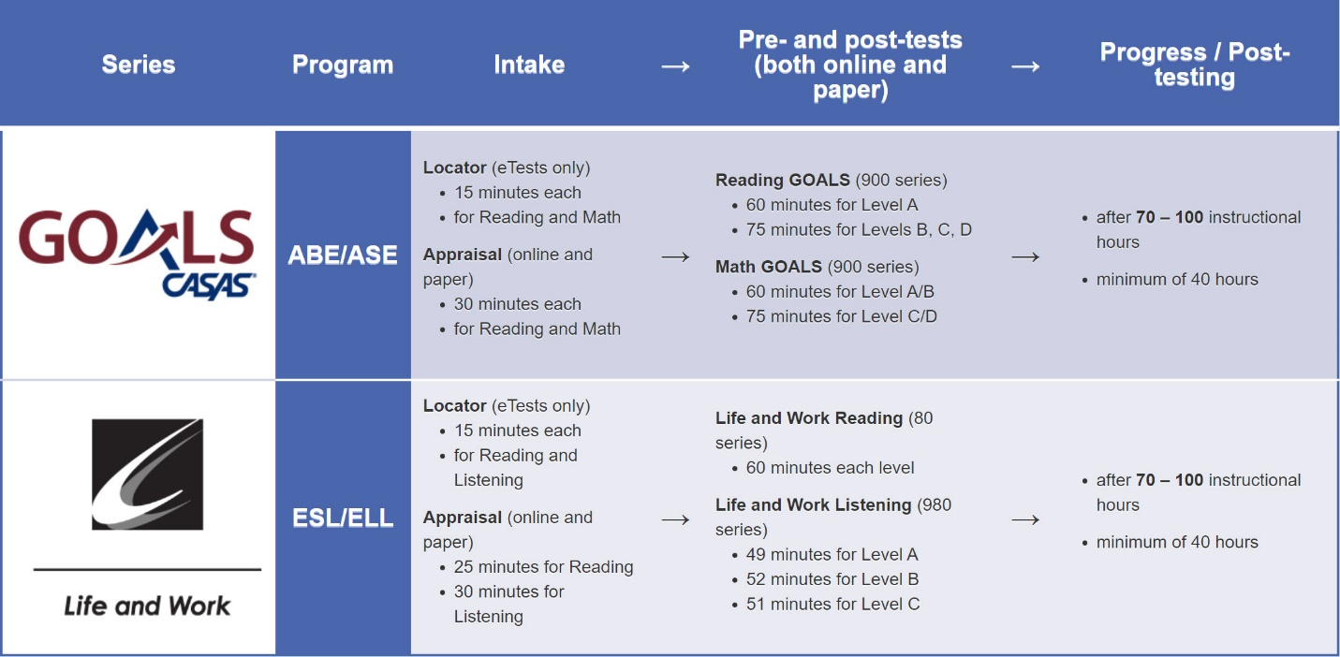
4. What is the maximum time allowed at intake for an ABE student who takes the following?
Reading GOALS Locator + Reading GOALS, Level A
+
Math GOALS Locator + Math GOALS, Level A/B
2 hours
2 1/2 hours
3 1/2 hours
4 hours
Notes:
This is an ANIMATED slide with 1 click for correct answer.

Slide 23
Welcome Back!

Slide 24
Breakout Rooms
Click to Join
Volunteer shares their screen
Collaborate
Return to the meeting

Slide 25
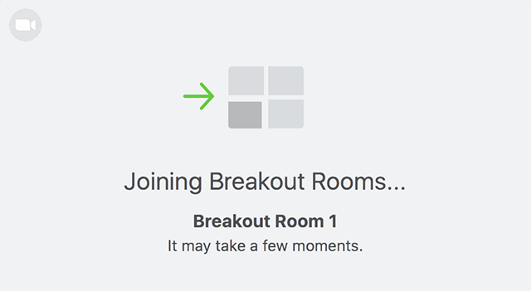
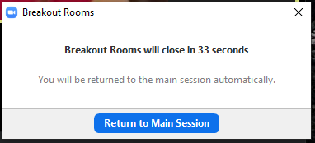
Breakout Rooms
Notes:
This is an ANIMATED slide with 3 clicks.

Slide 26
Unit 3: Checks For Understanding
1. What is the purpose of a Locator or Appraisal?
Document completion of educational functioning levels
Identify instructional needs
Determine an appropriate pretest
All of the above
2. You may use a Locator or Appraisal as a Pretest.
True
False
3. How is an Appraisal different from a Locator?
It has more questions and takes longer.
It can be used with Paper and eTests.
It can be used for instructional program placement.
It can be used to determine eligibility for job-training programs.
All of the above.
4. Testing new students is usually faster with eTests.
True
False
5. What is the purpose of the Intake Screening?
It determines if a locator or appraisal is suitable for a student.
It determines which pretest to give a student with beginning level skills.
It can provide valuable information about a student’s speaking and writing skills and previous education.
All of the above.
6. Which type of assessment presents test items widely distributed along the CASAS scale?
Appraisal or Locator
Intake Screening
Pretest
Post-test
7. Which type of assessment presents test items clustered at a specific level?
Locator
Appraisal
Progress test (Pre- and Post-tests)
Intake Screening
8. What provides general information about what a scale score means in terms of job and life skills functioning
Answer sheet demographics
Next Assigned Test report
CASAS Skill Level Descriptors
Scale Score Conversion charts

Slide 27
Welcome Back!

Slide 28
Unit 3: Checks For Understanding
1. What is the purpose of a Locator or Appraisal?
Document completion of educational functioning levels
Identify instructional needs
Determine an appropriate pretest
All of the above
2. You may use a Locator or Appraisal as a Pretest.
True
False
3. How is an Appraisal different from a Locator?
It has more questions and takes longer.
It can be used with Paper and eTests.
It can be used for instructional program placement.
It can be used to determine eligibility for job-training programs.
All of the above.
4. Testing new students is usually faster with eTests.
True
False
Check your Answers!
How did you do?
Notes:
CFU’S CHECK your Answers! Take a look at the answers to the Checks for Understanding.
How did you do?

Slide 29
Unit 3: Checks For Understanding
Check your Answers!
5. What is the purpose of the Intake Screening?
It determines if a locator or appraisal is suitable for a student.
It determines which pretest to give a student with beginning level skills.
It can provide valuable information about a student’s speaking and writing skills and previous education.
All of the above.
6. Which type of assessment presents test items widely distributed along the CASAS scale?
Appraisal or Locator
Intake Screening
Pretest
Post-test
7. Which type of assessment presents test items clustered at a specific level?
Locator
Appraisal
Progress test (Pre- and Post-tests)
Intake Screening
8. What provides general information about what a scale score means in terms of job and life skills functioning?
Answer sheet demographics
Next Assigned Test report
CASAS Skill Level Descriptors
Scale Score Conversion charts
How did you do?

Slide 30
Welcome Back!

Slide 31
Polls
Answer the poll.
Submit your answer.

Slide 32
Welcome Back!

Slide 33
Breakout Rooms
Click to Join
Volunteer shares their screen
Collaborate
Return to the meeting

Slide 34
Welcome Back!

Slide 35
Training Completion
Training Verification
Training Evaluation
Test Security Agreement
Certificate of Completion

Slide 36
Steps to Complete your Training
Click: Link put in the Chat box
Enter: Training Passcode ####
Click: Enter here
Click: Test Security Agreement
Complete
Submit
Click: Get Your Certificate!
Notes:
This is an ANIMATED slide with 5 clicks for each highlighted text.
Note: Click 4 has 2 additional automated text.

Slide 37
Certificate of Completion
DOWNLOAD and save to your computer.
PRINT the Certificate displayed on your screen.
∗∗∗
Your certificate is sent to you automatically as an email attachment.
You can return to the module until June 30 to:
Get another copy of your Certificate.
Review training content.

Slide 38
Welcome Back!

Slide 39
Polls
Answer the poll.
Submit your answer.

Slide 40
Thank you for attending!
Assessment (CASAS eTests Online and Paper)
National External Diploma Program
Annual National Summer Institute
TOPSpro Enterprise Accountability Software
Online and face-to-face training
QuickSearch Online curriculum materials database
Workforce Skills Certification System
For Training Support, send an email to training@casas.org.
Join monthly News & Updates Webinars, at:
https://www.casas.org/social-media-newsroom/webinars
Images by Freepik Stories https://stories.freepik.com
Be CASAS Connected
Use #AdultEdu and #CASAScommunity to connect.
/CASASsystem
/CASASsystem
/CASASAssessment
www.casas.org
casas@casas.org
1-800-255-1036

