Slide 1
CASAS Website Account
Please indicate in the Chat box if you can successfully Login to the CASAS website at www.casas.org.
✓ Yes! I can log on.
∅ No, I cannot log on.
Notes:
Display this slide while admitting participants from the Waiting Room.

Slide 2
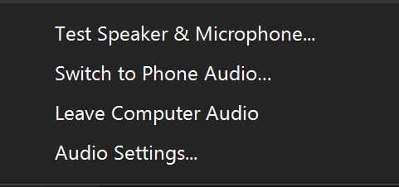
Switch to Phone Audio
Click the Mute icon UP Arrow
Click Switch to Phone Audio
########
########
Notes:
This is an ANIMATED slide with 2 clicks for each point.

Slide 3
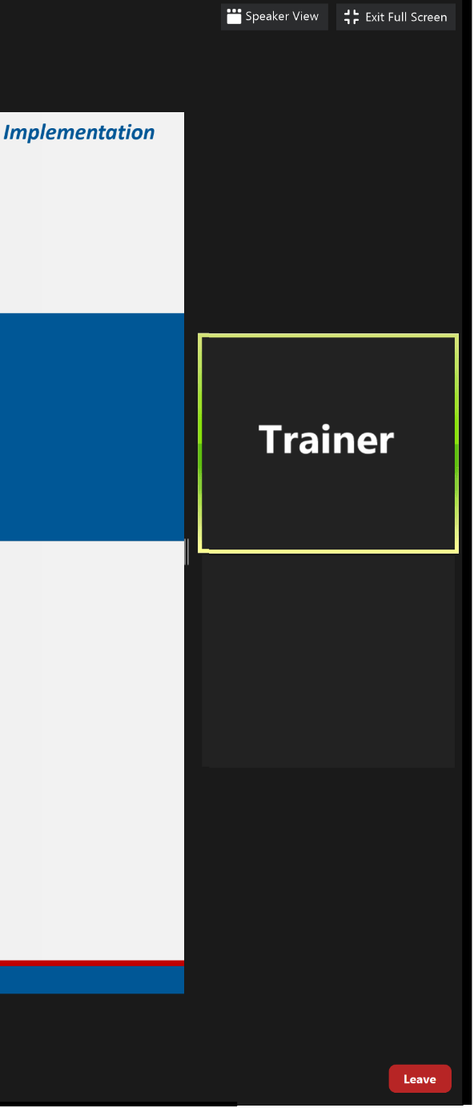
Meeting Controls & Screen Display
Mute and unmute your microphone
Start a screen share
See who's currently in the meeting
Drag vertical bar right to increase the display
Turns your camera on or off
Access the window to chat with trainers
Notes:
This is an ANIMATED slide with 7 clicks for each point.

Slide 5
Welcome!
We are so glad you are here.
Please introduce yourself in the Chat box by entering:
Your Name
Your Organization

Slide 6
Module 2 CASAS eTests Implementation
Presented by
Chrissy Palumbo, National Program Specialist
Dawn Montgomery, Technical Implementation Specialist
www.casas.org
casas@casas.org
1-800-255-1036
© 2020 CASAS — Comprehensive Adult Student Assessment Systems.
Notes:
Display this slide at the top of the hour!

Slide 7
Agenda
About this Training
Unit 1. Test Administration
Unit 2. Intake Screening
Unit 3. Locators & Progress Tests
Unit 4. Going Live! First Steps
Unit 5. Going Live! Next Steps
Unit 6. What's Next?
Training Completion

Slide 8
Polls
Answer the poll.
Submit your answer.

Slide 9
Polls
Close the poll
Answer the poll
Scroll the poll
Submit the poll
Notes:
This is an ANIMATED slide with 4 clicks for each point.

Slide 10
We would like to get to know you.
Role at your agency
Agency size and population served
Testing method and environment
How often testing occurs

Slide 11
Training Content
Content is presented in Books on the training site.
Navigate the content with the RIGHT arrow.
Notes:
This is an ANIMATED slide with 1 click for the arrows.

Slide 12
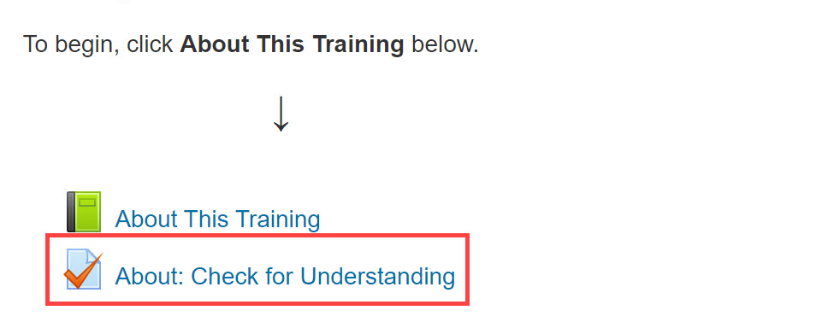
Check for Understanding
Notes:
This is an ANIMATED slide with 2 clicks for “Attempt activity now” and getting 100%.

Slide 13
Return to the Meeting Room
Click the blue video icon in the Taskbar at the bottom of your computer monitor.
Notes:
This is an ANIMATED slide without any clicks.

Slide 14
Connecting to the Training Site
Go To
Click training.casas.org in the Chat box.
Your web browser will open to the Training site.
Log In
Scroll down and click the Module 2 training title.
Enter your log in credentials and click Login.
Enroll
When you are returned to the Training website,
Click Enter Here to enroll in Module 2.
Notes:
This is an ANIMATED slide with 3 clicks for each Chevron.

Slide 15
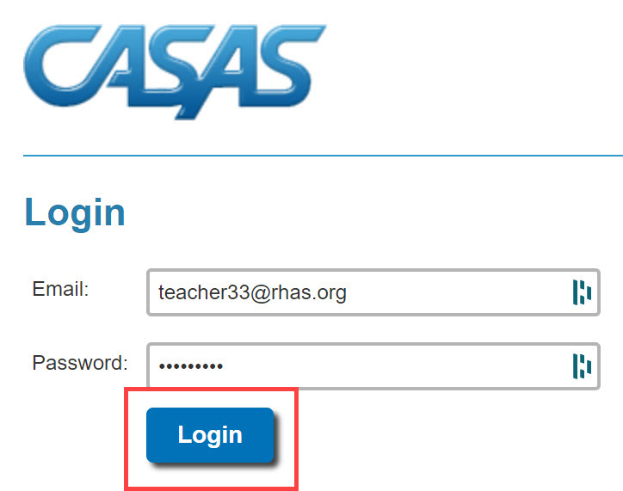
Connecting to the Training Site
Training.casas.org
Enroll in Module 2
Module 2: CASAS eTests Implementation
Notes:
This is an ANIMATED slide with 4 clicks for each highlighted text.

Slide 16
Welcome Back!

Slide 17
Breakout Rooms
Click to Join
Volunteer shares their screen
Collaborate
Return to the meeting

Slide 18
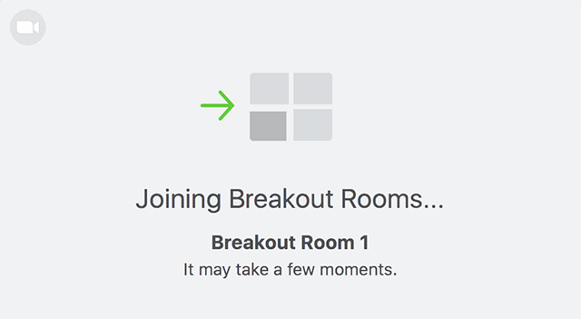
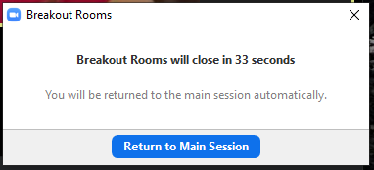
Breakout Rooms
Notes:
This is an ANIMATED slide with 3 clicks.

Slide 19
Welcome Back!

Slide 20
Unit 2. Check for Understanding
What is the purpose of the Intake Screening?
Determines if a locator or appraisal is suitable for a student.
Determines which pretest to give a student with beginning level skills.
Can provide valuable information about a student’s speaking and writing skills and previous education.
All of the above.
✓
Notes:
This is an ANIMATED slide with 1 click for the Answer ‘d’

Slide 21
2.1 If an ESL student scores 6 or more on the Oral Screening, give...
Locator + Pretest
2.2 If an ESL student has lower-level literacy skills and scores less than 6 on the Oral Screening, give…
Reading and Writing Screenings
2.3 If an ESL student has little or no difficulty with the Reading Screening, give…
Level A
2.4 If an ESL student has some difficulty on the Reading Screening, give…
Form 27
Notes:
This is an ANIMATED slide with 4 clicks.

Slide 22
Welcome Back!

Slide 23
Polls
Answer the poll.
Submit your answer.

Slide 24
Welcome Back!

Slide 25
Breakout Rooms
Click to Join
Volunteer shares their screen
Collaborate
Return to the meeting

Slide 26
Welcome Back!

Slide 27
Polls
Answer the poll.
Submit your answer.

Slide 28
Welcome Back!

Slide 29
Training Completion
Training Verification
Training Evaluation
Test Security Agreement
Certificate of Completion
Notes:
Begin Training Completion no later than 15 minutes remaining.

Slide 30
Steps to Complete your Training
Click: Link put in the Chat box
Enter: Training Passcode ####
Click: Enter here
Click: Test Security Agreement
Complete
Submit
Click: Get Your Certificate!
Notes:
This is an ANIMATED slide with 5 clicks for each highlighted text.
Note: Click 4 has 2 additional automated text.

Slide 31
Certificate of Completion
DOWNLOAD and save to your computer.
PRINT the Certificate displayed on your screen.
∗∗∗
Your certificate is sent to you automatically as an email attachment.
You can return to the module until June 30 to:
Get another copy of your Certificate.
Review training content.

Slide 32
Welcome Back!

Slide 33
Polls
Answer the poll.
Submit your answer.

Slide 34
Thank you for attending!
Assessment (CASAS eTests Online and Paper)
National External Diploma Program
Annual National Summer Institute
TOPSpro Enterprise Accountability Software
Online and face-to-face training
QuickSearch Online curriculum materials database
Workforce Skills Certification System
For Training Support, send an email to training@casas.org.
Join monthly News & Updates Webinars, at:
https://www.casas.org/social-media-newsroom/webinars
Images by Freepik Stories https://stories.freepik.com
Be CASAS Connected
Use #AdultEdu and #CASAScommunity to connect.
/CASASsystem
/CASASsystem
/CASASAssessment
www.casas.org
casas@casas.org
1-800-255-1036

