Slide 1

CASAS Website Account
Please indicate in the Chat box if you can successfully Login to the CASAS website at www.casas.org.
✓ Yes! I can log on.
∅ No, I cannot log on.

Slide 2
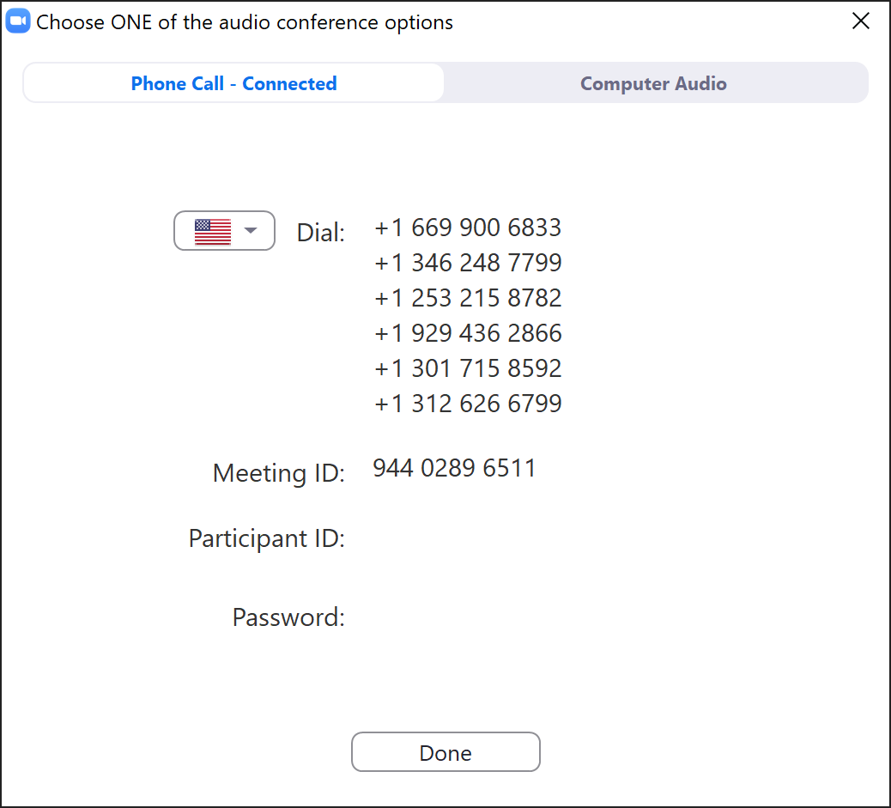
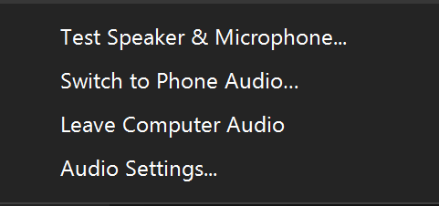
Switch to Phone Audio
Click the Mute icon UP Arrow
Click Switch to Phone Audio
########
########
Notes:
This is an ANIMATED slide with 2 clicks for each point.

Slide 3
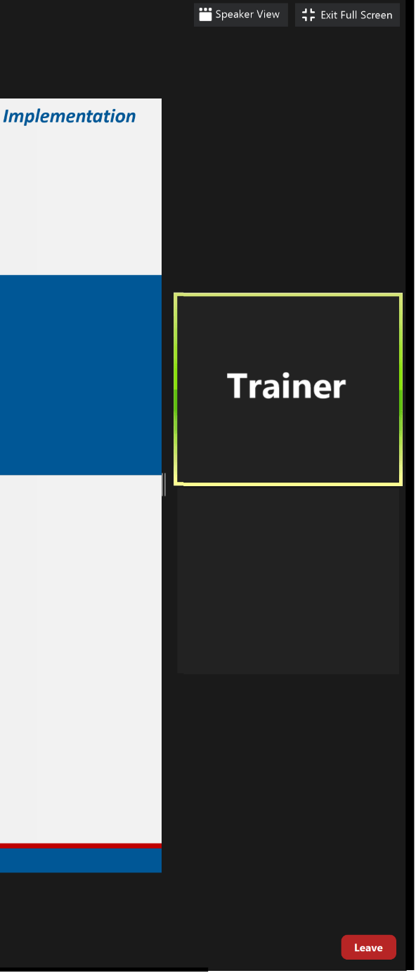
Meeting Controls &
Screen Display
Mute and unmute your microphone
Start a screen share
See who's currently in the meeting
Drag vertical bar right to increase the display
Turns your camera on or off
Access the window to chat with trainers
Notes:
This is an ANIMATED slide with 7 clicks for each point.

Slide 4


Slide 5

Welcome!
We are so glad you are here.
Please introduce yourself in the Chat box by entering:
  Your Name
  Your Organization
Notes:
Display this slide while admitting participants from the Waiting Room.

Slide 6
Module 4
Test Results and Reports
Presented by
Chrissy Palumbo, National Program Specialist
Dawn Montgomery, Technical Implementation Specialist
www.casas.org
casas@casas.org
1-800-255-1036
© 2020 CASAS — Comprehensive Adult Student Assessment Systems.
Notes:
Display this slide at the top of the hour!

Slide 7
Agenda
About this Training
Unit 1. Assessments
Unit 2. Content Standards
Unit 3. Competencies
Unit 4. Task Areas
Unit 5. Review
Unit 6. Reports
Unit 7. Resources
Unit 8. What's Next?
Training Completion

Slide 8

Polls
Answer the poll.
Submit your answer.

Slide 9
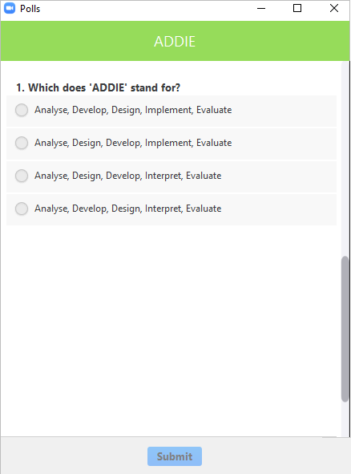
Polls
Close the poll
Answer the poll
Scroll the poll
Submit the poll
Notes:
This is an ANIMATED slide with 4 clicks for each point.

Slide 10

We would like to get to know you.
Role at your agency
Agency size and population served
Testing method and environment
How often testing occurs
Notes:
Descriptions should be brief.

Slide 11


Training Content
Content is presented in Books on the training site.
Navigate the content with the RIGHT arrow.
Notes:
This is an ANIMATED slide with 1 click for the arrows.

Slide 12
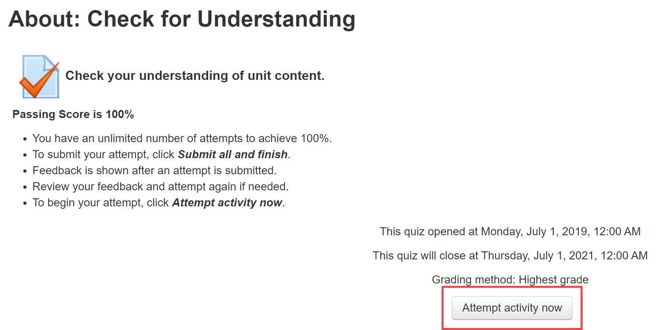
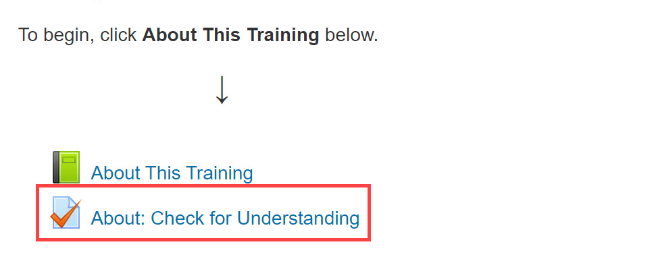
Check for Understanding
Notes:
This is an ANIMATED slide with 2 clicks for “Attempt activity now” and getting 100%.

Slide 13

Return to the Meeting Room
Click the blue video icon in the Taskbar at the bottom of your computer monitor.
Notes:
This is an ANIMATED slide without any clicks.

Slide 14
Connecting to the Training Site
Go To
  Click training.casas.org in the Chat box.
  Your web browser will open to the Training site.
Log In
  Scroll down and click the Module 4 training title.
  Enter your log in credentials and click Login.
Enroll
  When you are returned to the Training website,
  Click Enter Here to enroll in Module 4.
Notes:
This is an ANIMATED slide with 3 clicks for each Chevron.

Slide 15
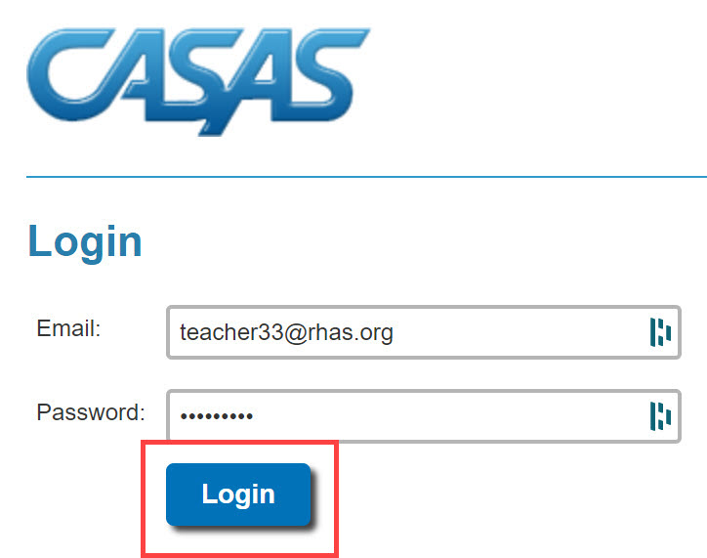
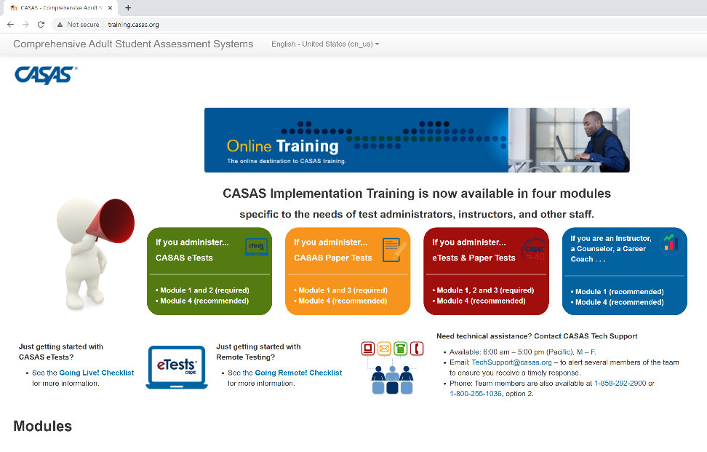
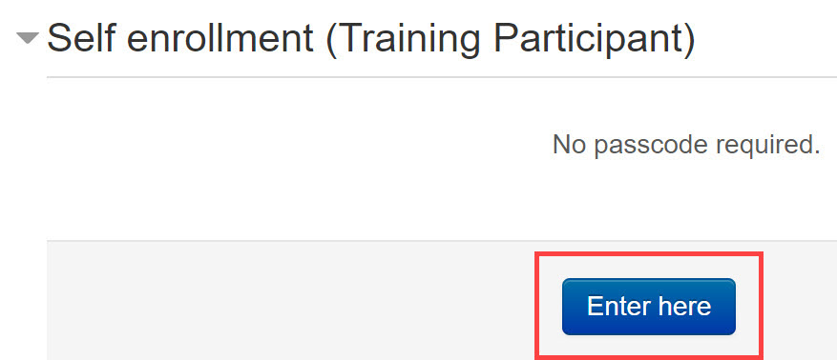
Connecting to the Training Site
Training.casas.org
Enroll in Module 1
Module 1: CASAS Implementation Basics
Notes:
This is an ANIMATED slide with 4 clicks for each highlighted text.

Slide 16

Welcome Back!

Slide 17
Polls
Answer the poll.
Submit your answer.

Slide 18
Welcome Back!

Slide 19
Unit 2. Check for Understanding
Is it True or is it False?
1. CASAS test items align with CASAS Content Standards and correlate to CCR Standards.
☑ True
2. All CASAS Reading Standards are covered in all CASAS instructional levels.
☒ False
Notes:
This is an ANIMATED slide with 1 click for the Answer ‘d’

Slide 20
Welcome Back!

Slide 21
Unit 3. Check for Understanding
1. Which description best describes a CASAS competency?
An academic skill in language and math
The format of a test item
A functional life skill
All of the above
2. María just had a baby. She has been reading information and discussing "baby-proofing" ideas with her husband.
What competency is this?
1.9.6 Interpret information related to automobile maintenance
2.3.2 Identify the months of the year and the days of the week
3.4.2 Identify safety measures that can prevent accidents and injuries
3. Your boss asked you to write a memo about the new procedure for switching schedules. You've never written a memo before.
What competency is required to write the memo?
2.8.4 Interpret policies and procedures of educational institutions regarding attendance, grades, conduct, student rights, etc.
4.6.2 Interpret and write work-related correspondence, including notes, memos, letters, and e-mail
5.1.7 Identify how to contact public officials about issues and concerns
4. Mohamed has a new wristwatch. While standing in line at the supermarket, someone asks him the time.
What competency is required here?
2.3.1 Interpret clock time
2.8.4 Interpret policies and procedures of educational institutions regarding attendance, grades, conduct, student rights, etc.
3.1.2 Identify information necessary to make or keep medical and dental appointments
Notes:
This is an ANIMATED slide with 4 clicks for each answer.

Slide 22
Welcome Back!

Slide 23
Polls
Answer the poll.
Submit your answer.

Slide 24
Welcome Back!

Slide 25

Breakout Rooms
Click to Join
Volunteer shares their screen
Collaborate
Return to the meeting

Slide 26
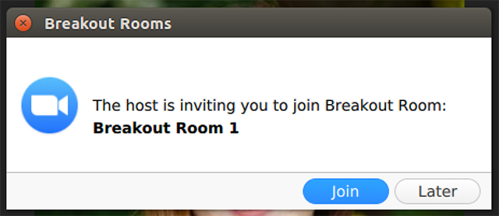
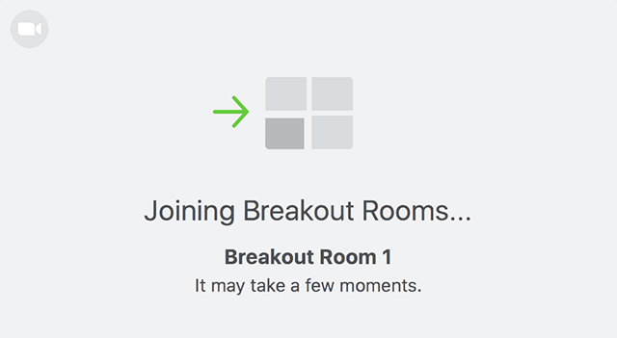
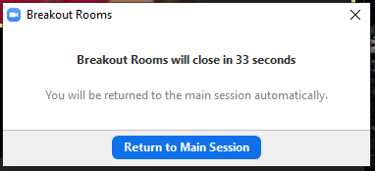

Breakout Rooms
Notes:
This is an ANIMATED slide with 3 clicks.

Slide 27
Welcome Back!

Slide 28

Unit 5: Check For Understanding
1. Which of the following are incorporated in all CASAS test items? Check all that apply.
Competencies
Content Standards
Curriculum development
Task Areas
2. Understanding the relationship between CASAS test items and CASAS Content Standards, Competencies and Task Areas or Item Types helps instructors target instruction to an individual’s needs based on test results.
True
False
3. Select the term that best fits the following descriptions.
Content Standards – Identify the author’s point or purpose including what the author wants to answer, explain or describe.
Task Areas – Use an illustration of a floor plan to answer questions on measurement.
Competencies – Identify job training needs and set learning goals.
Check your Answers!
How did you do?
Notes:
CFU’S CHECK your Answers! Take a look at the answers to the Checks for Understanding.
How did you do?

Slide 29
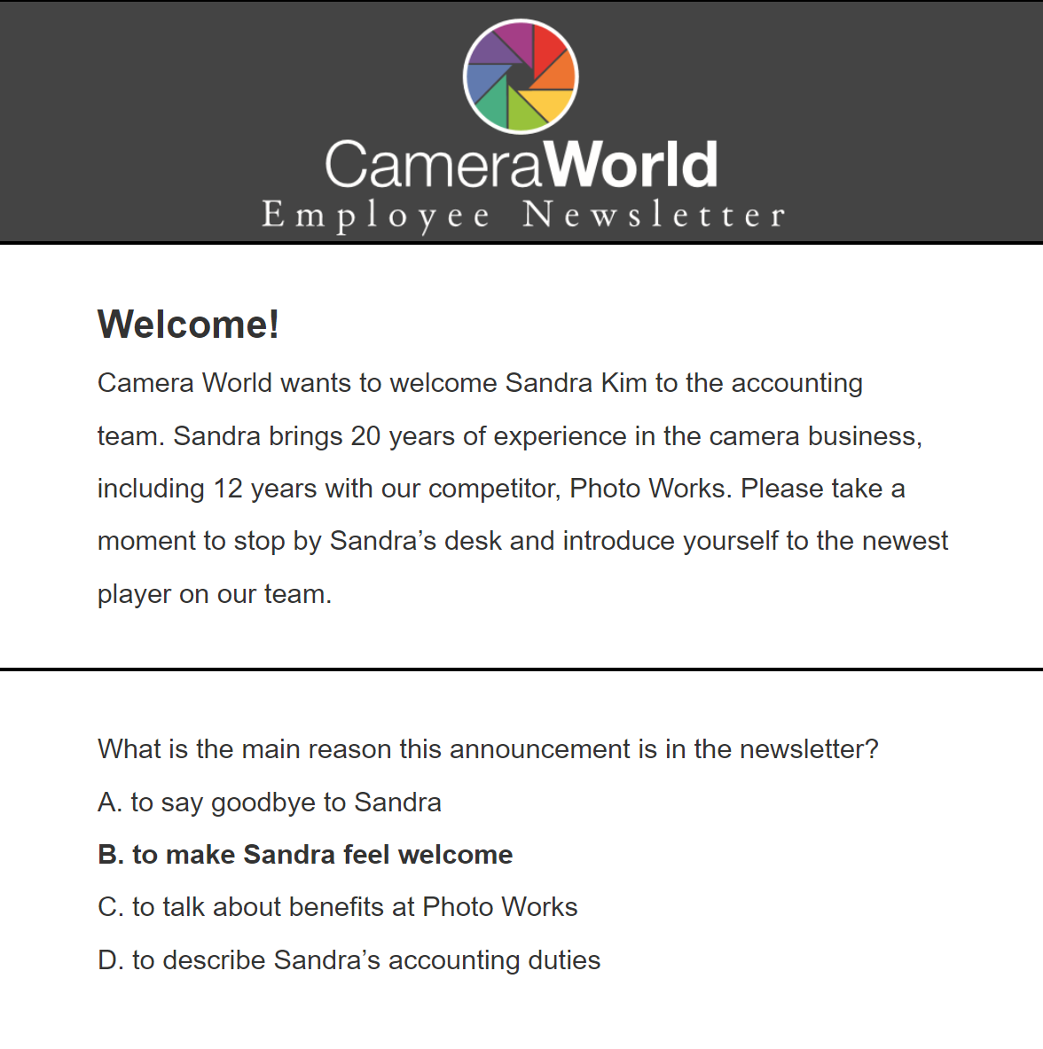
Unit 5. Check for Understanding
4.1 RDG 3.11 – Identify the main idea of a simple text or the central ideas or themes of a complex text, is measured in this test item. RDG: 3.11 is a...
CASAS Competency
CASAS Reading Standard
CCR Reading Standard
All of the above
4.2 Because this test item aligns with CASAS Reading Standard RDG 3.11, it also aligns with which CCR Standard?
CCR Anchor 2: A, B, C [R2.A,B,C]
CCR Anchor 3: A, B, C [R3.A,B,C]
Both a and b
4.3 This test item requires reading a newsletter, a type of informational text. Students who answered this test item correctly can determine the central idea of an informational text.
True
False
4.4 Would you group together students who answered this test item incorrectly for instruction on the main idea, central idea, and themes of simple or complex texts?
Yes
No
How did you do?

Slide 30
Unit 5. Check for Understanding
How did you do?
5.1 This test item includes which CASAS Competency?
4.6.2 Interpret and write work-related correspondence
4.6.3 Interpret written workplace announcements and notices
Both a and b
5.2 What type of instruction might you provide a student who misses this test item?
Reading a variety of company newsletters to determine the main idea.
Reading company notices to determine the central idea of the text.
Both a and b.
6. Which is an example of a measurable competency?
Complete a job application
Read library materials
Understand life concepts
Learn about presidents
7. Mr. Kim sent a package to his mother in Seattle. She never received the package. Mr. Kim needs to go to the post office and find out what happened.
Which competency will he need to use?
5.3.6 Interpret information or identify requirements for establishing residency and/or obtaining citizenship
2.4.5 Interpret procedures for tracking shipments
7.6.3 Distinguish fact from opinion, fiction from non-fiction, and point of view in media messages and presentations

Slide 31
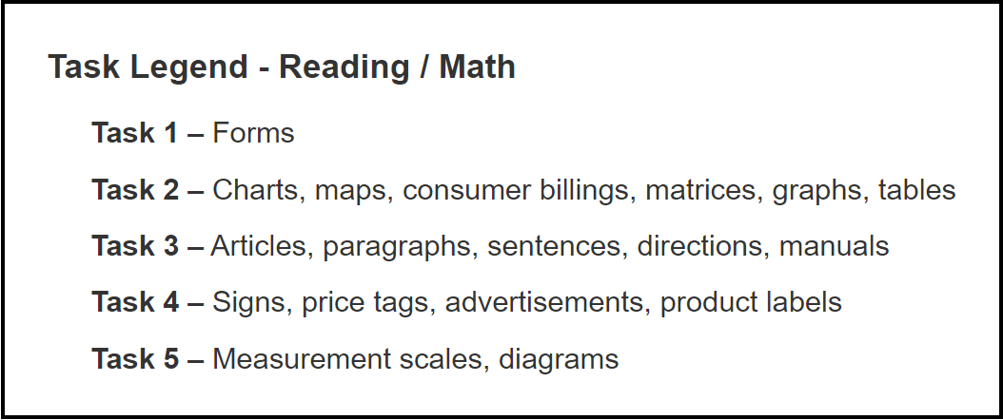
Unit 5. Check for Understanding
8. This test item includes which CASAS Reading Task?
Task 1 – Forms
Task 2 – Charts, maps, consumer billings, matrices, graphs, tables
Task 3 – Articles, paragraphs, sentences, directions, manuals
Task 4 – Signs, price tags, advertisements, product labels
Task 5 – Measurement scales, diagrams
How did you do?

Slide 32
Welcome Back!

Slide 33
Breakout Rooms
Click to Join
Volunteer shares their screen
Collaborate
Return to the meeting

Slide 34
Welcome Back!

Slide 35
Unit 6: Check For Understanding
1. Why is it important for teachers to access TOPSpro Enterprise?
For reports to help them understand and interpret test results.
For reports that suggest how they can better focus their teaching.
For reports that show how well students are meeting recognized standards.
All of the above.
2. Summary reports may be used to inform class instruction while Individual Student reports provide information to guide individual student instruction.
True
False
3. Many reports in TOPSpro Enterprise can be generated for an individual student and an entire class.
Student Content Standard Performance = Student-based
Individual Skills Profile = Student-based
Competency Performance Summary = Class-based
Student Competency Performance = Student-based
Learning Gains Summary = Class-based
Content Standard Performance Summary = Class-based
Personal Score Report = Student-based
Check your Answers!
How did you do?
Notes:
CFU’S CHECK your Answers! Take a look at the answers to the Checks for Understanding.
How did you do?

Slide 36

Unit 6: Check For Understanding
Check your Answers!
4.1 These Score Reports can only be accessed if you use CASAS eTests.
True
False
4.2 The Student Test Summary and Learning Gains Summary reports provide valuable information for teachers to review after progress testing.
True
False
4.3 Which report gives the student immediate feedback after taking a test on eTests?
Personal Score Report
Next Assigned Test
Student Test Summary
Learning Gains Summary
5.1 How can teachers benefit from sorting student performance reports by correct answers in descending order when reviewing the report with a student?
The student is encouraged as their attention is first drawn to areas of strength at the top of the report.
The teacher can reinforce student achievement.
The teacher can easily help the student identify specific areas that need improvement displayed at the end of the report.
All of the above.
How did you do?

Slide 37
Unit 6: Check For Understanding
5.2 How can teachers benefit from sorting class reports by correct answers in ascending order when planning lessons for class instruction?
The teacher can readily identify the specific skills needed most by the entire class displayed at the top of the report.
The teacher can focus their instruction on areas of greatest need spending less class time on mastered skills.
The teacher can track progress in previously targeted areas of instruction.
All of the above.
9. The Test Score Overview is a new class report that allows you to select which of the following options to display in a single report?
CASAS Scale Score
National Reporting System (NRS) Educational Functioning Level (EFL)
Grade Level Equivalent (GLE)
All of the above.
Check your Answers!
How did you do?
Notes:
CFU’S CHECK your Answers! Take a look at the answers to the Checks for Understanding.
How did you do?

Slide 38
Welcome Back!

Slide 39
Training Completion
Training Verification
Training Evaluation
Test Security Agreement
Certificate of Completion
Notes:
2-3 minutes all together 5 minutes

Slide 40
Steps to Complete your Training
Click: Link put in the Chat box
Enter: Training Passcode ####
Click: Enter here
Click: Test Security Agreement
  Complete
  Submit
Click: Get Your Certificate!
Notes:
This is an ANIMATED slide with 5 clicks for each highlighted text.
Note: Click 4 has 2 additional automated text.

Slide 41

Certificate of Completion
DOWNLOAD and save to your computer.
PRINT the Certificate displayed on your screen.
∗∗∗
Your certificate is sent to you automatically as an email attachment.
You can return to the module until June 30 to:
  Get another copy of your Certificate.
  Review training content.

Slide 42
Welcome Back!

Slide 43
Polls
Answer the poll.
Submit your answer.

Slide 44












Thank you for attending!
Assessment (CASAS eTests Online and Paper)
National External Diploma Program
Annual National Summer Institute
TOPSpro Enterprise Accountability Software
Online and face-to-face training
QuickSearch Online curriculum materials database
Workforce Skills Certification System
For Training Support, send an email to training@casas.org.
Join monthly News & Updates Webinars, at:
https://www.casas.org/social-media-newsroom/webinars
Images by Freepik Stories https://stories.freepik.com
Be CASAS Connected
Use #AdultEdu and #CASAScommunity to connect.
/CASASsystem
/CASASsystem
/CASASAssessment
www.casas.org
casas@casas.org
1-800-255-1036

