Slide 1



CASAS and HiSET® Correspondence Study – Update
Tanya Haug
National Director, ETS High School Equivalency Test (HiSET)
THaug@ETS.ORG
Jared Jacobsen
Senior Research Analyst, CASAS
jjacobsen@CASAS.org

Slide 2

Purpose of the Study
To provide evidence that CASAS GOALS tests are appropriate instruments to determine student readiness to take the HiSET Reading and Math sections.
To estimate student readiness to take the HiSET Reading and Math sections based on their CASAS GOALS test score.

Slide 3
About CASAS Reading and Math GOALS Tests
Reading and Math GOALS are aligned with the Career and College Readiness Standards (CCRS) for Adult Education.
ABE Reading GOALS is approved by National Reporting System for Adult Education (NRS).
Math GOALS was submitted for NRS approval.
Both measure NRS Levels 1 through 6 and CASAS levels A-D.
Analyses and research studies have provided strong evidence of the validity and reliability of the GOALS tests.

Slide 4
About HiSET Tests
HiSET Is The Fastest Growing Exam In The Market
  Currently, adopted in U.S. 28 states and territories
  Over 1 million tests delivered
5 HiSET subtests: Mathematics, Science, ELA-Reading, ELA-Writing and Social Studies
  Aligned to the Career and College Readiness Standards (CCRS) for Adult Education
National battery pass rate: 76.5%
  Over 42,000 passers in 2017
Total completion rate: 65.7%
  Out of the 85,214 examinees who tested, a total of 56,006 examinees completed the full battery in 2017

Slide 5
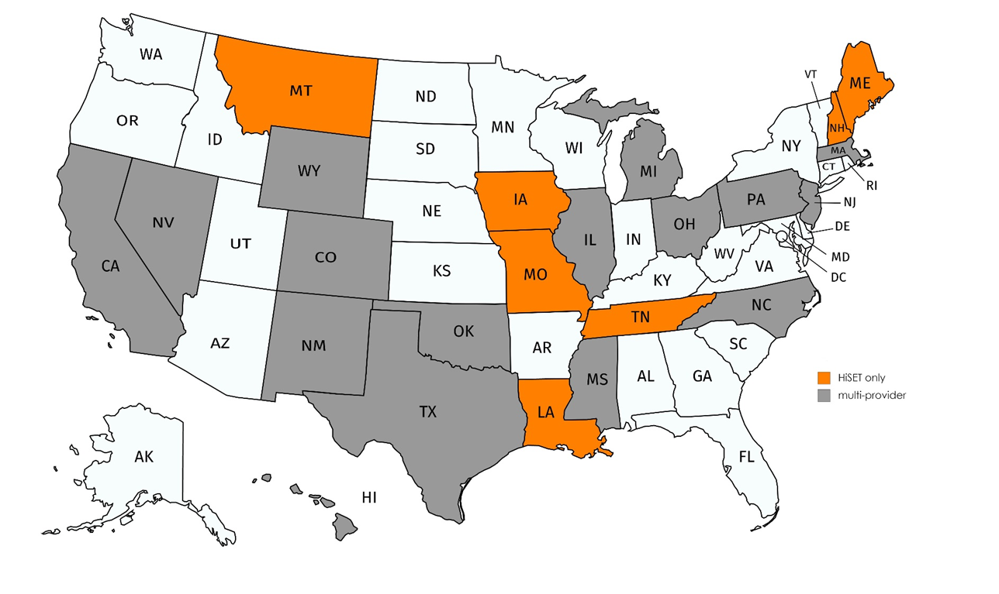
The Current HiSET Program Landscape
Learn more at www.hiset.ets.org
5 Pacific Islands
American Samoa
Guam
Marshall Islands
Northern Marianas
Palau
23 states total
7 HiSET only states
16 multi-vendor states

Slide 6
Study Methodology
Administer a Reading and/or Math GOALS test to adult learners.
  Learner must be functioning at CASAS Level C or D
Administer a HiSET Language Arts Reading and/or Mathematics assessment to same adult learners.
The tests may be administered in either order, but both administrations must occur within two weeks.
Sample population must be diverse and representative of adult education population.

Slide 7
Why is Comparison of Reading/Math GOALS with HiSET Appropriate?
HiSET is designed to certify that an examinee has attained an equivalent amount of knowledge as a high school graduate. Therefore it is most fitting to compare the HiSET to level C and D GOALS forms.
Both are aligned with CCRS for Adult Education.
HiSET Reading content is broken down into process categories: Comprehension, Inference and Interpretation, Analysis, Synthesis, and Generalization.
Reading GOALS covers these main process categories.

Slide 8
Why is Comparison of Reading/Math GOALS with HiSET Appropriate?
The GOALS Math series assesses an ABE student’s ability to solve quantitative problems using fundamental concepts and reasoning skills.
The questions reflect mathematical knowledge used in employment as well as everyday life situations, and that require use of numerical operations, measurement, algebraic thinking, data interpretation, and logical thinking.

Slide 9
Math GOALS/HiSET Math Content Comparison

Slide 10
Preliminary Reading Results*
Test-takers who took Reading GOALS form 905R or 906R (Level C) and HiSET Language Arts Reading had a correlation of 0.567 between scores.
Test-takers who took Reading GOALS form 907R or 908R (Level D) and HiSET Language Arts Reading had a correlation of 0.571 between scores.
* All results are preliminary and we cannot yet make final
conclusions from the data.

Slide 11
Preliminary Reading Results – Level C Form*
NRS Level | % Pass HiSET Language Arts | N
NRS Level 2 | 9.1% | 11
NRS Level 3 | 40.7% | 27
NRS Level 4 | 56.5% | 46
Conservative Estimate | 90.4% | 52
* All results are preliminary and we cannot yet make final conclusions from the data.

Slide 12
Preliminary Reading Results – Level D Form
NRS Level | % Passed HiSET Language Arts | N
Inacurrate Score | - | 3
NRS Level 4 | 43.8% | 16
NRS Level 5 | 64.4% | 45
NRS Level 6 | 82.5% | 40

Slide 13
Preliminary Math Results – Level C/D Form
NRS Level | % Passed HiSET Language Arts | N
Inacurrate Score | 36% | 14
NRS Level 4 | 52% | 31
NRS Level 5 | 81% | 27
NRS Level 6 | 91% | 11

Slide 14
Preliminary Math Results
Test-takers who scored into NRS Level 4 had a mean HiSET score of 7.2.
Test-takers who scored into NRS Level 5 had a mean HiSET score of 9.4.
Test-takers who scored into NRS Level 6 had a mean HiSET score of 13.2.
 |  | HiSET Mathematics
Math GOALS NRS Level | N | Mean HiSET Score | SD
Inaccurate Score | 14 | 6.00 | 3.89
NRS Level 4 | 31 | 7.16 | 4.10
NRS Level 5 | 27 | 9.37 | 3.50
NRS Level 6 | 11 | 13.18 | 3.71
Total | 83 | 8.48 | 4.35

Slide 15
Summary of Preliminary Results
Preliminary results indicate a strong relationship between performance on CASAS GOALS tests and HiSET Reading and Math tests.
Additional examinee data will be collected and analyzed before making final conclusions and recommendations regarding readiness to take the HiSET Reading and Math tests.
* All results are preliminary and we cannot yet make final conclusions from the data.

Slide 16
Benefits of Participating
Help develop a valuable tool for educators to determine student readiness to take the HiSET.
Provide your participating students with no-cost vouchers for HiSET Reading and Mathematics Assessments.
No-cost CASAS field-test administrations.
CASAS provides a small stipend (gift card) for participants.

Slide 17
How to Participate
Contact Nicole Jordan njordan@casas.org or Karen Burger kburger@casas.org .
Contact Tanya Haug THaug@ETS.ORG
We will make sure the test sessions are set up on eTests.
We will ensure you have the necessary HiSET vouchers for all participants.

Slide 18
Thank You for Attending!
Be sure to visit the CASAS website at www.casas.org
Follow us on Twitter twitter.com/CASASsystem and use the hashtag #casassi2018 to tweet updates, photos, and stories.
Keep in touch with Facebook facebook.com/CASASsystem use the hashtag #casassi2018 to share photos and post stories.
Visit us on the YouTube Channel

