Slide 1
National Consortium, Certified Trainers, and Trainers-in-Progress Meeting
Notes:
PRESENTER/TRAINER NOTES: Pat

Slide 2
Introductions
Tell us about yourself
Name
Agency or Organization
State

Slide 3
Schedule of Events
Time | Event | Location
12:00 – 2:00 pm | Registration | Grand Ballroom Foyer
1:30-4:50pm | National Consortium and Certified Trainer Meeting and Discussion Groups | Garden 3
5:00 - 7:00 pm | Social | South Tower Pool (Rooftop)
Notes:
PRESENTER/TRAINER NOTES: Pat

Slide 4
Professional Development
We would like to thank all of our CASAS State and National Certified Trainers, as well as all of our Trainers-in-Progress
New State Certified Trainers:
Stacy Everding (MN)
Precious Hill (FL)
Catherine O’Neil (FL)
Jodi Ruback (WA)
Daisy Shah (FL)
New National Certified Trainers:
Celina Paula (FL)
Pamela Jo Wilson (FL)
Notes:
PRESENTER: Pat (ask all trainers to stand, then acknowledge the newly certified)

Slide 5
Measuring Success and Reporting Outcomes
WIOA Program Trends
Integration of Education and Training (IET)
Career pathways, transitions, co-enrollment
EL Civics- Civic Participation and Citizenship Preparation
Common Measures across WIOA Programs:
Measurable Skill Gains for all partners
Diplomas, credentials, degrees, industry certifications
Employment and wages
Transition to post secondary education and training

Slide 6
Technology Trends Impacting Adult Education
Use of mobile devices and apps for delivering education on demand, blended learning, distance learning, communicating with students. (X-Prize for Adult Literacy)
Open learning resources easily accessible via the Internet to incorporate into the learning process
Expansion of Data systems and data sharing, along with concerns about privacy and security (SSN to track employment and wages)

Slide 7
CASAS Strategies to Support States in Measuring Success and Reporting Outcomes
New CASAS GOALS Assessments
Aligned with Adult CCR Standards
Documenting skills gains and workforce skills
Reports to guide instruction and improve programs
Reports for local agency and state accountability
Practice tests available in new student portal
Technology: e-Test and TE
On-line e-test delivery with immediate test results
Electronic sharing of data with WIOA partners
New: mobile attendance reporting module
New: Student Portal for follow up employment surveys and more!
In Development: Case management portal for Counselors/transition specialists.
Notes:
PRESENTER: Pat

Slide 8
CASAS Strategies to Support States in Measuring Success and Reporting Outcomes
EL Civics
New: Civic Objective and Additional Assessment Plan (COAAP) for the 2020 Census
New COAAPs for supporting IET Programs
Alignment with Indicators of Immigrant Integration
In development: Instructional resources for COAAPs available online in collaboration with OTAN
Writing
Automated essay scoring of writing samples

Slide 9
Assessment, Research and Resources
NRS Approved Assessments
Next Steps for GOALS
Writing Assessment Update
Field Testing and Research Studies

Slide 10
CASAS NRS-approved Assessments for ABE
NRS-approved through 2025
Reading GOALS (900 series)
NRS-approved through 2022
Math GOALS (900 series)

Slide 11
CASAS NRS-approved Assessments for ESL
NRS-approved through February 2021 (like all other NRS-approved ESL tests)
Life and Work Reading (80 series)
Beginning Literacy, Forms 27 and 28 and
Reading for Language Arts (Forms 513/514)
Life and Work Listening (980 series)

Slide 12
Next Steps for GOALS
Reading GOALS for ESL – OCTAE has requested additional data
Math GOALS – OCTAE has requested additional data
Listening GOALS – in development
Notes:
PRESENTER/TRAINER NOTES: Linda

Slide 13
Reading Series
Notes:
Nancy

Slide 14
Reading GOALS Series
CASAS Level | Form Number | Number of Test Items | Timing
A | 901 902 | 39 | 60 min.
B | 903 904 | 40 | 75 min.
C | 905 906 | 40 | 75 min.
D | 907 908 | 40 | 75 min.
Reading GOALS Locator: 104R (12 questions)
Aligned to the CCCR Standards for Adult Education and CASAS Competencies
Shift to increased focus on measuring content standards
NEW: Targeted assessment of vocabulary
Notes:
The new Reading and Math GOALS Locators are fixed form tests. They are not Computer Adaptive Tests (CATs) as in the Life and Work Reading series.

Slide 15
Alignment of CASAS Reading Standards and College and Career Readiness Standards (CCRS)
CASAS Reading GOALS Content Areas | CCRS Reading Anchor*
Vocabulary | R4
Reading Comprehension Skills
Locate detail | R1
Main idea; Author’s purpose | R2, R6
Higher Order Reading Skills
Locate/compare details; Infer/draw conclusions | R1
Text structure and features | R5
Author’s point of view | R6
Analyze claim/argument | R8
*CCRS Reading Standards R7, R9 and R10 are measured across content areas.
www.casas.org/si
CASAS Implementation Basics
Notes:
CCRS = College and Career Readiness Standards for Adult Education (national)
Reading Comprehension Skills = DOK 1
Higher Order = DOK 2 & 3
DOK = Depth of Cognitive Demand
CCRS Reading Standards: https://lincs.ed.gov/publications/pdf/CCRStandardsAdultEd.pdf
R.CCR.1: Read closely to determine what the text says explicitly and to make logical inferences from it; cite specific textual evidence when writing or speaking to support conclusions drawn from the text.
R.CCR.2: Determine central ideas or themes of a text and analyze their development; summarize the key supporting details and ideas.
R.CCR.3: Analyze how and why individuals, events, and ideas develop and interact over the course of a text.
R.CCR.4: Interpret words and phrases as they are used in a text, including determining technical, connotative, and figurative meanings, and analyze how specific word choices shape meaning or tone.
R.CCR.5: Analyze the structure of texts, including how specific sentences, paragraphs, and larger portions of the text (e.g., a section, chapter, scene, or stanza) relate to each other and the whole.
R.CCR.6: Assess how point of view or purpose shapes the content and style of a text.
R.CCR.7: Integrate and evaluate content presented in diverse formats and media, including visually and quantitatively, as well as in words.*
R.CCR.8: Delineate and evaluate the argument and specific claims in a text, including the validity of the reasoning as well as the relevance and sufficiency of the evidence.
R.CCR.9: Analyze how two or more texts address similar themes or topics in order to build knowledge or to compare the approaches the authors take.
R.CCR.10: Read and comprehend complex literary and informational texts independently and proficiently.

Slide 16
NRS EFLs and Reading GOALS Scale Score Ranges
NRS EFL | ABE/ASE Levels | Reading GOALS Scale Score Ranges | Life and Work Reading Scale Score Ranges
1 | Beginning ABE Literacy | 203 and below | 200 and below
2 | Beginning Basic Education | 204 - 216 | 201 - 210
3 | Low Intermediate Basic Education | 217 - 227 | 211 - 220
4 | High Intermediate Basic Education | 228 - 238 | 221 - 235
5 | Low Adult Secondary Education | 239 - 248 | 236 - 245
6 | High Adult Secondary Education | 249 and above | 246 and above

Slide 17
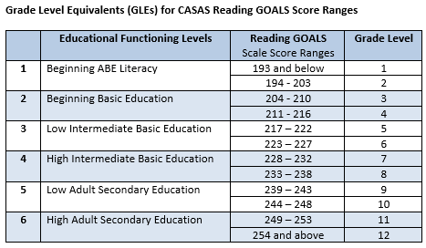
WIOA Title I/EFLs, CASAS scores, and GLEs
Math GLEs also available on CASAS website
Notes:
Math GLE on web site
It’s important that we know the definition of “Basic Skills Deficient” as we work with our other WIOA partners, including Title I agencies.

Slide 18
Math Series
www.casas.org/si
Notes:
Nancy

Slide 19
Math GOALS Series
CASAS Level | Form Number | Number of Test Items | Timing
A/B | 913 914 | 40 | 60 min.
C/D | 917 918 | 38 | 75 min.
Math GOALS Locator: 104M (10 questions)
Aligned to the CCCR Standards for Adult Education and CASAS Competencies
Shift to increased focus on measuring mathematical concepts
Formulae are provided so focus is on math concepts and skills, not memorization.
Basic calculators are provided on screen (eTests) or by the site location for paper testing.

Slide 20
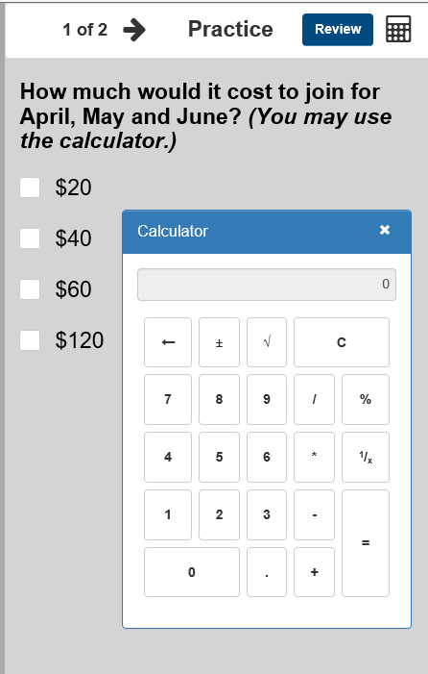
On-screen calculator
Click on icon
Midtown Gym costs $40 per month to join
but is having a half-price special
for August.
Calculator opens!
It can be moved to any position on the screen.
It includes basic functions.

Slide 21
Math GOALS Test Design
Math Series
NRS EFL Level | NRS EFL for Mathematics | A/B Forms | C/D Forms
1 | Beginning Literacy | Enter & Complete
2 | Beginning Basic | Enter & Complete
3 | Low Intermediate | Enter & Complete
4 | Middle Intermediate | Entry into Level 4 | Enter & Complete
5 | High Intermediate |  | Enter & Complete
6 | Adult Secondary |  | Entry into Level 6

Slide 22
CASAS Math Blueprint
Math Series
CASAS Content Domains | CASAS Level A/B | CASAS Level C/D | College and Career Readiness Standards (CCRS) Covered by CASAS Math Goals Series
M1: Number Sense | 33% | 22% | At the A/B level, use basic concepts of number system, place values, operations of addition, subtraction, multiplication and division, fractions, fraction equivalents, ratios and proportions. At the C/D level, use advanced number concepts such as comparing fractions, using operations with rational numbers and exponents.
M2: Algebra | 12% | 25% | At the A/B level, understand and reason with properties of four operations, explain patterns in four operations, solve basic one-variable equations. At the C/D level, generate equivalent equations and those with two or more variables, understand radicals, use lines and linear equations, use functions and functional expression, including inequalities, polynomials, quadratics, and exponential models.
M3: Geometry | 10% | 26% | At the A/B level, identify and reason with shapes and their attributes in 2- and 3-dimensions, find area and volume. At the C/D level, solve problems of angle, area, congruence, similarity, trigonometry, volumes of cone, pyramids and spheres.
M4: Measurement* | 45% | 12% | At the A/B level, measure with standard units, time intervals, liquid masses and volumes, area, unit conversions, angle measurements. At the C/D level, understand/apply Pythagorean theorem, use volume measurements for complex modeling.
M5: Statistics and Probability** | - | 15% | At the A/B level, understand categories, identify relevant data in tables, represent data in graphs, understand variability, and describe distributions. At the C/D level, understand probability, sampling, draw inferences, summarize and interpret data categorical and quantitative data, draw inferences, investigate associations in bivariate data.

Slide 23
Old to New NRS Math EFLs and Scale Score Ranges
 | NRS EFL | Old ABE/ASE EFLs | Life Skills Math Scale Score Ranges
 | 1 | Beginning Literacy | 200 & below
 | 2 | Beginning Basic | 201 - 210
 | 3 | Low Intermediate | 211 - 220
 | 4 | High Intermediate | 221 - 235
 | 5 | Low Adult Secondary | 236 - 245
 | 6 | High Adult Secondary | 246 & above
NRS EFL | New ABE/ASE EFLs for Mathematics | Math GOALS Scale Score Ranges
1 | Beginning Literacy | 193 & below
2 | Beginning Basic | 194 - 203
3 | Low Intermediate | 204 - 214
4 | Middle Intermediate | 215 - 225
5 | High Intermediate | 226 - 235
6 | Adult Secondary | 236 & above

Slide 24
Transitioning Continuing Students to GOALS
Continuing students transitioning from Life and Work Reading and Life Skills Math to Reading and Math GOALS must take a pretest in the new GOALS series.
Pre- and post-test results must always be in the same test series.
Recommend giving the Reading GOALS Locator (104R)
The same CASAS testing procedures and reports apply for Reading and Math GOALS.
Agencies may create their own testing sessions for ABE or contact CASAS Tech Support for assistance with adding new templates for GOALS test sessions (800-255-1036, ext. 2).
Test timing: an average of 2.5 – 3 hours to test in two modalities at Intake

Slide 25
GOALS Series Reports and Content Standards
CASAS Content Standards reports and CASAS Competency reports are similar for the GOALS test series.
In addition…
NEW CCRS reports will be available in July 2019 for the Reading and Math GOALS series.
CASAS Reading Standards, Second Edition has been uploaded to the CASAS website.
CASAS Math Standards are available on the CASAS website.
They are both aligned to the CCRS.
NEW CASAS Listening Standards are in development

Slide 26
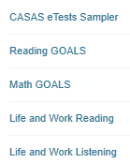
NEW - Sample Items in CASAS eTests Format and HTML Enhancements
Students and teachers can have direct access to the new CASAS eTests Sampler
New HTML version with
clearer images
+ and – buttons to easily enlarge prompt (e.g., reading passage) and question/answer options
new test navigation features in GOALS series
Notes:
ACTIVITY –
Option 1 Print and pass out 1 set of Sample Test Items (Levels A, B, C and D) to small groups. (You may choose which test series to include.)
https://www.casas.org/product-overviews/curriculum-management-instruction/sample-test-items/reading-goals
Option 2 – If the training room has internet connection, you can demonstrate any of the sample test items by going to:
https://www.casas.org/product-overviews/curriculum-management-instruction/sample-test-items/reading-goals or
https://casasportal.org/eTests
Option 3 – If the training room has internet connection and participants have laptops, they can find and review sample items.
Ask participants to browse through the forms.
ANSWER: Going from A to D, the items get more difficult; questions use more advanced language; reading passages are longer

Slide 27
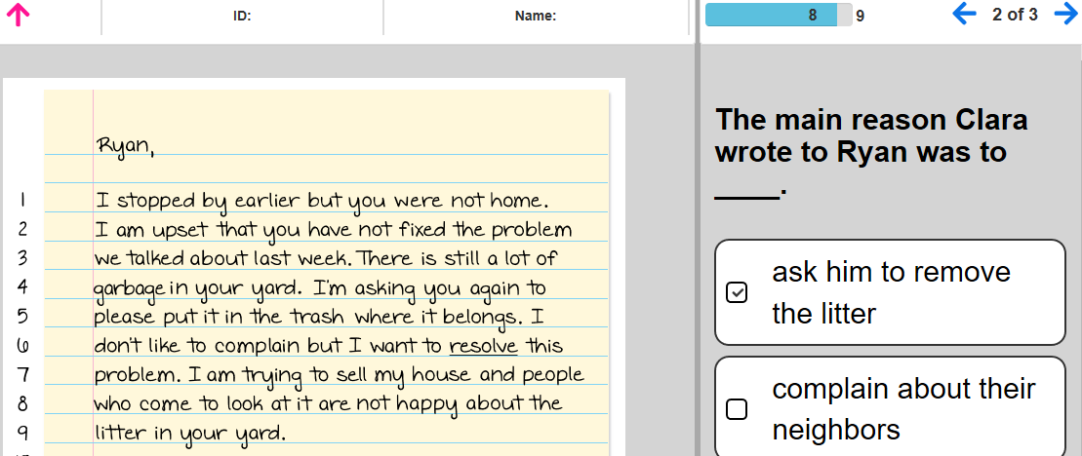
NEW – CASAS eTests Format and HTML Enhancements
Shows how many items relate to the same display
Progress bar shows how many items are in the test and how many items have been taken

Slide 28
Writing Assessment Update
CASAS has successfully piloted automated scoring for the CASAS Written Prompt with clients entering the diagnostic phase of the NEDP program.
Initial validation studies showed 80% exact agreement between the CASAS Written Prompt scored by CASAS master scorers and the automated essay scoring engine -- a very good result.
Automated scoring will be offered for all NEDP clients starting in June 2019.
CASAS has plans to offer the CASAS Written Prompt in CASAS e-Tests for non-NEDP test takers. Stay tuned!

Slide 29
Assessment and Research- High School Equivalency Studies
CASAS is collaborating with GED Testing Service and ETS HiSET on research studies.
Purpose
Provide adult education programs with information to determine student readiness to take the HiSET and GED reading and math sections based on CASAS test scores.
Benefit
Cut scores will be established on CASAS Reading and Math GOALS tests that will indicate student readiness to take the corresponding HiSET and GED sections.

Slide 30
Assessment and Research
Many thanks to all programs that have joined the CASAS Field Testing Team!
Participating field test sites are listed in the folder.
Notes:
PRESENTER/TRAINER NOTES: Linda

Slide 31
Current and Upcoming Research Studies
Additional data collection for Math GOALS
Ongoing studies for Reading GOALS for ESL and Listening GOALS
HiSET/CASAS Comparison Study (Level C/D Students)
GED/CASAS Comparison Study (Level C/D Students)
See the “CASAS Field Testing Update” handout for more details.
To participate in CASAS field testing and research studies, send an email to: fieldtesting@casas.org
Or contact:
Karen Burger (kburger@casas.org)
Kay Hartley (khartley@casas.org)
Notes:
PRESENTER/TRAINER NOTES: Linda

Slide 32
Transitions
National External Diploma Program (NEDP)
Workforce Skills Certification System (WSCS)

Slide 33
The National External Diploma Program (NEDP)
Competency-based
applied performance assessment system
series of performance tasks that parallel job and life situations
Notes:
PRESENTER: Margaret

Slide 34
NEDP Update
NEDP State Expansion
Professional Development Series
Marketing
Written Prompt Autoscore
NEDP Changing Lives Scholarships

Slide 35
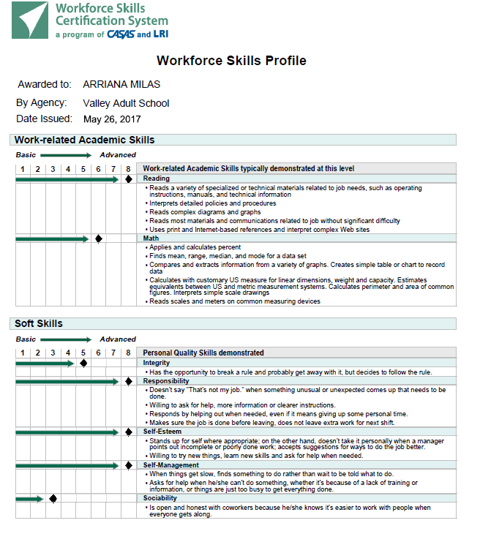
Workforce Skills Certification System (WSCS)
Certify work readiness skills for job seekers
Enhance career pathways
Prepare local talent to meet local business needs
Generate WSCS Certificates with TOPSpro
Work-related Academic Skills
Soft Skills
Notes:
PRESENTER/TRAINER NOTES: Jane
Update: Changes for 2014-15- WSCS fully integrated into TOPSpro Enterprise

Slide 36
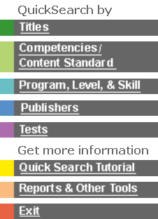
Resources
Provides an essential link between assessment and instruction in the CASAS system.
An easy-to-use database of 2,300+ commercially available instructional materials.
Titles coded to
Skill levels
CASAS Competencies
Content standards

Slide 37
Break- 15 minutes

Slide 38
WIOA Panel Addressing IET/IELCE
Panelists:
Glenda Rose, Train PD @ TCALL, Texas A&M University
Cory Rayala, Adult Education Office, California Department of Education
Sigrun Utash, Simi Institute for Careers and Education
Moderator:
Lori Howard (CASAS)

Slide 39
WIOA Panel Addressing IET/IELCE
Which Career Pathways has your agency implemented in 2018-19? Describe the collaborations that took place to make those Career Pathways work.
What were your challenges and successes in those Career Pathways?
What is your plan for continuous improvement of those Career Pathway programs?
Which new Career Pathways do you plan to implement in 2019-20?

Slide 40
Technology on the Way
Mobile Attendance
Student Portal
Executive Dashboard
API Gateway – Badges first
Case Management

Slide 41
Student Portal
Phase 1
NRS Core Performance Follow Up Survey
Unique Student IDs across agencies
Sample GOALS items in simulated test
Phase 2
Student Registration
Monitor Educational Progress
Interact with Education Provider
Notes:
Presenter: Richard
By SI we’ll have NRS Tables 1-4, Summary Audit, and Periods of Participation Tracking. The DIR is a question.
There’s no chance we’ll have NRS Tables 5+, because we have very little time to develop the AEBG Tables and AEBG DIR which are also urgently needed and should be available for SI. Just as for NRS, we won’t have all the AEBG Tables ready by SI, but we’ll have the most critical ones.

Slide 42
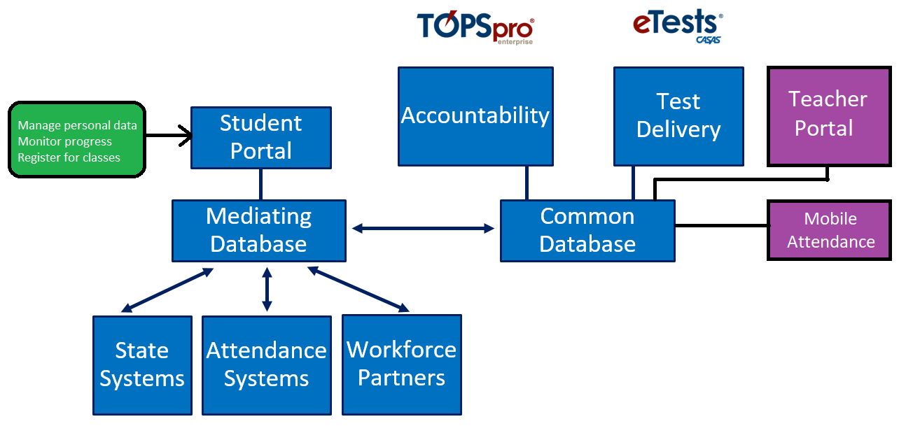
Application Diagram

Slide 43
Mobile Access

Slide 44
Student Portal- Benefits
Students able to access own records
New channel of communication
Uses mobile devices
Helps retain students
Find students after leaving program
Ability to follow up on student outcomes
Practice taking a test with CASAS eTests
Allow students to register for classes
Complete demographics from home
Better engage students in their education
Assist students in meeting goals
Offer services including distance learning

Slide 45
Reports and Training Update
Teacher Resources
New Implementation Training Modules/Format

Slide 46
Teacher Resources
Quick Search
Sample Test Items
Competencies
Content Standards
New Reading Content Standards
Low-level Lessons
CASAS Handbook for Teachers
Key Reports for TE Users – Assessment to Instruction
Notes:
Presenter: Patty

Slide 47
CASAS Implementation Training
Reformatted and updated to:
Meet the needs of the field
Train for specific roles in the assessment process
Provide more detailed guidance for agencies starting to implement eTests
Provide targeted guidance for teachers that do not conduct testing

Slide 48
Implementation Basics
Module 1. Implementation Basics
Module 2. CASAS eTests Implementation
Module 3. Paper Test Implementation
Module 4. Interpreting Test Results and Reports
:
User Role* | Module 1 | Module 2 | Module 3 | Module 4
Tester – Administer eTests only | x | x |  | Optional
Tester – Administer Paper only | x |  | x | Optional
Tester – Administer eTests & Paper | x | x | x | Optional
Teachers | X |  |  | x
*Testers must complete at least two modules, including Module 1.

Slide 49
General Topic Workgroups
CASAS Certified Trainers
Student Portal/TOPSpro Enterprise
CASAS eTests: Implementation Strategies
ESL Reading and Listening Assessment and Standards
WIOA Implementation: Program Effectiveness

Slide 50
Workgroup Wrap-up and Closing Remarks
Group report-back
Comments and additional thoughts?

Slide 51
Join us at the 2020 CASAS National Summer Institute!
June 23-25, 2020
Hyatt Regency
Orange County, California
Thank you for attending!
Help improve the Summer Institute, take the survey!
Facebook.com/CASASsystem use #casassi2019 to share!
@CASASsystem use #casassi2019 to tweet!
CASASAssessment

