Slide 1
Core Performance Follow Up Employment and Earnings Survey
February 6, 2019

Slide 2
Agenda
History and Overview of Follow up Process
Important Dates for Employment and Earnings Follow Up Survey
Description of Student Portal in TOPSpro Enterprise (TE)
Features of Student Portal
Create Survey Definition
Run Core Performance Population Report
Save Exit Population and Generate Survey
View and respond to Survey in Student Portal

Slide 3
History and Overview of Follow up Process
For both WIA and WIOA II – eligible learners who exit require follow up for employment and post-secondary outcomes
WIA – 1999-2012:
Required survey of all exited learners
Used Primary/Secondary goals to identify eligible learners
WIA – 2012-2016:
Used random sampling of exited learners
NRS cohorts system used different data elements for each follow up area to identify eligible learners

Slide 4
NRS Table 5 Follow up Process
Implementation of WIOA in July 2016 changed the follow up requirements for NRS Table 5
All WIOA II learners who exit are eligible for follow up
Follow up is to be done 2 quarters and 4 quarters after exit
No more NRS cohorts definitions
No more random sampling
Emphasis on data matching

Slide 5
NRS Table 5 Follow up Process
Implementation of WIOA in July 2016 changed the follow up requirements for NRS Table 5
All WIOA II learners who exit are eligible for follow up
In the 1999-2012 survey, we followed up with all learners and were required to get a 50% student response rate
In 2012-2016, using random sampling, we were required to get a 70% response rate

Slide 6
NRS Table 5 Follow up Process
Implementation of WIOA in July 2016 changed the follow up requirements for NRS Table 5
All WIOA II learners who exit are eligible for follow up
In the current survey process, required response is now 100%
This doesn’t mean we’ll get 100% of our students to respond – but does mean all students are counted when reporting state and agency level results

Slide 7
NRS Table 5 Follow up Process
Implementation of WIOA in July 2016 changed the follow up requirements for NRS Table 5
This doesn’t mean we’ll get 100% of our students to respond – but does mean all students are counted when reporting state and agency level results
Example: If an agency receives responses from 50% of eligible students, and then 50% of those respondents report “yes I got a job” – then that agency’s job attainment rate is 25%.

Slide 8
Data Matching
CA initiated two data matches:
Chancellor’s Office (CCCCO) for post-secondary outcomes
CCCCO/post-secondary data match to include a “fuzzy match” (looks for demographics in addition to SSN)
Employment Development Department (EDD) for employment and wages outcomes
EDD/employment match requires Social Security Number (SSN)

Slide 9
Data Matching
Historically, about 10% of CA WIOA learners include SSN in the statewide data submission
CDE has emphasized use of SSN for data matching purposes, and posted a memorandum on appropriate use of learner SSN, with a sample consent form: https://www.cde.ca.gov/sp/ae/ir/mgtbulletin20171.asp
CA developed a new follow up survey to obtain supplemental jobs and wages information for NRS Table 5, so that the state does not rely exclusively on students with SSN.

Slide 10
Process -- New Follow up Survey Implementation
Implementation of WIOA in July 2016 changed the follow up requirements for NRS Table 5
In 2017, CA developed a supplemental survey to accompany the data matching, with emphasis on new ways to improve student survey responses
Initiated a pilot of 11 agencies in Spring 2018
Pilot achieved a 54% response rate
CDE stipulated survey implementation for beginning of PY 2018-19--requirement for 2Q/4Q after exit entailed that surveying begin 3Q of 18-19

Slide 11
3Q PY 2018-19 April 30, 2019
PY 2018-19
PY 2019-20
1Q
2Q
3Q
4Q
1Q
2Q
3Q
4Q
Exit 1Q = Follow up 3Q
Enter Employment
Increase Wages

Slide 12
4Q PY 2018-19 August 1, 2019
PY 2018-19
PY 2019-20
1Q
2Q
3Q
4Q
1Q
2Q
3Q
4Q
Exit 2Q = Follow up 4Q
Enter Employment
Increase Wages

Slide 13
1Q PY 2019-20 October 31, 2019
Exit 1Q = Follow up 1Q
Enter Employment 4Q after exit
Exit 3Q = Follow up 1Q
Enter Employment 2Q after exit
Increase Wages
1Q
2Q
3Q
4Q
1Q
2Q
3Q
4Q
PY 2018-19
PY 2019-20

Slide 14
2Q PY 2019-20 January 31, 2020
Exit 4Q = Follow up 2Q
Enter Employment 2Q
Increase Wages
Exit 2Q = Follow up 2Q
Enter Employment 4Q
1Q
2Q
3Q
4Q
1Q
2Q
3Q
4Q
PY 2018-19
PY 2019-20

Slide 15
3Q PY 2019-20 April 30, 2020
Exit 1Q = Follow up 3Q
Enter Employment 2Q
Increase Wages
Exit 3Q = Follow up 3Q
Enter Employment 4Q after
1Q
2Q
3Q
4Q
1Q
2Q
3Q
4Q
PY 2018-19
PY 2019-20

Slide 16
Important Dates
Oct. 25 CDE letter to field on Survey Guidelines
Nov. 5 CASAS letter to field on Nov. 22-23 statewide auto merge of duplicate IDs
Jan 9 TE Update with new core performance features – letters #1 and #2- Identify and Save Exit population
Jan 29 Additional TE Update
Feb 1 (approx.) letter #3 with final instructions, clearing way to begin surveying
Mid Feb Distribute Follow Up Survey via TE and Student Portal to eligible students
Mid Mar Make direct contact to non-respondents to improve student response rate
April 30 First due date for core performance employment and earnings survey

Slide 17
Using TE and Student Portal to Implement Survey
Description of Student Portal in TOPSpro Enterprise (TE)
Run Core Performance Population Report and Wizard to identify eligible learners
Save Core Performance Student Population and Generate Survey
Create and Customize the Survey to your own agency and students
Students view and respond to Survey in Student Portal

Slide 18
Accountability
Test Delivery
Student Portal
Mediating Database
Common Database
State Systems
Attendance Systems
Workforce Partners

Slide 19
NRS Core Performance Wizard
Generating the population that qualifies for follow-up measures

Slide 20
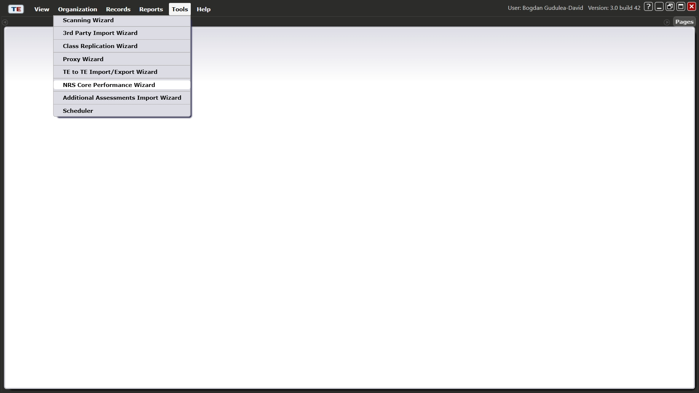

Slide 21
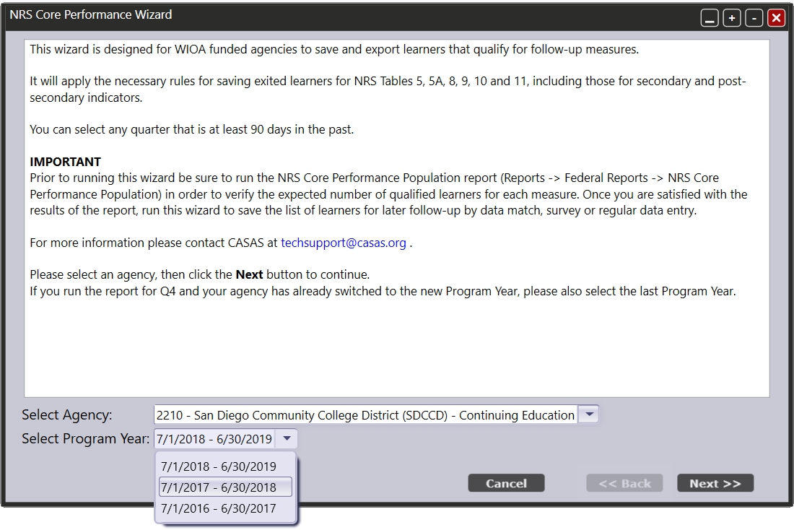

Slide 22
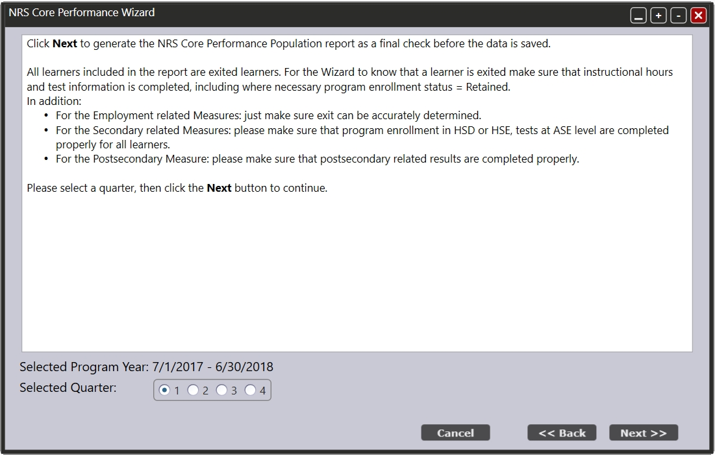

Slide 23
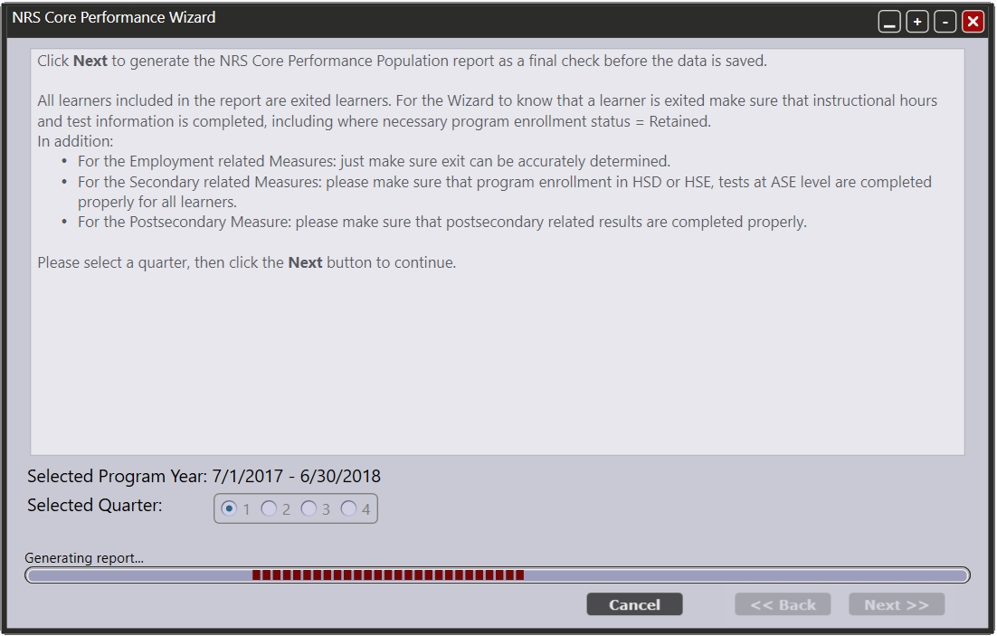

Slide 24
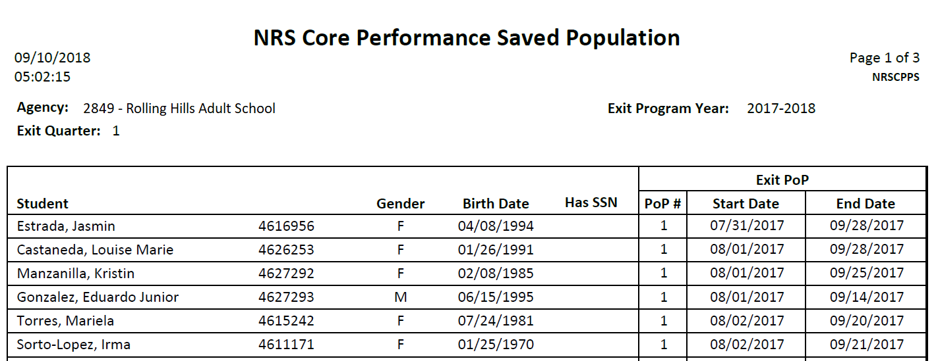

Slide 25
Saved Core Performance Student Population
Viewing the exited population in the dedicated lister

Slide 26
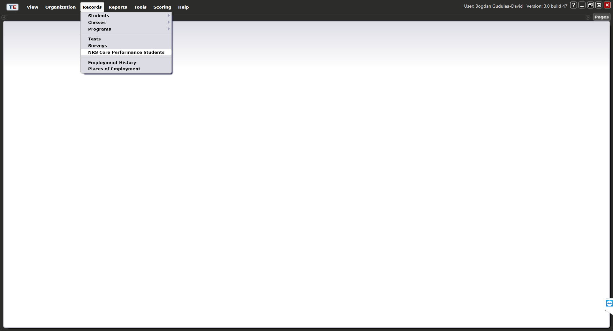
There are two new listers under the TE Records menu:
Surveys Lister
NRS Core Performance Students Lister

Slide 27
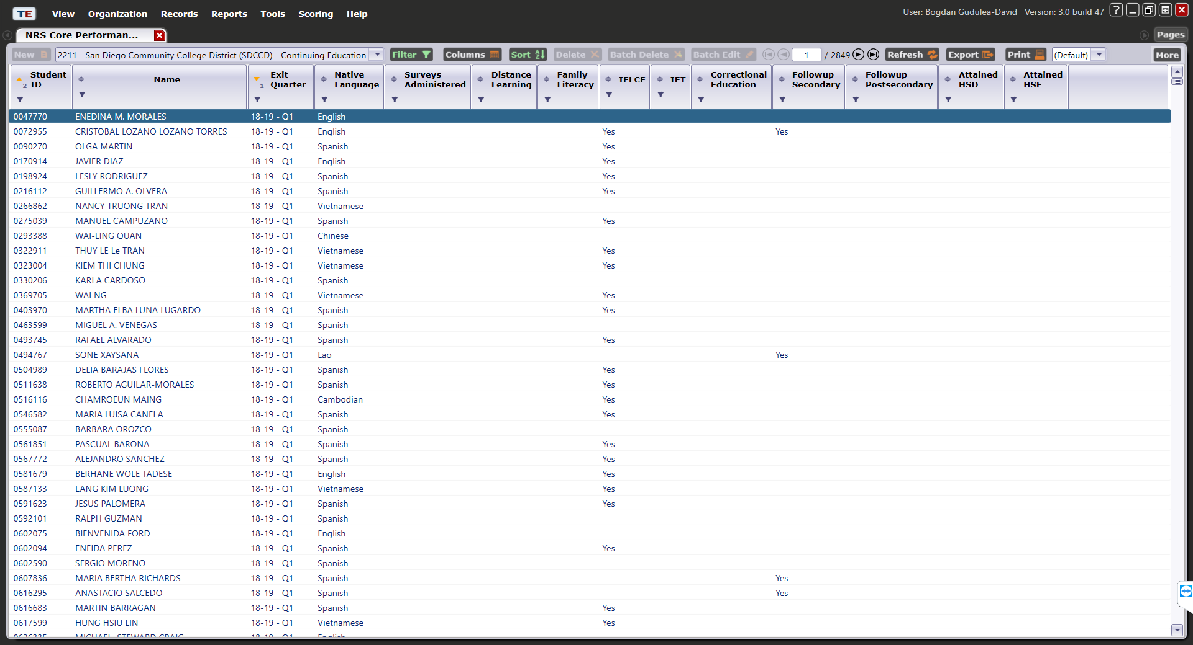
NRS Core Performance Students Lister
The NRS Core Performance Students lister provides the qualifying criteria and personal information for eligible students.

Slide 28
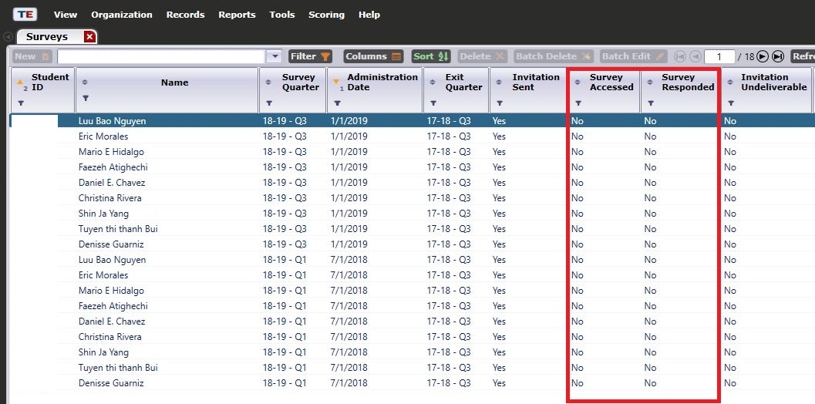
Surveys Lister
The Surveys lister enables agencies to track the progress of the survey administration.

Slide 29
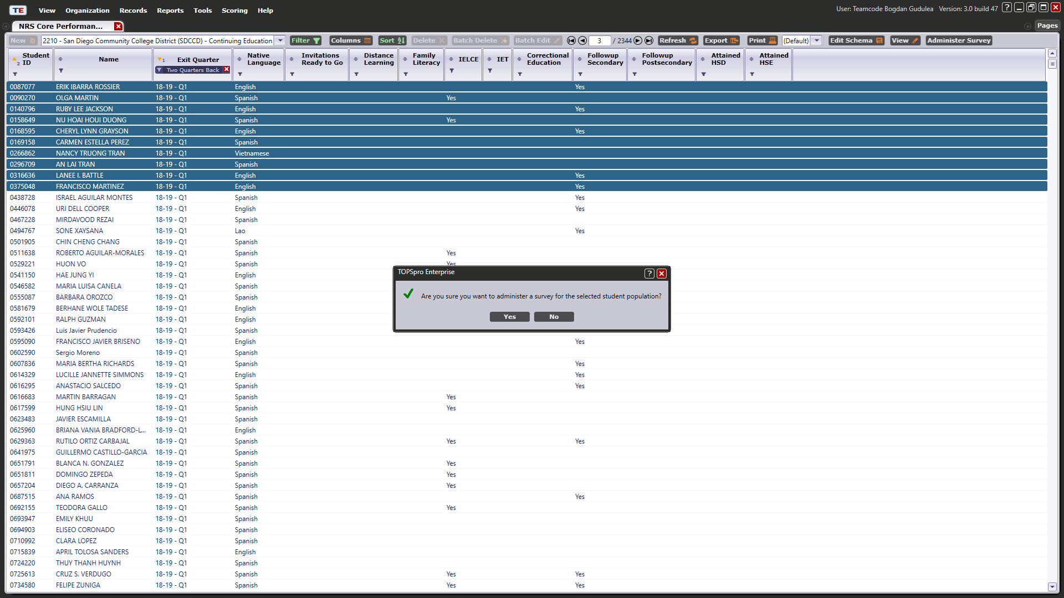

Slide 30
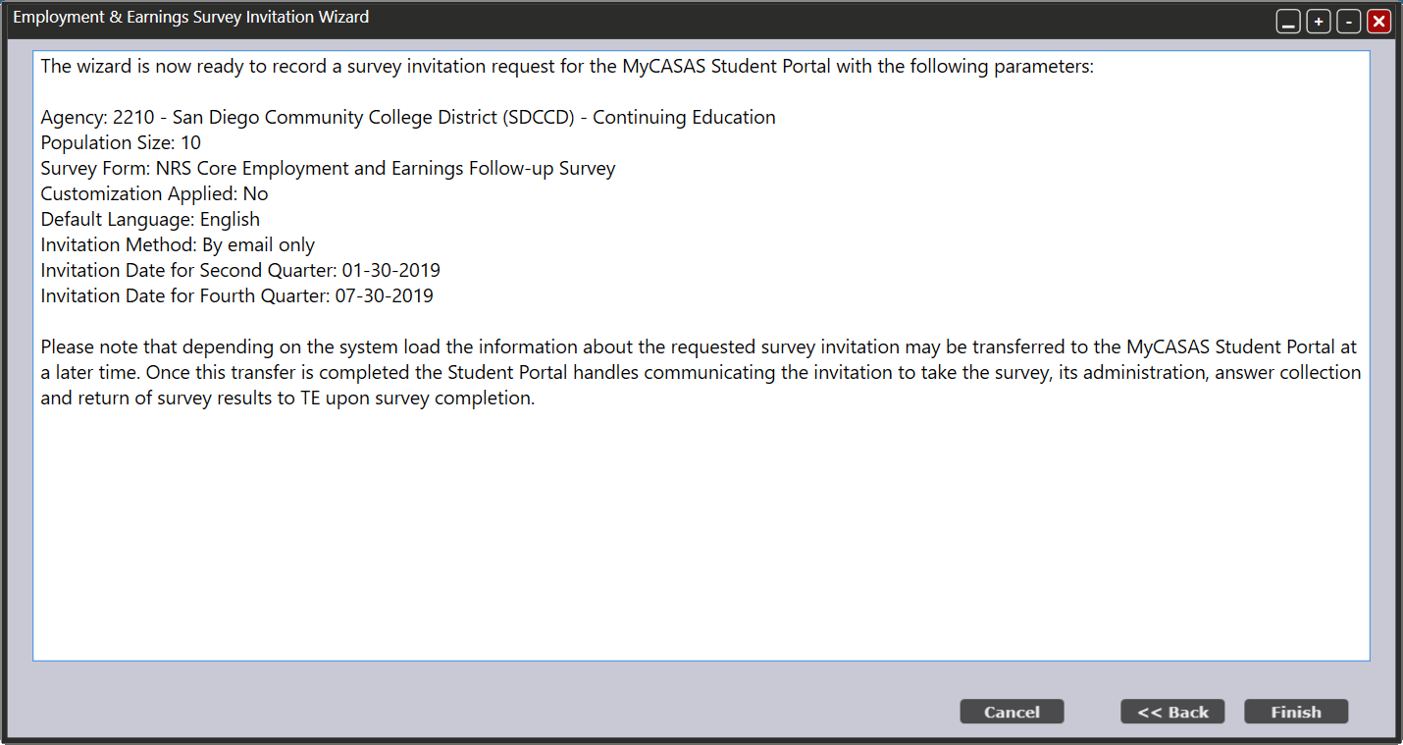

Slide 31
Customize Survey
Selecting customization options for the survey based on agency preferences

Slide 32
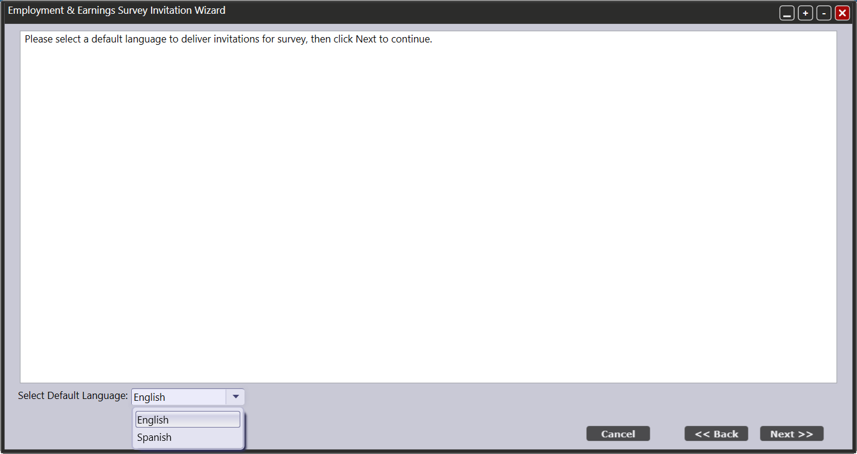

Slide 33
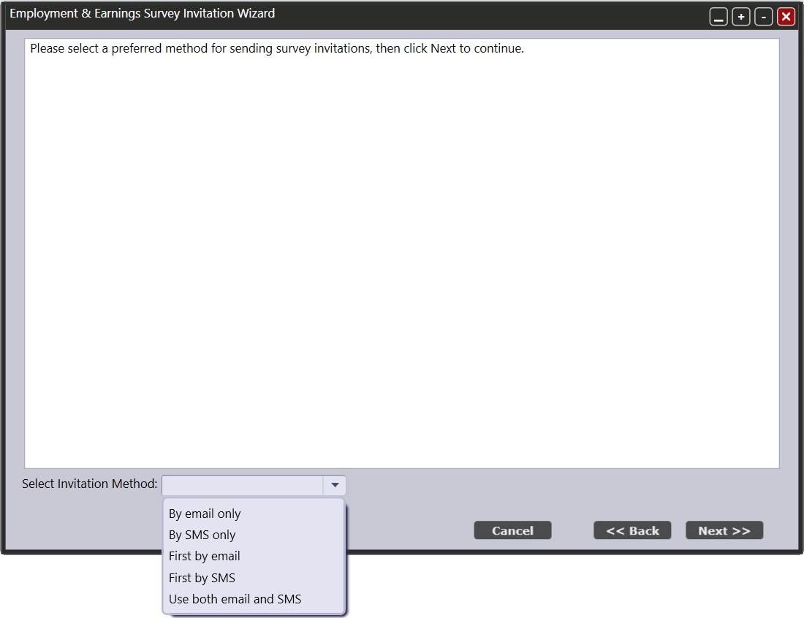
Before finishing the Wizard, you can select the specific language as well as whether to send the survey by e-mail, text message, or both.

Slide 34
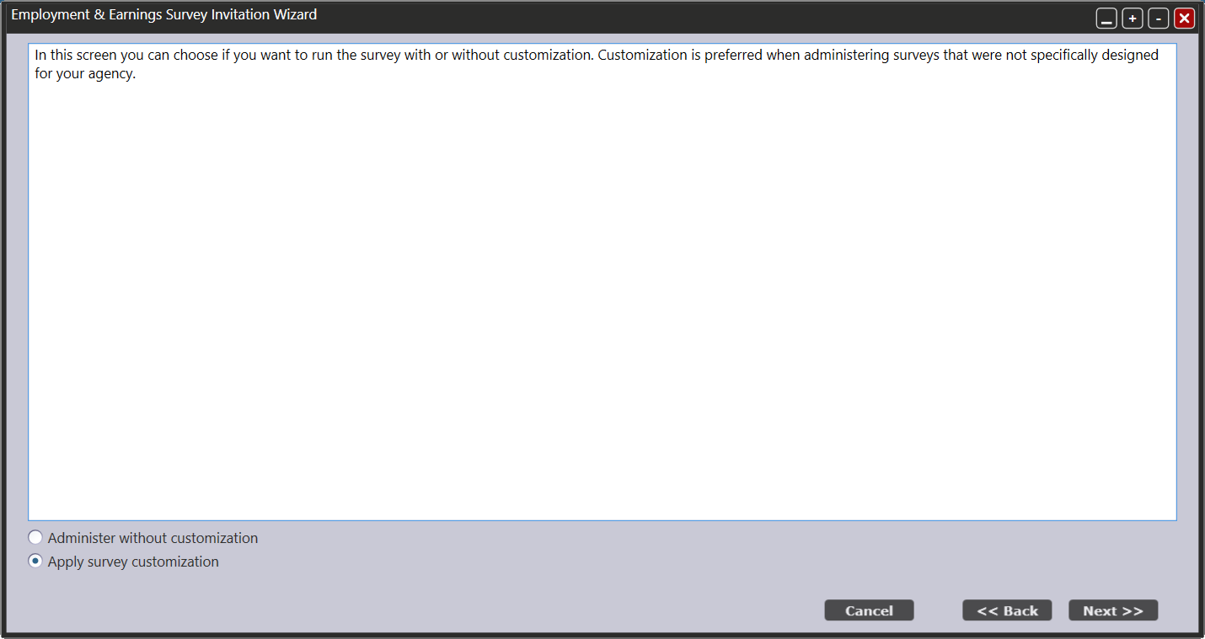

Slide 35
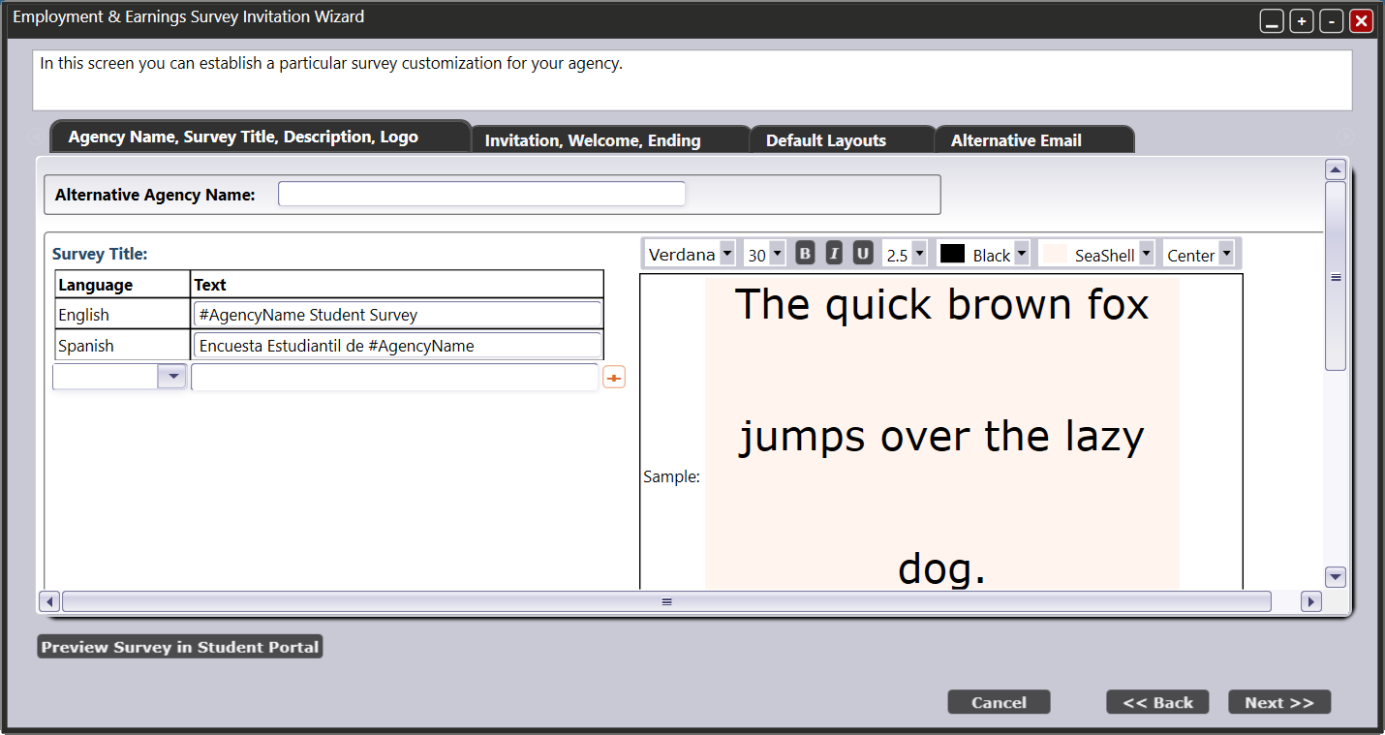

Slide 36
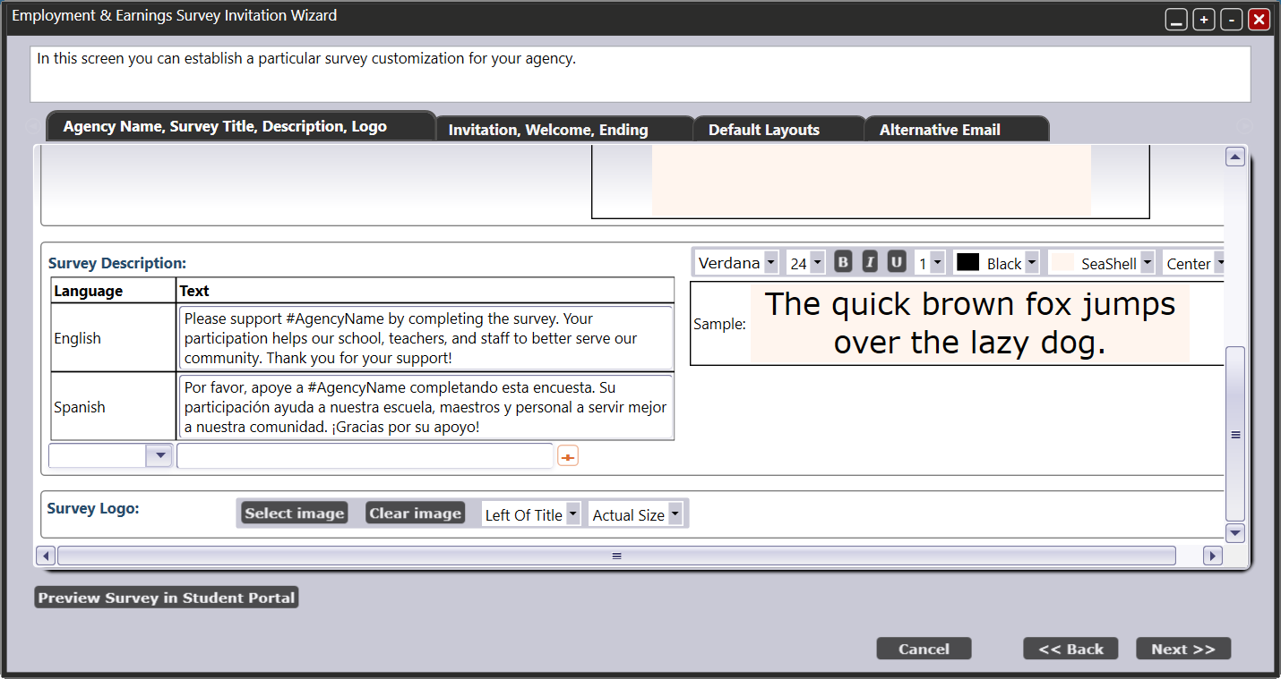

Slide 37
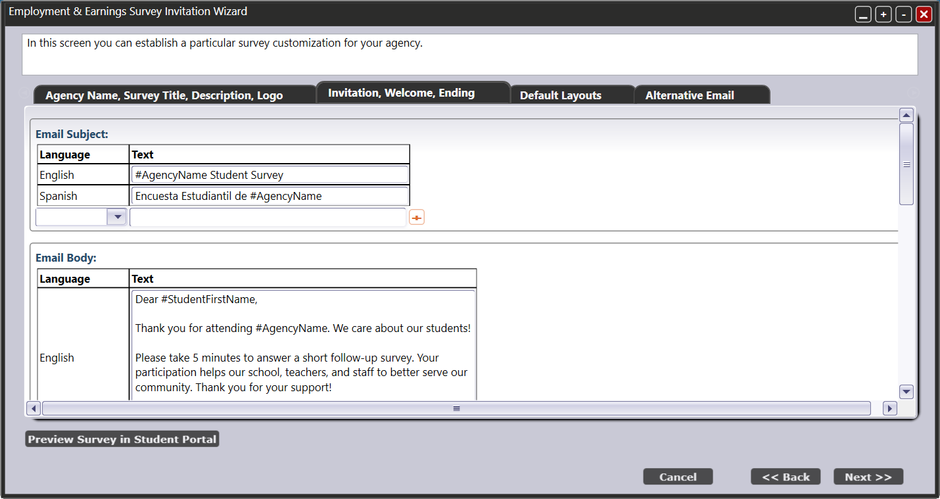

Slide 39
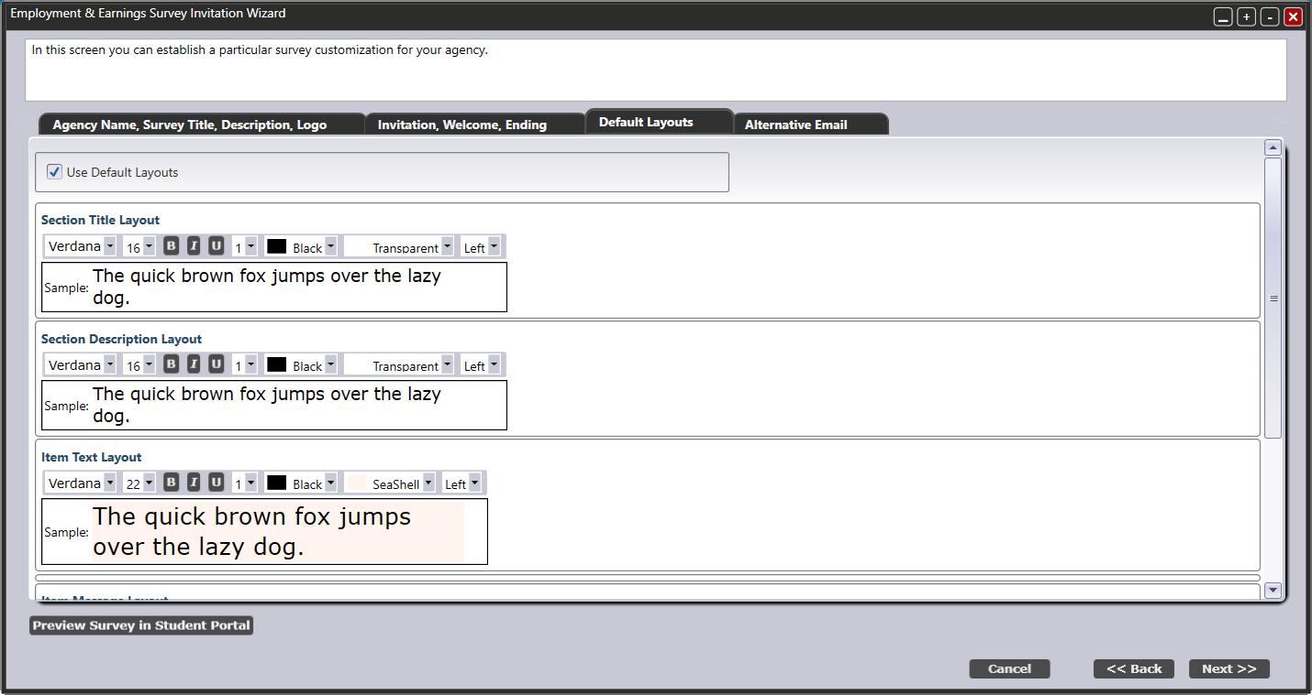

Slide 40
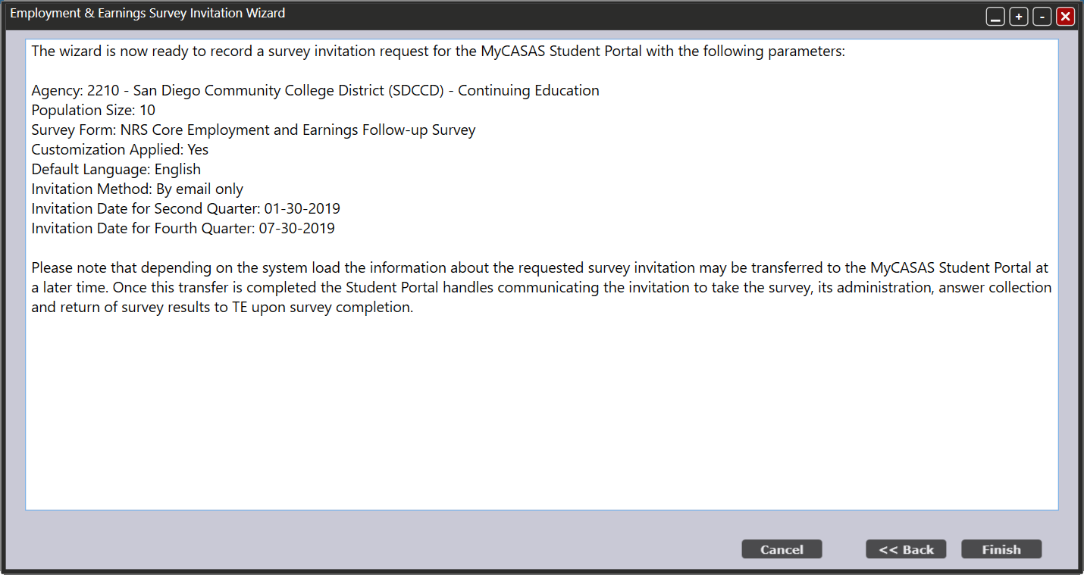

Slide 41
Student Portal
Taking the survey

Slide 42
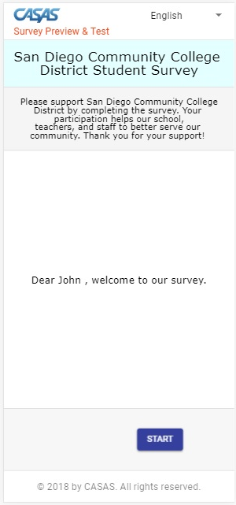

Slide 43
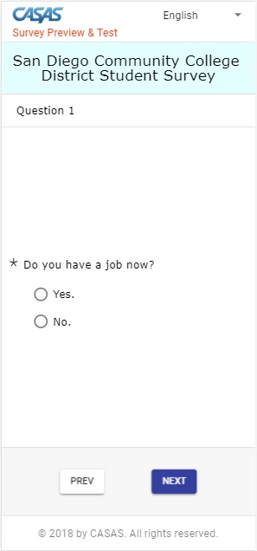

Slide 44
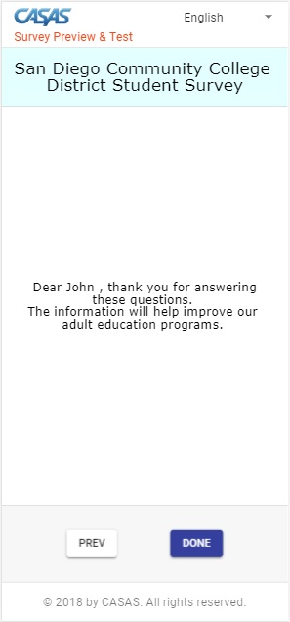

Slide 45
Additional Follow up Survey Webinar Dates
Tuesday Jan 15, 10am
Tuesday Jan 22, 10am
Wednesday Jan 30, 1pm Focus on TE features
Monday Feb 4, 1pm Focus on TE features
Tuesday Feb 5, 1pm (new) Focus on TE features
Wednesday Feb 6, 10am Focus on state/NRS policy
Tuesday Feb 12, 10am Focus on TE features
Tuesday Feb 26 10am Focus on TE features

