Slide 1
Beyond Implementation Basics Training
<Presenter Name>
<Presenter Agency/Organization>
<Presenter Contact Information>
Notes:
PRESENTER/TRAINER NOTES:
Remind participants to sign the sign-in sheet.

Slide 2
Welcome!
Have you completed
Implementation Training?
This training is for participants who:
Have completed CASAS Implementation Training
Want to expand their CASAS knowledge
Need to be recertified in CASAS Implementation
Notes:
PRESENTER/TRAINER NOTES:
Welcome participants and introduce yourself.
Explain that this session is for participants who have completed CASAS Implementation Training (IT), either face-to-face or online.
This session is not appropriate for participants new to CASAS.

Slide 3
Training Content
This training covers:
Pre-assessment
Implementation at your agency
Evaluating implementation effectiveness
Review of CASAS
Resources to support instruction
Resource for your program
Notes:
PRESENTER/TRAINER NOTES:
Review bullets.

Slide 4
Participant Materials
Training presentation
Activity packet
CASAS Competencies
CASAS Skill Level Descriptors
Training completion direction
Notes:
PRESENTER/TRAINER NOTES:
Review training packet materials.
All participants complete their training by submitting verification electronically.
Verification information is added to the CASAS contact database to:
authorize the ordering of CASAS assessments.
authorize the administering of CASAS assessments.
document participation – verified by sign-in sheet from trainer.
Directions for completing training verification are included in packets (or handed out at the end of training).
NOTE TO TRAINER: Submit Sign-In Sheet within one week of completed training in one of three ways:
E-mail attachment to ttellez@casas.org (preferred)
FAX to: 858-292-2910
Mail to:
CASAS
Attn: T. Tellez
5151 Murphy Canyon Rd., Suite 220,
San Diego, CA 92123-4339

Slide 5
Training Objectives
At the end of this training, you will be able to:
Recall links between curriculum, instruction, and assessment
Identify and use CASAS Competencies, Task Areas, and Content Standards
Interpret and use test results to inform instruction
Identify instructional resources
Identify professional development resources
Notes:
PRESENTER/TRAINER NOTES:
Review bullets.

Slide 6
Activity 1: Think about your agency
What is your role at your agency?
Does your agency have an intake process?
How does your agency place students?
What CASAS tests does your agency use?
How does your agency score CASAS tests?
Who receives test results at your agency and when?
Do your teachers use test results to inform instruction?
Notes:
PRESENTER/TRAINER NOTES:
“Here are some questions to help you think about CASAS implementation at your agency.”
Take a few minutes and work on Activity 1.
Elicit a few responses afterwards.
Point out similarities and differences between agencies.
Explain that you will allow time at the end of the session for any questions if needed.

Slide 7
Think About It
We encourage you to share these topics with others at your agency. Use them to think about and evaluate the effectiveness of your program.
Intake and assessment process
Placement into program, level, and classroom
Pretest results
Using test results to inform instruction
Post-test results
Reporting results
Professional development
Rewards and challenges
Notes:
PRESENTER/TRAINER NOTES:
The next few slides present topics to share with staff at your agency.
Time permitting, discuss a few of the topics as a group.

Slide 8
Think About It
Intake and Assessment Process
What does the process
look like at your agency?
Is it effective?
Do you use CASAS
Appraisals for placement
and intake?
Notes:
PRESENTER/TRAINER NOTES:
Time permitting, pick one question to discuss as a group.

Slide 9
Think About It
Placement in Program, Level, and Classroom
How are placement decisions made at your agency?
Is the process effective?
Is there a policy for moving students to higher or lower classes if needed?
Notes:
PRESENTER/TRAINER NOTES:
Time permitting, pick one question to discuss as a group.

Slide 10
Think About It
Pretest Results
Who administers the pretests at your agency?
Do teachers receive test results?
If so, how soon after testing do instructors receive results?
How do teachers use test results?
Notes:
PRESENTER/TRAINER NOTES:
Time permitting, pick one question to discuss as a group.

Slide 11
Think About It
Using Results to Inform Instruction
Does your agency use a set curriculum?
If not, do instructors develop their own curriculum?
Do instructors use test results to inform instruction?
Notes:
PRESENTER/TRAINER NOTES:
Time permitting, pick one question to discuss as a group.

Slide 12
Think About It
Post-Test Results
What is the interval between pre- and post-testing at your agency?
Who administers the post-tests?
How soon do instructors receive results?
How are results used?
Notes:
PRESENTER/TRAINER NOTES:
Time permitting, pick one question to discuss as a group.

Slide 13
Think About It
Reporting Results
What does the data collection and reporting system look like at your agency?
How do administrators use test results?
Who reports results to the state (or your agency’s funding source)?
Notes:
PRESENTER/TRAINER NOTES:
Time permitting, pick one question to discuss as a group.

Slide 14
Think About It
Professional Development
What professional development opportunities are available at your agency?
Staff meeting
Workshops
Seminars
Conferences
Continuing Education Units (CEUs)
Other
Notes:
PRESENTER/TRAINER NOTES:
Encourage discussion if time permits.
With budget cuts in many states, more professional development is being provided online.

Slide 15
Think About It
Rewards and Challenges
Consider your role in your agency
Write down one of the biggest rewards you have felt in your job.
Write down one of the biggest challenges you’ve encountered in your job.
Notes:
PRESENTER/TRAINER NOTES:
Give participants a few minutes to think about the above.
Participants can write their responses on their presentation handout.
Solicit feedback.

Slide 16
Let’s Review
Advantages of using
CASAS Competencies
Competency Coding System
Task Areas and Item Types
Content Standards
Notes:
PRESENTER/TRAINER NOTES:
Find out if there are participants who use CASAS eTests or TOPSpro Enterprise.
California-funded agencies use TOPSpro Enterprise but non-funded agencies and agencies outside of California may not be using it.
CASAS encourages agencies to use CASAS eTests Online together with TOPSpro Enterprise Online.

Slide 17
Advantages of Using
Nationally recognized system for computer delivery of standardized and adaptive assessments
Access anywhere with Internet connection
Provides synchronized “real-time” date for accurate results
Reports available immediately after test administration
Streamline assessment and placement
Replace Appraisal with short, computer-adaptive locator
Administer locator + pretest in one sitting
Automatically assigns next test
Notes:
PRESENTER/TRAINER NOTES:
Agencies have the option of using web-based tests in combination with paper-based tests.
Encourage participants to contact techsupport@casas.org for additional information about how to get started with CASAS eTests Online.

Slide 18
Let’s Review
CASAS Competencies
Key component and building block of CASAS system
What information do you get from a competency?
What is the link between competencies and test items?
Do you use the competencies to help plan instruction?
Why are competencies important in the larger picture of assessment and instruction?
Notes:
PRESENTER/TRAINER NOTES:
Have participants look at questions in terms of their agency.
Get feedback from participants on the final bullet about why competencies are important.

Slide 19
Let’s Review
Competency Coding System
7.7.4 Demonstrate ability to use e-mail and other messaging systems
Content Area: Learning and Thinking Skills
Competency Area: 7.7 – Demonstrate the ability to use information and communication technology
Competency Statement: Demonstrate ability to use e-mail and other messaging systems
 Complete Activity 2 in your packet.
Notes:
PRESENTER/TRAINER NOTES:
Every competency is identified with a three-digit number.
The first digit refers to the content area.
This slide shows Content Area 7 - Learning and Thinking Skills.
The second digit corresponds to a competency area.
7.7 Demonstrate the ability to use information and communication technology.
The three-digit competency statement 7.7.4 describes a measurable action.
Demonstrate ability to use e-mail and other messaging systems.
Every test item in the CASAS system corresponds to at least one specific three-digit competency statement.
Ask participants to complete Activity 2 in their packet.
Have participants work with a partner and select one of three scenarios.
Have each group report back on one specific scenario and competencies they chose.

Slide 20
Let’s Review
Task Areas and Item Types
What is a task area?
Where do you find task areas on CASAS reports?
What is the link between task areas and test items?
Do you use task areas to help plan instruction?
If so, how?

Slide 21
Let’s Review
Task Areas and Item Types
Reading and Math Task Areas
Forms
Charts, maps, consumer billings, matrices, graphs, or tables
Stories, articles, paragraphs, sentences, directions, or pictures
Signs, price tags, ads, or product labels
Measurement scales and diagrams

Slide 22
Let’s Review
Task Areas and Item Types
Listening Item Types
Picture prompts
Comprehension questions
Predict next line of dialogue
Identify true statement based on prompt

Slide 23
Let’s Review
Content Standards
What are Content Standards?
Why are they important?
Does your program promote using Content Standards to help plan instruction? If so, how?
Notes:
PRESENTER/TRAINER NOTES:
Review questions.
Solicit feedback.

Slide 24
Let’s Review
Content Standards
Clear statements of skills that students need at specific levels
Example: Interpret simple written instructions
Identify the underlying basic skills associated with CASAS Competencies
Support instructional planning
Available in reading, math, and listening
CASAS Reading Content Standards have been aligned with the Common Core State Standards
Download CASAS Content Standards at: www.casas.org > Product Overviews > Curriculum Management & Instruction > CASAS Basic Skills Content Standards
Notes:
PRESENTER/TRAINER NOTES:
Review bullets.
Visit linked resource if time permits and Internet connection is available.

Slide 25
Let’s Review…
Content Standards
Categories for Reading, Listening, and Math
Reading Content Standards Categories
R1 Beginning Literacy/Phonics R2 Vocabulary R3 General Reading Comprehension R4 Text in Format R5 Reference Materials | R6 Reading Strategies R7 Reading and Thinking Skills R8 Academic-Oriented Skills R9 Literary Analysis
Listening Content Standards Categories
L1 Phonology L2 Vocabulary L3 Grammar L4 General Discourse L5 Informational Discourse L6 Strategies and Critical Thinking
Math Content Standards Categories
M1 Number sense M2 Algebra M3 Geometry M4 Measurement M5 Statistics, Data Analysis and Probability
Notes:
PRESENTER/TRAINER NOTES:
This slide shows content standards categories for reading, listening, and math.

Slide 26
Let’s Review
Using Content Standards
 Complete Activity 3 in your packet.
Notes:
PRESENTER/TRAINER NOTES:
This slide shows an example of how content standards work with competencies to support instruction.
Walk through the information with participants.
The CASAS Competency shown here, 1.4.2, correlates to the reading example.
For students to decode or understand the rental ad shown, they need to be able to interpret abbreviations and read basic sight words.
“Are there any other underlying basic skills they might need to understand this rental ad?”
one possible answer: recognize and understand numbers
Have participants only complete the top half of Activity 4.
Allow ten minutes and have them work in pairs or groups.
Have several participants share with the group.
If time permits, have participants work in pairs or groups to select a competency from the previous slide and complete the exercise on the bottom half of the page.
Encourage them to use the second mapping activity as a staff development topic at their agency.

Slide 27
Resources to Support Instruction
Maximize your curriculum design and instruction
Test Results, Data, and Reports
Complimentary Online CASAS Resources
CASAS Content Standards Worksheets
Sample Test Items
QuickSearch Online
Curriculum Modules
Notes:
PRESENTER/TRAINER NOTES:
Explain that CASAS does not have a fixed curriculum but provides a number of resources to support curriculum design.

Slide 28
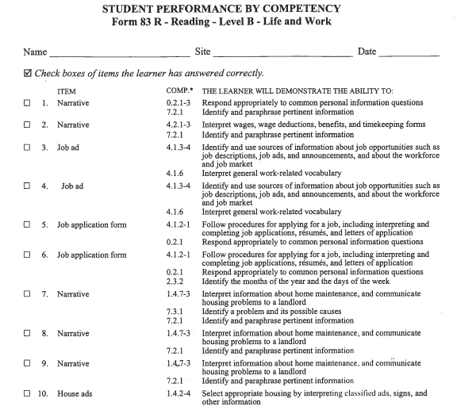
Resources to Support Instruction
Manual
Report
per form
per class
Worksheets are
available in
Test Administration
Manuals (TAM)
Notes:
PRESENTER/TRAINER NOTES:
For programs that score answer sheets manually, these individual student worksheets are available in the TAMs.
The format in this report is similar to reports generated through TOPSpro Enterprise.

Slide 29
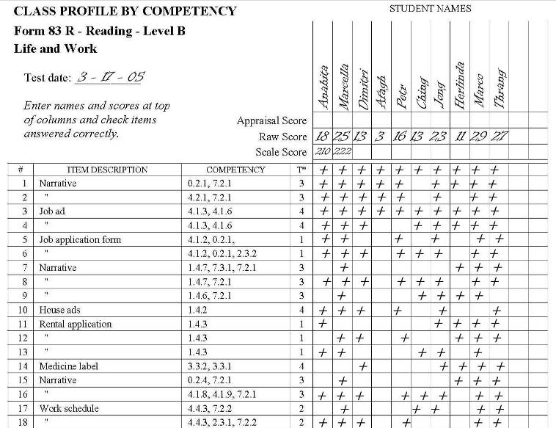
Resources to Support Instruction
Manual
Report
per form
per class
Worksheets are
available in
Test Administration
Manuals (TAM)
Notes:
PRESENTER/TRAINER NOTES:
For programs that score answer sheets manually, these individual student worksheets are available in the TAMs.
The format in this report is similar to reports generated through TOPSpro Enterprise.

Slide 30
Advantages of using
Nationally recognized learner management and accountability software
Advantage for Teachers!
Automates test scoring
Calculates student learning gains by class
Produces customized class reports to help plan instruction
Advantage for Administrators!
Provides reports to meet accountability standards and measure program effectiveness.
Tracks students enrolled in multiple programs.
Notes:
PRESENTER/TRAINER NOTES:
Review bullets.
Emphasize that even if an agency administers paper-based tests, they can benefit from using TOPSpro Enterprise to process results for automated scoring, recording, and reporting test information.

Slide 31
Advantages of using
Nationally recognized learner management and accountability software
Advantage for Decision Makers!
Generates NRS reports according to WOIA federal guidelines
Rolls up data from local to regional to state level
Provides aggregated statewide data

Slide 32
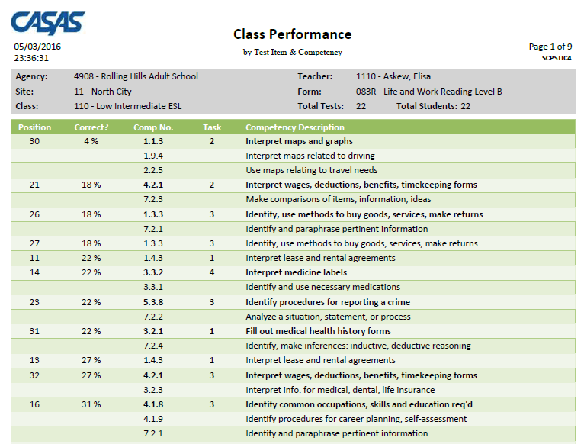
Resources to Support Instruction
Sample report shows the competency number per test item and student item responses sorted by percentage correct per form and per class.
Notes:
PRESENTER/TRAINER NOTES:
This slide shows a Class Performance report sorted by percentage correct.
This report is a popular alternative to the Class Profile report from a previous slide.
Go over the headings: position – test question number; correct – percentage of students who answered a particular item correctly; comp. no. – competency statement number; task – task area; competency description – bold statements = main competency addressed; non-bold statements = second or third competencies addressed.
Teachers can readily identify areas of greatest need to develop lessons that address those needs and prepare students for post/progress-testing.
Sample report available on the CASAS website at: www.casas.org > Product Overviews > Software > TOPSpro Enterprise > Sample Reports
Ask if anyone has questions.

Slide 33
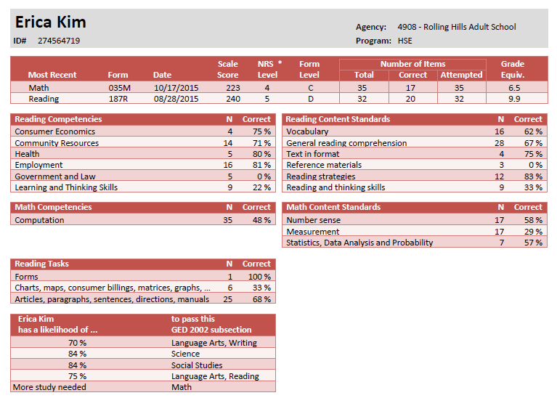
Resources to Support Instruction
Sample report
shows
competencies
assessed in
math and reading for an individual student.
Notes:
PRESENTER/TRAINER NOTES:
This slide shows an example of an Individual Skills Profile report.
This sample displays competencies assessed in reading and math and includes a predictor for the likelihood of passing different GED subsections.
CASAS is currently undertaking a study with HiSET and the new GED to update the predictor for either type of High School Equivalency (HSE) exam.
This is a very popular report among ABE, HSE, and HSD programs as well as workforce readiness programs.
Sample report available on the CASAS website at: www.casas.org > Product Overviews > Software > TOPSpro Enterprise > Sample Reports
Ask if anyone has questions.

Slide 34
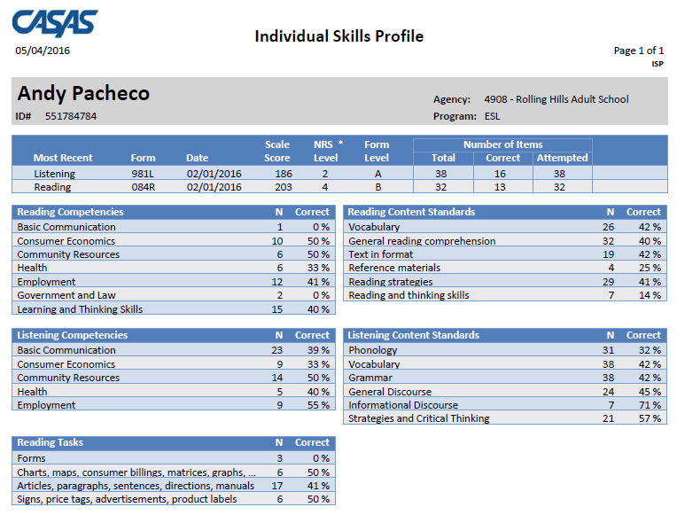
Resources to Support Instruction
Sample report shows competencies assessed in listening and reading for an individual student.
Notes:
PRESENTER/TRAINER NOTES:
This is another example of an Individual Skills Profile report.
This sample displays competencies assessed in reading and listening.
Sample report available on the CASAS website at: www.casas.org > Product Overviews > Software > TOPSpro Enterprise > Sample Reports
Ask if anyone has questions.

Slide 35
Resources to Support Instruction
Sample shows test results by competency number and statement for each test item and if the student correctly answered the item. Report available per form and per student.
Notes:
PRESENTER/TRAINER NOTES:
The Student Performance report shows individual student test results on a given test form. The report -
Displays the competency number and statement for each test item.
Indicates if the student correctly answered the item.
This sample report is sorted by order of test item.
This is the electronic version of worksheets provided in TAMs.
Sample report available on the CASAS website at: www.casas.org > Product Overviews > Software > TOPSpro Enterprise > Sample Reports
Ask if anyone has questions.

Slide 36
CASAS Content Standards Worksheets
Help teachers prioritize Competencies and Content Standards for classroom instruction.
Basic Skills Content Standards by Test Item Correlations
Provide information about the basic skills content standards contained in each test form.
Student Performance by Content Standard
Documents correlate CASAS test items to CASAS Basic Skills Content Standards.
Download at www.casas.org > Product Overviews > Curriculum Management & Instruction > CASAS Basic Skills Content Standards
Notes:
PRESENTER/TRAINER NOTES:
Review bullets.
Visit linked resource if time permits and Internet connection is available.

Slide 37
Sample Test Items
Familiarize students and instructors with test item format and delivery
Students practice test-taking skills
Sample items are not a predictor of performance
Sample items are available in printable booklets, presentations, and
Download Sample Test Items at www.casas.org > Product Overviews > Curriculum Management & Instruction > Sample Test Items
Notes:
PRESENTER/TRAINER NOTES:
Review bullets.
Ask if anyone is currently using sample test items, what are they using and how are they using them.
Visit linked resource if time permits and Internet connection is available.

Slide 38
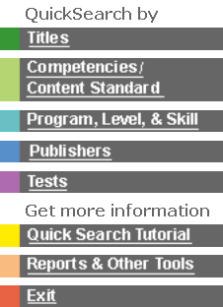
Online
Provides an essential link between assessment and instruction in the CASAS system.
An easy-to-use database of commercially available instructional materials.
Titles coded to skill levels, CASAS Competencies, and skill areas.
Complimentary, unlimited access.
www.casas.org > Product Overviews > Curriculum Management & Instruction > Instructional Materials: QuickSearch Online
Notes:
Introduce QuickSearch Online by reviewing bullets.
This database is complimentary with unlimited access
Helps program coordinators and instructors select materials to match curriculum.
Participants may search by title, competency, program, level, skill area, publisher, and test form.
Encourage participants to use QuickSearch to identify which competencies are targeted in curriculum they are already using.
If you have access to the Internet, you may wish to go to QuickSearch at this point and demonstrate how to use the database.
Suggestion: ask participants for the title of a favorite instructional resource and “Search by Title” to see CASAS Competencies addressed in that title.
Visit linked resource if time permits and Internet connection is available.

Slide 39
Curriculum Modules
Adult Low—Level Literacy
CASAS Competencies and Content Standards linked with informal assessment and CASAS standardized assessment.
Universally designed strategies with alternate formats, metacognitive and self-determination skills, and community transition activities.
Use with pre-beginning and beginning readers.
Ten theme-based modules for learning progression.
No cost, unlimited access.
Visit: www.casas.org > Product Overviews > Curriculum Management & Instruction > Curriculum Modules (Low Level Literacy)
Notes:
PRESENTER/TRAINER NOTES:
Review bullets.
Visit linked resource if time permits and Internet connection is available.

Slide 40
Resources for Your Program
Activity packet
Discussion Questions
For Instructors
For Program Managers and Administrators
Checklists
Assessment Process
Planning for Instruction
CASAS Website
Training and Support
Education Providers
Workforce Development
Business and Industry
Social Media Newsroom
40
Notes:
PRESENTER/TRAINER NOTES:
Review bullets.
Review CASAS Website resources.
Explain to participants that the Resource Section is for them to take back to their agencies.
Encourage them to share these resources with other staff.
These are designed to generate discussion and may be used as staff development activities.
Visit linked resources if time permits and Internet connection is available.

Slide 41
Case Study
Complete the Case Study in your activity packet.
Work in groups of 2-3 if possible, or work alone.
When your group finishes, we will review answers together.
Notes:
PRESENTER/TRAINER NOTES:
Review the instructions listed on this slide.
Set a start and end time.
Before starting the Case Study, ask if anyone has questions.

Slide 42
Review Training Objectives
You should be able to:
Recall links between curriculum, instruction, and assessment
Identify and use CASAS Competencies, Task Areas, and Content Standards
Interpret and use test results to inform instruction
Identify instructional resources
Identify professional development resources
Notes:
PRESENTER/TRAINER NOTES:
Review bullets.

Slide 43
What’s Your Success Story?
CASAS is collecting videos and stories to highlight youth and adult education and training success across the country.
Share how CASAS has helped your learners or program.
The challenge
The solution
The outcome
Share your story!
www.casas.org > Social Media Newsroom > Success Stories
Notes:
PRESENTER/TRAINER NOTES:
Visit the CASAS website to read how agencies and programs across the country are using CASAS to assist adults functioning at or below a high school level in attaining the basic literacy skills to function effectively on the job, in the community, and in the family.
See how programs establish comprehensive performance accountability systems, address core indicators of performance, integrate literacy and occupational skill instruction, and evaluate the effectiveness of adult education and literacy programs.
We invite you to Share Your Story!
The Challenge (briefly describe the challenge your program was facing)
The Solution (What did CASAS provide to help you overcome that challenge? Which CASAS assessments, resources, people/staff, etc. helped?)
The Outcome (what was the result of implementing CASAS?)
Visit linked resource if time permits and Internet connection is available.

Slide 44
Training Completion
Go online to complete your training
Sign and submit the Test Security Policy Agreement
Generate a Certificate of Completion
After verifying your training completion online —
You are authorized to order and administer CASAS Appraisals and leveled pre- and post-tests
Submit your training verification online at http://training.casas.org/
Notes:
PRESENTER/TRAINER NOTES:
Participants complete their training by submitting verification electronically.
Distribute Training Completion Directions (if not included in packets).
Review directions on how participants submit verification after they have attended the training.
Ask participants to fill-in information for this training on the directions handout:
Workshop ID
Date of Training
Name of Trainer(s)
Training Location Name, Address, State
They will need to include this information when verifying their training.
This information is added to the CASAS contact database to verify training completion.
Visit linked resource if time permits and Internet connection is available.
Ask if anyone has questions.

Slide 45
Contact Information
Mail
CASAS
5151 Murphy Canyon Rd., Suite 220
San Diego, CA 92123-4339
Website: www.casas.org
Telephone
(858) 292-2900 or (800) 255-1036
Fax
(858) 292-2910
E-Mail
General questions:
casas@casas.org
Websites:
Click Feedback at bottom of any web page
Technology Support Team:
techsupport@casas.org
Workshops:
http://www2.casas.org/online_registration/
Notes:
PRESENTER/TRAINER NOTES:
Be sure all participants signed the Sign-in-Sheet.
IMPORTANT!
Remind participants that their training is not official until they follow directions for completing training verification online.
Make sure participants fill-in information for this training on the directions handout before leaving:
Workshop ID
Date of Training
Name of Trainer(s)
Training Location Name, Address, State
Turn in the completed Sign-In Sheet to CASAS within one week of completed training.

Slide 46
Thank You for Attending!
Be sure to visit the CASAS website at www.casas.org.
Follow us on Twitter twitter.com/CASASsystem and use hashtag #casassi2016 to tweet updates, photos, and stories.
Keep in touch with Facebook facebook.com/CASASsystem and use hashtag #casas to share photos and post stories.
Create your CASAS pinboard on Pinterest https://www.pinterest.com/casassystem/
Visit us on the CASAS YouTube Channel.

