Slide 1
From the Inside Out
CASAS Assessments

Slide 2
CASAS Vocabulary
Competencies
Content Standards
Tasks
CASAS Assessments
  Test Form
  Test Level
  Test Administration Manual
Appraisal, Pre-Test, Post-Test
Raw Scores
Scale Scores

Slide 3
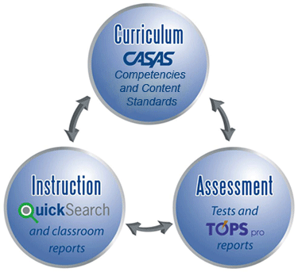
The CASAS System
CASAS is a nonprofit organization dedicated to improving youth and adult education services.
CASAS is an integrated systems approach with four key components.

Slide 4
CASAS – Comprehensive Adult Student Assessment Systems
learner-centered curriculum management
used nationwide in
    Adult Basic Education (ABE)
    English as a Second Language (ESL)
    workplace literacy
    family literacy
    employment and training
    welfare reform/TANF
    citizenship
    correctional programs
meets Workforce Innovative Opportunity Act (WIOA) requirements.
appropriate for native and non-native English speaking youth and adults

Slide 5
CASAS Assessments address literacy and academic skills in the contexts of…
Life and Work
  Basic Communication
  Consumer Economics
  Community Resources
  Health
  Employment
  Government and Law
Academic Subjects for secondary level programs
  English/Language arts
  Mathematics
  American government
Citizenship
Special Needs
  Employability
  Life skills and academic subject tests
Notes:
t

Slide 6
Validity of CASAS Assessments
Content Validity
Reviewed and approved by adult education practitioners as valid indicators of student mastery
revalidated periodically by the CASAS National Consortium, representing more than 30 states
Aligned to NRS Educational Functioning Levels, Common Core and other state and national standards
Test Development
All CASAS multiple-choice tests and calibrated item test banks are based on the Rasch Model of Item Response Theory (IRT), the same model used to develop the GRE and GMAT.
All items and forms are evaluated and developed according to the industry standards and guidelines outlined by the American Educational Research Association (AERA,) American Psychological Association (APA) and National Council on Measurement in Education (NCME).
Reliability
Studies indicate CASAS tests yield consistent results in student placement and measurement of student educational progress with respect to NRS Educational Functioning Levels.
Construct Validity:
Designed to measure basic skills in the context of adult functional tasks
Tests are appropriate for students in adult education and workforce programs
Additional information on the psychometric properties of CASAS tests can be found in the CASAS Technical Manuals.

Slide 7
“Educators of adults have long recognized that relating instructional content to the specific contexts of learners’ lives and interests increases motivation to learn”
By integrating academic content with situations or issues that are meaningful to students, instructors can help adults acquire skills more rapidly than through approaches that focus only on subjects
(Dirkx and Prenger 1997, p. 2).

Slide 8
CASAS Test Items
Competencies
Task Areas
Content Standards
are based on the application of functional language skills in realistic everyday life or workplace contexts.
Every test item addresses
one or more competencies,
a task area,
and several content standards.

Slide 9
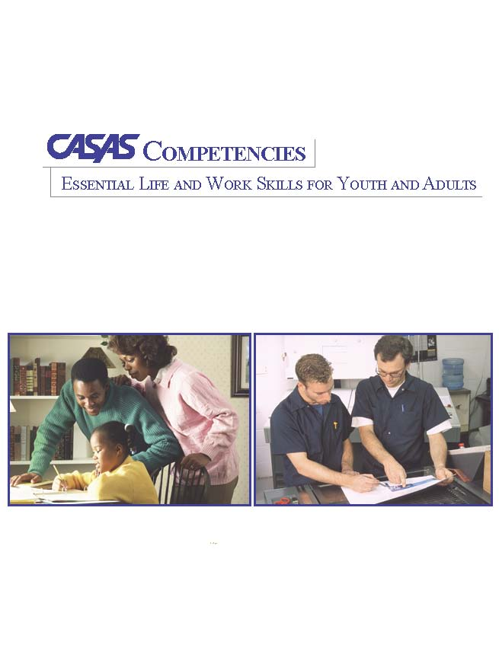
What are Competencies?
Competency Content Areas
0. Basic Communication
1. Consumer Economics -
2. Community Resources
3. Health
4. Employment
5. Government and Law
6. Computation
7. Learning to Learn
8. Independent Living Skills
CASAS Competencies are measurable learning objectives written in a functional life skills context.
CASAS tests are aligned to these competencies.
CASAS Web site: www.casas.org/ About CASAS / CASAS Competencies
9
Notes:
Show the competency – within the content area == spell it out more. Consumber economics =

Slide 10

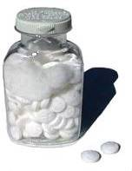
The Competency Coding System
Content Area
  3. Health
Competency Area
  3.4 Understand basic health & safety procedures
Competency Statements
  3.4.1. Interpret product label directions and safety warnings
  3.4.2. Identify safety measures that can prevent accidents and injuries
Every test item in the CASAS system is associated with a specific competency.
Notes:
The Competency Coding System
Every competency is identified with a three digit number. The first digit always refers to the content area.
The second digit refers to a competency area. 3.4 represents the content area of health and the more specific competency area of “understanding basic health and safety procedures”. The three digit competency statement describes a measurable action. Every test item in the CASAS system is associated with a specific competency.

Slide 11
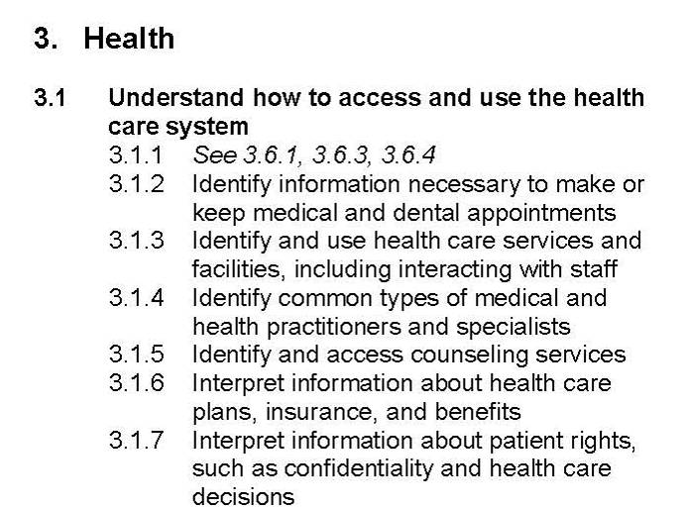
Why Use Competencies?
These competencies provide
instructional objectives for curriculum
direct links to test content for monitoring student learning
criteria for program evaluation
a referencing system for instructional materials
Competency Area
The numbering systems for Competencies, Tasks and Content Standards are reflected in testing reports for your students and classes.
Content Area
Competency Statement
Notes:
Double-check that the competency area, content area are correct

Slide 12
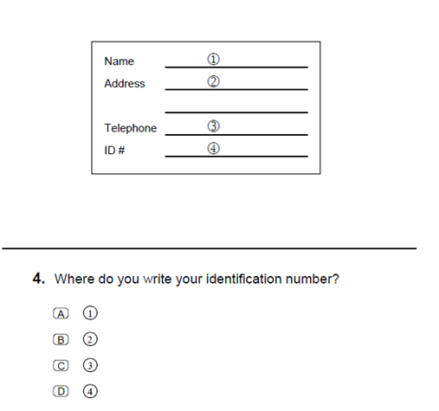
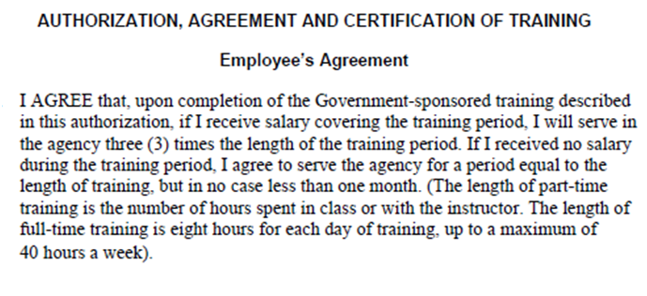
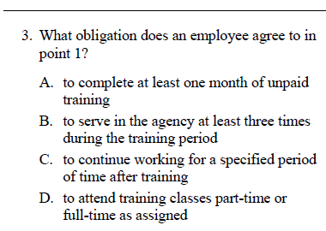
CASAS Competency 4.4.3 at two levels:
Interpret job-related signs, charts, diagrams, forms and procedures, and record information on forms, charts and checklists, etc.
Level A
Level D
Notes:
Add in an ABC and D

Slide 13
What are Content Standards?
The literacy and academic skills that students need to be successful in mastering the CASAS Competencies.
Reading
R1 Beginning literacy/phonics
Listening
L1 Phonology
Math
M1 Number Sense
R2 Vocabulary
R3 General reading comprehension
R4 Text in format
R5 Reference materials
R6 Reading strategies
R7 Reading and thinking skills
R8 Academic-oriented skills
R9 Literary Analysis (ABE/ASE only)
L2 Vocabulary
L3 Grammar
L4 General Discourse
L5 Informational Discourse
L6 Strategies and Critical Thinking
M2 Algebra
M3 Geometry
M4 Measurement
M5 Statistics, Data Analysis and Probability
Writing
W1 Beginning Literacy
W2 Spelling and Mechanics
W3 Grammar and Sentence Structure
W4 Vocabulary/Word Choice
W5 Organization
W6 Content
W7 Writing for Varied Purposes
W8 Academic-oriented Skills
Speaking
S1 Phonology/ Pronunciation
S2 Vocabulary
S3 Grammar
S4 General Discourse
S5 Informational Discourse
S6 Strategies and Critical Thinking
Notes:
13
Here are the categories for Reading Content Standards from the most basic to advanced for ASE level students.
They also have a coding system similar to the CASAS Competencies.

Slide 14
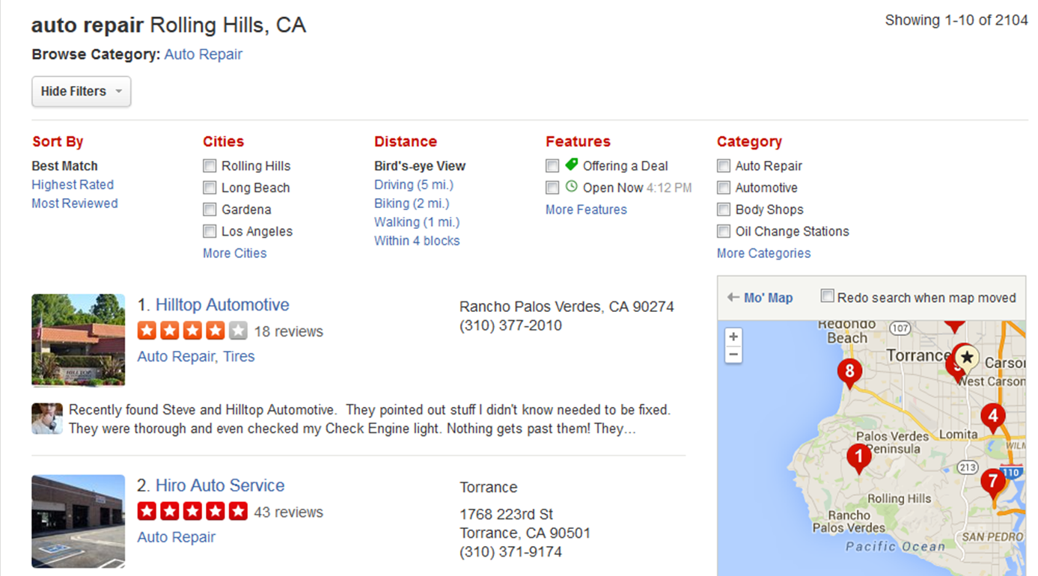
CASAS Competency
Community Resources 2.1.1 --Use a telephone directory
Locate information organized in groups or categories
R5.3
Find a word or number in an alphabetical, numeric or other ordered listing
R5.1
R6.2 Scan simple text to find specific information
R6.2
R3.12 Use supporting illustrations to interpret text
R3.12
Use capitalization as a clue to interpret words
R2.4
Notes:
14
Let’s go back to our CASAS Competency Activity. We found the various competencies students would need to be able to do in order to tackle having to get to work when their car won’t start.
If we find that our students are having difficulty with a competency, it’s time to look at the Content Standards that support that competency. Students may have a gap in their knowledge of a particular skill.
Here is one of the competencies we identified in our activity – 2.1.1 – Use a telephone directory. What Basic Skills Content Standards must the student be adept at in order to succeed in the skill of using a telephone directory?
Students will need to look for items alphabetically
Read numbers
Read ads

Slide 15

CASAS Basic Skills Content Standards
What reading skills are embedded in this
CASAS Level A test question?
Beginning Literacy/Phonics
Identify the letters of the English alphabet (upper and lower case)
Vocabulary
Relate letters to sounds
Recognize that letters make words and words make sentences
Read from left to righ, top to bottom, front to back
Interpret common symbols (e.g., restroom signs, traffic signs, #, >, ?)
Read basic sight words (e.g., the, is)
Interpret common high frequency words and phrases in everyday contexts (e.g., signs, ads, labels)
General Reading Comprehension
Interpret common punctuation and sentence-writing conventions (e.g., capitalized first word)
Read and undertand simple sentences that contain familiar vocabulary
Interpret basic sentence structure and grammar (e.g., statements, questions, negative; adjectives modifying nouns)
Use supporting illustrations to interpret text
Scan simple text (e.g., ads, schedules, forms, paragraphs to find specific information)
Reading Strategies

Slide 16
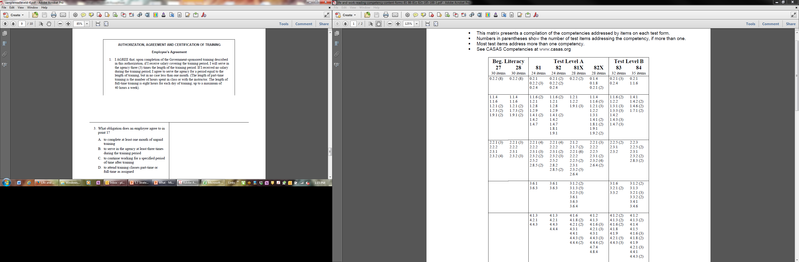
CASAS Basic Skills Content Standards
What academic skills are embedded in this
CASAS Level D test question?
General Reading Comprehension
Make connections between related information across different sections of a text
Reading Strategies
Scan complex or extended text to find specific information
Read and understand complex texts
Reading and Thinking Skills
Vocabulary
Interpret specialized vocabulary in context (e.g., consumer, work, field of interest)
Interpret complex sentence structure and grammar (e.g., relative clauses, perfect tenses)
Make connections between related information across different sections of a text
Interpret signal words as clues to the organization and content of a text
Interpret figurative meanings of words from context
Interpret analogies in familiar contexts
Interpret meaning of metaphors and similes in context
Skim complex text for general meaning or to determine subject matter or organization

Slide 17
Task Areas
Reading Tasks
Forms
Charts, maps, consumer billings, matrices, graphs, or tables
Stories, articles, paragraphs, sentences, directions, or pictures
Signs, price tags, ads, or product labels
Measurement scales and diagrams
Listening Tasks
Picture prompt
Comprehension question
Predict next line of dialogue
Identify true statement based on prompt

Slide 18

CASAS Task Areas at 2 Levels
Level A
Task 3 - Paragraphs
Level D
Task 3 - Paragraphs

Slide 19
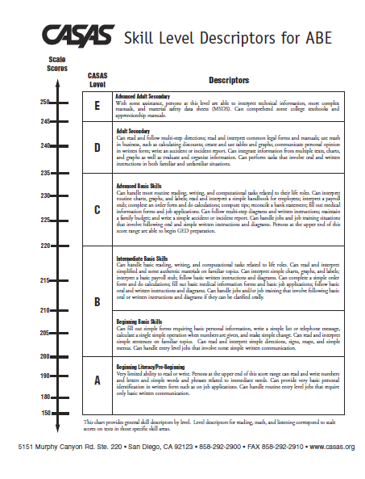
Skill Level Descriptors
The Skill Level Descriptors provide general information on how an adult learner’s scale score to the job-related and life skill tasks this person generally can accomplish.

Slide 20
What’s in a CASAS test question?
Competency
A measurable learning objective written in a functional life skills context.
Basic Skills Content Standard
the literacy skills that students need to be successful in mastering the competencies.
Task Area
Prompts such as photos, graphs, texts in CASAS Tests. Students must not only be able to read a sentence, but must be able to understand vocabulary in context.

Slide 21
ESL & ABE:
What can a CASAS Level A student do?
ESL – Beginning Low
180-190 CASAS Scale Score
Reading/Writing: Listening/Speaking: Functions in a very limited way in situations related to immediate needs; asks and responds to basic learned phrases spoken slowly and repeated often. Reading/Writing: Recognizes and writes letters and numbers and reads and understands common sight words. Can write own name and address.
ABE – Beginning Literacy
150-200 CASAS Scale Score
Reading/Writing: Very limited ability to read or write. Persons at the upper end of this score range can read and write numbers and letters and simple words and phrases related to immediate needs. Can provide very basic personal identification in written form such as on job applications. Can handle routine entry level jobs that require only basic written communication.

Slide 22
What’s in this Level A CASAS test question?
Competency
Community Resources
Read, interpret, follow public signs, building directories
Task Area
Signs, price tags, ads or product labels
Content Standards
Beginning Literacy/Phonics
Vocabulary
General Reading Comprehension
Reading Strategies
Task 4

Slide 23
ESL & ASE:
What can a CASAS Level D student do?
ESL – Adult Secondary
235 - 245 CASAS Scale Score
Reading/Writing: Can read and interpret non-simplified materials on everyday subjects; can interpret routing charts, graphs, and labels; fill out medical information forms and job applications; and write an accident or incident report.
ABE – Adult Secondary
235-245 CASAS Scale Score
Reading/Writing: Can read and follow multi-step directions; read and interpret common legal forms and manuals; communicate personal opinion in written form; write an accident or incident report. Can integrate information from multiple texts, charts, and graphs as well as evaluate and organize information. Can perform tasks that involve oral and written instructions in both familiar and unfamiliar situations.

Slide 24
What’s in this Level D CASAS test question?
Competency
Employment
Interpret Employee handbooks, personnel policies, and job manuals
Task Area
Articles, paragraphs, sentences, directions and manuals
Content Standards
General Reading Comprehension
Reading Strategies
Task 3

Slide 25
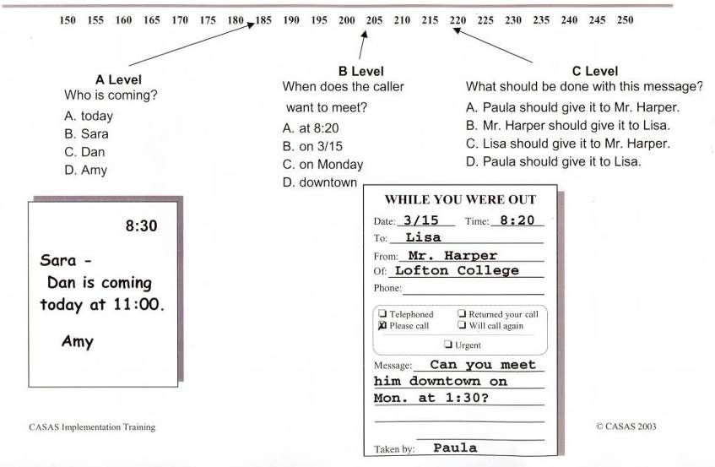
Sample Test Items at Three Levels
Competency 2.1.7: Take or interpret telephone messages
Page 33
Notes:
This slide was used earlier in this presentation, but is a handy reminder for this portion.
Here are examples of test items (or questions) at three different levels along the CASAS scale. Each test question has a display (a picture or a cue) which the student reads, and then a question with four multiple choice answers to select from. All of these test questions relate to competency 2.1.7: Take or interpret telephone messages.
At level A, the student reads a simple note, and selects the answer A, B, C, or D to a simple question: who is coming?”
At level B, the student reads the message and selects the answer to “When does the caller want to meet?” This type of question is around a reading level 205 on the CASAS scale.
At level C, the question may require some critical thinking. “What should be done with this message” is a question that is around a level 220 on the CASAS scale.

Slide 26
In Summary…..
Competencies, Content Standards and Tasks
create the foundation of the CASAS System.
Separately, they provide
  life and work skills contexts
  a variety of visual prompts
  the underlying basic literacy skills instruction that together work as the ladder to successful attainment of the learning objectives.

Slide 27

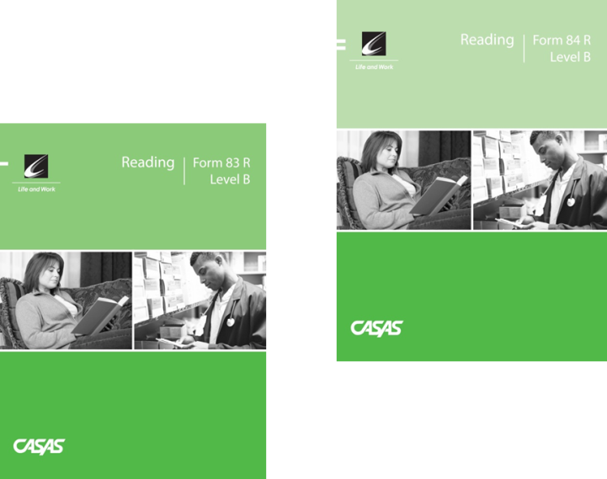

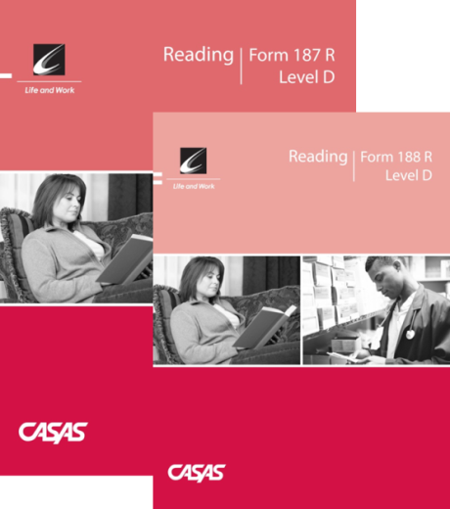
CASAS Assessments
CASAS progress tests (pretests and post-tests) have three principal uses:
  to identify a student’s skill level
  to guide instruction
  to measure learning progress

Slide 28
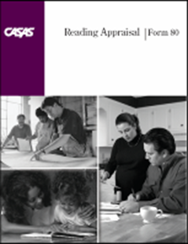
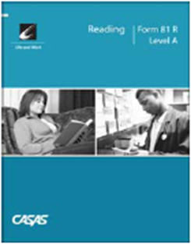

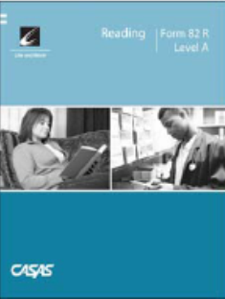
Place
Appraisal
Identifies the Pretest students should take.
Diagnose
Pre-Test
Establishes a baseline score and begins to diagnose learning needs
Instruct
Informal Assessment
Includes targeted instruction based on information from Pretests
Monitor
Post Test
Given after 70-100 hours of instruction. Results compared to previous test. Progress determined.

Slide 29
What’s the difference between the Appraisal and the Pretest?
180 185 190 195 200 205 210 215 220 225 230 235 240 250
Appraisals (Placement tests)
Appraisal test items are widely distributed along the CASAS scale. The items range from very easy items to difficult items.
Level B
Pre- and Post-Tests (Progress Tests)
Progress test items are clustered at a specific level.
Notes:
This chart shows the difference between an appraisal and a pre post test.

Slide 30


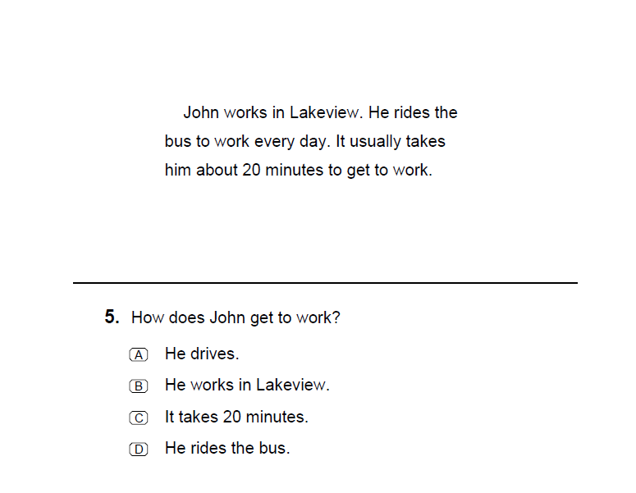
Level A
Scale Score Range <150-200
150-180 = Beginning Literacy
May not be literate in any language.
181-190 = Low Beginning ESL
Recognizes and writes letters and numbers and reads and understand common sight words. Can write own name and address.
191-200 = High Beginning ESL
Reads and writes letters and numbers and a limited number of basic sight words and simple phrases related to immediate needs. Can write basic personal information on simplified forms.

Slide 31


Level B
Scale Score Range
201-220
201-210 Low Intermediate
Can read and interpret simple material on familiar topics. Able to read and interpret simple directions, schedules, signs, maps, and menus.
211-220 High Intermediate
Can read and interpret simplified and some authentic material on familiar subjects.

Slide 32
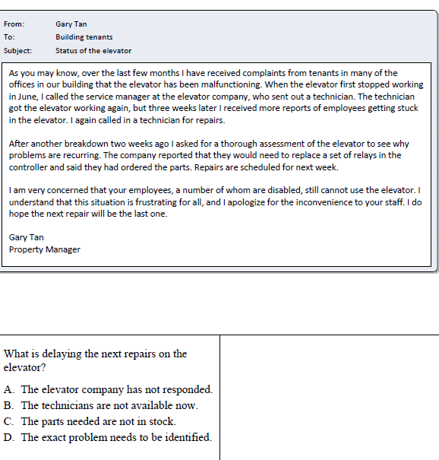


Level C
Scale Score Range
221-235
Can read and interpret simplified and some non-simplified materials on familiar topics. Can interpret simple charts, graphs, and labels; interpret a payroll stub, and complete a simple order form; fill out medical information forms and job applications.
Notes:
Should add in research about teaching within a context students can use
Add in slide of CASAS at 3 levels
Scaffolding

Slide 33
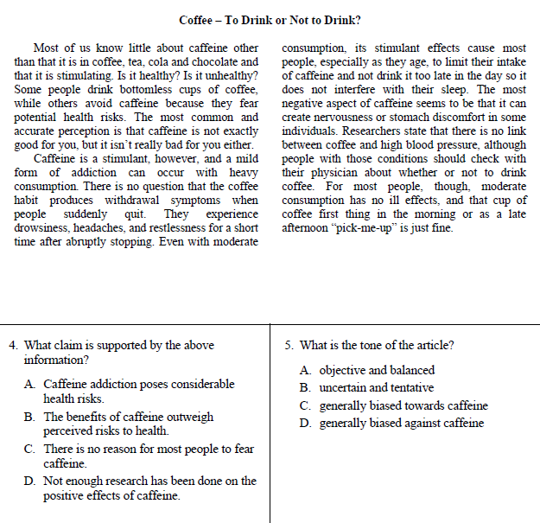


Level D
Scale Score Range 236-245
Can read and interpret non-simplified materials on everyday subjects; can interpret routine charts, graphs, and labels; fill out medical information forms and job applications; and write an accident or incident report.
Can read and interpret non-simplified materials on everyday subjects; can interpret routine charts, graphs, and labels; fill out medication information forms and job applications.

Slide 34
Interpreting CASAS Test Results
The three main uses of CASAS test results are:
To identify the learner’s skill level.
  All CASAS tests are scored on a common scale that is correlated to a continuum of instructional levels and learner skill levels.
To measure learning gains.
  Test scores identify the correct CASAS progress test level into which students should be placed. Some programs use test scores and skill levels to place students into the appropriate class level or to track educational progress.
As input to targeting instruction.
  Reports of test results show student and class performance on specific competencies and basic skills can provide useful information on learner strengths and weaknesses.

Slide 35
Raw Scores and Scale Scores
Raw Scores: Students’ scores are found by counting the number they got correct on the test. This score is called a raw score.
Converting the Raw Score: raw scores are always converted to scaled scores. Scaled scores are used to determine students’ levels.
The CASAS Skill Level Descriptor charts provide descriptions of the abilities a person scoring at any particular level may be expected to have. The levels correspond to instructional levels commonly used in ESL and ABE adult education programs and correlate to the National Reporting System Educational Functioning Levels (see www.casas.org).
  For example, on this test form, if the raw score is 15, then the scale score is 206.
Scale scores from different tests (reading and listening) should never be averaged!
Page 25
Notes:
Converting the Raw Score
Remember, the raw score is the number correct on the test. But this is not the score you will use. You will use a “scale score”. Convert the raw score to a scale score using a chart like this one. Each appraisal manual contains the raw to scale conversion charts. For example, if the reading raw score is 15, then the scale score is 209.
Each test modality (reading, listening) provides a picture of the ability of a student for the skill tested. Attempting to average scores from different tests will not provide an accurate performance level of a student. CASAS scores were not designed to be averaged together.

Slide 36
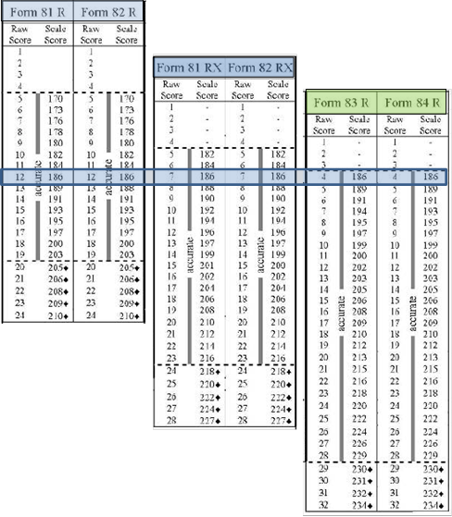
Scale Scores
Each appraisal and test form has its own raw to scale score conversion chart. The left column displays the raw score, or number correct a student earned on the test. The right side of the chart displays the scale score.
When standardized progress tests are developed, at least two alternate forms of the test for each instructional level are developed to measure progress so that students take one form as a pre test and the alternate form as a post test.
If you are using paper-based tests, It is important to use the raw to scale score conversion chart for the specific form of the test administered. CASAS eTests does the conversion automatically.

Slide 37
  For example, Rosa Hernandez takes a CASAS Level A Form 81R, which has 24 questions. She earns raw score of 12.
  Teo Gonzalez takes a Level A Form 81RX – a Level A test with an extended range of 28 questions. He earns a raw score of 7.
  While they both took Level A tests, they took different forms, each student earned a raw score of 186. They have the same level of skills in reading.

Slide 38
A scale score of 186 in each of these test levels have the same meaning:
ESL
Low Beginning
Recognizes and writes letters and numbers and reads and understands common sight words. Can write own name and address.
ABE
Beginning Literacy/Pre-Beginning
Very limited ability to read or write. Persons at the upper end of this score range (150-200) can read and write numbers and letters and simple words and phrases related to immediate needs. Can provide very basic personal identification in written form such as on job applications.

Slide 39
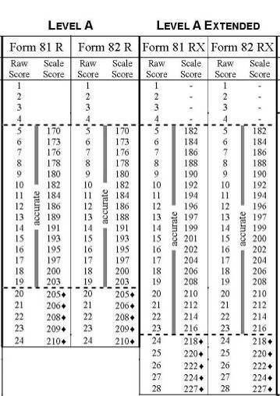
Why use different forms?
Monitoring students’ growth requires multiple test forms. To prevent students from taking the same set of questions for both pre and post testing, tests designed to measure progress after an instructional period of time need to have two alternate forms. The scale score standardizes the progress measure across forms.
First Post-Test
Pretest
Third Post-Test
Student now has a high enough scale score to move to Level AX or B tests for next post-test.
Second Post-test
Student now has a high enough scale score to move to Level AX.

Slide 40
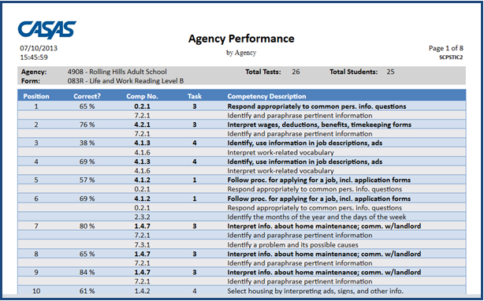
TOPSpro Report: Class Performance by Competency
The Task Number tells you the format in which the question was asked.
Test Question Number
The Competency Description gives more detail of the Competency Number
Percentage of Students who answered this question correctly
The Competency Number on which this question was based
Notes:
So, let’s look at some more things on this report.
What date was this report printed?
What test dates are included in this report?
Which class is this report for?
What test form is covered in this report? (If students in your class took different test forms, there will be a page printed for each form.)
How many tests are represented in this report? (23)
How many students took Form 83R? (24)
Why don’t these numbers match? (One student has been in class long enough to take an 83 R, 84R, and an 83 R again.)

Slide 41
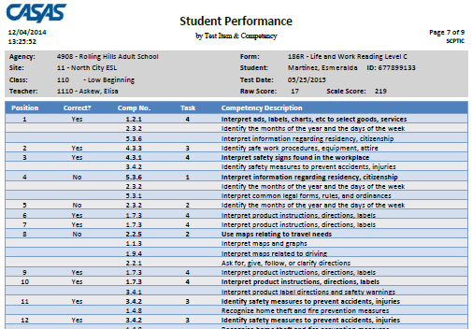

Slide 42
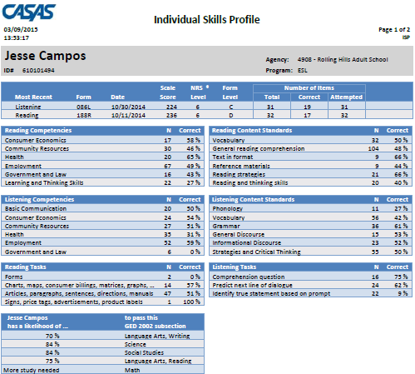

Slide 43
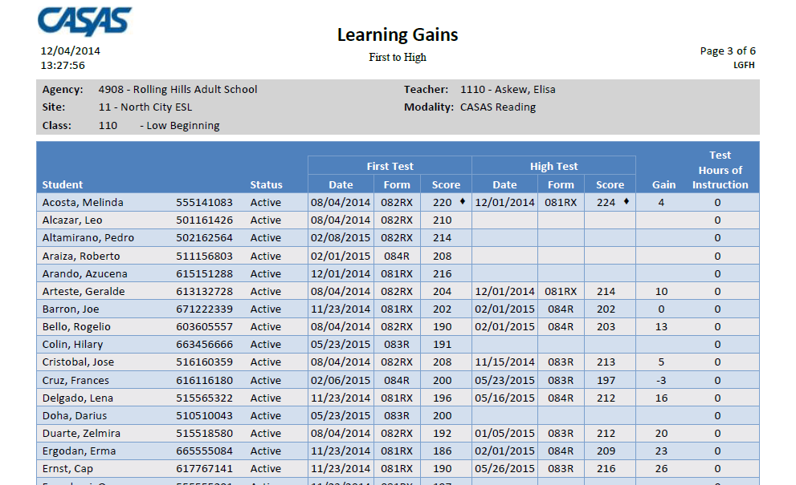

Slide 44
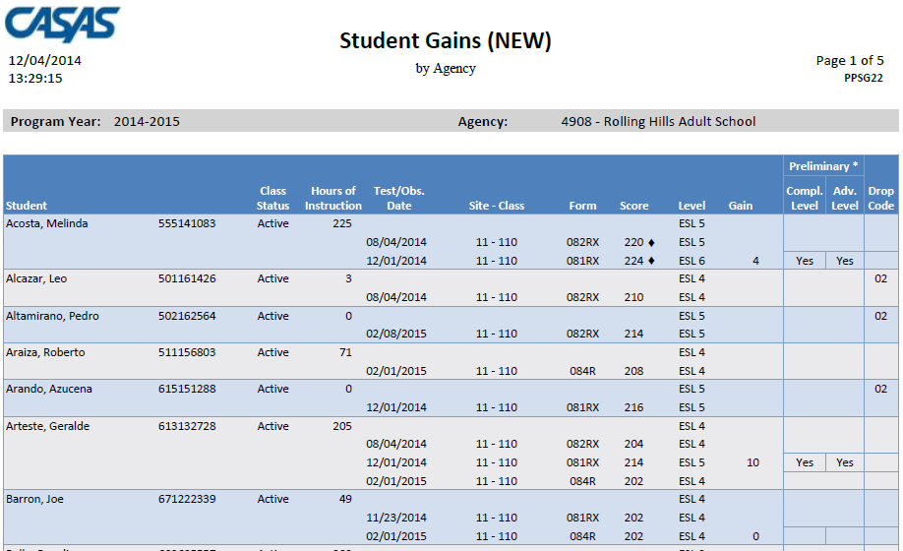

Slide 45
Using CASAS Competencies and Content Standards in Curriculum, Assessment, and Instruction
Assessment results provide feedback to learners and instructors to target further instruction.
Incorporating CASAS Competencies and Content Standards into curriculum and using the CASAS assessment system can help programs better meet learner, community, and program needs and fulfill federal, state, and local reporting requirements.
The CASAS resource QuickSearch Online database lists more than 2,300 print, audio, visual and computer-based instructional materials, and correlates them to the CASAS Competencies, Content Standards and Tasks.

Slide 46
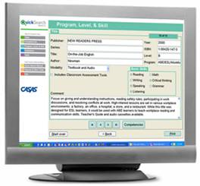
QuickSearch
Quick, easy access to database of more than 2,000 instructional materials
Includes print, audio, video, and software materials
Correlated to CASAS Competencies (and to Content Standards in 2008)
Search by
  Title
  Competency
  Program, Level, and Skill
  Publisher
  CASAS Assessment
Notes:
Instructional Materials Quick Search help program coordinators and instructors select materials to match their curriculum.
Review points and benefits of Instructional Materials Quick Search Updated annually to include new materials from publishers and software companies.

Slide 47
Use QuickSearch to find Resources
Leading text series’ titles are correlated by CASAS competencies, instructional level, type of learner (ESL, ABE, ASE), mode of instruction and linked within the database to selected CASAS pre- and post assessments.
“Quick Searches" can be done for instructional materials by:
Skill area
Program (including Civics, Family Literacy, Workplace)
Specific CASAS assessment series, i.e. Life and Work, WLS, ECS
Year of publication of instructional materials
Websites for learners
Page 41
Notes:
You know how to find out what your students need to learn by student, class, and program. Now, how do you develop or find instructional materials to address these needs?
Skill area: reading, math, listening, writing, speaking, critical thinking, and government and history
QuickSearch is available online at www.casas.org – You can minimize this PowerPoint and go to casas.org. Have the teachers give you suggestions to look up on QuickSearch.

Slide 48
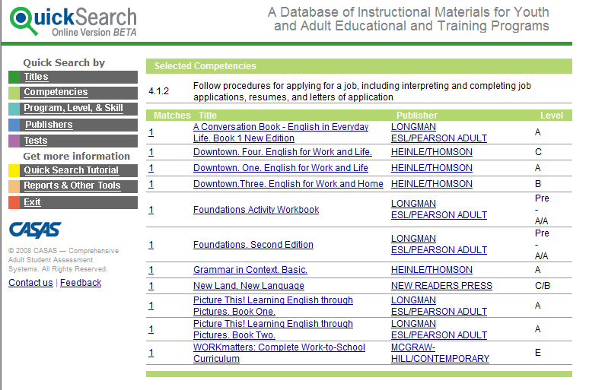
QuickSearch by Competencies
Competency selected for this report: 4.1.2
Page 41
Notes:
This QS screen lists the results of a search by competency
Competency 4.1.7 and Level B are specified
Mention that multiple competency searches are possible. The books that address all or most of the competencies appear first; the books that address only one of the selected competencies appear last

