Slide 1
CASAS
Implementation Training
2018 - 19

Slide 2
Purpose
To certify participants to administer CASAS tests
To ensure uniform test administration practices
To meet the yearly training requirement
(if applicable in your state)

Slide 3
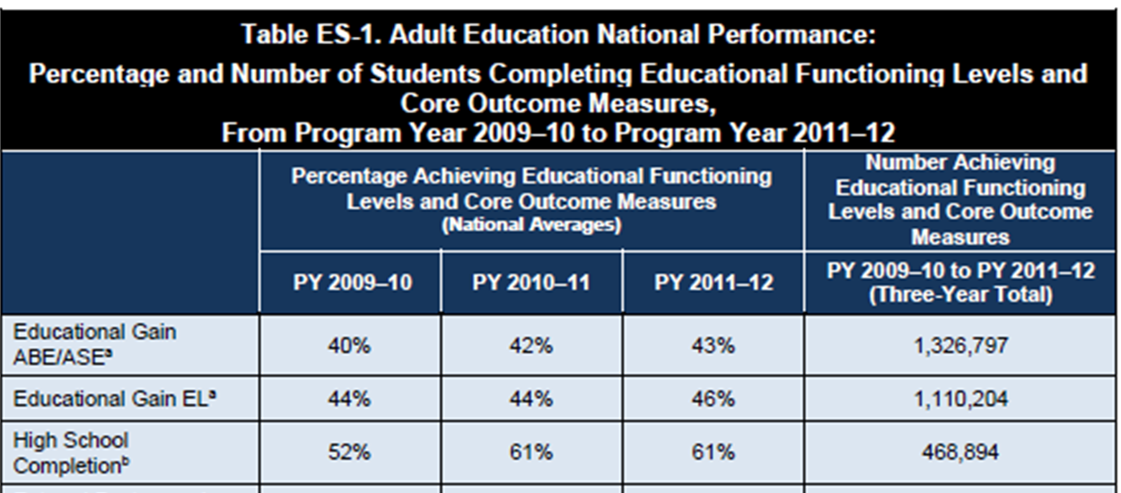
Why are certified testers important?
Accurate testing provides proof of your agency’s ability to serve students
You are an important part of showing success!
Notes:
“You are an important part of students’ success.”
You are one of the first staff to spend substantial time with students before they go off to class.
(So, don’t be in a rush to get them tested. Keep the atmosphere welcoming and relaxed.)
You can make a difference in the persistence of the student (persistence: students stay long enough in the program to pre and post test)
Explain why testing is so important for them – correct program and class placement, accurate measurement of their learning gains, and that the data is used to make sure that classes and programs meet the needs of the students.

Slide 4
With someone you don’t work with ask:
What is your role at your agency?
What is the size of your agency?
What population do you serve?
Do you use computer- and/or paper-based testing?
Does testing take place in classrooms and/or test centers?
Does testing takes place at end of session or “on demand”?
Think about this during the training:
What is your agency’s assessment process?
How can it be improved to benefit students, teachers, and administrators?
Notes:
WARM-UP
5 minutes - Pair activity
Ask participants to introduce themselves to someone from another agency,
Share their role at agency, size of agency, population served, computer or paper-based testing, test in testing center or in classroom, test at end of session or “on demand”.
3 minutes – Group activity – Do a quick poll of group; raise hands if:
Work in Community College?, K-12 Adult Ed?, Corrections?, One-stop?, Other?
Testing is computer-based only? Paper-based only? Both computer and paper?
Testing happens in classroom? In test center? Other?
Testing takes place at end of quarter/semester? Or is testing “on demand” (e.g., when student completes 100 hours)?
Who administer the tests? Teachers in classroom? Roving assessment specialists? Test center assessors?
Think about your agency’s assessment process during the training.
How can the assessment process be improved that would benefit students, teachers, and administrators?
Don’t answer now. We’ll revisit these questions at the end.

Slide 5
Agenda
CASAS Overview
Curriculum
    Competencies
    Content Standards
    Tasks
Assessment
    Intake Screening
    Administering the Locator or Appraisal
    Administering Pre- and Post-tests
Instruction
    Reports
Assessment
Curriculum
Instruction

Slide 6
What is CASAS?
Comprehensive Adult Student Assessment Systems
CASAS is a nonprofit organization dedicated to improving youth and adult education services.
CASAS is an integrated systems approach with three key components.
Assessment
Curriculum
Instruction
Notes:
PRESENTER/TRAINER NOTES:
Began in 1980 as a partnership of the California Department of Education and a consortium of local adult education agencies.
Has expanded to a nationwide, field-based consortium since 1985.
Assessments used in 30+ states, Singapore, and the Pacific Rim.
Provides research, assessment, accountability, program evaluation, and data services.
The CASAS key components are assessment, instruction, curriculum, with the outcome of accountability.
We will cover the key components in more detail throughout the training.

Slide 7
Common Misconceptions
Not a proficiency test
Not required to “finish” a test
As a monitoring tool, CASAS assessments are used to determine skills a student has at entry and how much they’ve improved throughout the year.
Not a “Life Skills” test. Literacy and academic skills are assessed in the context of adult situations.

Slide 8

What are CASAS Competencies?
Competency Content Areas
0. Basic Communication
1. Consumer Economics
2. Community Resources
3. Health
4. Employment
5. Government and Law
6. Computation
7. Learning to Learn
8. Independent Living Skills
CASAS Competencies are measurable learning objectives written in a functional life skills context.
CASAS tests are aligned to these competencies.
www.casas.org
Notes:
Within each of these more general Competency Areas are specific Competency Statements.

Slide 9
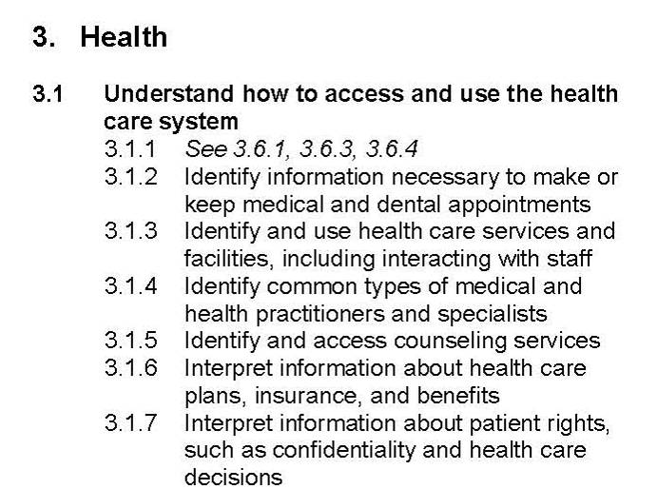
Importance of Competencies
Competencies provide
instructional objectives for curriculum
direct links to test content for monitoring student learning
criteria for program evaluation
a referencing system for instructional materials
Content Area
Competency Area
The numbering systems for Competencies, Tasks and Content Standards are used in test reports for your students and classes.
Competency Statement
Notes:
Under each of the nine Content Areas are Competency Areas. And finally, more specific Competency Statements give the clear objective for students to achieve.
Each Content Area is identified by a number, 0-8. This is followed by Competency Area and Competency Statement numbers, which creates the 3-digit Competency Coding System.
Remind participants that they won’t need to remember what each number in the system means; just know that these numbers that they will TopsPro Enterprise (TE) reports refer back to these competencies.

Slide 10
Using CASAS Competencies
Problem: You should start work at 9:00 a.m., but you have a car that won’t start.
What skills would you need to teach your students?
Basic Communication
0.1.2 -- Understand or use appropriate language for information purposes
(to call a tow truck, identify location)
0.1.3 -- Understand or use appropriate language to influence or persuade (to call employer)
0.2.1 -- Respond appropriately to common personal information questions
Consumer Economics
1.2.6 – Identify places to purchase goods and services, including the internet
1.7.5 -- Interpret information to obtain repairs
1.9.6 -- Interpret information related to automobile maintenance
Community Resources
2.1.8 -- Use a telephone or similar device to make and receive calls
2.3.1 -- Interpret clock time
Notes:
This slide models the following activity. Have participants open their CASAS Competency booklets to follow along. There are plenty of other competencies to teach along with the ones listed here.
Bonus: Ask teachers how long this “problem” should take to teach in their class (before you begin looking for the various competencies.) After you have completed this exercise, ask them again how long it would take to teach this “problem.” This is an excellent activity for new teachers who fly through material!

Slide 11
Activity: Select CASAS Competencies
In small groups or pairs:
Choose one problem-solving scenario from Activity Packet – page 2.
Using the CASAS Competencies, choose 2-3 competencies that would help students solve the problem.
Notes:
Activity Packet - page 2
Assign groups around the room to Problems 1 – 6.
This saves time since they don’t have to read all problems and decide as a group which one to choose.
3 - 5 minutes
ANSWERS – Possible – but accept others
1 4.2.1; 6.2
2 5.2.5; 2.7.7; 6.8.1
3 5.1.1; 5.1.2
4 3.3.1; 3.3.2
5 1.5.1; 1.6.1; 2.1.8
6 2.8.1; 2.8.2; 2.8.3

Slide 12
What are Content Standards?
Basic Skills Content Standards identify the underlying basic skills (literacy and academic skills) associated with CASAS Competencies.
Reading
R1 Beginning literacy/phonics
Listening
Math
R2 Vocabulary
R3 General reading comprehension
R4 Text in format
R5 Reference materials
R6 Reading strategies
R7 Reading and thinking skills
R8 Academic-oriented skills
R9 Literary Analysis (ABE/ASE only)
L2 Vocabulary
L3 Grammar
L4 General Discourse
L5 Informational Discourse
L6 Strategies and Critical Thinking
M2 Algebra
M3 Geometry
M4 Measurement
M5 Statistics, Data Analysis and Probability
M1 Number Sense
L1 Phonology
www.casas.org
Notes:
All content standards are posted at www.casas.org
Reading,
Math,
Listening,
Writing,
Speaking

Slide 13
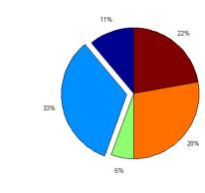
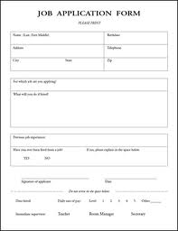

What are Task Areas?
Reading Tasks
Forms
Charts, maps, consumer billings, matrices, graphs, or tables
Stories, articles, paragraphs, sentences, directions, or pictures
Signs, price tags, ads, or product labels
Measurement scales and diagrams
Listening Tasks
Picture prompt
Comprehension question
Predict next line of dialogue
Identify true statement based on prompt
Tasks are how test items are presented. It’s important to practice these tasks in the classroom.

Slide 14
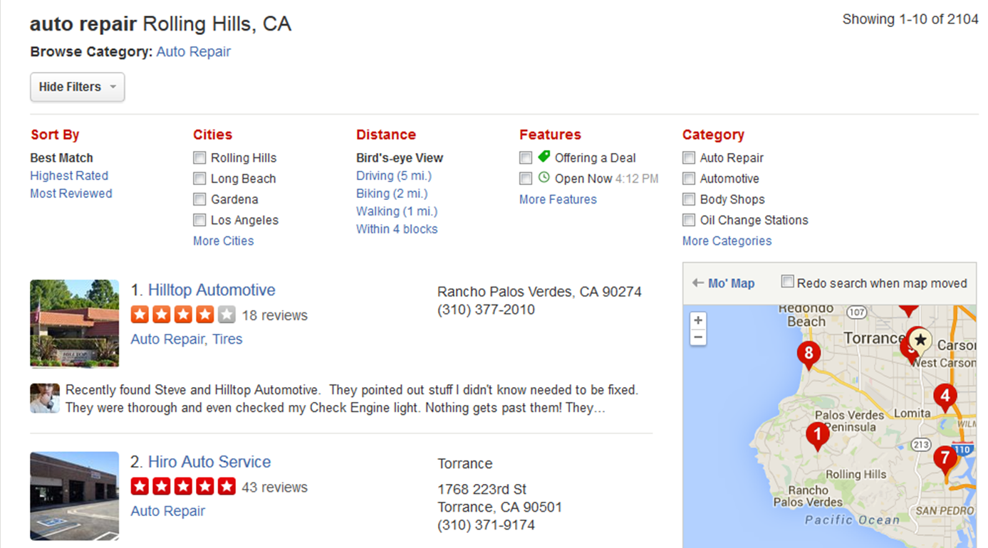
Skills needed to find auto repair services
CASAS Competency: Consumer Economics 1.2.6 –Identify places to purchase goods and services, including the internet
Reading Task Areas: maps – 2; directions – 3; advertisements – 4
Locate information organized in groups or categories
R5.3
Find a word or number in an alphabetical, numeric or other ordered listing
R5.1
Scan simple text to find specific information
R6.2
Use supporting illustrations to interpret text
R3.12
Use capitalization as a clue to interpret words
R2.4
Content Standards
Notes:
14
Competencies, content standards and tasks all work together in a real-life setting.
What Reading Basic Skills Content Standards must the student be able to do in order to succeed in “Identify places to purchase goods and services, including the internet”?
Students will need to look for items alphabetically
Read numbers
Read ads

Slide 15

Competencies, Task Areas and Content Standards
Competency
A measurable learning objective in a functional life skills context.
Basic Skills Content Standards
are the underlying academic skills students need to be successful in mastering competencies
(e.g., students must be able to understand vocabulary in context).
Task Area
In CASAS Reading tests, these are the written or graphic prompts.
Notes:
All these elements are included in item test development

Slide 16
CASAS Tests overview

Slide 17




The Assessment Process
Locator/Appraisal
Identifies the Pretest students should take.
Diagnose
Pre-Test
Establishes a baseline score and
diagnoses learning needs
Instruct
Informal Assessment
Includes targeted instruction based on information from tests
Monitor
Post Test
Given after 70-100 hours of instruction.
Results compared to previous test to determine progress.
Place

Slide 18






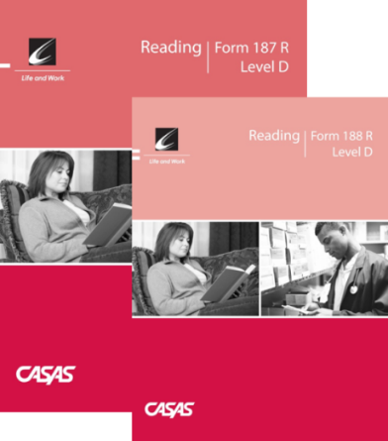

CASAS Assessments: Levels and Forms
Life and Work Reading Series
Covers from Beginning Literacy to transition to post-secondary
Two forms of each level test (e.g., Level A has Form 81 and Form 82).
82 is NOT a higher level test than 81. Both tests have the same level of difficulty.
All forms are developed to national testing standards and are approved for NRS reporting.
Forms are color-coded by level across all series.
Activity: Review and compare test items in the Sample Test Booklets at levels A, B, C, and D
Notes:
ACTIVITY - Pass out 1 set of Sample Test Items (Levels A, B, C and D) to small groups.
(Check # of sample sets you have and divide large group up accordingly.)
Ask participants to browse through the forms.
ANSWER: Going from A to D, the items get more difficult; questions use more advanced language; reading passages are longer
Note Colors for levels
A level – Blue
B Level – Green
C Level – Brown
D Level - Red

Slide 19
NRS Tests for ESL, ABE and ASE*
(ASE includes GED, HiSet, TASC and HSD)
ESL
ABE and ASE
Give reading and/or listening
Life and Work Reading,
80 series
Life and Work Listening, 980 series
Give reading and/or math
Life and Work Reading, 80 series
Life Skills Math, 30 series
GOALS Reading, 900 series
If student scores 235 + (D Level) on appraisal:
Secondary Level Assessment series
Language Arts Forms 513-514 (Level D)
Math Forms 505-506 (Level D)
*All tests approved through June 2019 – except GOALS Reading approved through 2025
Notes:
GOALS Reading information is at www.CASAS.org – i.e. sample test items, FAQ’s, other roll-out information

Slide 20
Computer-delivered tests and
Paper-based tests
While CASAS eTesting and Paper-based testing have many similarities, there are some significant differences when administering the tests.
For this training, items specific to
  Computer-delivered* tests are in yellow
  Paper-based tests are in brown
Items that apply to both are in blue.
*NEW - test using Chromebooks now and IPads soon

Slide 21
CASAS Testing Requirements
Computer-delivered tests
Paper-based
Computers
Internet access or agency-based server
Test Administration Manuals
  By test series
  By test type:
Reusable test booklets
  By test series
  By form/level
Answer sheets
Test Administration Manuals
  By test series
  By test type:
Scanner/Staff to manually score

Slide 22
Test Administration Manuals
Essential for administering paper-based & computer-based tests
A Test Administration Manual (TAM) contains:
  answer keys
  scoring guidelines
  score conversion charts
  next assigned test charts
  competency and content standard content
  class and student profiles
  standardized test administration procedures and policies
  test security protocols
  resources for testing and instructional support
Notes:
Every testing site should have a Test Administration Manuals (TAM) available for all test administrators to refer to.

Slide 23
Test Security
Computer-delivered tests
Paper-based tests
CASAS eTests Coordinator or Proctor starts and stops testing sessions so that tests cannot be accessed by students outside testing sessions.
Each computer used for CASAS eTesting will be registered.
Testing stations will only be active where a proctor is present.
Keep all testing materials, including test booklets, CDs, answer sheets, test manuals and related materials in secure storage, available only to those involved in test administration.
Develop a system to distribute and collect testing materials, including numbering the test booklets.
Test administrators are responsible for the security of all test materials in their possession.

Slide 24
Accommodations in Test Administration Procedures
You may provide these accommodations in testing conditions for documented disabilities without contacting CASAS:
  allowing extended time
  giving supervised breaks
  providing a sign language interpreter (for test administration directions only)
  testing in an alternate room
It is not an appropriate accommodation to read a CASAS test or to allow use of a vocabulary pen, dictionaries, calculators or other electronic devices.
Refer to CASAS Assessment Accommodations at CASAS.org for more information
Computer-delivered
Paper-based
Display options (font size, color)
Time allowed
A colored overlay
Large-print testing booklet
Large-print answer sheet
Braille test
Notes:
The latest information CASAS Policies on Accommodations is posted on the CASAS website.
There are many different types of accommodations. If the information you need on the accommodations is not on the website, contact CASAS.

Slide 25
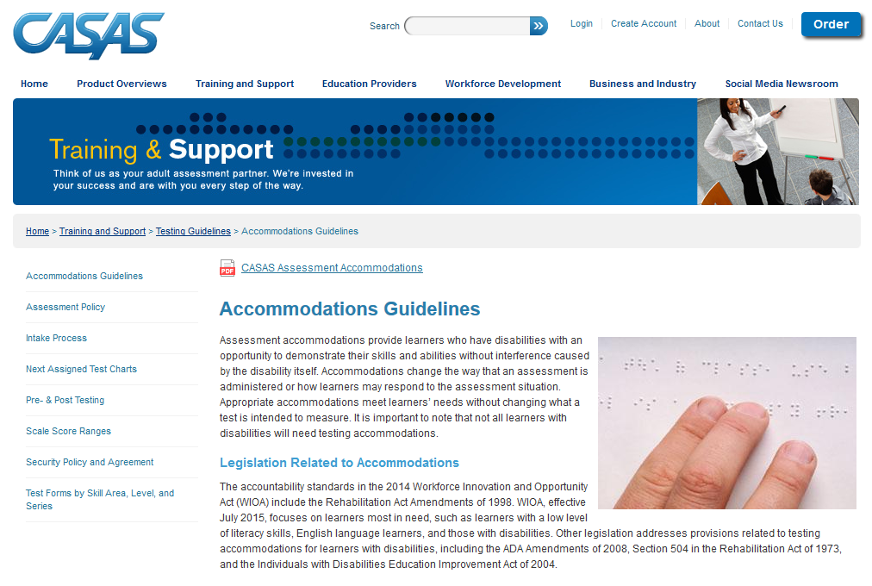
Accommodations
For up-to-date information, go to www.casas.org and refer to the Guidelines for Providing Accommodations Using CASAS Assessment for Learners with Disabilities. The paper includes a matrix with sample accommodations for specific disabilities.
Email CASAS at casas@casas.org for information on other test formats. Do not change a test format locally. Alternate test formats must meet standardized test development procedures.
www.casas.org
Notes:
The latest information CASAS Policies on Accommodations is posted on the CASAS website.
There are many different types of accommodations. If the information you need on the accommodations is not on the website, contact CASAS.

Slide 26
Intake Screening

Slide 27
Intake
For all incoming students
observe how well the student communicates and fills out registration forms
administer CASAS writing screening or other writing assessment (optional)
consider number of years of formal schooling and other information on demographic records
consider other factors affecting class placement (any certificates or degrees…)

Slide 28



Informally assess student’s basic writing and reading ability by observing how well the student can complete your agency’s registration form.
Little or no difficulty?
Administer Locator
in CASAS eTests
to determine Pretest
Administer paper Appraisal
to determine Pretest

Slide 29
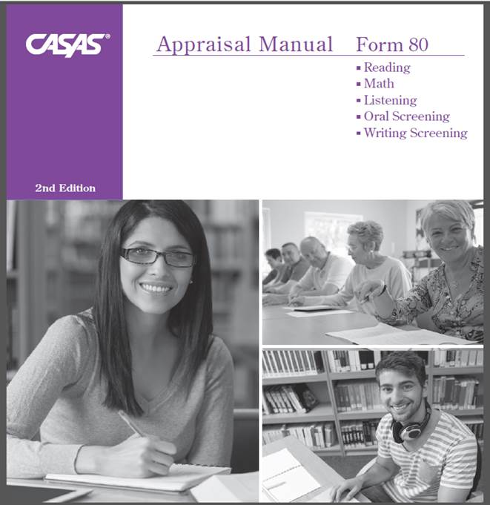
Oral and Writing Screening for ELLs
The Oral Screening is an optional one-on-one oral interview used to screen ESL/ELL learners for taking listening and reading locators or appraisal tests.
  six questions
  5 minutes
Refer to p. 15 of the 80 Appraisal TAM
The Writing Screening is an additional optional tool to screen ESL/ELL learners for taking reading and listening locators or appraisals.
Examinees write
  two sentences that are dictated
  5 minutes
Refer to p. 11 of the 80 Appraisal TAM

Slide 30
Question | Response
What’s your name? | This question is not scored. It may be omitted if the tester knows the examinee.
How long have you been in the United States? To clarify, ask: When did you come to the United States? | Some possible responses: Four years; 1987; etc.
2. Tell me why you want to learn English. To clarify, ask: Why do you want to study English? | Any appropriate reason may be acceptable.
3. Do you read in your native language? If Yes, ask: What do you like to read? If No, ask: Why not? | Yes. Some possible responses: names of books, types of books, subjects. No. Some possible responses: I didn’t go to school in my country; I can’t read; I have no time to read; etc.
4. What work did you do in your country? or What work are you doing now? | Any appropriate response is acceptable. If the person has not worked, expressing that fact is also correct.
5. How many years did you go to school in your country? To clarify, ask: How long did you go to school in your country? | Any appropriate response is acceptable.
Administering the
Oral Screening
Administer
one-on-one
Introduce yourself
Ask the questions
  Repeat the question once, if needed
  Use the clarification questions,
  if needed
Form 80 Appraisal TAM, pages 14 & 15

Slide 31
Scoring Rubric – Oral Screening
Points | Guidelines
0 | No answer, incomprehensible, or does not answer the question. Note: If the examinee responds, “I don’t know,” it is up to the administrator to determine whether this answer represents an appropriate response or lack of comprehension.
1 | Comprehensible but not grammatically correct. Note: Comprehensible = understandable and relevant
2 | Comprehensible and grammatically correct. Note: Answers that are appropriate and represent what a native speaker would provide would be given 2 points; therefore, some one-word answers would be given 2 points.
Form 80 Appraisal TAM pg. 14

Slide 32
Using Oral Screening results to select pretest for Beginning Level ELLs
Score of 6 or more:
  Give the Locator online or the Appraisal
  for Reading and/or Listening
Score of 5 or less:
  Give the Beginning Literacy Screening
    Do not give the Locator or Appraisal
  These items are the same as the Form 27 Practice Items

Slide 33
Using Beginning Literacy Screening results to select pretest for Beginning Level ELLs
Unable to answer?
If the student has…
Great difficulty
Mark the test record as “Too Low to Test.”
Try testing again in a couple of weeks.
Some difficulty
Pretest with Form 27 or 28
Little or no difficulty
Pretest with Form 81 or 82 for Reading
Notes:
The Beginning Literacy Screening items are the same as the Form 27 Practice Items.

Slide 34
Locators and Appraisals

Slide 35
Locators and Appraisals
Computer-delivered
Paper-based
Locators
Reading 102R and Math 102M -- Computer Adaptive Tests (CAT)
Listening 89L -- Fixed Form
10-15 minutes
Leads students seamlessly into the appropriate pretest.
Reading GOALS 900R – Fixed Form
Form 80 Appraisals -
Reading, Listening, and Math
Reading for all programs, Levels A-D
30 minutes each
Form 130 - Math Appraisal
Math for ABE and ASE programs
Listening for ESL/ELL, Levels A-C
Math for ABE/ASE, Levels A-D
Levels A – D
25 minutes
OR
Notes:
Form 80 Math Appraisal is new. Agencies use this with the 30 Math Series. Reading GOALS 900R is new and should be used with the Reading GOALS series for ABE/ASE programs.

Slide 36
What’s the difference between
Locators/Appraisals and Pretests?
180 185 190 195 200 205 210 215 220 225 230 235 240 250
Locators and Appraisals (Placement tests)
Test items are widely distributed along the CASAS scale and range from very easy items to difficult items.
These scores can not be used for pre- and post-testing.
Level B
Pre- and Post-Tests (Progress Tests)
Progress test items are clustered at a specific level.
Notes:
This chart shows the difference between an appraisal and a pre post test. Appraisals can not be used for pre and post-testing.

Slide 37
Reading Locators/Appraisals
Locators/Appraisals cover a wide range of difficulty for ESL/ELL and ABE/ASE students.
Low Beginning ESL/ELL
Beginning Literacy ABE
High Beginning ESL/ELL
Beginning Basic ABE
Low Intermediate ESL/ELL
Intermediate Basic ABE
High Intermediate ESL/ELL
Intermediate Basic ABE
Advanced ESL/ELL
Advanced Basic ABE
Advanced Adult Secondary
Adult Secondary
Locator/Appraisal Test Items

Slide 38
General Testing Guidelines
Allow adequate space between students.
Ask students to turn off and put away their cell phones.
All personal items must be off the tables.
Tell students not to talk or get help from other students during the test.
Scratch paper is allowed for math tests, but not for listening tests. All scratch paper must be collected and shredded after the test.
No cell phones, dictionaries, translators, or any other items allowed.
Notes:
Ask participants – What do you remember about taking standardized tests in school?
Remind them that CASAS tests are standardized, government approved with strict testing policies.

Slide 39
Testing Procedures
Computer-delivered tests
Paper-based tests
Demonstrate how to respond to test items
Demonstrate how to input demographics information, if used in your agency
Demonstrate on the whiteboard how to fill in the bubbles properly.
Have students bubble in any demographics you are collecting.
Have students write the form number in the box marked Form Number and fill in the Test Date. (This can also be filled in by testing staff in advance.)

Slide 40
Testing Procedures for Both Formats
(CASAS eTests and Paper)
Guessing by the examinees should be discouraged. Explain that if they can’t answer a question they don’t need to mark an answer, and can go on to the following questions.
Circulate during testing to make sure examinees are marking answers at the correct number on the answer sheet.
Maintain a positive attitude and atmosphere about the testing, as your attitude can influence students’ attitudes and performance.
For students with disabilities, please refer to the CASAS guidelines for making the appropriate accommodations
Notes:
Circulating during all testing is important. Make sure that students are not using their cell phones!

Slide 41
Administer the Locator or Appraisal
Computer-delivered Locators
Paper-based Appraisals
Two practice items will be presented on the screen. Students will have two chances to answer.
Provide additional time and help with the practice items for any students that need it.
Have examinees open their test booklets to the test directions and practice items. Read the directions aloud.
Point out the location of the box on the answer sheet for answering the practice items.
Take the time to have everyone answer the practice items, then discuss and help as needed.
Advise students to do their best but not to spend more than a few minutes on any one question.
  Don’t guess.
  Stop when you can’t answer any more questions.
  Walk around the room to check students’ work.
Notes:
Ask participants “Why?” to most of these instructions – don’t assume they know or understand the importance of each

Slide 42
Appraisal Instructions Script
Open your test booklet to page 1. Find the directions at the top of the page. Look at the directions as I read them. [Read directions.]
Look at the practice questions. Find the box on your answer sheet for answering the practice questions. Go ahead and read practice 1 and 2 and mark your answers.
What’s the answer to the first practice question? The answer is _. Did you mark _? [Explain.] The answer to the second practice item is _. [Explain and help any students that need assistance.]
We're ready to begin the test. You will mark your answer for the first question on line 1 of your answer sheet. Do not write in the test booklet.
There are 25 items on the test . You have 25 minutes.
If you don’t know the answer, that’s OK. You don’t have to mark an answer. Just go to the next question. Stop when the questions get too difficult.
Do your own test; don’t get help from other people. No dictionaries. No calculators.
When you’re finished, or if you can’t answer any more questions, put your pencil down and wait and I will take your test. Any questions?
Turn the page and begin the test.
[After 25 minutes] Is anyone not finished? You can take a little extra time to answer the question you are working on if you need it.
Notes:
Remind participants that standardized tests means standardized administration of tests, too.
Note that the slide is brown for paper-based tests.

Slide 43
During the Test
Check periodically to make sure that everyone is working individually and marking their answers correctly.
Computer-delivered tests
Paper-based tests
Time left shows on the screen.
Examinees will see a prompt to allow them to finish the question they are working on before test ends.
As examinees finish, have them put their answer sheet inside their test booklet and wait.
Announce when time is up. Allow examinees who are not finished to answer the question they are working on.
Notes:
Some students may finish before time is up.

Slide 44
Scoring the Appraisal
Computer-delivered tests
Paper-based tests
Scoring is done automatically and students begin their appropriate pre-test with no interruption
Tests can be hand-scored or scanned into TE or use the NCR Appraisal sheets (for purchase.)
  If scanned into TE, the raw score (the number correct) will be converted into a scale score
  If hand-scored, the raw score must be converted into a scale score.
Run Next Assigned Test report to see which pretest students should take.

Slide 45
After the Test
Pick up all test booklets and answer sheets and any scratch paper (math tests).
Check answer sheets to see that answers are clearly marked and that changed answers are completely erased.
Check that the correct test form is on the answer sheet.
Check the test booklets and erase any pencil marks.
Shred all scratch paper.
Return all test booklets and answer sheets to a secure location. Test administrators are responsible for the security of all test materials in their possession.
Notes:
Paper-based tests

Slide 46
Raw Scores and Scale Scores
Raw to Scale Score Reading Appraisal Form 80
Raw Score | Scale Score
1 | 171*
2 | 180*
3 | 185*
4 | 189
5 | 193
6 | 196
7 | 199
8 | 201
9 | 204
10 | 207
11 | 209
12 | 212
13 | 214
14 | 216
15 | 219
16 | 222
17 | 224
18 | 227
19 | 230
20 | 234
21 | 237
22 | 240
23 | 242
24 | 244
25 | 246
Raw Score: the number of questions a
student answers correctly
Scale Scores: converts a student's raw score on a test to a common scale that allows for comparison between students.
Each test form has its own Raw to Scale Score chart.
Be sure to use the correct chart to convert the raw score to the scale score.
For example, if the raw score is 12, then the scale score is 212.
Notes:
Converting the Raw Score
Remember, the raw score is the number correct on the test. But this is not the score you will use. You will use a “scale score”. Convert the raw score to a scale score using a chart like this one.
NOTE – eTests automatically scores each test and calculates the raw and scale score.
This is a key training point.

Slide 47
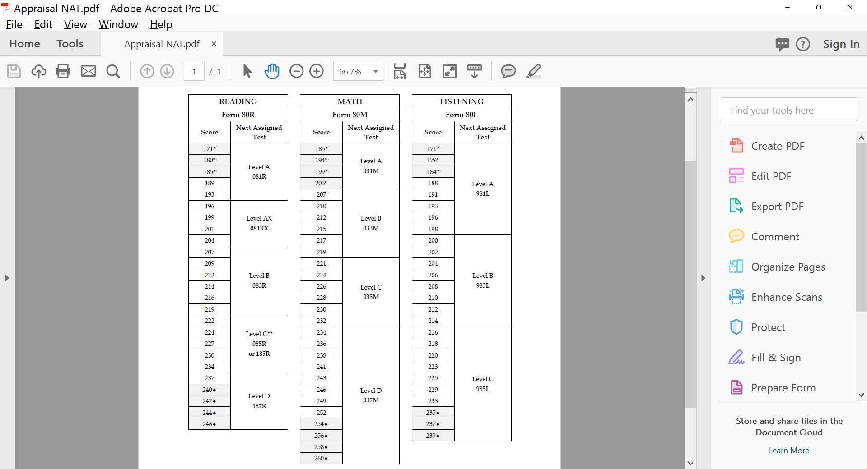
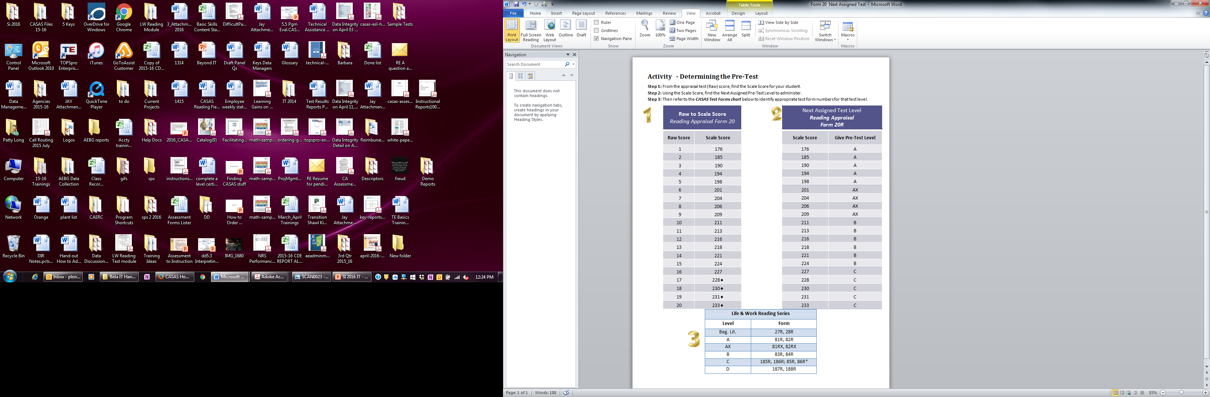
Determining the
Pretest
Raw to Scale Score Reading Appraisal Form 80
Raw Score | Scale Score
1 | 171*
2 | 180*
3 | 185*
4 | 189
5 | 193
6 | 196
7 | 199
8 | 201
9 | 204
10 | 207
11 | 209
12 | 212
13 | 214
14 | 216
15 | 219
16 | 222
17 | 224
18 | 227
19 | 230
20 | 234
21 | 237
22 | 240
23 | 242
24 | 244
25 | 246
Using the Raw to Scale Score Chart and the Next Assigned Test Level Chart, what pretest form should this student take?

Slide 48
Appraisal Activity
What is Manuel Ortiz’ Form 80 Appraisal raw score? ______
What is his appraisal scale score _________ ?
What pretest form could he take _________?
See pages 3 & 4 in Activity Packet
Notes:
See page 3 and 4 in the Activity Packet for a copy of Manuel’s appraisal answer sheet.
ANSWERS
What is Manuel Ortiz’ Form 80 Appraisal raw score? 6 correct
What is his Appraisal Scale Score? 196
What pre-test form could he take? 81RX or 82RX

Slide 49
Pre- and Post Tests
PreTesting

Slide 50
Key Points for Testing
Computer-delivered tests
Paper-based
Circulate and help students with practice items as needed.
If a student is answering a question at the end of the allowed testing time for that test, a prompt appears explaining that the student can finish working on that question, and then the test will end.
Go over the practice questions with students.
If a student is answering a question at the end of the hour, that student is allowed to finish working on that question, but then you must end the test.
Time allotment: 1 hour (except new Reading GOALS, Levels B – D – 75 minutes)
Students are not allowed to stop testing and continue at another time.
No dictionaries, calculators or cell phones are allowed. Scratch paper ONLY for math tests. (Must be collected and shredded after testing.)
You may not read questions or answers to students.
Notes:
When paper-testing different levels at the same time, start with the highest level.
For example, hand out booklets for students taking the D Level, go over practice items and then have them start. Then do the same with each level.

Slide 51

Testing Guidelines
Appropriate
Inappropriate
  Review practice questions together
  Provide start and end times on the board
  Provide a relaxed, unhurried atmosphere.
  Provide scratch paper (for math tests only) and pencils
  Reading questions to students
  Calculators
  Translation devices
  Limiting time for testing
  Allowing students to stop and take the test at a later time.
Notes:
51

Slide 52

Valid Scale Scores
Inaccurate Scale Scores
Re-test immediately for a pre- or post-test
Scale Scores
  If pre-test score is in the conservative estimate range (high end or  score), retest at a higher level.
  Conservative estimate post-test scores can be used for reporting purposes.
Conservative Estimate Scale Scores

Slide 53
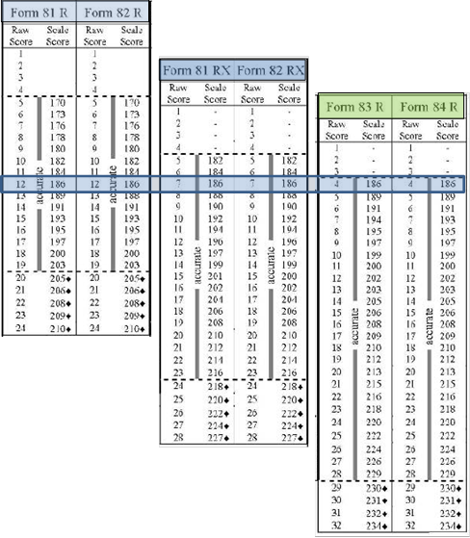
Scale Scores
Each appraisal and test form has its own raw to scale score conversion chart. The left column displays the raw score, or number correct a student earned on the test. The right side of the chart displays the scale score.
There are at least two alternate forms for each test level.
It is important to use the raw to scale score conversion chart for the specific form of the test administered.
Notes:
It isn’t necessary for agencies to use these charts if they use eTests or TOPSpro Enterprise because the software automatically determines the raw and scale scores. It is important that test administrators know how the scores are calculated.

Slide 54
For example, Rosa Hernandez takes a CASAS Level A Form 81R, which has 24 questions. She earns a raw score of 12 and a scale score of 186.
Teo Gonzalez takes a Form 81RX – a Level AX test with an extended Level A range. He earns a raw score of 7 and also has a scale score of 186.
Both students have the same skill level in reading -- 186. They took different test forms and got different raw scores but have the same scale score based on the score conversion charts.
Notes:
A 186 score has the same meaning across test levels.

Slide 55
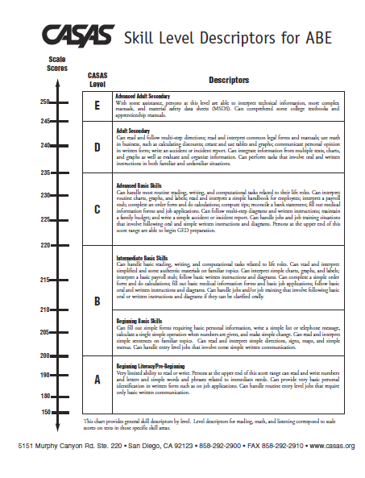
Skill Level Descriptors
The Skill Level Descriptors provide general information on how to interpret an adult learner’s scale score with respect to the job-related and life skill tasks this person generally can accomplish.
Notes:
Each test modality (e.g., reading, listening) measures the ability of a student for the skill tested. You should not assume student’s writing and speaking skills are the same as their reading skills.
CASAS scores from more than one modality should not be averaged.
Testing reading skills? Only the reading descriptors apply.

Slide 56
A student that scores a 186 on any test form has the reading skills described below.
ESL/ELL
Low Beginning
Recognizes and writes letters and numbers and reads and understands common sight words. Can write own name and address.
ABE
Beginning Literacy/Pre-Beginning
Very limited ability to read or write. Persons at the upper end of this score range (150-200) can read and write numbers and letters and simple words and phrases related to immediate needs. Can provide very basic personal identification in written form such as on job applications.

Slide 57
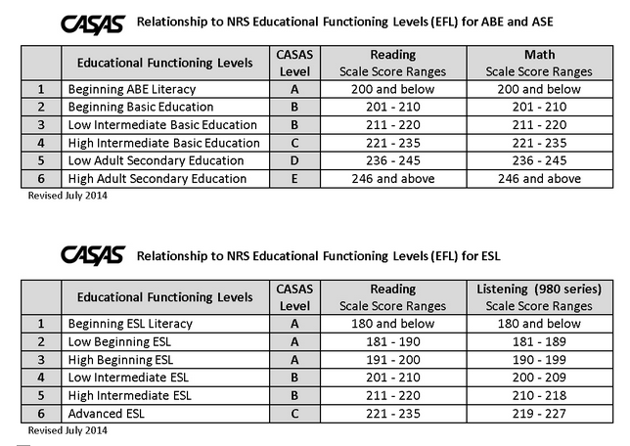
WIOA Title II NRS/CASAS Levels
Notes:
Agency testing information is reported to the federal government – Office of Vocational, Adult, and Training Education (OCTAE) via the state education office. This is the agency that grants the WIOA funding to each state. States report how many students are placed at each level and how many students complete an EFL (Educational Functioning Level) in OCTAE’s National Reporting System (NRS). CASAS scale score ranges are aligned to the NRS EFLs.

Slide 58
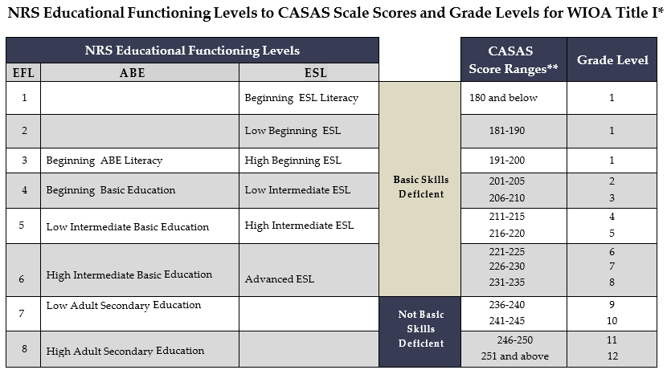
WIOA Title I/CASAS Levels
Notes:
It’s important that we know the definition of “Basic Skills Deficient” as we work with our other WIOA partners, including Title I agencies.

Slide 59
Pretest and Placement Activity
Manuel took a Level A (extended) 82RX for a pretest.
  What was his scale score?
  Using the Skill Level Descriptors, what can Manuel do?
  What level class should he be placed in using the NRS/CASAS Levels? (see slide 57)
  If Manuel took both Reading and Listening tests, how would you place him?
  See page 5 in the Activity Packet
Notes:
Refer to page 5 in the Activity Packet
If a student takes two pretests in different skill areas (e.g., reading and math), CASAS generally recommends placing the student in a class based on the lower test score.
ANSWERS
What was his scale score? 196
Using the Skill Level Descriptors, what can Manuel do?
High Beginning ELL. Reading: Reads letters and numbers and a limited number of basic sight words and simple phrases related to immediate needs. Can handle routine entry-level jobs that involve only the most basic written communication in English and in which all tasks can be demonstrated. (SPL 3)
What level class should he be placed in using the WIOA CASAS Levels? High Beginning ESL
If Manuel took both Reading and Listening tests, how would you place him? CASAS recommends placing on lower test score

Slide 60
Instruction

Slide 61
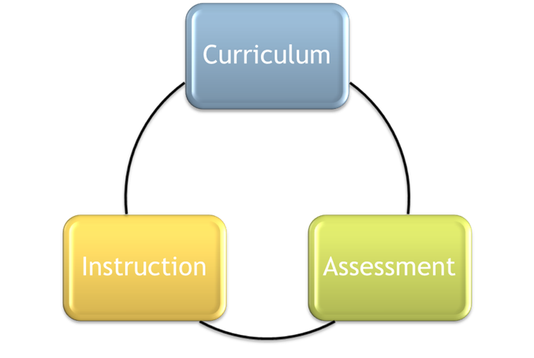
Targeting Instruction Using TE* Reports
Reports on test results give instructors valuable information to help their students.
Reports show students’ strengths and
weaknesses, and more specifically, which
  Competencies
  Content standards and
  Task areas
instructors should target instruction.
Go to www.casas.org and search on Key Reports
to find the 10 most popular Instructional reports.
*TOPSpro Enterprise = TE
Notes:
Ask, “How soon do teachers receive testing reports at your agency?
Discuss. If teachers don’t get reports, why? Is it because teachers don’t ask for them? Do they know about reports?
Ideally, reports should be sent to teachers by a week or two after testing. The next slides will go over a few key reports.

Slide 62
Class Performance by Competency
The Task Number tells you the format in which the question was asked.
Percentage of students who answered this question correctly
The Competency Number on which this question was based
The Competency Description gives more detail of the Competency Number
See pages 6 & 7 in Activity Packet
Notes:
Refer to page 6 & 7 in Activity packet.
Look at some more things on this report. Ask the group:
What date was this report printed? (08/17/2017)
Which class is this report for? ( 110 – Low Intermediate ESL)
What test form is covered in this report? (82RX) (If students in your class took different test forms, there will be a page printed for each form.)
How many tests are represented in this report? (28)
How many students took Form 83R? (26)
Why don’t these numbers match? (Two students have been in class long enough to take an 82RX, an 81RX, and then 82RX again.)

Slide 63
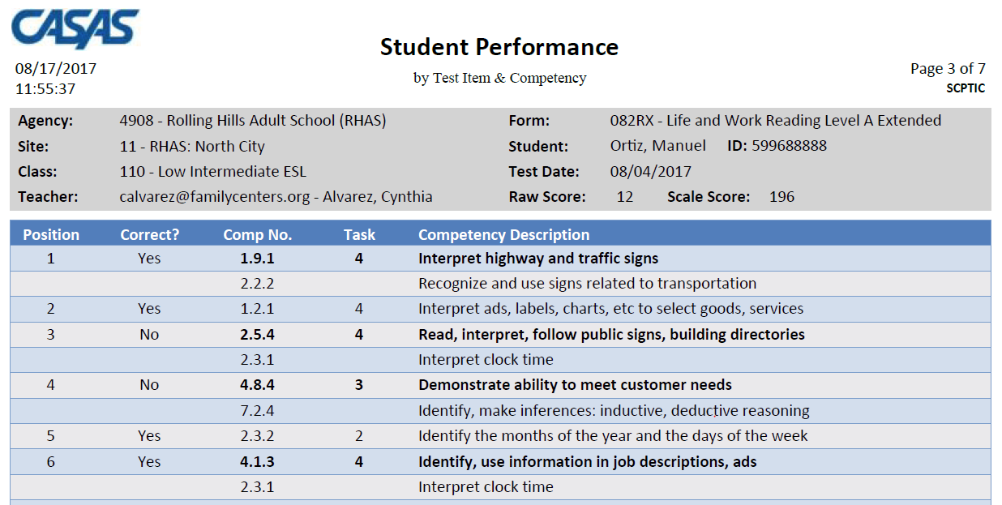
Student Performance by Competency
The same report printed by individual student
See pages 8 & 9 in Activity Packet
Notes:
Activity Packet pages 8 & 9
ANSWERS
,
Who is the student? Manuel Ortiz
What test did he take? 82RX
Raw Score? 12
Scale Score? 196

Slide 64
This report shows class performance for one or more items that address the same competency.
(“No. of Items” shows the number of student responses.)
Notes:
This class report has been sorted by combining the results of all test items that measure the same competency. For example,
Competency 0.1.4 was assessed 1 time (1x) by 28 students = 28
Competency 4.4.4 was assessed 2 times (2x) by 28 students = 56
Competency 4.4.3 was assessed 3 times (3x) by 28 students = 84

Slide 65
Class Performance by Test Item and Competency
Reports can be printed in a variety of ways. This is sorted by items correct.
Notes:
This report was sorted by Items Correct, lowest to highest.

Slide 66
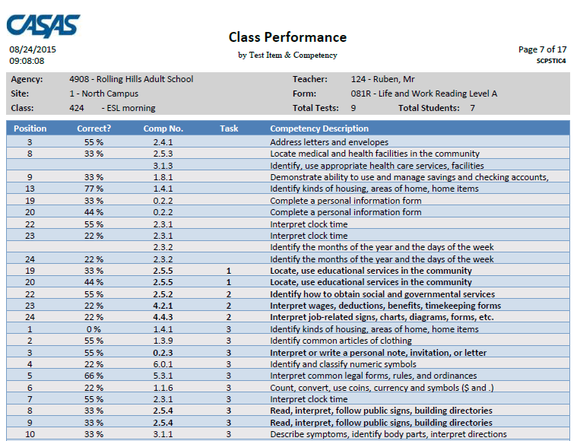
Class Performance by Competency
Competency Task Number Legend
1 – Forms
2 – Charts, tables, graphs, maps
3 – Articles, paragraphs, sentences, directions
4 – Signs, price tags, advertisements, product labels
5 – Measurement scales, diagrams
This report is sorted by Task.
Notes:
This is the same report as the previous page, but in TE Report Setup, the report has been sorted by Task Area
Discuss how sorting by Task can be helpful in targeting instruction.
Did the class have a lot of difficulty with Task 2?
Then integrate more activities using Charts, Maps, etc., into your instruction.

Slide 67
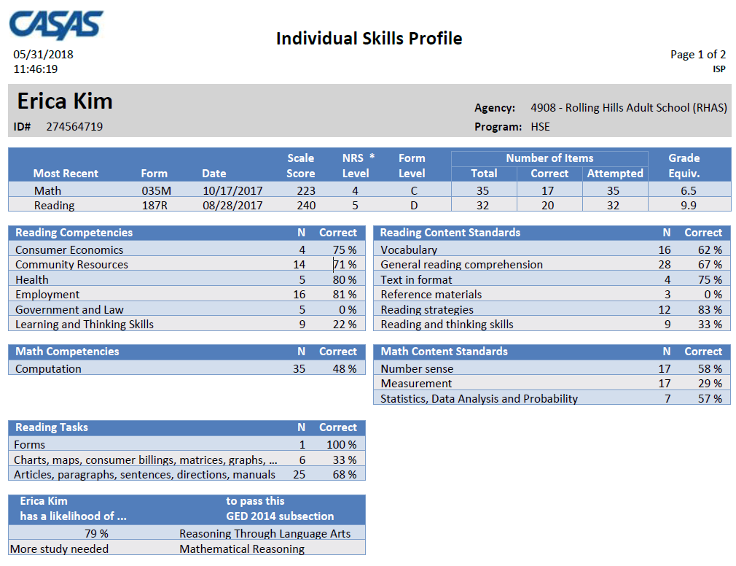
Individual Skills Profile
This is a good report for students and teachers.
It includes a prediction of readiness to take and pass the GED.
See page 10 in Activity Packet
Notes:
Refer to page 10 in Activity Packet
Study of the CASAS Relationship to GED® 2014 posted at www.CASAS.org.
There are ongoing studies being conducted with HiSET and GED and the new CASAS GOALS reading and math series.

Slide 68
Targeting Instruction
Use these resources:
  QuickSearch Online
  CASAS Competencies
    {Test series} Competency Content
    (Refer to sample on pages 11 & 12 in Activity Packet)
  CASAS Content Standards
    Aligned with College and Career Readiness
    Standards for Adult Education
www.casas.org
Notes:
Activity Packet – pages 11 & 12 – CASAS Life and Work Reading Test Series Competency Content
This document tallies all the competencies covered in the Life and Work Reading series. There are similar documents for the other test series posted on the CASAS web site.
Programs use this information – along with QuickSearch -– while planning their curriculum to make sure they have instructional materials that covers content in the assessments.

Slide 69
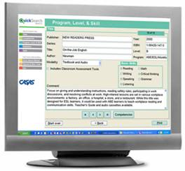
QuickSearch
Quick, easy access to database of more than 2,000 instructional materials
Includes print, audio, video, and software materials
Correlated to CASAS Competencies and Content Standards
Search by
  Title
  Competency
  Program, Level, and Skill
  Publisher
  CASAS Assessment
  See pages
Notes:
Instructional Materials Quick Search help program coordinators and instructors select materials to match their curriculum.
Programs can use the CASAS Life and Work Test Series Competency Content
Review points and benefits of Instructional Materials Quick Search Updated annually to include new materials from publishers and software companies.

Slide 70
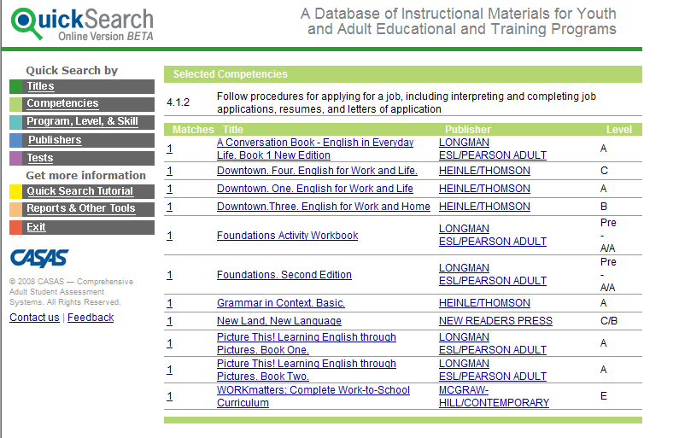
QuickSearch by Competencies
Competency selected for this report: 4.1.2
www.casas.org
Notes:
This QS screen lists the results of a search by competency
Competency 4.1.2 is specified
Mention that multiple competency searches are possible. The books that address all or most of the competencies appear first; the books that address only one of the selected competencies appear last

Slide 71
Test Preparation Guidelines
Appropriate
Inappropriate
Use diagnostic information from test results to target instruction in:
    Task Areas
    CASAS Competencies
    Content Standards
Quick Search
CASAS Practice Tests
Teaching to a particular test item
Teaching specific vocabulary in a test item
Limiting curriculum to what the test covers
Notes:
71
This slide is important because it provides guidance on appropriate test preparation activities.

Slide 72
Post-testing

Slide 73
Determining Schedule for Post-Testing
We suggest post-testing more than once a year.
  Base your testing calendar on your school schedule:
    managed enrollment schedule
    at the end of the quarter or semester or term
  CASAS recommends 70 – 100 hours of instruction be provided between pre- and post-testing.
    A minimum of 40 hours of instruction between pre- and post-testing is allowed for exceptional situations when needed (e.g. student is leaving the program early).
      That does NOT mean that you test at the 40-hour mark.
  Your Local Assessment Policy must clearly state the instructional hours between pre- and post-tests and how often tests will be given.
Notes:
25+ years of research show that students show an average gain of 5 points after 70 -100 hours of instruction.

Slide 74
What do you need for Post-testing?
Computer-delivered tests
Paper-based
Arrange for students to take CASAS eTests.
When students sign in, the appropriate post-test form will be automatically selected for the student to take.
If you have scanned pretest results into TE, generate and use your Next Assigned Test (NAT) report.
If you have hand-scored the pretests, use the Next Assigned Test chart in the TAM to select the post-test form for each student.
  Paired tests always must be in the same skill area and same test series.
Gather test booklets for class.
Hand out answer sheets.
Go over directions.
Go over practice questions.
Administer the test as you did the pretest.

Slide 75
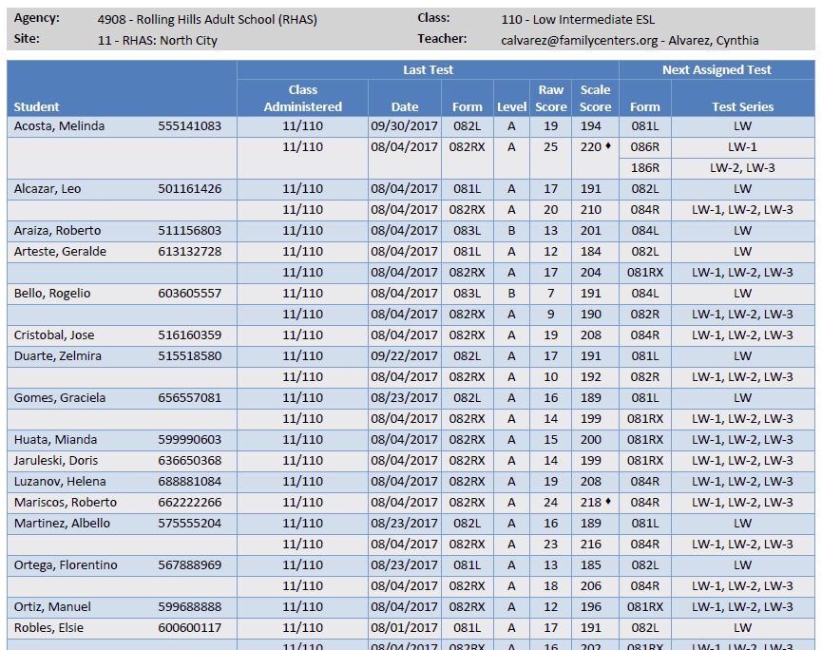
Next Assigned Test Report
See page 13 in Activity Packet
Notes:
Refer to page 13 in the Activity Packet
Review the report with participants. – what does each column show?
ANSWER
Student
Last test
Class Administered (agencies codes)
Date
Form
Raw Score
Scale Score
Next test
Form
Test series

Slide 76
Post-test Activity
What post-test should you give Manuel?
Use the Next Assigned Test Report –
page 11 in Activity Packet.
Notes:
Refer to page 11 in the Activity Packet
ANSWERS
What post-test should you give Manuel? 81RX

Slide 77
Learning Gains Report
You’ll find the Learning Gains report in TE under Reports > Test Results > Learning Gains.
There are several options for this report:
  First to Last
  Last to First
  First to High
  First to Second
  Highest to First
  Last Two Tests
See page 14 in Activity Packet
Notes:
Refer to page 14 in the Activity Packet

Slide 78
Activity - Learning Gains
Did Manuel make a learning gain?
  Pretest score _______
  Post-test score ______
  Learning Gain _______
Based on this information, would you move him to a higher-level class at your agency at this point?
  See Learning Gains report in Activity Packet – p. 12
  Refer to slide 57 and discuss other considerations.
See page 14 in Activity Packet
Notes:
ACTIVITY – see page 14 in Activity Packet
ANSWERS
Did Manuel make any gains?
Pre-test score 196
Post-test score 202
Learning Gain? +6 points
Based on this information, would you move him to a higher-level class at your agency at this point? discuss

Slide 79
Next Steps
Implementing at Your Agency

Slide 80
Now what?
Identify and Assign Testers
  All testers must complete Implementation Training – available 24/7 online.
  Complete eTests computer-delivered training
    Coordinator training (minimum one per site)
    Proctor training (all testers)
    Online Implementation Agreement (one per agency)
Calendar testing for the year
  Make sure everyone at your agency knows dates
Have everyone who helps with testing sign the testing agreement (at the back of the TAM)

Slide 81
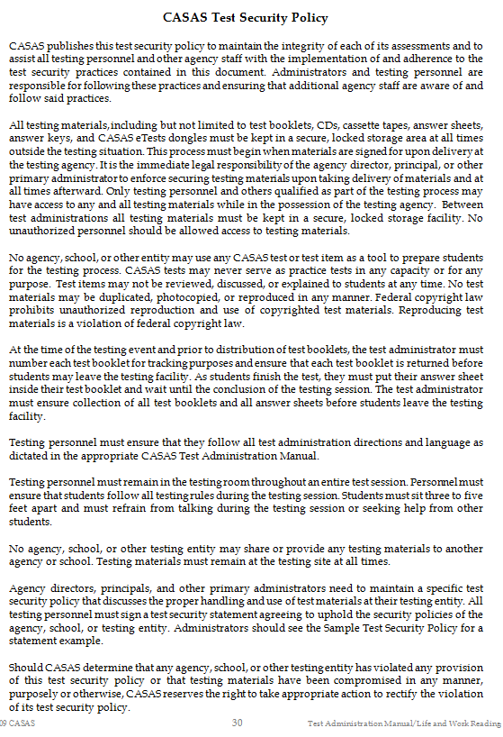
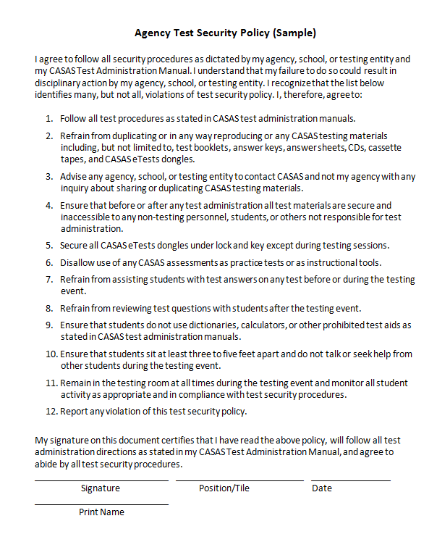
Test Security Policy
Found in TAMs and on CASAS.org
Keep signed copies on file at your agency
www.casas.org
Notes:
Go to CASAS.org and search for Test Security policy.
The Test Security Policy is the document all employees who have anything to do with testing must read and sign.
Agencies can add information to the document on the right to customize to meet local needs. Have the staff sign the policy and keep on file at your agency.

Slide 82
Closing Activity
Discuss with a partner
What are two things you learned today that could improve your agency’s assessment process?
How will it benefit students, teachers, and administrators?
Notes:
Activity
Partners to discuss questions,
After a few minutes, ask for a few ideas to be shared with larger group.

Slide 83
Congratulations!
You are now a certified Test Administrator!
You have –
  Learned about the Intake process that includes Oral Screening, Writing Screening, and Beginning Literacy Screening
  Learned how to administer an appraisal and pretest
  Used the raw score to determine the scale score
  Used the scale score to determine the pre-test
  Reviewed instructional reports to analyze skills and target instruction
  Prepared students appropriately for post-testing
  Learned how to administer post-tests

Slide 84
Want to Learn More?
Sign up for online training at www.casas.org
Online Resources for Teachers
The Teacher’s Handbook
Assessment to Instruction
Using CASAS Resources to Improve Instruction
Send questions to trainer@casas.org
CASAS Certified Trainers
are incredibly important for quality programs!
Thank you!
Notes:
Remind participants that some trainings may have a CA bent, as we have a contract with the state, but others are more than welcome to attend.

Slide 85
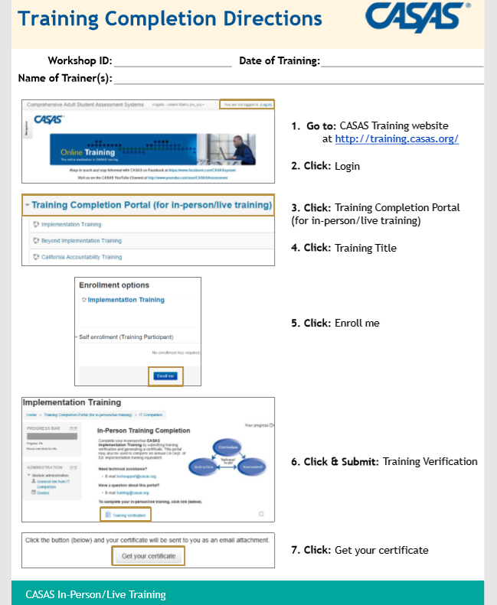
Would you like a certificate showing you completed CASAS Implementation Training?
Follow the instructions on your handout to print a certificate for your files.

