Slide 1
Implementation Training
2017 - 18

Slide 2
Warm-Up
Think About It
What is your agency’s process for intake?
Notes:
On scratch paper, have participants write a brief outline of the process at their agency. When finished, have them share. No in-depth questioning at this point. We’ll revisit at the end.

Slide 3
Purpose
To certify participants to administer CASAS tests.
To meet the yearly training requirement (if applicable in your state.)
To ensure uniform test administration practices.

Slide 4
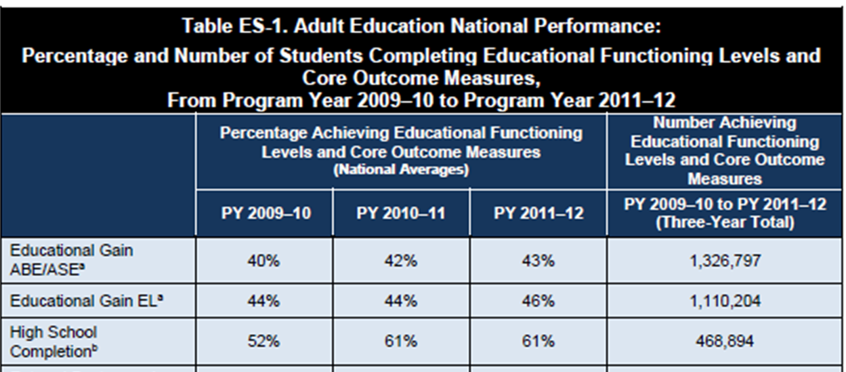
Why are our Certified testers so great?
Accurate testing provides proof of your agencies’ ability to serve students
You are an important part of their success!
Notes:
“You are an important part of students’ success.”
You are one of the first staff to spend substantial time with students before they go off to class. (So, don’t be in a rush to get them tested. Keep the atmosphere welcoming and relaxed.)
You can make a difference in the persistence of the student (persistence: students stay long enough in the program to pre and post test)
Explain why testing is so important for them – correct program and class placement, accurate measurement of their learning gains, and that the data is used to make sure that classes and programs meet the needs of the students.

Slide 5

Agenda
CASAS Program Overview
  What is CASAS?
Curriculum
    Competencies
    Content Standards
    Tasks
Assessment
    Administering the Appraisal
    Reading and Writing Screening for ESL/ELL
    Administering Pre- and Post Tests
Instruction
    Testing Reports

Slide 6
What is CASAS?
Comprehensive Adult Student Assessment Systems
CASAS is a nonprofit organization dedicated to improving youth and adult education services.
CASAS is an integrated systems approach with three key components.
Assessment
Curriculum
Instruction
Notes:
PRESENTER/TRAINER NOTES:
Began in 1980 as a partnership of the California Department of Education and a consortium of local adult education agencies.
Has expanded to a nationwide, field-based consortium since 1985.
Assessments used in 30+ states, Brazil, El Salvador, Singapore, and the Pacific Rim.
Provides research, assessment, accountability, program evaluation, and data services.
The CASAS key components are assessment, instruction, curriculum, with the outcome of accountability.
We will cover the key components in more detail throughout the training.
“Let’s take a look at these components one by one.

Slide 7

What are Competencies?
Competency Content Areas
0. Basic Communication
1. Consumer Economics -
2. Community Resources
3. Health
4. Employment
5. Government and Law
6. Computation
7. Learning to Learn
8. Independent Living Skills
CASAS Competencies are measurable learning objectives written in a functional life skills context.
CASAS tests are aligned to these competencies.
CASAS Web site: www.casas.org/ About CASAS / CASAS Competencies
7
Notes:
Within each of these more general Competency Areas are specific Competency Statements –detailed outcome measures for your students.

Slide 8

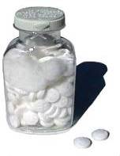
The Competency Coding System
Content Area
  3. Health
Competency Area
  3.4 Understand basic health & safety procedures
Competency Statements
  3.4.1. Interpret product label directions and safety warnings
  3.4.2. Identify safety measures that can prevent accidents and injuries
Every test item in the CASAS system is associated with a specific competency.
Instructional Reports display test items and coordinating competencies.
Notes:
The Competency Coding System
Every competency is identified with a three digit number. The first digit always refers to the content area.
The second digit refers to a competency area. 3.4 represents the content area of health and the more specific competency area of “understanding basic health and safety procedures”. The three digit competency statement describes a measurable action. Every test item in the CASAS system is associated with a specific competency.

Slide 9
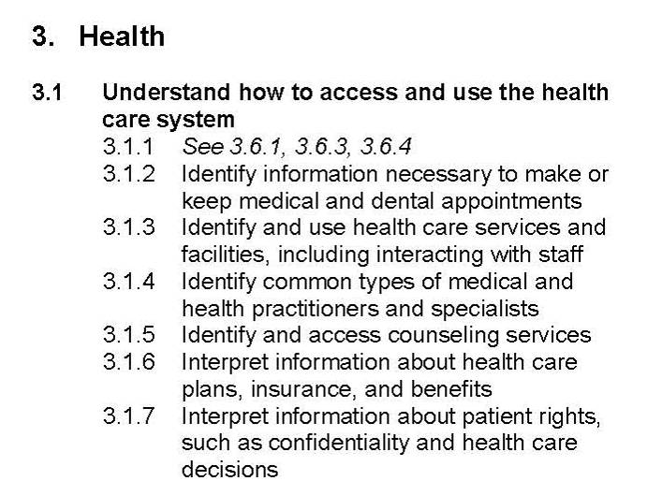
Importance of Competencies?
Competencies provide
instructional objectives for curriculum
direct links to test content for monitoring student learning
criteria for program evaluation
a referencing system for instructional materials
Competency Area
The numbering systems for Competencies, Tasks and Content Standards are reflected in testing reports for your students and classes.
Content Area
Competency Statement
Notes:
Under each of the nine Content Areas are Competency Areas. And finally, more specific Competency Statements give the clear objective for students to achieve.
Each Content Area is identified by a number, 0-8. This is followed by Competency Area and Competency Statement numbers, which creates the 3-digit Competency Coding System.
Remind participants that they won’t need to remember what each number in the system means; just know that these numbers that they will see on TE reports refer back to these competencies.

Slide 10
Using CASAS Competencies
Problem: You should start work at 9:00 a.m., but you have a car that won’t start.
What skills would you need to teach your students?
Basic Communication
0.1.2 -- Understand or use appropriate language for information purposes (to call a tow truck, identify location)
0.1.3-- Understand or use appropriate language to influence or persuade (to call employer)
0.2.1-- Respond appropriately to common personal information questions
Community Resources
2.1.8 --Use a telephone or similar device to make and receive calls
2.1.1 --Use a telephone directory
2.3.1 --Interpret clock time
Consumer Economics
1.9.6 -- Interpret information related to automobile maintenance
0.1.7 -- Understand, follow or give instructions
1.9.8 --Interpret information about automobile insurance
1.7.5 -- Interpret information to obtain repairs
Notes:
Use after page 6 “CASAS Competencies” (before moving on to “What are Task Areas?”)
This slide models the activity on the next slide. Have participants open their CASAS Competency booklets to follow along. There are plenty of other competencies to teach along with the ones listed here.
Bonus: Ask teachers how long this “problem” should take to teach in their class (before you begin looking for the various competencies.) After you have completed this exercise, ask them again how long it would take to teach this “problem.” This is an excellent activity for new teachers who fly through material!

Slide 11
Activity:
Selecting CASAS Competencies
In small groups or pairs:
Choose one problem-solving scenario from your handout.
In your CASAS Competencies, choose at least 3 competencies that would help students solve the problem.

Slide 12
What are Content Standards?
Basic Skills Content Standards identify the underlying basic skills (literacy and academic skills) associated with CASAS Competencies.
Reading
R1 Beginning literacy/phonics
Listening
L1 Phonology
Math
M1 Number Sense
R2 Vocabulary
R3 General reading comprehension
R4 Text in format
R5 Reference materials
R6 Reading strategies
R7 Reading and thinking skills
R8 Academic-oriented skills
R9 Literary Analysis (ABE/ASE only)
L2 Vocabulary
L3 Grammar
L4 General Discourse
L5 Informational Discourse
L6 Strategies and Critical Thinking
M2 Algebra
M3 Geometry
M4 Measurement
M5 Statistics, Data Analysis and Probability
Writing
W1 Beginning Literacy
W2 Spelling and Mechanics
W3 Grammar and Sentence Structure
W4 Vocabulary/Word Choice
W5 Organization
W6 Content
W7 Writing for Varied Purposes
W8 Academic-oriented Skills
Speaking
S1 Phonology/ Pronunciation
S2 Vocabulary
S3 Grammar
S4 General Discourse
S5 Informational Discourse
S6 Strategies and Critical Thinking

Slide 13
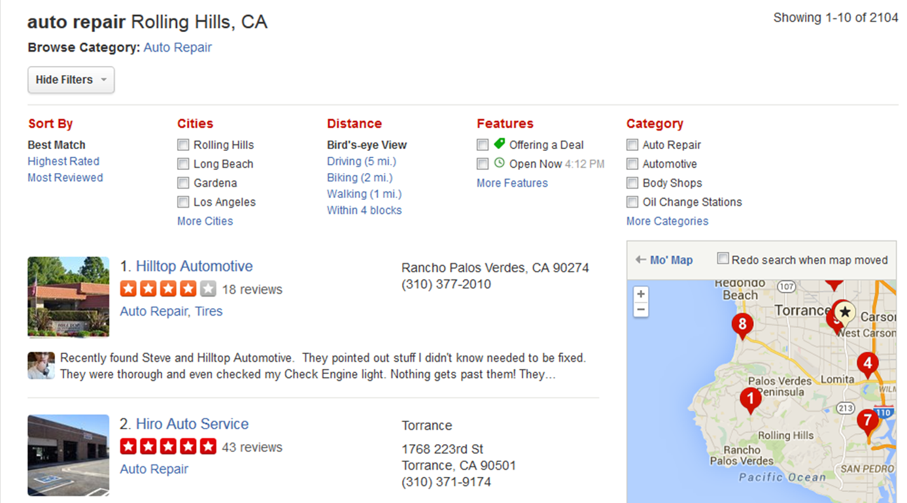
Skills needed to find auto repair
CASAS Competency - Community Resources 2.1.1 --Use a telephone directory
Reading Task Areas – advertisements (4), paragraphs and directions (3), maps (2)
Locate information organized in groups or categories
R5.3
Find a word or number in an alphabetical, numeric or other ordered listing
R5.1
R6.2 Scan simple text to find specific information
R6.2
R3.12 Use supporting illustrations to interpret text
R3.12
Use capitalization as a clue to interpret words
R2.4
Content Standards
Notes:
13
This is how competencies, content standards and tasks all work together in a real-life setting.
What Basic Skills Content Standards must the student be able to do in order to succeed in the skill of using a telephone directory?
Students will need to look for items alphabetically
Read numbers
Read ads

Slide 14
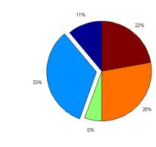
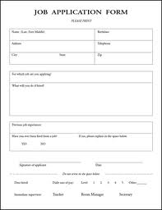

What are Task Areas?
Reading Tasks
Forms
Charts, maps, consumer billings, matrices, graphs, or tables
Stories, articles, paragraphs, sentences, directions, or pictures
Signs, price tags, ads, or product labels
Measurement scales and diagrams
Listening Tasks
Picture prompt
Comprehension question
Predict next line of dialogue
Identify true statement based on prompt
Tasks are how test items are presented. It’s important that these tasks are practiced in the classroom.

Slide 15

Competencies, Task Areas and Content Standards
Competency
A measurable learning objective written in a functional life skills context.
Basic Skills Content Standard
The literacy skills students need to be successful in mastering the competencies.
Task Area
The written or graphic prompts in CASAS Tests. Students must not only be able to read a sentence, but must be able to understand vocabulary in context.
Notes:
While the question looks simple for the student, there is a lot of information imbedded in CASAS test questions.

Slide 16
Overview
Screening for ESL/ELL : Speaking and Writing
Appraisal
Pretest
Post-Test
CASAS Tests

Slide 17
Computer-delivered tests and
Paper-based tests
While CASAS eTesting and Paper-based testing have many similarities, there are some significant differences when administering the tests.
For this training, items specific to
  Computer-delivered tests are in Yellow
  Paper-based are in Brown
Items that apply to both are in Blue

Slide 18




The Assessment Process
Appraisal
Identifies the Pretest students should take.
Diagnose
Pre-Test
Establishes a baseline score and begins to diagnose learning needs
Instruct
Informal Assessment
Includes targeted instruction based on information from tests
Monitor
Post Test
Given after 70-100 hours of instruction. Results compared to previous test. Progress determined.
Place

Slide 19
Intake
For all incoming students:
observe how well the student communicates and fills out forms
consider number of years of formal schooling and other information on demographic records
administer CASAS writing screening or other writing assessment
consider other factors affecting class placement (years of schooling, any certificates or degrees…)
Notes:
Whether you have an ESL/ELL program, ABE program or ASE/GED program, program placement is the same (with a few exceptions.)

Slide 20


Informally assess student’s basic writing and reading ability by observing how well the student can complete your agency’s registration form.
Little or no difficulty?
Administer
Computer Adaptable Test (CAT) in eTests to determine Pre-test.
Administer
Appraisal
to determine Pre-test.

Slide 21
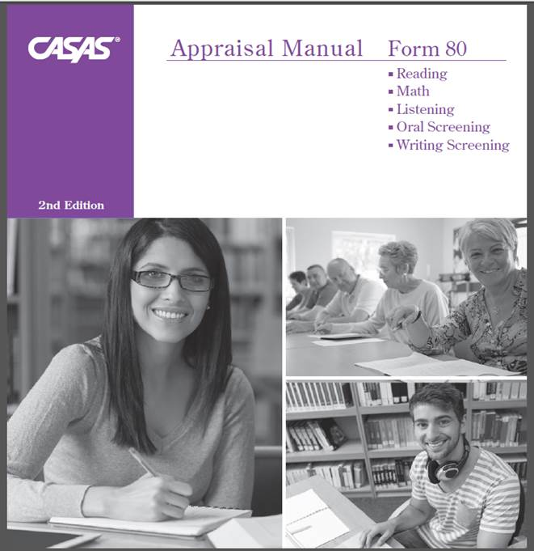
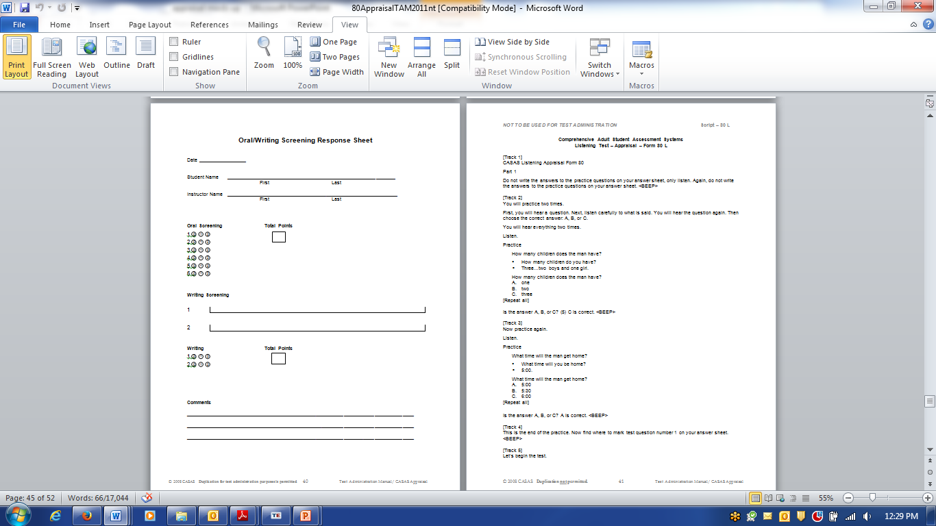
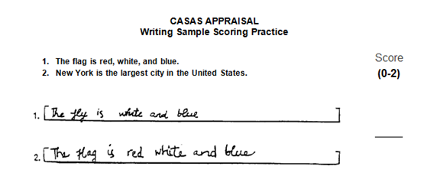
Difficulty completing the registration form or answering basic questions?
Administer the
Oral and Writing Screening
located in your
Appraisal Form 80
Test Administration Manual (TAM.)
Each take 5 minutes
Helps eliminate misplacing the student in tests and classes

Slide 22
ESL/ELL - If the student has difficulty completing registration forms
Unable to answer?
Go directly to practice items on Form 27/28.
If the student has great difficulty, mark their test record as “Too Low to Test.” Try testing again in a couple of weeks.
Some difficulty? Pretest with Form 27 or 28
Little or no difficulty?
Pretest with Form 81 or 82 for Reading
Able to answer?
  Administer the
  CAT or Form 80 Reading Appraisal

Slide 23
Oral and Writing Screening
The Oral Screening is an optional one-on-one oral interview used to screen ESL/ELL learners for taking the listening and reading appraisal tests.
  six questions
  5 minutes
Refer to page _____ of the 80 Appraisal TAM
The Writing Screening is an additional (and optional) tool to screen ESL/ELL learners for taking reading and listening appraisals
Examinees write
  two sentences that are dictated
  5 minutes
Refer to page 40 of the 80 Appraisal TAM
Found on page ___ of the 80 Appraisal TAM

Slide 24
Question | Response
What’s your name? | This question is not scored. It may be omitted if the tester knows the examinee.
How long have you been in the United States? To clarify, ask: When did you come to the United States? | Some possible responses: Four years; 1987; etc.
2. Tell me why you want to learn English. To clarify, ask: Why do you want to study English? | Any appropriate reason may be acceptable.
3. Do you read in your native language? If Yes, ask: What do you like to read? If No, ask: Why not? | Yes. Some possible responses: names of books, types of books, subjects. No. Some possible responses: I didn’t go to school in my country; I can’t read; I have no time to read; etc.
4. What work did you do in your country? or What work are you doing now? | Any appropriate response is acceptable. If the person has not worked, expressing that fact is also correct.
5. How many years did you go to school in your country? To clarify, ask: How long did you go to school in your country? | Any appropriate response is acceptable.
Administered one-on-one
Introduce yourself
Ask the questions
  Repeat the question once, if needed
  Use the clarification question, if needed
Appraisal TAM pg. 20 & 21

Slide 25
Scoring Rubric – Oral Screening
Points | Guidelines
0 | No answer, incomprehensible, or does not answer the question. Note: If the examinee responds, “I don’t know,” it is up to the administrator to determine whether this answer represents an appropriate response or lack of comprehension.
1 | Comprehensible but not grammatically correct. Note: Comprehensible = understandable and relevant
2 | Comprehensible and grammatically correct. Note: Answers that are appropriate and represent what a native speaker would provide would be given 2 points; therefore, some one-word answers would be given 2 points.
Appraisal TAM pg. 20

Slide 26
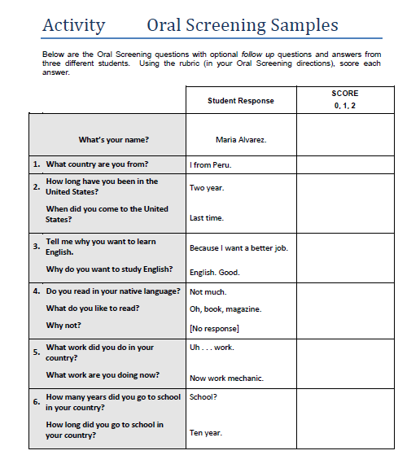
Activity: Oral Screening Scoring
Oral Screening Scoring Rubric
Points | Guidelines
0 | No answer, incomprehensible, or does not answer the question. Note: If the examinee responds, “I don’t know,” it is up to the administrator to determine whether this answer represents an appropriate response or lack of comprehension.
1 | Comprehensible but not grammatically correct. Note: Comprehensible = understandable and relevant
2 | Comprehensible and grammatically correct. Note: Answers that are appropriate and represent what a native speaker would provide would be given 2 points; therefore, some one-word answers would be given 2 points.
Notes:
5-10 minutes
Have participants work alone or in groups to assign scores to the student responses using the rubric.
As a class, ask participants for the scores they assign. If there is any dissent among the group, have them explain why they chose the score.
Agencies can more clearly define the rubric if they need to.

Slide 27
Writing Screening
Use the Oral/Writing Screening Response Sheet (Appraisal TAM page 40)
To begin the test, say:
  “You will write two sentences. I will say each sentence three times. Now listen, and write Sentence 1.”
Dictate the first sentence: The flag is red, white and blue.
  After a brief pause, repeat it.
  Pause again and repeat again.
Do the same with the second sentence:
  New York is the largest city in the United States.
The examinees should not get help from other students or look at other students’ responses.
Appraisal TAM pg. 17
Notes:
The test administrator should have a native or near-native accent in spoken English, and should speak in a loud, clear voice with an easy, natural pace when dictating the sentences.
The two sentences are The flag is red, white and blue.
New York is the largest city in the United States.

Slide 28
Scoring Rubric - Writing Screening
Points | Guidelines
0 | Nothing written, completely illegible or wrote the wrong sentence.
1 | Wrote some words correctly.
2 | Wrote the complete sentence correctly.

Slide 29
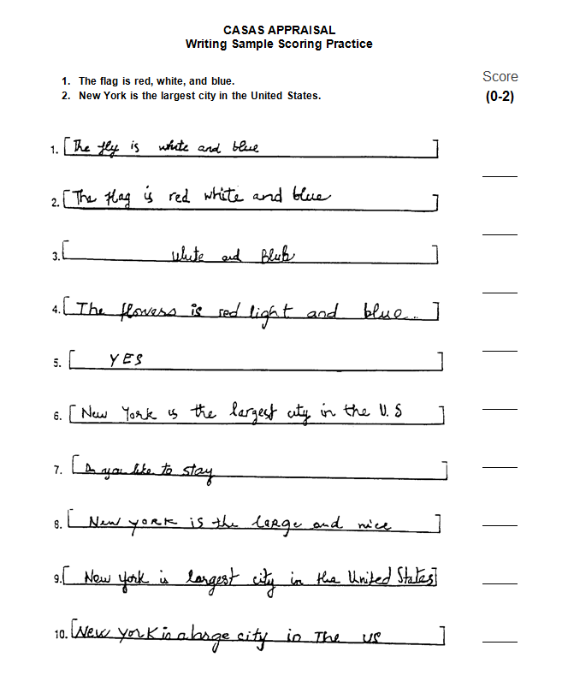
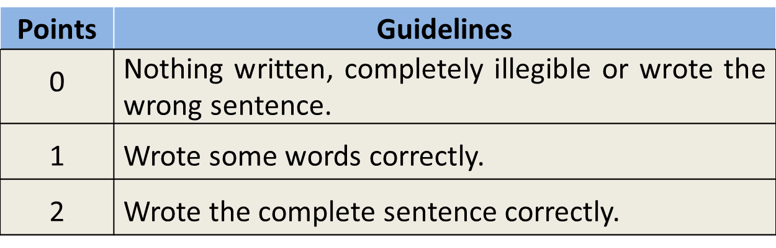
Activity: Writing Screening Scoring Practice
In groups or pairs, score the Writing samples using the Writing rubric. 10 minutes
Notes:
Give participants 10 minutes.
Use the next slides to go over the sentences. Answers are on the next 2 slides. Discuss any differences in scoring.
Ask, “How will giving a 2-sentence dictation help you with placing new students in your program?

Slide 30
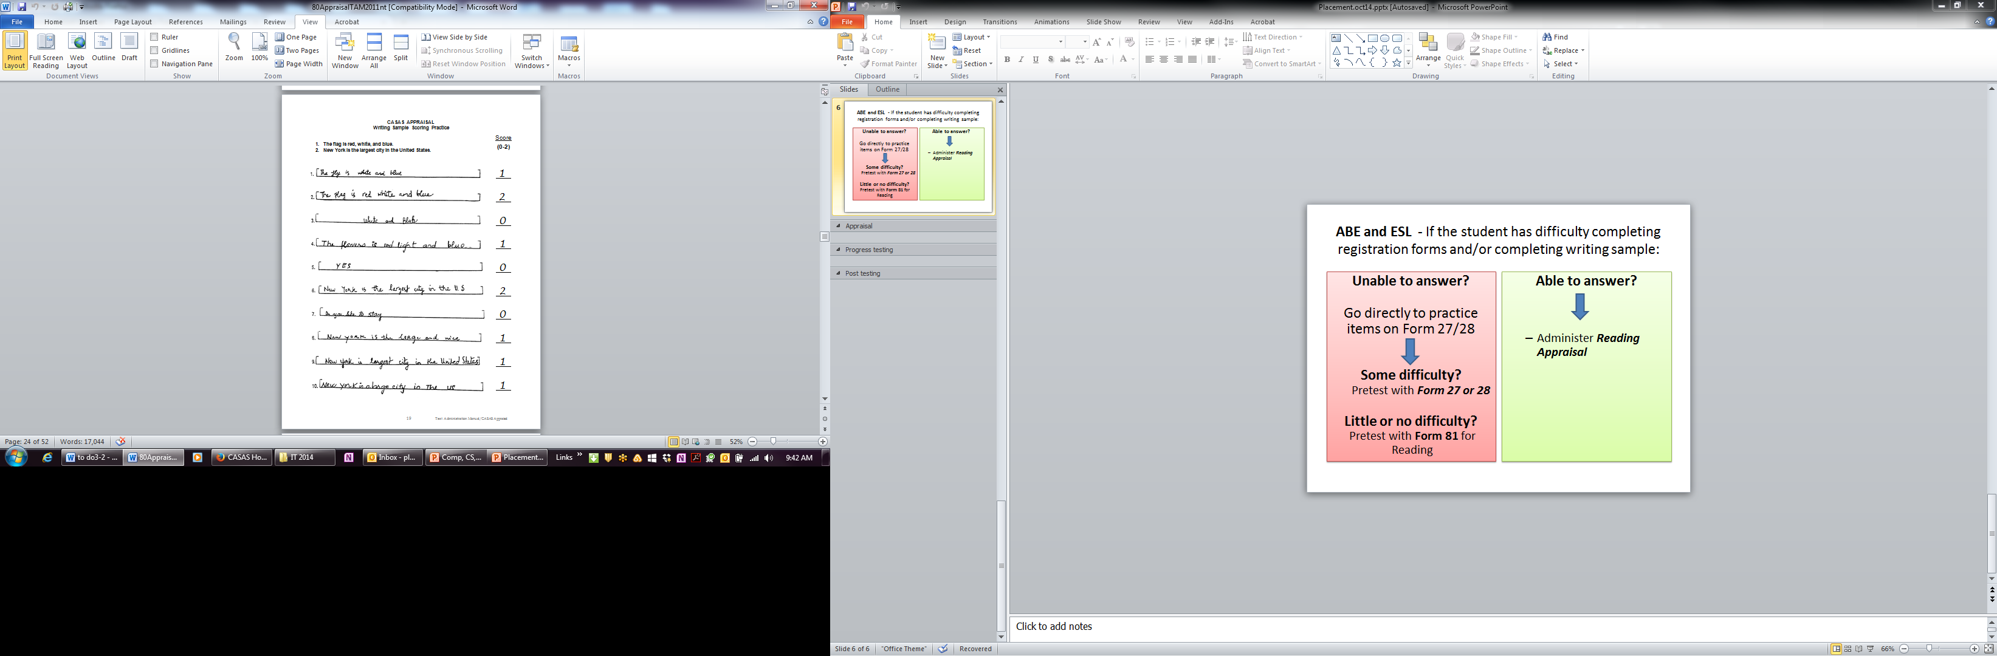
Notes:
Answers to Activity 3

Slide 31
Notes:
Answers to Activity 3

Slide 32

Using Screening Results
7 or more: Give the CASAS Appraisal for Reading or Listening
6 or fewer:
  Do not give the CASAS Appraisal
  Pre-test with either the
    Beginning Literacy Reading Assessment, Form 27 or 28
    Level A Reading Test, Form 81R or 82R
    Level A Listening Test, Form 981L or 982L
Notes:
At this point, you can hand out (or just show to the participants) the difference between questions in the 27/28 and the 81/82

Slide 33
CASAS Appraisal
General Testing Guidelines

Slide 34
CASAS Testing Requirements
Computer-delivered tests
Paper-based
Computers
Internet access or agency-based server
Test Administration Manuals
  By series
  By test type:
    Appraisal
    Progress
Reusable test booklets
  By series
  By form/level
Test Administration Manuals
  By series
  By test type:
    Appraisal
    Progress
Answer sheets
Scanner

Slide 35
CASAS Appraisals
Computer-delivered
Paper-based
Form 101 – Long CAT
Form 102 - Locator
Levels A – D
Reading, Math, Listening (fixed form)
30-40 minutes
Computer Adaptive Test (CAT)
Computer Adaptive Test (CAT)
Reading, Math, and Listening (fixed form)
10-15 minutes
Leads students seamlessly into the appropriate Pre-Test.
17-20 randomly selected items
Form 80 – Reading, Listening & Math
Reading test for all programs Levels A-D
30 minutes each
Levels A – D
25 minutes
Form 130 - Math
Math for ABE and ASE programs
Listening for ESL/ELL/ELL programs Levels A-C
Math for ABE/ASE programs Levels A - D
Notes:
Form 80 Math Appraisal is new. Agencies use this with the 30 Math Series.

Slide 36
What’s the difference between the Appraisal and the Pretest?
180 185 190 195 200 205 210 215 220 225 230 235 240 250
Appraisals (Placement tests)
Appraisal test items are widely distributed along the CASAS scale. The items range from very easy items to difficult items.
Level B
Pre- and Post-Tests (Progress Tests)
Progress test items are clustered at a specific level.
Page 26
Notes:
This chart shows the difference between an appraisal and a pre post test.

Slide 37
Reading Appraisal
As this is an appraisal used with learners of all skill levels, test items cover a wide range of difficulty for ESL/ELL and ABE/ASE students
Low Beginning ESL/ELL
Beginning Literacy ABE
High Beginning ESL/ELL
Beginning Basic ABE
Low Intermediate ESL/ELL
Intermediate Basic ABE
High Intermediate ESL/ELL
Intermediate Basic ABE
Advanced ESL/ELL
Advanced Basic ABE
Advanced Adult Secondary
Adult Secondary
Appraisal Test Items
Notes:
Ask participants why you wouldn’t place a student in class just from this reading appraisal –
Testing only one skill
So how do you insure accurate classroom placement

Slide 38
General Testing Guidelines
Allow adequate space between students.
Ask students to turn off their cell phones.
All personal items must be off the tables.
Tell students not to talk or get help from other students during the test.
Scratch paper is allowed for math tests, but not for listening tests. All scratch paper must be collected and shredded after the test.
No cell phones, dictionaries, translators, or any other items allowed.
Notes:
Ask participants – What do you remember about taking standardized tests in school?
Answers may be – no bathroom breaks, no talking, no dictionaries, no calculators, etc.
Remind them that CASAS tests are standardized, government approved with strict testing policies.

Slide 39
Testing Procedures
Computer-delivered tests
Paper-based tests
Demonstrate how to input demographics information
Demonstrate “Applying Item Responses” in the eTest administration manual
Demonstrate on the whiteboard how to fill in the bubbles properly.
Have students bubble in any demographics you are collecting.
Have students write the form number in the box marked Form Number and fill in the Test Date.

Slide 40
Test Security
Computer-delivered tests
Paper-based tests
eTest Coordinator or Proctor starts and stops testing sessions so that tests cannot be accessed by students outside testing sessions.
Each computer used for eTesting will be registered and only those testing stations will be active where a proctor is present.
Keep all testing materials, including test booklets, CDs, answer sheets, test manuals and related materials in secure storage, available only to those involved in test administration.
Develop a system to distribute and collect testing materials, including numbering the test booklets.
Test administrators are responsible for the security of all test materials in their possession.

Slide 41

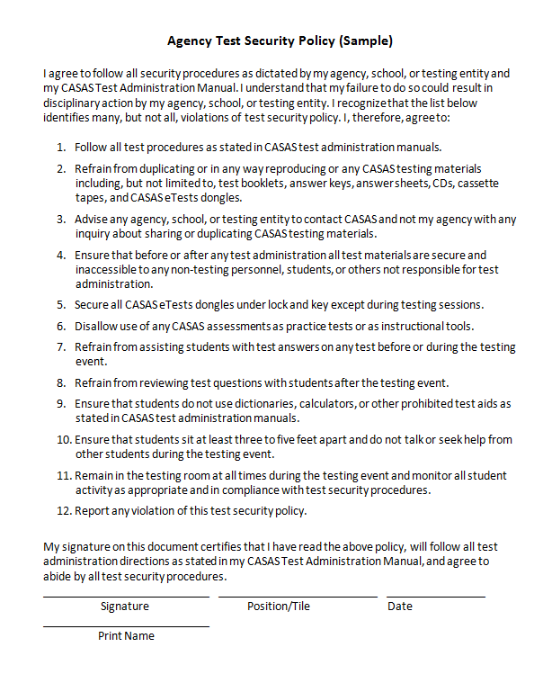
Test Security Policy
Found on pages 30 & 31 in the LWR TAM
Keep signed copies on file at your agency
Notes:
The Test Security Policy is the document all employees who have anything to do with testing must read and sign.
Agencies can add information the document on the right. Have the staff sign the policy and keep on file at your agency.

Slide 42
Accommodations in Test Administration Procedures
You may provide these accommodations in testing conditions for documented disabilities without contacting CASAS:
  allowing extended time
  giving supervised breaks
  providing a sign language interpreter (for test administration directions only.)
  testing in an alternate room
It is not an appropriate accommodation to read a CASAS test or to allow use of a vocabulary pen, dictionaries, calculators or other electronic devices.
Computer-delivered
Paper-based
a colored overlay
Large-Print testing booklet
Large-Print Answer Sheet
Braille Test
Display options (font size, color)
Time allowed
Notes:
Remind participants that there are so many different accommodations requested that they can always call CASAS for more information if they can’t find what they need on
the Accommodations page on our website.
Refer to the 80 Appraisal TAM, page 25, Local Agency Responsibility, if participants ask more questions about Accommodations.

Slide 43
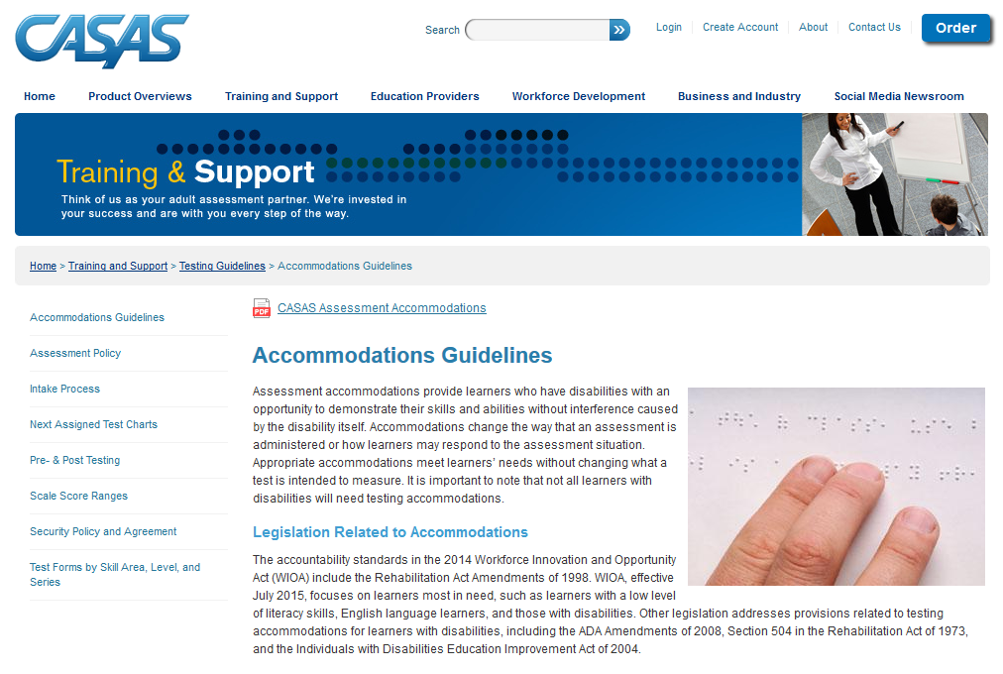
Accommodations, cont.
Contact CASAS at 1‑800‑255-1036 for information on other test formats. Do not change a test format locally. Alternate test formats must meet standardized test development procedures.
For more information, go to www.casas.org and refer to the Guidelines for Providing Accommodations Using CASAS Assessment for Learners with Disabilities. The paper includes a matrix with sample accommodations for specific disabilities.

Slide 44
Testing Procedures for both Formats
Guessing by the examinees should be discouraged. Explain that if they can’t answer a question they don’t need to mark an answer, and can go on to the following questions.
Circulate during testing to make sure examinees are marking answers at the correct number on the answer sheet.
Maintain a positive attitude and atmosphere about the testing, as your attitude can influence students’ attitudes and performance.
For students with disabilities, please refer to the CASAS guidelines for making the appropriate accommodations
Notes:
Circulating during all testing is important. Make sure that students are not using their cell phones!

Slide 45
Administer the Appraisal
Computer-delivered tests (Locator or Long CAT)
Paper-based (Form 80)
Two practice items will be presented on the screen. Students will have two chances to answer.
Have examinees open their test booklets to the test directions and practice items. Read aloud the directions.
Point out the location of the box on the answer sheet for answering the practice items.
Take the time to have everyone answer the practice items, then discuss as needed.
Advise them to do their best but not to spend more than a few minutes on any one question.
  Don’t guess
  Stop when you can’t answer any more questions
  Walk around the room to check students’ work
Notes:
Ask participants “Why?” to most of these instructions – don’t assume they know or understand the importance of each
*Let participants know that while they need to use the 80 Appraisal at their agencies, for training purposes we are using the old Form 20.

Slide 46
Appraisal Instructions Script
Open your test booklet to page 1. Find the directions at the top of the page. Look at the directions as I read them. [Read directions.]
Look at the practice questions. Find the box on your answer sheet for answering the practice questions. Go ahead and read practice 1 and 2 and mark your answers.
What’s the answer to the first practice question? The answer is _. Did you mark _? [Explain.] The answer to the second practice item is _. [Explain.]
We're ready to begin the test. You will mark your answer for the first question on line 1 of your answer sheet. Do not write in the test booklet.
There are 25 items on the test . You have 25 minutes.
If you don’t know the answer, that’s OK, you don’t have to mark an answer. Just go to the next question. Stop when the questions get too difficult
Do your own test; don’t get help from other people. No dictionaries. No calculators.
When you’re finished, or if you can’t answer any more questions, put your pencil down and wait and I will take your test. Any questions?
Turn the page and begin the test.
Is anyone not finished? You can take a little extra time if you need it.
Notes:
Hand out Appraisal test booklets and answer sheets to participants (individually or in pairs).
Demonstrate the entire process with group, with you as the “test administrator.” Remind participants that standardized tests means standardized administration of tests, too.
Note that the slide is brown for paper-based tests. Please refer to the eTest Administration Manual for eTest directions.

Slide 47
During the Test
Check periodically to make sure that everyone is working individually and marking their answers correctly.
Computer-delivered tests
Paper-based tests
Time left shows on the screen.
Examinees will see a prompt to allow them to finish the question they are working on before test ends.
As examinees finish, have them put their answer sheet inside their test booklet and wait.
Announce when time is up. Allow examinees who are not finished to answer the question they are working on.
Notes:
Tell participants that with the paper-based tests, most students will likely be done before time is up.

Slide 48
After the Test
Pick up all test booklets and answer sheets and any scratch paper (math tests.)
Check answer sheets to see that answers are clearly marked and that changed answers are completely erased.
Check that the correct test form is on the answer sheet.
Check the test booklets and erase any pencil marks.
Shred all scratch paper.
Return all test booklets and answer sheets to a secure location. Test administrators are responsible for the security of all test materials in their possession
Notes:
Paper-based tests

Slide 49
Activity Administer the Appraisal Pairs
Role-Play: Administer the test as you would in a classroom.
Designate 1 teacher and 1 student
  Teacher documents:
  Appraisal Testing Script
  Form 20 Appraisal Reading Test Booklet
  Student documents:
  Test Record Answer Sheet (Self-Scoring)
    (Answer the first 5 questions only)
Notes:
Explain that Form 20 Appraisal is no longer used at agencies, so is now used for training purposes.
Yes, you just demonstrated this on slide 45. Now they’ll know how to do it.
As participants are doing the role play, write a raw score from 1 – 25 on “students” answer sheets

Slide 50
Interpreting CASAS Test Results
The three main uses of CASAS test results are:
To identify the learner’s skill level.
  All CASAS tests are scored on a common scale that is correlated to a continuum of instructional levels and learner skill levels.
To measure learning gains.
  Test scores identify the correct CASAS progress test level into which students should be placed. Some programs use test scores and skill levels to place students into the appropriate class level or to track educational progress.
As input to targeting instruction.
  Reports of test results show student and class performance on specific competencies and basic skills can provide useful information on learner strengths and weaknesses.

Slide 51
Raw Scores and Scale Scores*
Raw to Scale Score Reading Appraisal Form 20
Raw Score | Scale Score
1 | 176
2 | 185
3 | 190
4 | 194
5 | 198
6 | 201
7 | 204
8 | 206
9 | 209
10 | 211
11 | 213
12 | 216
13 | 218
14 | 221
15 | 224
16 | 227
17 | 228♦
18 | 230♦
19 | 231♦
20 | 233♦
Raw Score: The number of questions students answered correctly
Converting the Raw Score: Use the chart to determine Scale Score.
  Each CASAS Test Form has its own Raw to Scale Score chart in their Test Administration Manuals. Charts cannot be used interchangeably.
  For example, on this test form, if the raw score is 12, then the scale score is 216.
Notes:
Converting the Raw Score
Remember, the raw score is the number correct on the test. But this is not the score you will use. You will use a “scale score”. Convert the raw score to a scale score using a chart like this one. Each appraisal manual contains the raw to scale conversion charts. For example, if the reading raw score is 12, then the scale score is 216.
This is a key training point.

Slide 52
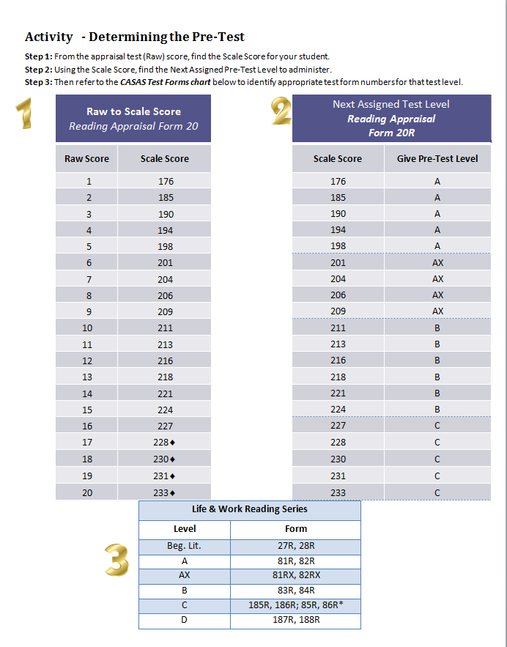
Activity Determining the Pre-test
Using the Raw to Scale Score Chart and the Next Assigned Test Level Chart, what Pre-test form should your student take?
Notes:
Quick, general question to all participants. Yes, it’s hard to read, but they have a hard copy in their packet.

Slide 53
Pre- and Post Tests
Pre and Post Tests

Slide 54
CASAS Progress Tests
for program placement and monitoring educational progress
two forms (versions) at each level of testing to alternate testing (pre- and post)
3 series to choose from*:
  Life and Work (Reading and Listening)
  Secondary Level Assessment Series (Reading and Math)
  Life Skills (Math)
    *All NRS approved until July 2017
Notes:
These 3 are NRS approved until July 1, 2017.
Two Forms at each level – show the test booklets. Tell participants that the Level A, Form 82 is not a more difficult test than a Form 81. All standardized tests are required to have at least two forms of a test. The next slides go into detail about test levels and forms
Explain that the pre-test is the first accurate test given in a program year, and all other tests (in the same modality) are post-tests for that year.

Slide 55
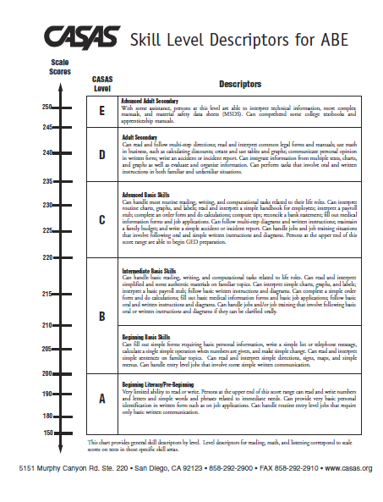
Skill Level Descriptors
The Skill Level Descriptors provide general information on how an adult learner’s scale score to the job-related and life skill tasks this person generally can accomplish.
Notes:
Each test modality (reading, listening) provides a picture of the ability of a student for the skill tested. Attempting to average scores from different tests will not provide an accurate performance level of a student. CASAS scores were not designed to be averaged together, nor should you assume student’s writing and speaking skills are the same as their reading skills.
Testing reading skills? Only the reading descriptors apply.

Slide 56
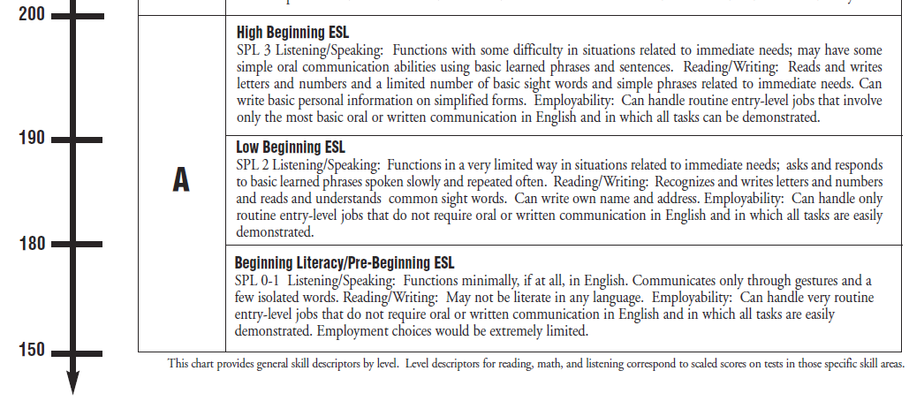
Life and Work Reading Tests
Level A
82RX
81RX
82R
81R
27R
28R
Notes:
Hand out the Skill Level Descriptors.
Show the Level A test booklets.
Remind them that the work they did for the ESL/ELL Speaking and Writing Screening and the Appraisal helps determine which test the student needs.

Slide 57
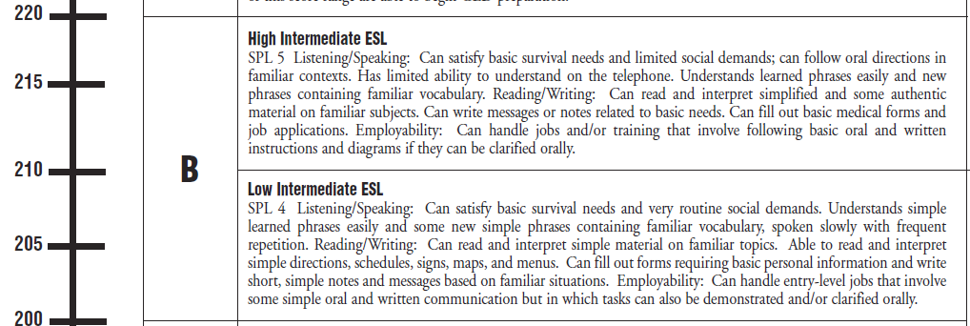
Level B
Form 83R
Form 84R
Notes:
Show the Level B test Booklets

Slide 58
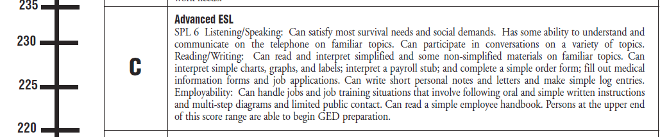
Level C
185 R
186 R
85R
86 R
Notes:
Show the Level C test booklets.
Explain that the 185/186 are more life and work focused in content and the 85/86 are more work skills focused. Agencies should choose one pair or the other for their programs.

Slide 59
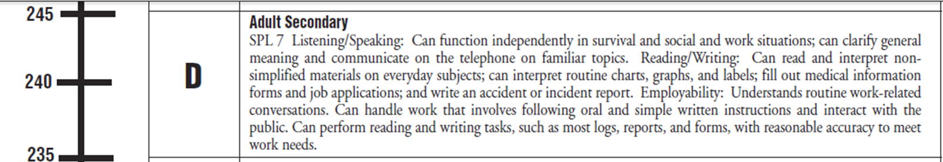
Level D
187 R
188 R

Slide 60
Test Administration Manuals
Essential in administering tests – paper-based and computer-based.
A test administration manual (TAM) contains the
  answer keys
  scoring guidelines
  score conversion charts
  next assigned test charts
  competency and content standard content
  class and student profiles
  standardized test administration procedures and policies
  test security protocols
  resources for testing and instructional support

Slide 61




Assessment Process
1. Place
2. Diagnose
3. Instruct
4. Monitor
Screening and Appraisal
Determine program, level placement
Identify pretest level
Pretest
Diagnose learning needs based on pretest score
Instruction
Use TE Reports to identify instructional needs
Post-test
Select based on pretest score
Monitor progress
Notes:
There are four main ways to track a learner’s performance with assessments. First, place students into your program by using a screening instrument or an appraisal. For ESL/ELL this can include an oral interview to check listening/speaking level, a form to screen for literacy and/or a short simple reading test. You can use your own screening instruments or the CASAS appraisal which includes literacy screening, oral interview and a listening and reading test for ESL/ELL. Next pre-test your students at their appropriate class level to diagnose their learning needs.
Third, provide instruction, and finally, post-test your students to measure their progress.

Slide 62
California Assessment Policy
*The CDE requires WIA Title II funded local agencies to test all students enrolled in ABE, ESL/ELL, and ASE instructional programs.
Pre-tests are recommended as soon as the student enrolls in the program
Post tests are recommended at the end of each quarter, semester, or term to document continuous learner improvement – after approximately 70-100 hours of instruction.
Document is available for download on the CDE and CASAS Web sites Home > Training and Support > CASAS Peer Communities > California Accountability
  *For other states, please contact your reporting agency
Notes:
All states have a state assessment policy.

Slide 63
Key Points for Testing
Computer-delivered tests
Paper-based
If a student is answering a question at the end of the hours, the student will see a prompt that will allow him to complete that question, but then the test will end.
Go over the practice questions with students. If testing different levels at the same time, start with the highest level: Hand out booklets for the D Level, go over practice items and then have the start. Then do the same with each level.
If a student is answering a question at the end of the hour, that student is allowed to complete that question, but then you must end the test.
Time allotment: 1 hour
Students are not allowed to stop testing and continue at another time.
No dictionaries, calculators or cell phones are allowed. Scratch paper ONLY for math tests. (Must be collected and shredded after testing.)
You may not read questions or answers to students.
Notes:
Preparation for Testing
Dictionaries or calculators are not allowed.

Slide 64

Testing Guidelines
Appropriate
Inappropriate
  Review practice questions together
  Provide start and end times on the board
  Provide a relaxed, unhurried atmosphere.
  Provide scratch paper (for math tests only) and pencils
  Reading questions to students
  Calculators
  Translation devices
  Limiting time for testing
  Allowing students to stop and take the test at a later time.
Page 32
Notes:
64
So, let’s show you some more about appropriate strategies for making gains…

Slide 65
Activity Pre-testing
In groups of 3 or more, designate one participant as “Teacher.”
Role-play testing of students at different levels.
  Teacher documents
    How to Test document
    Life and Work test booklets
    4 CASAS Test Answer Sheets
    Raw – to – Scale Score Charts for 80 series reading
Once your “students” have taken the pre-test, take the Raw Score and find the Scale Score on the Scale Score Charts in your folder.
Notes:
Based on their Appraisal “results,” have participants tell you what pre-test they should have.
Make sure “teacher” wasn’t a teacher during the appraisal practice.
Let “students” answer a few questions.
Write a raw score on each student’s answer sheet (5-30)

Slide 66

Valid Scores
Inaccurate Re-test immediately whether a pre or posttest
Accurate
Accurate Pretest
  Test score is within the accurate range or conservative estimate range (high end or  score)
Valid score and works for benchmarks. If a pre-test, you should re-test at a higher level, but not required.
Notes:
Define * scores and ◊ scores

Slide 67
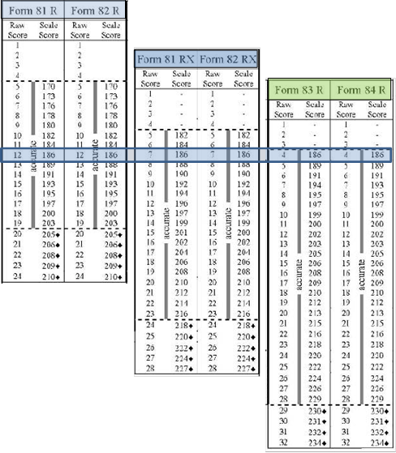
Scale Scores
Each appraisal and test form has its own raw to scale score conversion chart. The left column displays the raw score, or number correct a student earned on the test. The right side of the chart displays the scale score.
When standardized progress tests are developed, at least two alternate forms of the test for each instructional level are developed to measure progress so that students take one form as a pre test and the alternate form as a post test.
It is important to use the raw to scale score conversion chart for the specific form of the test administered.
Notes:
While this isn’t required for agencies that use these charts if they use eTests or TOPSpro Enterprise (these programs determine raw and scale scores for you) it is important that test administrators know how the scores are calculated.

Slide 68
For example, Rosa Hernandez takes a CASAS Level A Form 81R, which has 24 questions. She earns raw score of 12.
Teo Gonzalez takes a Level A Form 81RX – a Level A test with an extended range of 28 questions. He earns a raw score of 7.
While they both took Level A tests, they took different forms, each student earned a raw score of 186. They have the same level of skills in reading.
Notes:
A 186 score has the same meaning across test levels. Where the 186 places in each of these test levels shows the difficulty of the test. Again, these aren’t “pass/fail” tests. Students should score in the mid-accurate range.

Slide 69
Activity What can your students do?
Determining Skills and Levels
Use your Skill Level Descriptors and determine what your students can do based on their Pre-test scale score and their level.
Remember that if the student took a Reading test, only the reading descriptors apply.

Slide 70
A scale score of 186 in each of these test levels have the same meaning:
ESL/ELL
Low Beginning
Recognizes and writes letters and numbers and reads and understands common sight words. Can write own name and address.
ABE
Beginning Literacy/Pre-Beginning
Very limited ability to read or write. Persons at the upper end of this score range (150-200) can read and write numbers and letters and simple words and phrases related to immediate needs. Can provide very basic personal identification in written form such as on job applications.

Slide 71
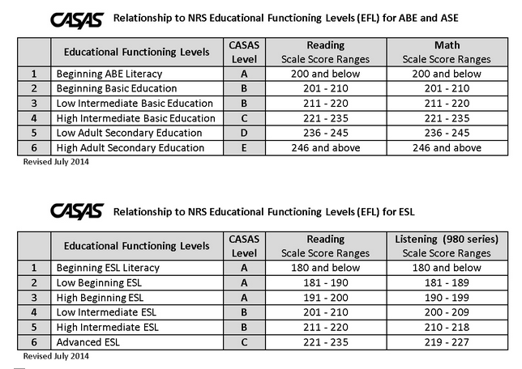
WIOA Title II NRS/CASAS Levels
Notes:
Agency testing information is reported to the federal government – Office of Vocational, Adult, and Training Education (OCTAE) This is the agency that grants the WIOA funding to each state. In return, we report our testing results to them. In order to get an unduplicated count of students, each student is reported by their pre-test level, according the charts above.
These reported levels have little to do with how agencies place student in classes. This count is based on one test and one skill (either reading, listening or math.)

Slide 72
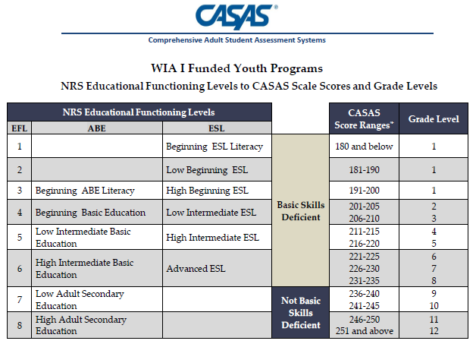
Preparing for WIOA
Notes:
Explain that as we work within WIOA parameters, it’s important that we know the definition of “Basic Skills Deficient.”

Slide 73
Instruction
TOPSPRO Enterprise

Slide 74

Targeting Instruction Using TE Reports
Reports on test results give instructors valuable information to help their students.
Reports show students’ strengths and weaknesses, and more specifically, which
  Competencies
  Content standards and
  Task areas
instructors should target instruction.
Notes:
Ask, “How soon do teachers receive testing reports at your agency?
Discuss. If teachers don’t get reports, why? Is it because teachers don’t ask for them? Do they know about reports?
Ideally, reports should be sent to teachers by a week or two after testing. The next slides will go over a few key reports.

Slide 75
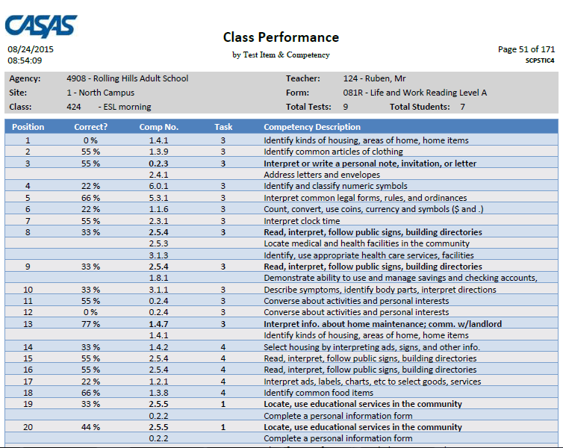
TOPSpro Report: Class Performance by Competency
The Task Number tells you the format in which the question was asked.
Test Question Number
The Competency Description gives more detail of the Competency Number
Percentage of students who answered this question correctly
The Competency Number on which this question was based
Notes:
So, let’s look at some more things on this report.
What date was this report printed?
What test dates are included in this report?
Which class is this report for?
What test form is covered in this report? (If students in your class took different test forms, there will be a page printed for each form.)
How many tests are represented in this report? (23)
How many students took Form 83R? (24)
Why don’t these numbers match? (One student has been in class long enough to take an 83 R, 84R, and an 83 R again.)

Slide 76
TOPSpro Reports: Class Performance by Test Item and Competency
Reports can be printed in a variety of ways. Here it’s printed by items correct.

Slide 77
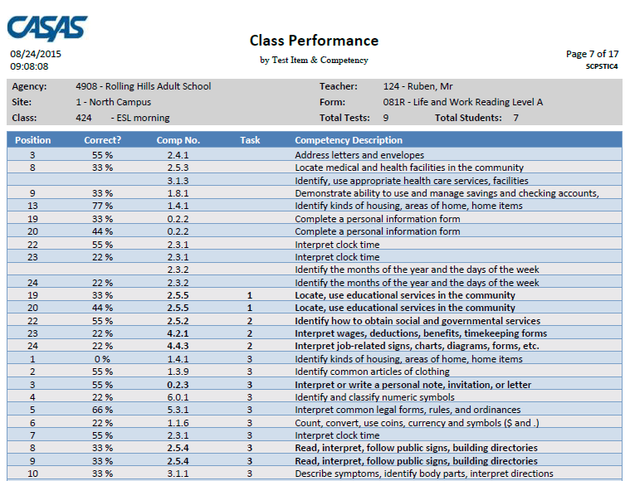
TOPSpro Report: Class Performance by Competency
Competency Task Number Legend
Task 1 – Forms
Task 2 – Charts, maps, consumer billings, matrices, graphs, tables
Task 3 – Articles, paragraphs, sentences, directions, manuals
Task 4– Signs, price tags, advertisements, product labels
Task 5 – Measurement scales, diagrams
Task 6 – Oral Cue
Here it’s printed by Task.
Notes:
This is the same report as the previous page, but in TE Report Setup, the report has been sorted by Task Area
Discuss how sorting by Task can be helpful in targeting instruction. Did the class have a lot of difficulty with Task 2? Then integrate more activities using Charts, Maps, etc., into your everyday instruction.

Slide 78
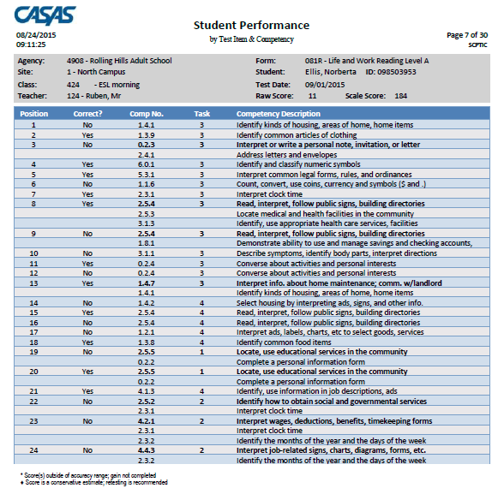
TOPSpro Report: Student Performance by Competency
The same report, but now it’s printed not by class, but by individual student.
Notes:
Ask,
Who is the student?
What test did she take?
Raw Score?
Scale Score?

Slide 79
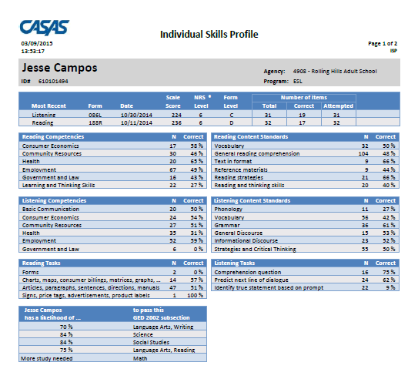
TOPSpro Report: Individual Skills Profile
This is a good report for teachers and students, especially ASE students.
Notes:
This report now shows just the most recent tests taken, not all tests taken.
N = number of times the item is presented in the tests the student took.

Slide 80
Post-testing

Slide 81
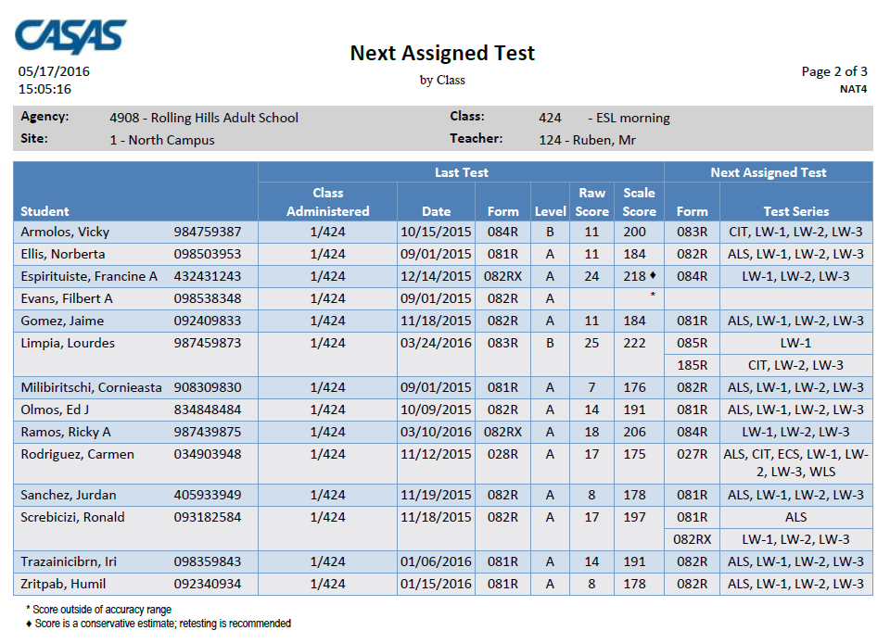
Next Assigned Test Report
Notes:
Review the report with participants. – what does each column show?

Slide 82
Test Preparation Guidelines
Appropriate
Inappropriate
Use diagnostic information from test results to “teach to”:
    Task Areas
    CASAS Competencies
    Content Standards
Quick Search
CASAS Practice Tests
Teaching to a particular test item
Teaching specific vocabulary in a test item
Limiting curriculum to what the test covers
Notes:
82

Slide 83
Determining Schedule for Post-Testing
We suggest post-testing more than once a year.
  Base your testing calendar on your school schedule:
    managed enrollment schedule
    at the end of the quarter or semester or term
  CASAS recommends 70 – 100 hours of instruction be provided between pre- and post-testing.
    A minimum of 40 hours of instruction between pre- and post-testing is allowed.
      That does NOT mean that you test at the 40-hour mark
  Your Local Assessment Policy must clearly state the instructional hours between pre- and post-tests and how often tests will be given
Notes:
25+ years of research show that students show an average gain of 5 points after every 100 hours of instruction.

Slide 84
Activity - Giving the Post-test
What are your next steps??
  What are you going to do first?
  What information do you need?
  What materials do you need?
Notes:
Leave this as an open question to participants. Ask questions as a review.
What are they going to do first?
What information do they need?
What materials do they need?
Some answers on the next slide…
Participants have a copy of the Next Assigned Test (everyone has a copy )
What test are you going to give…?
What are you going to do first?
eTesters?
Paper-based?

Slide 85
What do you need for Post-testing?
Computer-delivered tests
Paper-based
Send students to the eTest lab.
Use your Next Assigned Test (NAT) report.
Gather test booklets for class.
Hand out answer sheets.
Go over directions.
Go over practice questions.
Administer the test as you did the pre-test.
Notes:
Participants have a copy of the Next Assigned Test (everyone has a copy )
What test are you going to give…?
What are you going to do first?
eTesters?
Paper-based?
What if students…
ask to use a calculator?
Say they don’t understand a question?
Can you help them with it?
Is it ok to read it to them?
They say the test is too hard?
Give them a different one?
Forgot their glasses and can’t read the test?

Slide 86
Case Study

Slide 87
Next Steps
Implementing at Your Agency

Slide 88
Now what?
Assign Testers
  make sure they’ve completed IT and if using computer-delivered tests, Coordinator and Proctor training, also.
Calendar testing for the year
  make sure everyone at your agency knows
Have everyone who helps with testing sign the testing agreement (at the back of your TAMS)

Slide 89
Congratulations!
You are now a certified Test Administrator!
You have –
  Administered the Oral Screening and Writing Screening to students who you determined needed it
  Administered a Reading Appraisal
  Used the raw score to determine the scale score
  Used the scale score to determine the Pre-Test
  Administered the Pre-Test
  Read Instructional Reports to analyze skills and target instruction
  Prepared students appropriately for Post-testing
  Administered Post-tests

Slide 90
Want to Learn More?
Sign up for online training at
Home > Training and Support Register for Trainings and Meetings
Online Resources for Teachers
The Teacher’s Handbook
CASAS From the Inside Out
Assessment to Instruction
Using CASAS Resources to Improve Instruction
Starting September 2017
Notes:
Remind participants that the trainings may have a CA bent, as we have a contract with the state, but others are more than welcome to attend.

Slide 91

Thank you!
CASAS Certified Trainers
are incredibly important to us!
Let us know if you have any questions or need more information about the training

