Slide 1
Implementation Training
<Presenter Name>
<Presenter Agency/Organization>
<Presenter Contact Information>
Notes:
PRESENTER/TRAINER NOTES:
Have participants sign in for training.

Slide 2
Welcome!
Are you new to CASAS?
Have you completed Implementation Training?
This training is for:
Participants new to CASAS who have not completed Implementation Training.
Participants who have completed Implementation Training and want a “refresher.”
Notes:
PRESENTER/TRAINER NOTES:
Welcome participants and introduce yourself.
Explain that this training is designed for participants who are new to CASAS and who have not completed an initial Implementation Training (IT).
However, there may be participants who want a refresher and are welcome to attend this training.
Participants who have completed an IT and are not interested in a refresher may attend the Beyond Implementation Training (BIT) session.

Slide 3
Training Content
This training covers how to:
Select the appropriate test
Identify when to give the test
Administer the test
Score the test
Interpret test scores
Use test scores for program improvement
Locate resources to support all of the above
Notes:
PRESENTER/TRAINER NOTES:
Review bullets.

Slide 4
Participant Materials
Training presentation
Activity packet
CASAS Competencies
CASAS Skill Level Descriptors
Training completion directions
Notes:
PRESENTER/TRAINER NOTES:
Review training packet materials.
All participants complete their training by submitting verification electronically.
Verification information is added to the CASAS contact database to:
authorize the ordering of CASAS assessments.
authorize the administering of CASAS assessments.
document participation – verified by sign-in sheet from trainer.
Directions for completing training verification are included in packets (or distributed at the end of training).
NOTE TO TRAINER: Submit Sign-In Sheet within one week of completed training in one of three ways:
E-mail attachment to ttellez@casas.org (preferred)
FAX to: 858-292-2910
Mail to:
CASAS
Attn: T. Tellez
5151 Murphy Canyon Rd., Suite 220,
San Diego, CA 92123-4339

Slide 5
Training Objectives
At the end of this training, you will be able to:
Select appropriate CASAS tests
Administer and score CASAS tests
Interpret and use test results
Identify CASAS Competencies in relation to test items
Identify CASAS Content Standards in relation to test items
Link curriculum, instruction, and assessment
Identify resources for instruction
Notes:
PRESENTER/TRAINER NOTES:
Review bullets.

Slide 6
Think about your agency…
⬧ Who are your students?
⬧ What services do you provide for them?
⬧ Why and how do you assess your students?
⬧ What are some benefits of assessment?
⬧ How do you use assessment results?
Notes:
PRESENTER/TRAINER NOTES:
“Take some time to think about your agency as you view the questions presented on this and other slides.”
Take a few minutes to elicit responses from participants, especially on the fourth and fifth bullets.
Sometimes participants come into a training with negative, preconceived notions about assessment as an unnecessary irritant.
Discussing its benefits may help to dispel the negativity.
“How does the assessment process enhance your program?”

Slide 7
About CASAS
CASAS is a nonprofit organization dedicated to improving youth and adult education services.
CASAS is an integrated systems approach with four key components.
Download About CASAS
Curriculum
Assessment
Instruction
Accountability
Notes:
PRESENTER/TRAINER NOTES:
Began in 1980 as a partnership of the California Department of Education and a consortium of local adult education agencies.
Has expanded to a nationwide, field-based consortium since 1985.
Assessments used in 30+ states, Brazil, El Salvador, Singapore, and the Pacific Rim.
Provides research, program evaluation, and data services.
The CASAS key components are assessment, instruction, curriculum, and accountability.
Key components will be covered in more detail throughout the training.
Visit linked resource if time permits and Internet connection is available.

Slide 8
Assessment Process Overview
1. Place
2. Diagnose
3. Instruct
4. Monitor
Place students into a program, class, or level.
Oral Interview
Screening
Appraisal
Pretest students at the beginning of the an instructional term.
Use pretest results to identify appropriate instructional materials.
Post-test students to measure learning gains and progress.
Notes:
PRESENTER/TRAINER NOTES:
Briefly review information on this slide.
Ask participants to think about their own agencies and what kind of process they have in place for each step.
Placement –
Does the process involve an oral interview and appraisal test?
What else?
Diagnose –
Administer a pretest at the beginning of the instructional term – ideally within the first week
Instruct –
Use test results to help inform instruction
Monitor –
Administer the appropriate post-test to monitor progress and measure learning gains

Slide 9
Activity 1: Appraisal and Scoring
Take −
Form 80 Reading Appraisal
Score −
Form 80 Reading Appraisal
Notes:
PRESENTER/TRAINER NOTES:
Ask participants if they have seen or used the Form 80 Reading Appraisal.
The appraisal is an initial assessment
Explain the purpose of the appraisal: helps place students in level, class, and program.
Distribute test copies and self-scoring answer sheets.
IMPORTANT!
Collect test booklets after participants complete Activity 1.
Collect answer sheets after Presentation Slide 17.
Explain to participants:
Use the answer sheet provided.
Mark every other answer (all even or all odd).
Participants will have ten minutes to get as far as they can.
After ten minutes, go through the scoring process.
Score the Appraisal
Tear off strips along the top, bottom, and right sides of the answer sheet.
Open the answer sheet to the second page.
Count the correct answers. This is the raw score.
Find the box in the lower-right corner of the answer sheet.
Write the raw score in the appropriate box.
Find the corresponding scale score and write it in the appropriate box.

Slide 10
Raw Score and Scale Score
The raw score is the number of correct items.
Raw scores are always converted to scale scores.
A scale score helps to determine a student’s level and abilities.
Convert the raw score to a scale score using the score conversion chart.
does this automatically.
In this example, the raw score is 15.
⬧ What is the corresponding scale score?
Notes:
PRESENTER/TRAINER NOTES:
Review bullets.
Explain that each test form has a corresponding Score Conversion Chart.

Slide 11
Score Conversion Charts
Form 80 Appraisal
Listening Reading
Form 130 Appraisal
Reading Math
Notes:
PRESENTER/TRAINER NOTES:
This slide shows raw to scale score conversion charts for two commonly used CASAS appraisals.
Have participants look at the Life and Work Form 80 Appraisal for listening.
If a student’s raw score is 9, what is the corresponding scale score? (200)
Look at the ECS Form 130 Appraisal for math.
If the raw score is 19, what is the corresponding scale score? (238)
Each CASAS test has a raw to scale score conversion chart.
These charts are included in test administration manuals.
It’s important that participants know there are different charts for each different test form.
Note scores at the low end marked with an asterisk (*) are outside the accurate range.
Retesting at a lower level is required.
Scores at the high end of the range marked with a diamond (♦) are conservative estimates.
Conservative estimate scores may be used with caution. However, retesting at a higher level is recommended.

Slide 12
Nationally recognized system for computer delivery of standardized and adaptive assessments Advantages of Using
Access anywhere with Internet connection
Provides synchronized “real-time” data for accurate results
Reports available immediately after test administration
Streamline assessment and placement
Replace Appraisal with short computer-adaptive locator
Administer locator + pretest in one sitting
Automatically assigns next test
Notes:
PRESENTER/TRAINER NOTES:
Agencies have the option of using web-based tests in combination with paper-based tests.
We highly encourage agencies to use CASAS eTests Online.
Nationally recognized system for computer delivery of standardized and adaptive assessments
Use anywhere with Internet connection and computer running Windows (can be used on Macs running Windows)
No need for test booklets, CDs/cassettes, answer sheets or #2 pencils
Includes practice test items
Discourages cheating with no A, B, C, D indicators
Retractable toolbar identifies examinee, test form, remaining items and remaining time, and scale buttons to increase screen display.
Locator seamlessly moves examinee into an appropriate-level pretest
Provides summary results immediately after each test
Automatically assigns the next test
May be given individually or to a group
Accommodation features include:
screen-reader compatible
scalable displays, stems, options
Generate Student Competency Performance reports on-site!

Slide 13
Benefits of Using
Includes most widely used CASAS test series
Test administrations apply to any test form
Typical administration scenario −
Administer locator plus pretest in one sitting
Test(s) scored and recorded automatically
Printable summary of results displayed on screen
Automatic selection of next appropriate test
PPT Sampler
www.casas.org > Product Overviews > Curriculum Management & Instruction > Sample Test Items > CASAS eTests Online Sampler
For more information call CASAS @ 1-800-255-1036
Or contact a CASAS Technology Support Team member at techsupport@casas.org
Notes:
PRESENTER/TRAINER NOTES:
Review bullets.
Encourage participants to contact techsupport@casas.org for additional information about how to get started with CASAS eTests Online.
Visit linked resource if time permits and Internet connection is available.

Slide 14
Interpreting Test Scores
Look at the Skill Level Descriptors in your packet.
Use the descriptors to help interpret the scale score.
Skill Level Descriptors give context to the scale scores.
Skill Level Descriptors describe what a person can do or learn within a range of scale scores.
For a complete set of Skill Level Descriptors, go to:
www.casas.org > Product Overviews > Curriculum Management &
Instruction > CASAS Scale, Skill Levels, and Descriptors
Notes:
PRESENTER/TRAINER NOTES:
Use Skill Level Descriptors (SLD) to interpret scale scores.
Have participants look at Skill Level Descriptors for ABE and for ESL (included in training packets).
Explain that SLDs help interpret scale scores and provide context for what scale scores mean.
Descriptors for ABE contain information about reading, math, writing, and employability.
Descriptors for ESL contain information about listening and speaking, reading and writing, and employability.
Explain there are also SLDs for Intellectual Disabilities, Speaking, and Writing.
Visit linked resource if time permits and Internet connection is available.

Slide 15
Interpreting Test Scores
Look at the Skill Level Descriptors for
Adult Basic Education (ABE)
⬧ What types of jobs require a reading scale score of 215?
⬧ Give examples of entry-level jobs someone could manage with
reading skills at the Beginning Basic Skills level.
B
Intermediate Basic Skills
Can handle basic reading, writing, and computational tasks related to life roles. Can read and interpret simplified and some authentic materials on familiar subjects. Can interpret simple charts, graphs, and labels; interpret a basic payroll stub, follow basic written instructions and diagrams. Can complete a simple order form and do calculations; fill out basic medical information forms and basic job applications; follow basic oral and written instructions and diagrams. Can handle jobs and/or job training that involve following basic oral and written instructions and diagrams if they can be clarified orally.
Beginning Basic Skills
Can fill out simple forms requiring basic personal information, write a simple list or telephone message, calculate a single simple operation when numbers are given, and make simple change. Can read and interpret simple sentences on familiar topics. Can read and interpret simple directions, signs, maps, and simple menus. Can handle entry-level jobs that involve some simple written communication.
Excerpt from ABE Skill Level Descriptors
Notes:
PRESENTER/TRAINER NOTES:
This slide displays an excerpt from Skill Level Descriptors for ABE.
Ask questions.
Elicit responses.

Slide 16
Interpreting Test Scores
Look at the Skill Level Descriptors for
English as a Second Language (ESL/ELL)
⬧ Give examples of jobs appropriate for someone with reading and
listening skills at scale scores of 205.
⬧ What types of jobs could someone manage with skills at the High
Intermediate ESL level?
B
High Intermediate ESL
Listening/Speaking: Can satisfy basic survival needs and limited social demands; can follow oral directions in familiar contexts. Has limited ability to understand on the telephone. Understands learned phrases easily and new phrases containing familiar vocabulary. Reading/Writing: Can read and interpret simplified and some authentic materials on familiar subjects. Can write messages or notes related to basic needs. Can fill out basic medical forms and job applications. Employability: Can handle jobs and/or training that involve following basic oral and written instructions and diagrams if they can be clarified orally. (SPL 5)
Low Intermediate ESL
Listening/Speaking: Can satisfy basic survival needs and very routine social demands. Understands simple learned phrases easily and some new simple phrases containing familiar vocabulary, spoken slowly and with frequent repetition. Reading/Writing: Can read and interpret simple material on familiar topics. Able to read and interpret simple directions, schedules, signs, maps, and menus. Can fill out forms requiring basic personal information and write short, simple notes and messages based on familiar situations. Employability: Can handle entry-level jobs that involve some simple oral and written communication but in which tasks can also be demonstrated and/or clarified orally.
Excerpt from ESL Skill Level Descriptors
Notes:
PRESENTER/TRAINER NOTES:
This slide displays an excerpt from Skill Level Descriptors for ESL/ELL.
Ask questions.
Elicit responses.

Slide 17
Interpreting Test Scores
Using results from Activity 1 −
Look at the Skill Level Descriptors for ABE
⬧ What is your reading scale score?
⬧ What level does your score correspond to?
⬧ What type of job might you qualify for at your level?
Notes:
PRESENTER/TRAINER NOTES:
Ask questions.
Elicit responses.
IMPORTANT! It’s time to collect answer sheets.

Slide 18
What’s Next?
You have −
Administered a CASAS Appraisal
Scored the Appraisal
Converted the raw score to a scale score
Used the Skill Level Descriptors to identify skills
You are ready to −
Place students into appropriate level or program
Determine appropriate pretest level and form
combines Appraisal and pretest into one event to
quickly place students.
Notes:
PRESENTER/TRAINER NOTES:
Review what participants have accomplished so far.
Ask if anyone has questions.

Slide 19
Scale Score Ranges for Appraisals/Locators
Test items are widely distributed along the CASAS scale to determine general abilities.
Test items range from easy to difficult items.
Appraisals, 20 – 25 fixed items, 20 – 30 minutes
Locators, 7 – 9 items randomly-selected, 15 minutes
Notes:
PRESENTER/TRAINER NOTES:
The appraisal is an important part of the intake process.
Appraisal results help make decisions about level and program placement, and help identify the appropriate pretest.
The locator is a short, computer-adaptive test designed to automatically place the examinee into the appropriate-level pretest. Locators are available only in CASAS eTests and do not stand alone. Students take the locator and pretest in one sitting.
Placement is based on the lower pretest score when administering more than one modality – reading, math, listening.
Ask if anyone has questions.

Slide 20
Scale Score Ranges for Pre/Post-Tests
The scale (above) shows the approximate range of items on a B-level test.
Pre- and post-tests, 24 - 40 fixed items clustered at a specific level, 60 minutes
Measure progress and learning gains by comparing pre- and post-test scores.
Notes:
PRESENTER/TRAINER NOTES:
Use pretests to identify student needs.
Use post-tests to measure student gains and monitor progress.
Ask if anyone has questions.

Slide 21
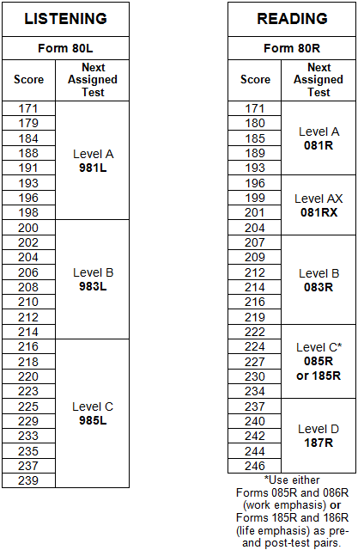
Next Assigned Test
Next Assigned Test charts identify the appropriate next test.
Each form has its own chart.
Form 80 Appraisal
Listening and Reading
Automatically assigns the next test.
www.casas.org > Training and Support > Testing Guidelines > Next Assigned Test Charts
Notes:
PRESENTER/TRAINER NOTES:
Introduce Next-Assigned Test (NAT) charts.
NOTE! This is a significant change to what is formerly known as Suggested Next Test (SNT) charts. NATs apply to both paper-based and computer/web-based testing. CASAS is currently revising SNT charts to reflect the format of NAT charts.
“Once you have an appraisal score, how do you know which test to administer?”
“NAT charts help you select the appropriate next test.”
“What is the next listening test for the student who scores 204 on Form 80 Listening? “ (983L)
“What is the next reading test for the student who scores 222 on Form 80 Reading?” (085R or 185R)
Review parts of the chart.
Point out that there is a separate chart for each appraisal and each reading, math, and listening test form.
Test administration manuals contain NAT charts and they are also available on the CASAS website.
Consider performance on classroom activities or informal assessments, educational background, life experiences, use of English outside classroom, etc. to decide which level to administer.
Ask if anyone has questions.

Slide 22
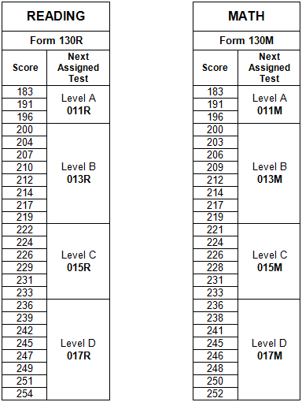
Next Assigned Test
Form 130 Appraisal
Employability Competency System (ECS)
Reading and math
Automatically assigns the next test.
www.casas.org > Training and Support > Testing Guidelines > Next Assigned Test Charts
Notes:
PRESENTER/TRAINER NOTES:
This slide shows Next-Assigned Test (NAT) charts for the Form 130 ECS Appraisal for Reading and Math.
“What is the next reading test for a student who scores 222 on Form 130 Reading?” (015R)
"What is the next math test for the student who scores 210 on Form 130 Math?” (013M)
Ask if anyone has questions.

Slide 23
Activity 2: Test Forms by Series − Reading
Level | Life and Work | Employability Competency System (ECS) | Workforce Learning Systems (WLS)
Beginning Literacy | 27R, 28R | 27R, 28R | 27R, 28R
A | 81R, 82R | 11R, 12R | 11R, 12R
AX | 81RX, 82RX | -- | --
B | 83R, 84R | 13R, 14R, 114R | 213R, 214R
C | 85R*, 86R* 185R, 186R | 15R, 16R, 116R | 215R, 216R
D | 187R, 188R | 17R, 18R | 17R, 18R
 | *Content has work emphasis
Notes:
PRESENTER/TRAINER NOTES:
This slide shows three major CASAS reading test series.
Briefly explain that Life and Work Reading Level C has four forms. The difference is in content:
Forms 185R and 186R have a balance between life and work-oriented items;
Forms 85R and 86R are primarily work-oriented.
“What is one next reading test form for the student who scored 222 on Form 130 Reading?”
85R and 86R, or
185R and 186R, or
15R, 16R, and 116R, or
215R and 216R
Ask if anyone has questions.

Slide 24
Assessment Process
Administer a pretest within the first week of class or program.
Pretests measure what students know when they enter a class or program.
Results help identify a student’s learning needs and help guide instruction.
Notes:
PRESENTER/TRAINER NOTES:
Review bullets.

Slide 25
Assessment Process
⬧ Think about your agency…
Who administers the pretests?
Where do students take the pretests?
What is the plan for make-up testing?
Who decides which pretest a student takes?
Who receives assessment results?
Are assessment results available in a timely manner?
Is the pretesting process effective?
can help improve the pretesting process.
Notes:
PRESENTER/TRAINER NOTES:
Ask participants to think about questions on the slide.
If time permits, solicit responses to the last bullet:
Is the pretesting process effective (at their agency)?

Slide 26
Standardized Test Administration
Components of standardized testing procedures
Planning for Testing
Getting Started
Giving the Test
Timing Guidelines
After the Test
Test Security Policy
Notes:
PRESENTER/TRAINER NOTES:
“Before we go on to post-tests and curriculum resources, let’s review standardized test administration procedures.”
“What is a standardized test?”
By definition, a standardized test is a test designed to be given under specified, standard conditions.
Standardization attempts to control external factors so that the assessment is a valid measurement tool that produces meaningful results.
All CASAS appraisals and progress tests are standardized tests.
Standardized tests:
Have specific administration procedures
Require training to score, administer, and interpret results
Are used for accountability purposes
Are based on years of research
Are not practice or unit tests

Slide 27
Assessment Process
Planning for Testing
 Dictionaries, calculators, and other mobile devices are not allowed during testing.
⬆Accommodations: Refer to Guidelines for Providing Accommodations for CASAS
Assessment for Learners with Disabilities
www.casas.org > Training and Support > Testing Guidelines > Accommodations Guidelines
Needed for Testing Day
Paper-based Tests
Test Administration Manual Test booklets (numbered for tracking and security) Answer sheets, #2 pencils, scratch paper for math tests A CD player for listening tests Overhead of answer sheet | Coordinator/Proctor Certification Computers Unique ID for each examinee, scratch paper for math tests Headsets for listening tests Practice tests
Notes:
PRESENTER/TRAINER NOTES:
This table shows what’s needed for testing day.
Number paper test booklets for tracking and security.
Most paper-based tests are available in CASAS eTests (online or desktop).
CASAS eTests Online is accessible anywhere with Internet connection and registered testing station with proctor presence.
Visit linked resource if time permits and Internet connection is available.

Slide 28
Assessment Process
Getting Started
For all testing options:
Provide a quiet testing environment
Space students apart
Maximum of 25 students per proctor
Explain purpose for testing
Ease student anxiety with practice
Assist in completing demographics
Demonstrate how to apply answers
For paper-based tests:
Pass out test booklets, pencils, answer sheets, and scratch paper for math tests only
For
Start testing session, start-up testing stations
Notes:
PRESENTER/TRAINER NOTES:
Review bullets.
This information may seem obvious but we have found that there are participants who are not familiar with standardized testing procedures.
Ask if anyone has questions.

Slide 29
Assessment Process
Giving the Test
For all testing options:
Review practice items
Encourage students to review answers
Write start and end times on the board
Begin the test
Monitor students
For paper-based tests:
Pass out test booklets, answer sheets, pencils, and scratch paper for math tests only
For
Start testing session, start-up testing stations
Notes:
PRESENTER/TRAINER NOTES:
Review bullets.
Ask if anyone has questions.

Slide 30
Assessment Process
Timing Guidelines
Appraisals/Locators:
Appraisals, 20 – 25 fixed items, 20 – 30 minutes
Locators, 7 – 9 randomly-selected items, 15 minutes
Pre- and post-tests for math and reading
Allow up to one hour.
Allow the same amount of time for pre- and for post-tests.
Students may have a few extra minutes to complete the question they are working on.
Appraisal, pre- and post-tests for listening
Timing is determined by the test CD or by
Do not stop the CD until instructed at the end of each section.
automatically advances.
Notes:
PRESENTER/TRAINER NOTES:
Review bullets.
Important: Timing of listening tests is predetermined –
For paper-based tests - always use the prerecorded CD.
For web-based tests – timing is built-in and includes auto-advance for test items (not on practice items).
Ask if anyone has questions.

Slide 31
Assessment Process
After the Test
Paper-based tests:
Collect test booklets, answer sheets, pencils, and scratch paper
Count test booklets, answer sheets, and pencils
Dismiss students
♦ ♦ ♦
Check test booklets for stray marks
If stray marks cannot be completely erased, destroy the booklet
Destroy scratch paper
Sharpen pencils for next testing
Score tests and convert raw score to scale score
Use Skill Level Descriptors to interpret results
Use the Next Assigned Test charts to identify the next appropriate test
Notes:
PRESENTER/TRAINER NOTES:
Review bullets.
Ask if anyone has questions.

Slide 32
Assessment Process
After the Test
:
Collect scratch paper (math tests only)
Logout students from testing station
Dismiss students with test results summary report (optional)
♦ ♦ ♦
Stop testing session (if no further testing needed)
Destroy scratch paper
Tests automatically scored and recorded in database
Use Skill Level Descriptors to interpret results
Next test is automatically assigned
Notes:
PRESENTER/TRAINER NOTES:
Review bullets.
Ask if anyone has questions.

Slide 33
Test Security Policy
CASAS publishes the test security policy to maintain the integrity of its assessments and to ensure implementation of and adherence to test security practices.
Security of Testing Materials
Test Administration
Confidentiality of Tests and Test Items
Copyright Infringement
Notes:
PRESENTER/TRAINER NOTES:
Test Security Policy Agreement
Agency directors, principals, and other primary administrators need to maintain a specific test security policy that addresses proper handling and use of test materials.
All testing personnel must sign a Test Security Policy Agreement agreeing to uphold the security policies of the agency, school, or testing entity.
Should CASAS determine that any agency, school, or other testing entity has violated any provision of this test security policy or that testing materials have been compromised in any manner, purposely or otherwise, CASAS reserves the right to take appropriate action to rectify the violation of its test security policy.
Ask if anyone has questions.

Slide 34
Test Security Policy
Guidelines Overview
Test materials must be kept in a secure location.
CASAS tests may not be copied, scanned, or duplicated.
Displays, questions, or answers from any CASAS test may not be used to create materials to help students answer CASAS test items.
Proctors must remain in the testing room at all times during testing.
Any assistive material such as electronic devices or dictionaries are strictly prohibited during testing.
Only students taking math tests are allowed to have scratch paper during testing. Scratch paper must be collected at the end of testing and destroyed.
Refer to CASAS Test Security Policy for complete details
www.casas.org > About CASAS > Privacy, Copyright, and Security Policy
Notes:
PRESENTER/TRAINER NOTES:
Download a copy of the Test Security Policy form, print, fill in the information, and save for your records.
All CASAS online self-paced training modules include electronic submission of the Test Security Policy Agreement.
The In-Person Training Completion Portal also includes electronic submission of the Test Security Policy Agreement.
Visit linked resource if time permits and Internet connection is available.

Slide 35
Resources to Support Instruction
Maximize your curriculum design and instruction
Pre-and Post-Testing Guidelines
Sample Test Items
CASAS Competencies
CASAS Content Standards
Task Areas
Test Results, Data, and Reports
Free Online CASAS Resources
Notes:
PRESENTER/TRAINER NOTES:
Explain that CASAS does not have a fixed curriculum but provides a number of resources to support curriculum design.

Slide 36
Resources to Support Instruction
Pre- and Post-Testing Guidelines
Typically programs provide approximately 70-100 hours of instruction before post-testing.
high intensity courses (i.e. a class meets more than 15 hours/week) may post-test at the end of a semester or other block of instruction, even if the instructional time is more than 100 hours
low intensity courses with fewer than 70 hours in a semester or other block of instruction, may choose to post-test at the end of the instructional period.
Programs may assess learners who leave the program before the scheduled post‐test time.
Post-testing should not occur before 40 hours of instruction.
Refer to your local or state assessment policy for guidelines on the required number of hours of instruction before post-testing.
Refer to www.casas.org > Training and Support > Testing Guidelines > Pre- & Post Testing
Notes:
PRESENTER/TRAINER NOTES:
Review bullets.
Visit linked resource if time permits and Internet connection is available.

Slide 37
Sample Test Items
Familiarize students and instructors with test item format and delivery
Help students practice test-taking skills
Not a predictor of performance
Available in printable booklets, presentations, and in
Download Sample Test Items at www.casas.org > Product Overviews > Curriculum Management & Instruction > Sample Test Items
Notes:
PRESENTER/TRAINER NOTES:
Review bullets.
Ask if anyone is currently using sample test items, what are they using and how are they using them.
Visit linked resource if time permits and Internet connection is available.

Slide 38
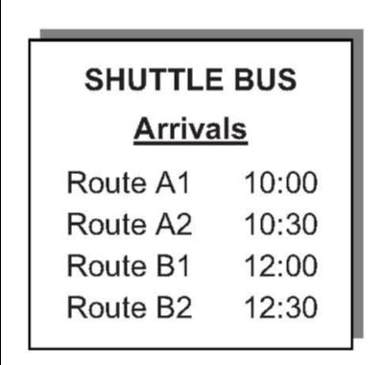
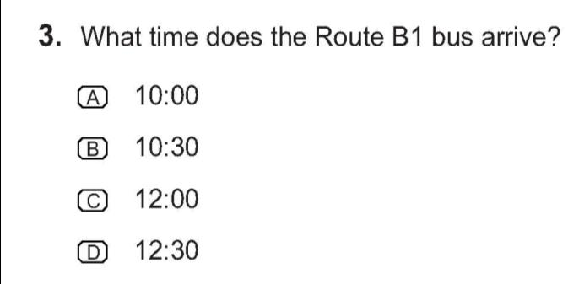
Resources to Support Instruction
CASAS Competencies
Skills for life and work.
Every test item is correlated to at least one CASAS Competency.
A competency is a measurable learning objective in a functional life skills context.
Notes:
PRESENTER/TRAINER NOTES:
This slides shows an example of the integration of Curriculum, Assessment and Instruction.
Curriculum might include a lesson on reading maps and schedules, and interpreting clock time.
This item would assess a student’s knowledge of what the teacher had taught.
Have participants take out the Competency list from their training packet and find the following two competencies:
Competency 2.2.2 - Recognize and use signs related to public transportation
Competency 2.2.4 - Interpret transportation schedules, fares and payment procedures
Ask if anyone has questions.

Slide 39
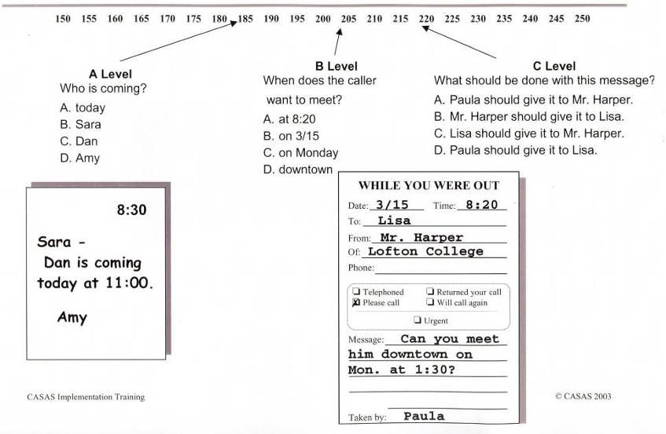
Resources to Support Instruction
Levels
Competency 2.1.7: Take or interpret telephone messages
Notes:
PRESENTER/TRAINER NOTES:
Explain that this slide shows how a competency may be assessed at different levels.
The test item display becomes more difficult and test questions/distractors become increasingly more difficult.
Ask if anyone has questions.

Slide 40
Resources to Support Instruction
CASAS Competencies
Examples:
Interpret medicine labels
Check sales receipts
Identify appropriate behavior, attire, attitudes and social interaction, and other factors that affect job retention and advancement
Interpret information about traffic tickets
Competency Content Areas
0. Basic Communication
1. Consumer Economics
2. Community Resources
3. Health
4. Employment
5. Government and Law
6. Math
7. Learning and Thinking Skills
8. Independent Living
Download CASAS Competencies at www.casas.org > Product Overviews > Curriculum Management & Instruction > CASAS Competencies
Notes:
PRESENTER/TRAINER NOTES:
Take time for participants to look through the Competencies.
CASAS Competencies are divided into nine content areas.
Here are two things to keep in mind:
The list is not a power list. The numbering system does not mean that 0 – Basic Communication – is easier than other content areas. It is just a method of organizing the competencies.
This is the master competency list – you would not be expected to teach every single competency.
Visit linked resource if time permits and Internet connection is available.

Slide 41
Activity 3: The Competency Coding System
Content Area
2. Community resources
Competency Area
2.2 Understand how to locate and use transportation
Competency Statements
2.2.2 Recognize and use signs related to transportation
2.2.4 Interpret transportation schedules and fares
Look at the competencies
⬧ What areas are relevant to the
populations you serve?
Notes:
PRESENTER/TRAINER NOTES:
Review the coding system.
Every competency is identified with a three-digit number.
The first digit refers to the content area.
This slide shows Content Area 2 – Community Resources.
The second digit corresponds to a Competency Area.
2.2 represents the competency area to “Understand how to locate and use different types of transportation and interpret travel related information.”
The three-digit competency statement, 2.2.2, describes a measurable action, Recognize and use signs related to transportation.
Competency statement 1.9.1 also addresses this content.
Every test item on CASAS assessments correlates to at least one specific competency.
Ask if anyone has questions.

Slide 42
Resources to Support Instruction
Test Series Competency Content Matrix: The Big Picture
Notes:
PRESENTER/TRAINER NOTES:
This is a Competency Content Matrix for the CASAS Life and Work Reading series.
Matrices may be found in TAMs and on the CASAS website.
Matrices show competencies addressed on each test form.
Numbers in parentheses show how many times the competency is assessed in a test level.
For example, ask participants to find Test Level C, Form 185.
Ask how many times Competency 2.5.5 is assessed.
Competencies without a number in parentheses are addressed only one time.
Most test items address more than one competency.
Ask if anyone has questions.

Slide 43
Resources to Support Instruction
CASAS Content Standards
Clear statements of skills that students need to have at specific levels
Identify the underlying basic skills associated with CASAS Competencies
Support instructional planning
Available in reading, listening, and math
Reading content standards have been aligned with the Common Core State Standards
Covered in more detail in the Beyond Implementation Training and in sessions at the Summer Institute
Download CASAS Content Standards at www.casas.org > Product Overviews >
Curriculum Management & Instruction > CASAS Basic Skills Content Standards
Notes:
PRESENTER/TRAINER NOTES:
Review bullets.
Explain that the next few slides cover an overview of CASAS Content Standards.
Content Standards are addressed in greater detail in other training sessions.
Visit linked resource if time permits and Internet connection is available.
Ask if anyone has questions.

Slide 44
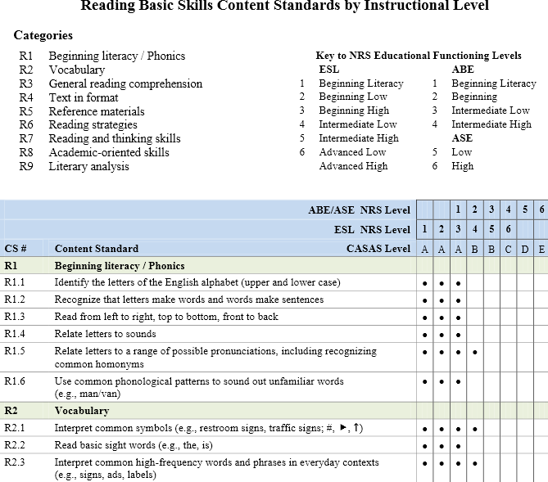
Resources to Support Instruction
Notes:
PRESENTER/TRAINER NOTES:
This slide shows an excerpt of Reading Basic Skills Content Standards by Instructional Level.
Point out the following:
Reading categories: R1-R9
Key to NRS Educational Functioning Levels for ESL and ABE/ASE
List of Content Standards and the NRS and CASAS levels, and ESL, ABE and ASE levels they are correlated to.
Ask if anyone has questions.

Slide 45
Resources to Support Instruction
Competency 3.41 Interpret product label directions and safety warnings
R4.8
Read a chart
R5.3
Locate info in groups or categories
R6.3
Scan complex text to find specific info
R3.4
Read and understand moderately complex text
R2.6
Interpret abbreviations in specialized contexts
Support Competencies
ABE Reading
CASAS Level B
Notes:
PRESENTER/TRAINER NOTES:
This slide shows how content standards support CASAS competencies.
Point out to participants that they have a copy of this in their Activity Packet.
This image can be used for a staff development activity.
Ask if anyone has questions.

Slide 46
Resources to Support Instruction
Task Areas
Test items are presented in a variety of task areas or display formats.
Task areas help to identify important skills that should be addressed during instruction.
Example: A student may comprehend the language on a test item but not understand the item display (bar chart, graph, pie chart, or other display formats).
Notes:
PRESENTER/TRAINER NOTES:
Review bullets.
Explain the importance of task areas.
Ask if anyone has questions.

Slide 47
Resources to Support Instruction
Task Areas and Item Types
Reading and Math Task Areas
Forms or fill-in-the-blank
Charts, maps, consumer billings, matrices, graphs, or tables
Stories, articles, paragraphs, sentences, directions, or pictures
Signs, price tags, ads, or product labels
Measurement scales and diagrams
Listening Item Types
Picture prompt
Comprehension question
Predict next line of dialogue
Identify true statement based on prompt
Notes:
PRESENTER/TRAINER NOTES:
This slide shows Task Areas for reading and Item Types for listening.
Task areas are included on fillable report templates in TAMs.
The task area is also clearly labeled on TOPSpro Enterprise reports.
Examples of reports are included later in this training.

Slide 48
Resources to Support Instruction
Task Areas and Test Items
⬧ What reading task area is addressed in this test item?
Notes:
PRESENTER/TRAINER NOTES:
Look at the item display in this sample test item.
Ask question.
Elicit responses.
Answer = Task Area 2.

Slide 49
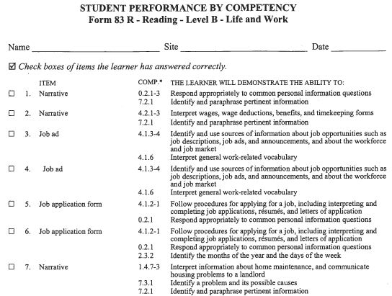
Resources to Support Instruction
Manual
Report
per form
per class
(Worksheets
available in Test
Administration
Manual - TAM)
Notes:
PRESENTER/TRAINER NOTES:
Explain the information presented on this report.
For programs that score answer sheets manually, these worksheets are available in the TAMs.
The format in this report is similar to reports generated through TOPSpro Enterprise.
The first column shows a check box.
The second column lists the item number.
This sample shows the first 7 items only on this particular test (Reading Form 083R).
The third column lists a brief item description.
The fourth column lists the specific competency or competencies assessed in a particular test item and shows the task area.
The fifth column provides a more detailed description of competency statements.
Ask if anyone has questions.

Slide 50
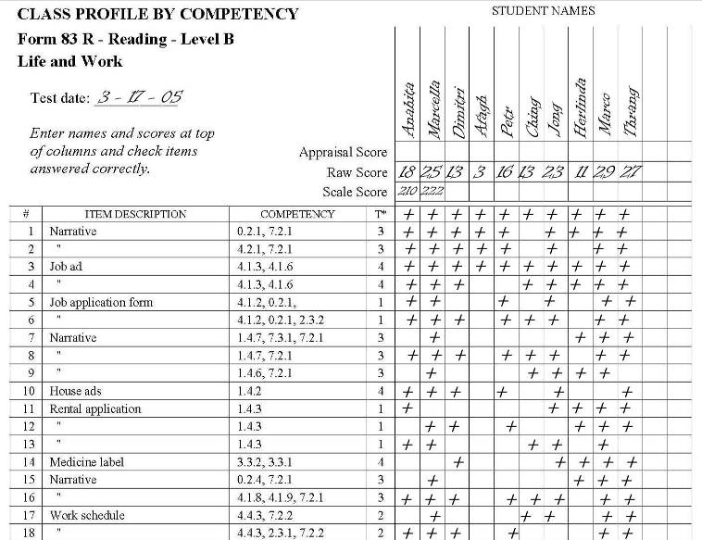
Resources to Support Instruction
Manual
Report
per form
per class
(Worksheets
available in Test
Administration
Manual - TAM)
Notes:
PRESENTER/TRAINER NOTES:
These worksheets are also in TAMs for programs that score answer sheets manually.
The format in this report also is similar to reports generated through TOPSpro Enterprise.
The first column lists the item number. This sample shows the first 18 items only.
The second column lists a brief item description.
The third column lists the specific competency or competencies assessed in a particular test item.
The fourth column shows the task area. We will look more closely at task areas in the next few slides.
The remaining columns list student names, raw and scale scores, and how they performed on each item.
Which student scored the lowest? (Afagh)
Do you think this test was an appropriate level for this student?
What test form would you recommend for this student’s next test?
Which student scored the highest? (Marco)
Do you think this test was an appropriate level for this student?
What test form would you recommend for this student’s next test?
Which item or items did the greatest number of students miss? (7 and 15)
Which competency statement/statements are these items correlated to?
1.4.7, 7.3.1, 7.2.1 and 0.2.4, 7.2.1)

Slide 51
Nationally recognized learner management and accountability software Advantages of Using
Advantage Teachers!
Automates test scoring.
Calculates student learning gains by class.
Produces customized class reports to help plan instruction.
Advantage Administrators!
Provides reports to meet accountability standards and measure program effectiveness.
Tracks students enrolled in multiple programs.
Advantage Decision Makers!
Generates NRS reports according to WIA II federal guidelines.
Rolls up data from local to regional to state level.
Provides aggregated statewide data.
Notes:
PRESENTER/TRAINER NOTES:
Review bullets.
Emphasize that even if an agency administers paper-based tests, they can benefit from using TOPSpro Enterprise to process results for automated scoring, recording, and reporting test information.

Slide 52
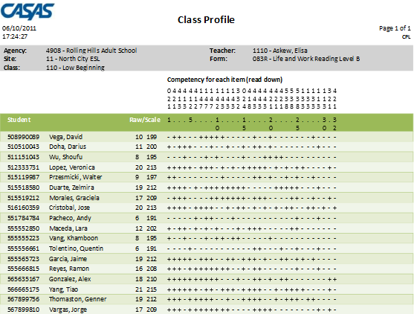
Resources to Support Instruction
Sample report displays the competency number per test item and student item responses.
per form
per class
Notes:
PRESENTER/TRAINER NOTES:
This is the electronic version of worksheets provided in TAMS.
Notice similarities between the two.
Sample report available on the CASAS website at: www.casas.org > Product Overviews > Software > TOPSpro Enterprise > Sample Reports

Slide 53
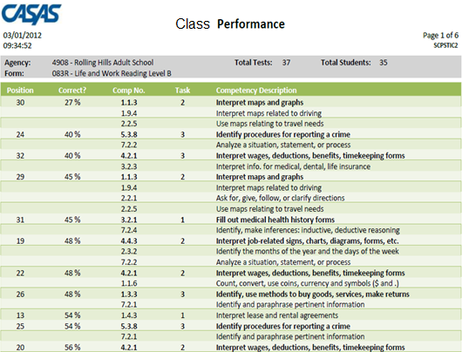
Resources to Support Instruction
Sample report displays the competency number per test item and student item responses sorted by percentage correct.
per form
per class
Class
Bold Competency Descriptions give details about the Competency Number
Test Question Number
Percentage of students who answered this question correctly
Non-bold Competency Descriptions and Numbers give additional details about the test item.
The Competency Number on which this question is based
Task Area
Notes:
PRESENTER/TRAINER NOTES:
This slide shows a Class Performance report sorted by percentage correct.
This report is a popular alternative to the Class Profile report from the previous slide.
Teachers can readily identify areas of greatest need to develop lessons that address those needs and prepare students for post/progress-testing.
Sample report available on the CASAS website at: www.casas.org > Product Overviews > Software > TOPSpro Enterprise > Sample Reports
Ask if anyone has questions.

Slide 54
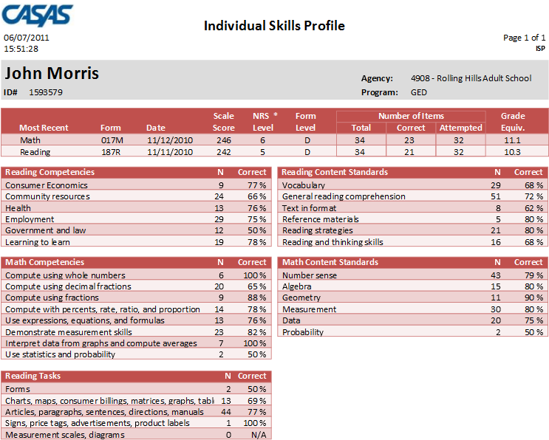
Resources to Support Instruction
Sample report displays competencies assessed in math and reading.
per student
Notes:
PRESENTER/TRAINER NOTES:
This slide shows an example of an Individual Skills Profile report.
This sample displays competencies assessed in reading and math and includes a predictor for the likelihood of passing different GED subsections.
CASAS is currently undertaking a study with HiSET and the new GED to update the predictor for either type of High School Equivalency (HSE) exam.
This is a very popular report among ABE, HSE, and HSD programs as well as workforce readiness programs.
Sample report available on the CASAS website at: www.casas.org > Product Overviews > Software > TOPSpro Enterprise > Sample Reports
Ask if anyone has questions.

Slide 55
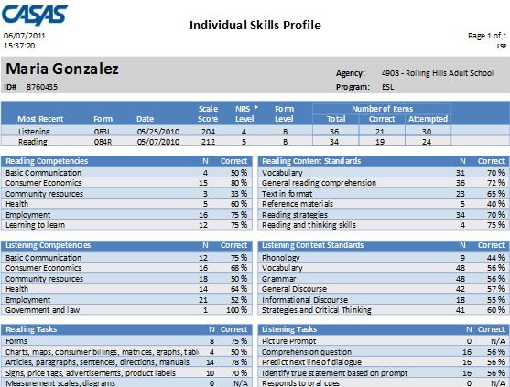
Resources to Support Instruction
Sample report displays competencies assessed in listening and reading.
per student
Notes:
PRESENTER/TRAINER NOTES:
This is another example of an Individual Skills Profile report.
This sample displays competencies assessed in reading and listening.
Sample report available on the CASAS website at: www.casas.org > Product Overviews > Software > TOPSpro Enterprise > Sample Reports
Ask if anyone has questions.

Slide 56
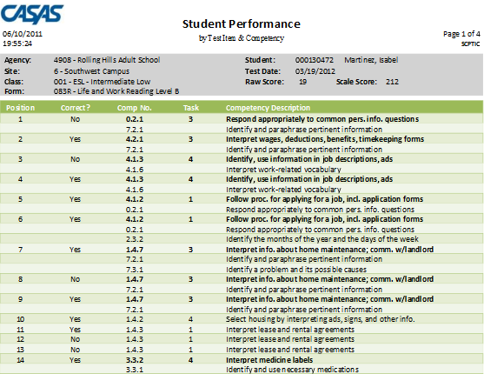
Resources to Support Instruction
Sample shows test results by displaying the competency number and statement for each test item and if the student correctly answered the item.
per form
per student
Notes:
PRESENTER/TRAINER NOTES:
The Student Performance report shows individual student test results on a given test form. The report -
Displays the competency number and statement for each test item.
Indicates if the student correctly answered the item.
This report is sorted by order of test item.
This is the electronic version of worksheets provided in TAMs.
Sample report available on the CASAS website at: www.casas.org > Product Overviews > Software > TOPSpro Enterprise > Sample Reports
Ask if anyone has questions.

Slide 57
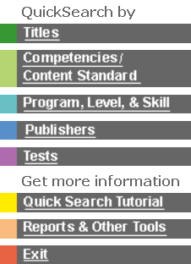
Online
Provides an essential link between assessment and instruction in the CASAS system.
An easy-to-use database of 2,300+ commercially available instructional materials.
Titles coded to skill levels, CASAS Competencies, and skill areas.
Complimentary, unlimited access.
www.casas.org > Product Overviews > Curriculum Management & Instruction > Instructional Materials: QuickSearch Online
Notes:
PRESENTER/TRAINER NOTES:
Introduce QuickSearch Online by reviewing bullets.
This database is complimentary with unlimited access
Helps program coordinators and instructors select materials to match curriculum.
Participants may search by title, competency, program, level, skill area, publisher, and test form.
Encourage participants to use QuickSearch to identify which competencies are targeted in curriculum they are already using.
If you have access to the Internet, you may wish to go to QuickSearch at this point and demonstrate how to use the database.
Suggestion: ask participants for the title of a favorite instructional resource and “Search by Title” to see CASAS Competencies addressed in that title.
Visit linked resource if time permits and Internet connection is available.

Slide 58
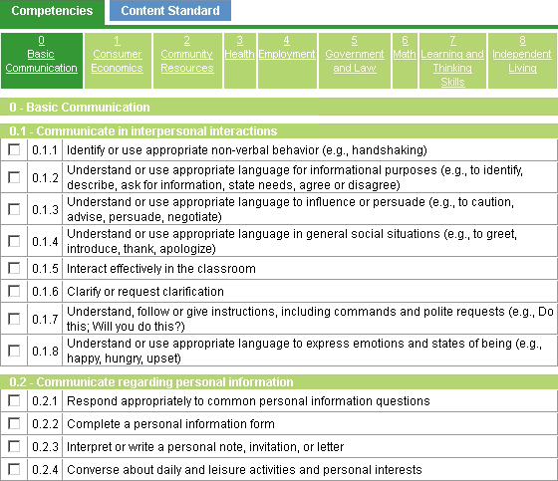
Find Instructional Materials by Competency
Notes:
PRESENTER/TRAINER NOTES:
This is a sample of how to search by competency.

Slide 59
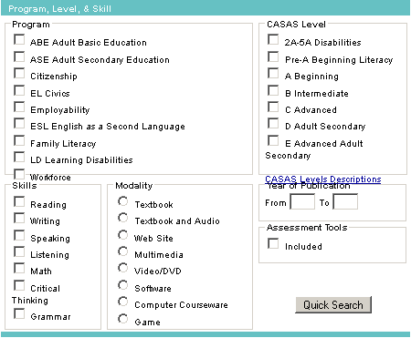
Narrow Your Results by Program, Level, and Skill
Notes:
PRESENTER/TRAINER NOTES:
This is a sample of how you can search by program, skill, modality, and level.

Slide 60
Curriculum Modules
Adult Low—Level Literacy
CASAS Competencies and Content Standards linked with informal assessment and CASAS standardized assessment.
Universally designed strategies with alternate formats, metacognitive and self-determination skills, and community transition activities.
Use with pre-beginning and beginning readers
Including those with intellectual disabilities, in programs for Adult Basic Education, Special Education & Rehabilitation, and Workforce Learning.
Notes:
PRESENTER/TRAINER NOTES:
Review bullets.

Slide 61
Curriculum Modules
Ten theme-based modules for learning progression.
Complimentary
Unlimited access
www.casas.org > Product Overviews > Curriculum Management & Instruction > Curriculum Modules (Low Level Literacy)
Notes:
PRESENTER/TRAINER NOTES:
Review bullets.
Visit linked resource if time permits and Internet connection is available.

Slide 62
Monitoring Progress
After a certain number of instructional hours, students take a post-test.
How is your program structured?
⬧ What is the interval of instruction between
pre- and post-testing:
By month? By semester? Other?
⬧ How do you determine which post-test a
student should take?
Notes:
PRESENTER/TRAINER NOTES:
Monitoring progress with post-tests is the final step in the assessment process.
Give participants time to look at questions and think about this part of the process at their sites.
Review intervals of instruction and what a participant’s state policy may mandate.
Answers:
Paper-based testing – use Next Assigned Test (NAT)* charts
CASAS eTests – next test automatically assigned
NEW! Next Assigned Tests (NATs) have been updated for all assessment forms.
Appraisals and Locators assign the same next test
No more “suggestion” of levels
Form numbers are indicated for next test
New NAT charts are posted on the website at: www.casas.org > Training and Support > Testing Guidelines > Next Assigned Test Charts
Ask if anyone has questions.

Slide 63
Activity 4: Review the Assessment Process
1. Place
2. Diagnose
3. Instruct
4. Monitor
Place students into a program, class, or level.
Oral Interview
Screening
Appraisal
Pretest students at the beginning of an instructional term.
Use pretest results to identify appropriate instructional materials.
Post-test students to measure learning gains and progress.
Notes:
PRESENTER/TRAINER NOTES:
Review the assessment process.
Ask if anyone has questions.

Slide 64
Case Study
Complete the Case Study in your activity packet.
Work in groups of 2-3 if possible, or work alone.
When your group finishes, we will review answers together.
Notes:
PRESENTER/TRAINER NOTES:
Review the instructions listed on this slide.
Set a start and end time.
Before starting the Case Study, ask if anyone has questions.

Slide 65
Review Training Objectives
You should be able to:
Select appropriate CASAS tests
Administer and score CASAS tests
Interpret and use test results
Identify CASAS Competencies in relation to test items
Identify CASAS Content Standards in relation to test items
Link curriculum, instruction, and assessment
Identify resources for instruction
Notes:
PRESENTER/TRAINER NOTES:
Review bullets.

Slide 66
Cost of Assessment
Online
WTUs (web-test units) / as low as $1.75 per unit
Paper-based tests
Most test booklets are reusable up to 5 times; 25 booklets / $75
Answer Sheets
TOPSpro Test Record /100 for $58
Self-scoring Appraisal answer sheets / 25 for $44
General Purpose Answer Sheets / tablet of 100 for $58
Test Administration Manuals
Appraisal Manuals / $79
Pre- and post-test manuals / $25
Notes:
PRESENTER/TRAINER NOTES:
The CASAS Catalog is available online from the CASAS website home page.
Use Online Ordering to quickly place your orders.
If time permits and Internet connection is available, click on hyperlinked images:
CASAS Catalog
Order Online

Slide 67
What’s Your Success Story?
CASAS is collecting videos and stories to highlight youth and adult education and training success across the country.
Share how CASAS has helped your learners or program.
The challenge
The solution
The outcome
Share your story!
www.casas.org > Social Media Newsroom
> Success Stories
Notes:
PRESENTER/TRAINER NOTES:
Visit the CASAS website to read how agencies and programs across the country are using CASAS to assist adults functioning at or below a high school level in attaining the basic literacy skills to function effectively on the job, in the community, and in the family.
See how programs establish comprehensive performance accountability systems, address core indicators of performance, integrate literacy and occupational skill instruction, and evaluate the effectiveness of adult education and literacy programs.
We invite you to Share Your Story!
The Challenge (briefly describe the challenge your program was facing)
The Solution (What did CASAS provide to help you overcome that challenge? Which CASAS assessments, resources, people/staff, etc. helped?)
The Outcome (what was the result of implementing CASAS?)
Visit linked resource if time permits and Internet connection is available.

Slide 68
Training Completion
Go online to complete your training
Sign and submit the Test Security Policy Agreement
Generate a Certificate of Completion
After verifying your training completion online —
You are authorized to order and administer CASAS Appraisals and leveled pre- and post-tests
Submit training verification at http://training.casas.org/
Notes:
PRESENTER/TRAINER NOTES:
Participants complete their training by submitting verification electronically.
Distribute Training Completion Directions (if not included in packets).
Review directions on how participants submit verification after they have attended the training.
Ask participants to fill-in information for this training on the directions handout:
Workshop ID
Date of Training
Name of Trainer(s)
Training Location Name, Address, State
They will need to include this information when verifying their training.
This information is added to the CASAS contact database to verify training completion.
Visit linked resource if time permits and Internet connection is available.
Ask if anyone has questions.

Slide 69
Contact Information
Mail
CASAS
5151 Murphy Canyon Rd., Suite 220
San Diego, CA 92123-4339
Website: www.casas.org
Telephone
(858) 292-2900 or (800) 255-1036
Fax
(858) 292-2910
E-Mail
General questions:
casas@casas.org
Websites:
Click Feedback at bottom of any web page
Technology Support Team:
techsupport@casas.org
Workshops:
http://www2.casas.org/online_registration/
Notes:
PRESENTER/TRAINER NOTES:
Be sure all participants signed the Sign-in-Sheet.
IMPORTANT!
Remind participants that their training is not official until they follow directions for completing training verification online.
Make sure participants fill-in information for this training on the directions handout before leaving:
Workshop ID
Date of Training
Name of Trainer(s)
Training Location Name, Address, State
Turn in the completed Sign-In Sheet to CASAS within one week of completed training.

Slide 70
Thank You for Attending!
Be sure to visit the CASAS website at www.casas.org.
Follow us on Twitter twitter.com/CASASsystem and use the hashtag #casassi2015 to tweet updates, photos, and stories.
Keep in touch with Facebook facebook.com/CASASsystem use the hashtag #casassi2015 to share photos and post stories.
Visit us on the CASAS YouTube Channel.

