Slide 1
Getting Started with Assessments

Slide 2
About Us
Non-profit organization started in 1980 to develop basic skills assessment for adult education programs
National leader in adult basic education and adult ESL assessment
Used in over 40 states and internationally
Approved by US Dept. of Ed for NRS Reporting for ABE and ESL
Developed by adult educators

Slide 3
How the System Works
1. Placement:
The CBT Locator available only for computer-based testing (CASAS eTests).
The locator test takes up to 15 minutes. An Appraisal test is typically 30-40 minutes.
2. Pretest:
Be sure to assess students in the same assessment series for their pretest and subsequent post-tests.
3. Instruct:
CASAS offers an online tool, QuickSearch Online, to locate instructor-recommended resources for classroom teachers.
4. Post-test:
CASAS recommends post-testing students after 70-100 instructional hours (or a minimum of 40 hours).

Slide 4
NRS Educational Functioning Level |  |  | CASAS Score Ranges | Grade Level
EFL | ABE | ESL
1 |  | Beginning ESL Literacy | 180 and below | 1
2 |  | Low Beginning ESL | 181 – 190 | 1
3 | Beginning ABE Literacy | High Beginning ESL | 191 – 200 | 1
4 | Beginning Basic Education | Low Intermediate ESL | 201 – 205 206 - 210 | 2 3
5 | Low Intermediate Basic Education | High Intermediate ESL | 211 – 215 216 – 220 | 4 5
6 | High Intermediate Basic Education | Advanced ESL | 221 – 225 226 – 230 231 – 235 | 6 7 8
7 | Low Adult Secondary Education |  | 236 – 240 241 – 245 | 9 10
8 | High Adult Secondary Education |  | 246 – 250 251 and above | 11 12

Slide 5
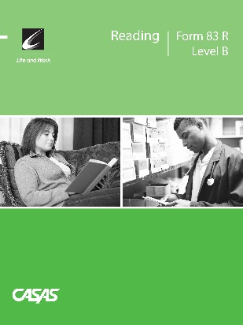
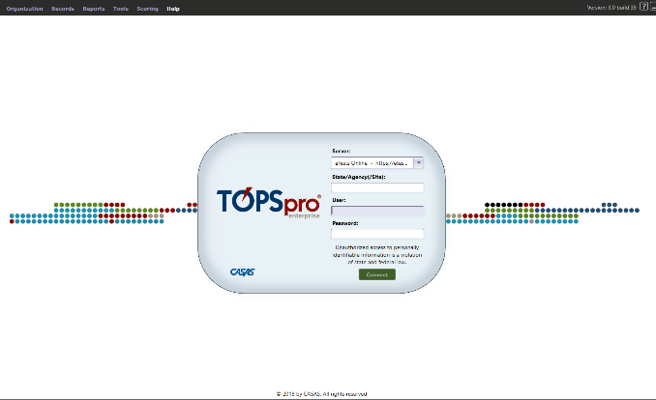
Our Products
Paper-based Assessments
Computer-based Assessments
Data Accountability Software

Slide 6
Intake Process
For all incoming students:
observe how well the student communicates and fills out registration forms
administer CASAS writing screening or other writing assessment (optional)
consider number of years of formal schooling and other information on demographic records
consider other factors affecting class placement (any certificates or degrees…)

Slide 7
Informal Assessment: Little or no difficulty?
Administer the paper appraisal:
Form 80 for L&W Reading & L&W Listening
Reading GOALS Appraisal for Reading GOALS
Start the “Intake: Pretest” testing session

Slide 8
Oral and Written Screening
The Oral Screening is an optional one-on-one interview used to screen ESL/ELL learners for taking listening and reading locators or appraisal tests. It is six questions.
The Writing Screening is an additional optional tool to screen ESL/ELL learners for taking reading and listening locators or appraisals. Examinees write two sentences that are dictated.

Slide 9
General Testing Guidelines
Allow adequate space between students.
Ask students to turn off and put away their cell phones.
All personal items must be off the tables.
Tell students not to talk or get help from other students during the test.
Scratch paper is allowed for math tests, but not for listening tests. All scratch paper must be collected and shredded after the test.
No cell phones, dictionaries, translators, or any other items allowed

Slide 10
General Testing Guidelines
Guessing by the examinees should be discouraged. Explain that if they can’t answer a question they don’t need to mark an answer, and can go on to the following questions.
Circulate during testing to make sure examinees are marking answers at the correct number on the answer sheet.
Maintain a positive attitude and atmosphere about the testing, as your attitude can influence students’ attitudes and performance.
For students with disabilities, please refer to the CASAS guidelines for making the appropriate accommodations

Slide 11
Testing Procedures
Demonstrate how to properly fill in the bubbles properly.
You may assist the learner as they complete the required demographic information.
Demonstrate how to respond to test items (practice items will appear at the beginning of each test form).
You may assist the learner as they complete the required demographic information.

Slide 12
Raw Scores & Scale Scores
Raw Score: the number of questions a student answers correctly
Scale Scores: the converted scored from a student's raw score that allows for comparison between students and test forms.
Inaccurate Scores: scores that do not accurately assess a student’s skills; i.e. a student scored too low on a form and needs to be retested at a lower level or a student scored too high on a form and needs to be retested at a higher level

Slide 13
Determining the Next Assigned Test
Raw to Scale Score Reading Appraisal Form 80
Raw Score | Scale Score
1 | 171*
2 | 180*
3 | 185*
4 | 189
5 | 193
6 | 196
7 | 199
8 | 201
9 | 204
10 | 207
11 | 209
12 | 212
13 | 214
14 | 216
15 | 219
16 | 222
17 | 224
18 | 227
19 | 230
20 | 234
21 | 237
22 | 240♦
23 | 242♦
24 | 244♦
25 | 246♦

Slide 14
Conclusion
Any final questions regarding CASAS paper assessments?
On to CASAS eTests!

