Slide 1
TOPSpro Enterprise Instructional Reports
CASAS Technology Trainers
Notes:
TOPSpro Enterprise (TE) Online offers teachers the access to performance reports that guide and support classroom instruction to improve student performance.
This hands-on lab will help you learn how to access TE Online to retrieve results, generate reports, and use results to inform instruction and document progress.
This session is appropriate for teachers, program coordinators, and administrators involved with monitoring and tracking student performance.

Slide 2
Instructional Reports
eTests Reports
Skills Profile
Competency Performance
Test History
Notes:
Reports from TE Online are always available for you to generate for your class.
This session focuses on reports that instructors most commonly rely on.

Slide 3
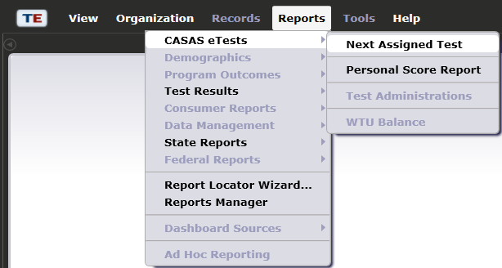
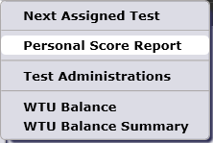
CASAS eTests Reports
Notes:
The CASAS eTests report category gives you access to reports directly related to web-based testing.
Next-Assigned Test
Personal Score Report

Slide 4
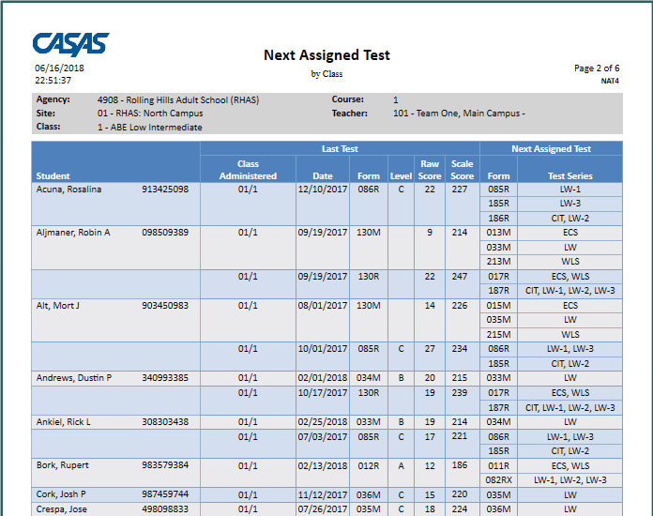
Next-Assigned Test (NAT)
Notes:
Access TE: Reports > CASAS eTests > Next-Assigned Test
Use General Settings > Special Options and set Display Class Based On > Class Enrollment.
Use the Navigator to select a Class Instance and generate the NAT.
This report is designed to take the legwork out of deciding which test to administer to individual students. TE makes this process easier with the Next-Assigned Test (NAT) report.
TE searches the database to find the last test a student took in all classes across sites. Based on the form and score of the last test taken, TE assigns the next test form for tests in each modality that a student tested in such as reading, math and listening.
This report should be used along with other measures, such as hours of instruction, student class work, and teacher judgment. Administrators, database managers, and teachers should remember that the number of hours of instruction between pre- and post-test might affect a decision to post-test with the NAT or override the NAT at the same level or at the next higher level. In addition, the following should be taken into consideration:
CASAS does not recommend a lower level form at post-test unless the pretest score was inaccurate.
Extended range forms (081RX or 082RX) are utilized differently than other forms because they are measured across levels.

Slide 5
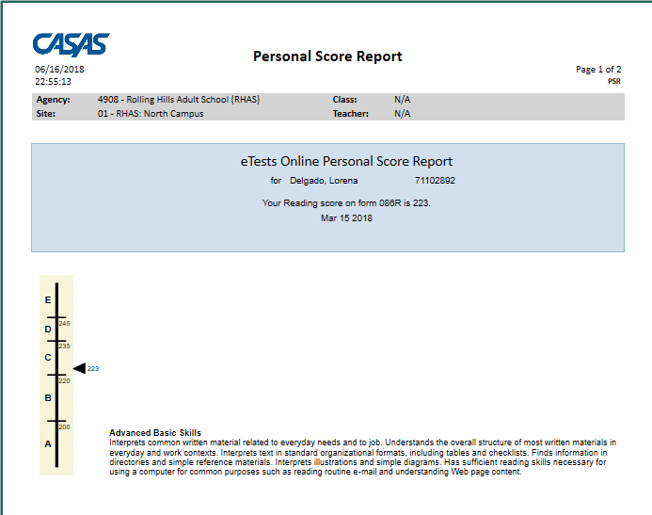
Personal Score Report (PSR)
Notes:
Access TE: Reports > Test Results > Skills Profile > Individual Skills Profile
Use the Navigator to select a Test and generate the PSR.
This is a copy of the Personal Score Report that students see displayed on the testing station screen after ending a test. Information displayed to the student may be customized to remove the levels bar and skills description.
The report gives a summary of the student’s results on a given form to provide them with immediate feedback after completing a test.
This is an optional report in eTests and if enabled, students may print the PSR.

Slide 6
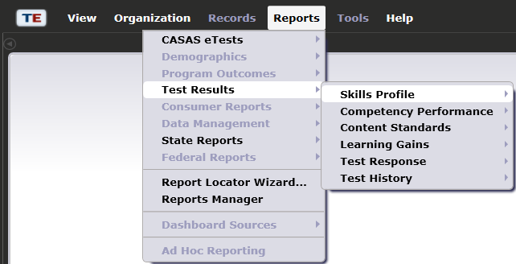
Skills Profile Reports
Notes:
The Test Results report category gives you access to performance reports for students and classes.
Skills Profile
Individual Skills Profile
Individual Skills Profile Summary

Slide 7
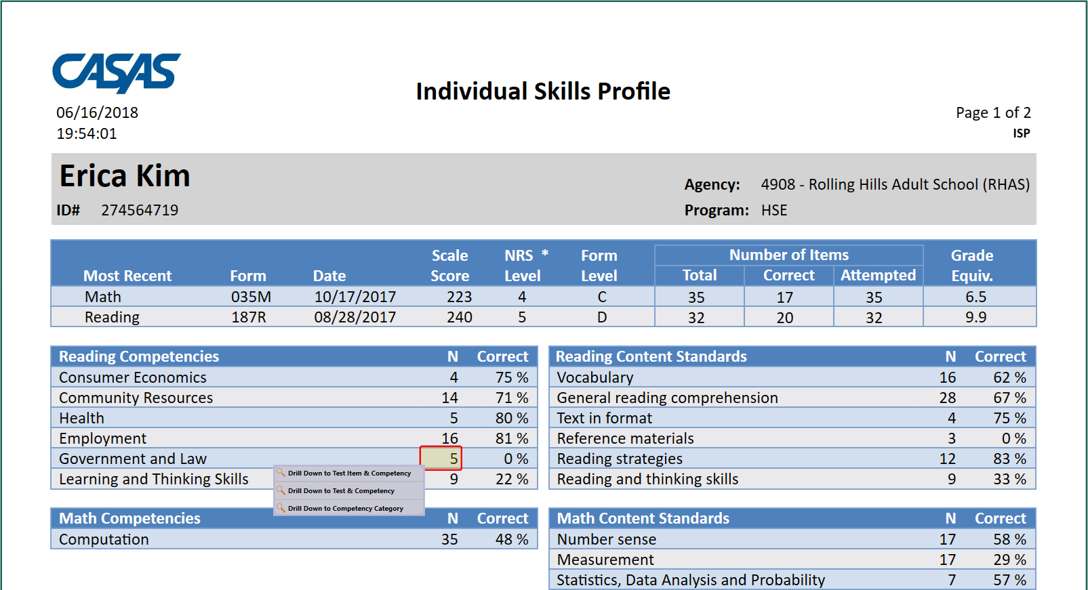
Individual Skills Profile (ISP)
Notes:
Access TE: Reports > Test Results > Skills Profile > Individual Skills Profile
Use the Navigator to select a Student from In Program Years and generate the ISP.
The Individual Skills Profile (ISP) shows how an individual student performed on the most recent reading, math, and listening test.
The report displays the CASAS Competency Content Areas and CASAS Basic Skills Content Standards Categories assessed for each test modality.
The Skills Profile identifies by percentage the number of competencies within a content area the student answered correct, and by percentage the number of underlying basic skills embedded in CASAS Competencies.
At far right is an optional setting that you may add to the report to indicate Grade Level Equivalency.
The HSE Predictor is included in the report when a test modality score is 236 and above to indicate the likelihood of the student passing a High School Equivalency Exam.
ACTIVITY:
Drill down to Test Item and Competency
Drill down to Test Item and Content Standard

Slide 8
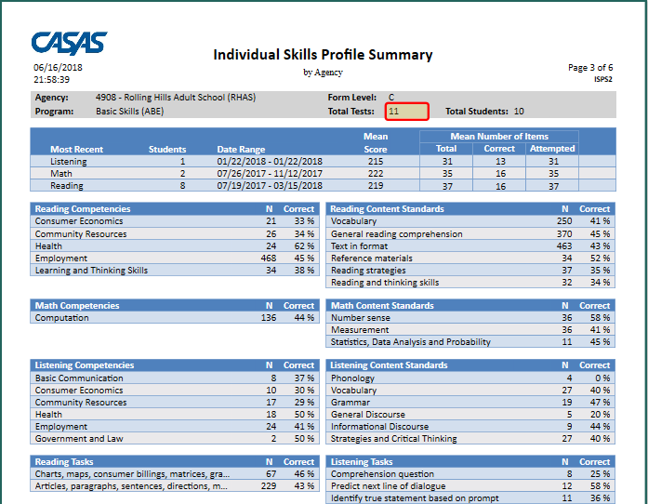
Individual Skills Profile Summary
Notes:
Access TE: Reports > Test Results > Skills Profile > Individual Skills Profile Summary
Use General Settings > Special Options and set Display Class Based On > Class Enrollment.
Use the Navigator to select a Class Instance and generate the ISPS.
The Individual Skills Profile (ISP) Summary shows how groups of students performed on the same form level with their most recent reading, math, and listening test.
As with the ISP, this report also displays CASAS Competency Content Areas and CASAS Basic Skills Content Standards Categories assessed for each test modality at the given form level.
The Skills Profile identifies by percentage the number of competencies within a content area, and by percentage the number of underlying basic skills embedded in CASAS Competencies the students answered correct.
ACTIVITY:
Drill down to Form Level to see the list of student functioning at that level.
Drill down to Total Tests to see the list of tests students took at the Form Level.

Slide 9
Competency Performance
Notes:
Competency Performance
Student Competency Performance
Competency Performance Summary by Class

Slide 10
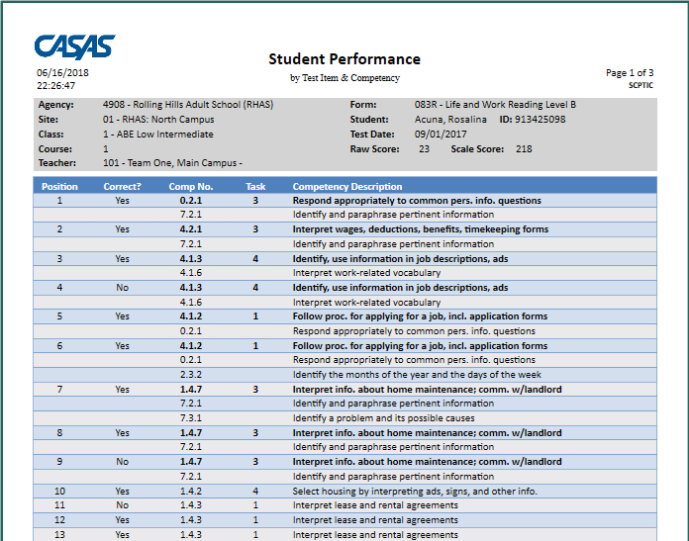
Competency Performance (Student)
Notes:
Access TE: Reports > Test Results > Competency Performance > Student Competency Performance
Use the Navigator to select a Test and generate the SCP report.
The Student Performance by Test Item & Competency report shows how an individual student responded on a given test form. This report displays by test item the competency number and statement, the task area for how the item was presented, and if the student answered the item correct.
This is an excellent report to give to individual students to provide them with feedback for their performance on the test and the life skills competencies they need to learn. Competency statements are more meaningful to students than raw or scale scores.
How to use:
Target weak areas of understanding.
Spend less time on mastered competencies.
Evaluate retest needs if the sale score falls below accurate range, or the student ran out of time to complete the test.
Use the report to discuss the competency areas of need with the student.

Slide 11
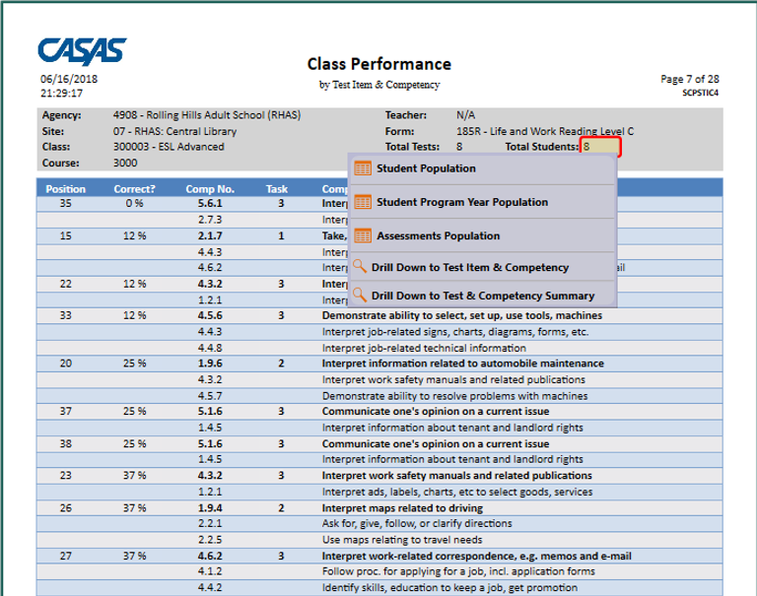
Competency Performance (Class)
Notes:
Access TE: Reports > Test Results > Competency Performance > Competency Performance Summary
Use General Settings > Special Options and set Display Class Based On > Class Enrollment.
Use the Navigator to select a Class Instance and generate the SCPS.
The Class Performance by Test Item & Competency report gives a summary of how students in the class performed on a given test.
Identifies the position of each test item on the form.
Indicates the percentage by which the number of students who took the form answered correct.
Includes the competency number and statement assessed per test item.
Specifies the task area for presenting each test item.
With this report, an instructor is able to see a percentage by which each item or each competency was successfully completed by the students who took the test.
How to use:
Teachers use this report to inform instruction and plan lessons.
Teachers also use this report to target the areas of greatest need to prepare their students for the next testing cycle.
Teachers can identify the students who took a given test and group instruction to work on competencies the students need most to learn.
Teachers can share the results with the class as a whole.
ACTIVITY: Drill down to the list of students who completed a given form.

Slide 12
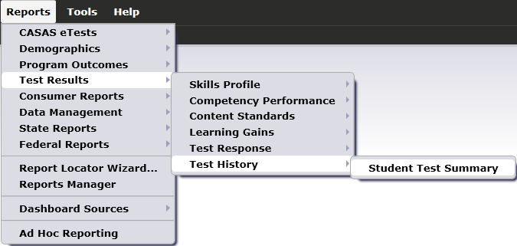
Test History Report
Notes:
Test History
Student Test Summary

Slide 13
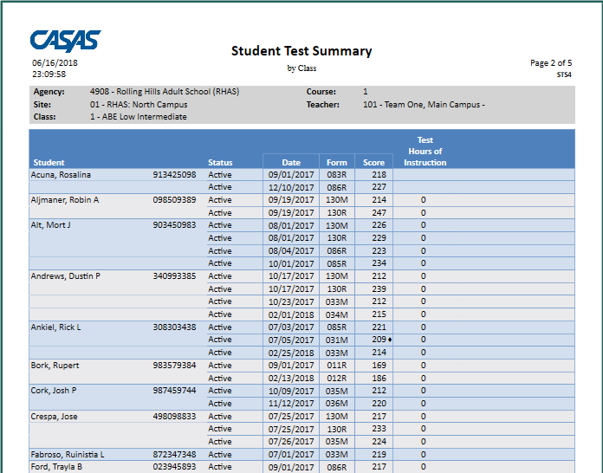
Student Test Summary (STS)
Notes:
Access TE: Reports > Test Results > Test History > Student Test Summary
In General Settings > Special Options, set Display Class Based On > Class Enrollment.
Use the Navigator to select a Class Instance and generate the STS.
The Student Test Summary by Class report lists every student that has taken a test in the selected class and displays test history for each student.
Tests are listed in test date order for each student.
The report displays test date, the specific test given (Form number), scale score, and cumulative hours of instruction.
The report also identifies test scores below the accurate range with an asterisk (*) and high-end conservative estimate scores with a diamond symbol ().
How to use:
Identify all tests each student has taken in a class.
Identify test scores that are invalid (asterisk) in a class.
Identify students who have taken a specific test (Form Number) in a class.
Sort tests by form number to see what students have taken each test.

Slide 14
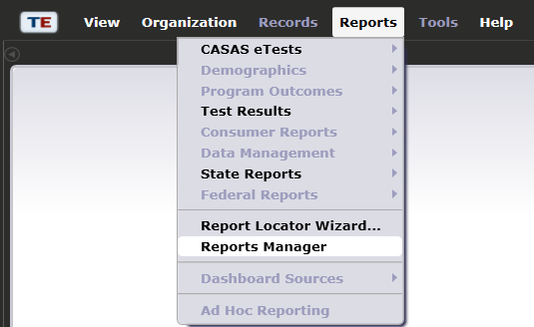
Reports Manager
Notes:
Access TE: Reports > Reports Manager
The Reports Manager is a virtual file cabinet that you have access to at any time, and from any location with Internet access to retrieve your saved reports.

Slide 15
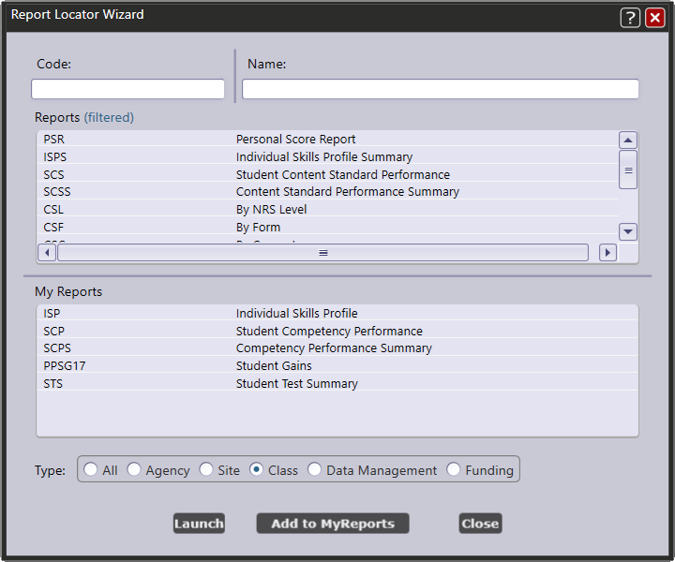
My Reports
Notes:
Use the Report Locator Wizard to choose the reports you generate most and make them My Reports.

Slide 16
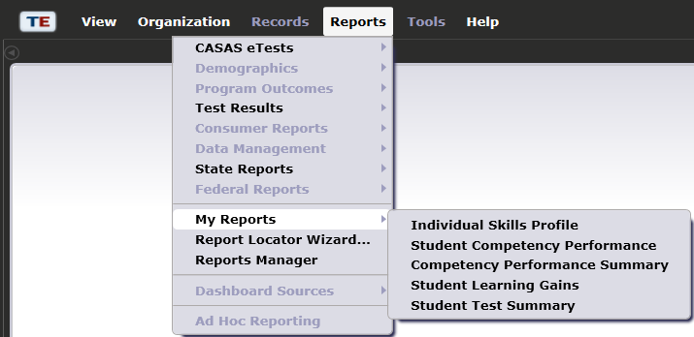
My Reports
Notes:
Access TE: Reports > My Reports
When you access TE reports, go to My Reports!

