Slide 1
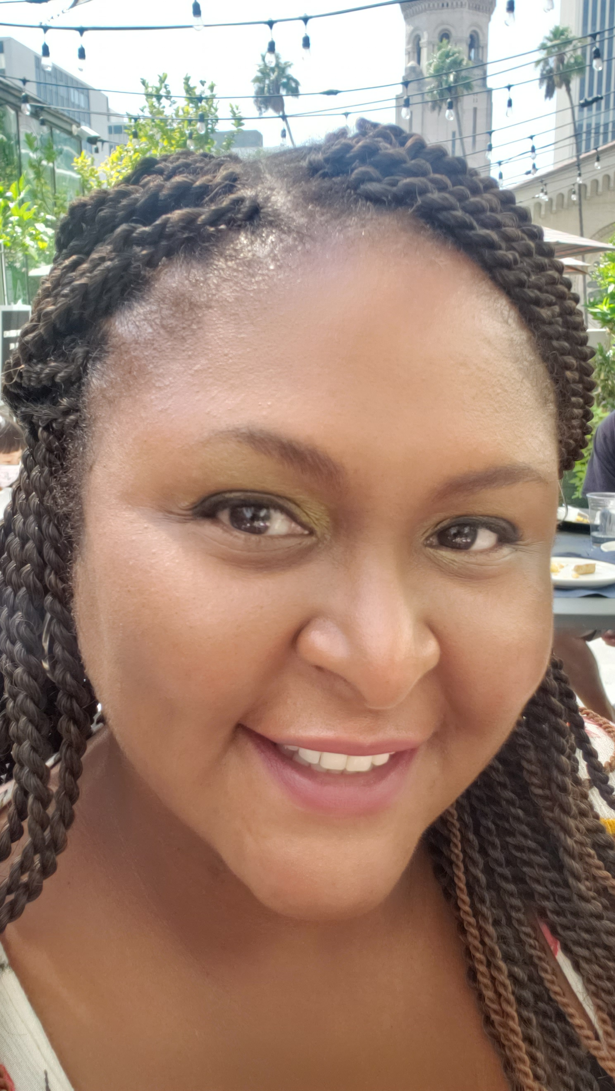
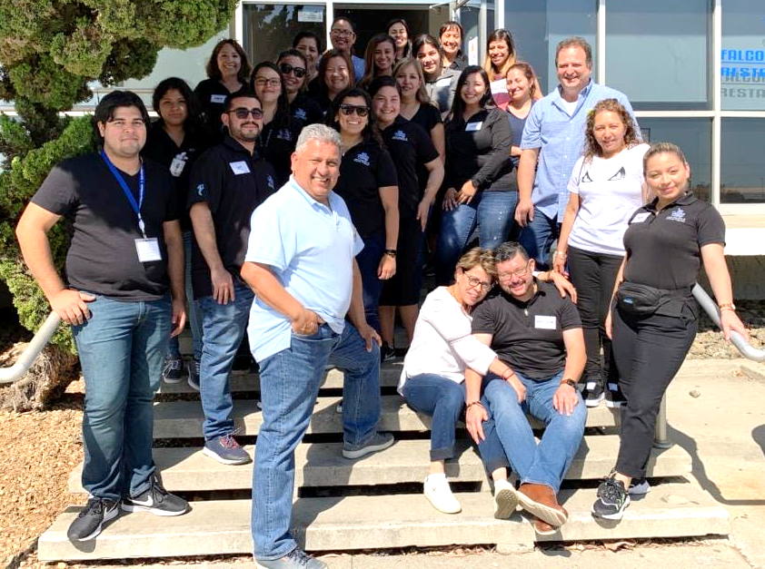
Implementation of TE Classmate
By Tischel Diaz, CASAS Coordinator
Adult Education and Diversity Programs (AED)
Notes:
Hello. My name is Tischel Diaz and I am the CASAS Coordinator for the Cerritos College Adult Education and Diversity Program, lovingly called AED

Slide 2
Cerritos College is one of the five largest community colleges in the Southeast regions of Los Angeles county. Our student population comes from Artesia, Bellflower, Buena Park, Cerritos, Cypress, Hawaiian Gardens, Lakewood, La Mirada, La Palma, Long Beach, Norwalk, Santa Fe Springs, and beyond. Cerritos serves an average of 22,000 students with over 10% of them funneling through the noncredit Adult Education & Diversity Programs (AED). On average, the AED department annually serves 1,300 ABE and 1,200 ESL students.
Adult Education and Diversity Programs
(AED)
Notes:
Cerritos College is one of five largest community colleges in the Southeast regions od LA county. Our students coming from many of the surrounding cities and beyond. We service an average of 22,000 students annually with over 10% of those funneling through our department at some point in their journey. Our department, AED, serves 1,300 ABE (including ASE) and 1,200 ESL students annually.

Slide 3
AED 2021-22 Program Offerings
ESL Level courses (5)
ESL Citizenship
ESL Conversation
HSE Preparation
Workplace Skills
Career Technical Education (CTE)
Basic Skills
Vocational ESL
Notes:
AED hosts a wide range of courses including:

Slide 4
2021-22 Course Modalities
In Person (in a classroom)
Hybrid (½ in classroom, ½ asynchronous or synchronous)
Remote (synchronous)
Notes:
In the fall, we offered three course modalities. However, in the Spring, we are pairing it down to two.

Slide 5
Why do we use TE Classmate?
Notes:
As a California Agency, we have access to an TopsEnterprise Enhanced which gives us access to track attendance and run accountability reports.

Slide 6
Canvas is our learning management system. It has become integral to our instruction during the pandemic and our initial switch to all Distance Learning coursework.
Adult Education and Diversity Programs
CONS:
Credit-Driven
No collection of positive attendance
Notes:
Our campus uses the Canvas Learning Management System. While this has helped with the transition to online learning and digital literacy implementation, the attendance integration isn’t the best as you are only able to record who is present, but not for how long.

Slide 7
Attendance for Community Colleges for noncredit programs
WIOA, Title II and CAEP funded agency
MIS Positive Attendance Reporting
Open Entry/ Open Exit Program
Daily Hours need back up
Reported at end of course term
Notes:
Noncredit at the Community College level comes with its own set rules. As a WIOA, Title II and CAEP funded agencies, tracking student hours whether it be on a daily, weekly, or monthly basis is needed. On top of that, as a community college, we are required to submit positive attendance for MIS Chancellors’ Office purposes as well. We need to account for daily hours for our students and report them at the end of each class’ term.

Slide 8
Cerritos AED Attendance
Cerritos AED uses TOPSpro Enterprise (TE) as our primary attendance database for Federal and California state reporting (including WIOA, CAEP and MIS data systems).
California Community Colleges are set on a credit-minded model of census dates and not positive attendance, so prior to the use of TE, we used old-fashioned and labor-intensive use of paper and pencil attendance there was no built-in positive attendance process or system in place.
Notes:
Cerritos uses the PeopleSoft System for all student records, but doesn’t currently have a tool for collecting daily attendance. In addition, by collecting attendance, we eliminate having to report the attendance into two or more systems.

Slide 9
Issues prior to TE Classmate
Many of our faculty own Mac computers and TE isn’t compatible with iOS systems.
If the instructor has a PC, using TE during class time can be cumbersome to switch between screens (either in person or online).
Notes:
Using TE was one solution we had for collecting daily attendance. However, as TE can only run a PC using a .Net framework, that was a hinderance for those faculty that used MAC computers. Pre-Covid, teachers would have access to a PC computer during class time, but switching back and forth for attendance during class could be a distraction if they were presenting. During covid this became an even greater issue as teachers with MAC computers no longer had access to a PC in the classroom.

Slide 10
What is TE Classmate?
A mobile app for entering attendance seamlessly to the TE database.
Available on both Android and iOS platforms
Negligible use of memory
Available with Enhanced TE (requiring TEUs) at no charge
Notes:
This brings us back to TE Classmate. TE Classmate is a mobile app for entering attendance seamlessly to the TE database. Its flexibility is that it is mobile and available on both Android and iOS platforms. Memory usage is negligible. It’s free for Enhanced TE users.

Slide 11
Piloting TE Classmate since Summer 2020
Faculty have been voluntarily using TE Classmate as an alternative to TE for daily attendance entry.
Notes:
We have been piloting TE Classmate app since Summer 2020. It was introduced at a faculty meeting and each faculty meeting since, I have current faculty users share a moment or so on how awesome its use has been!

Slide 12
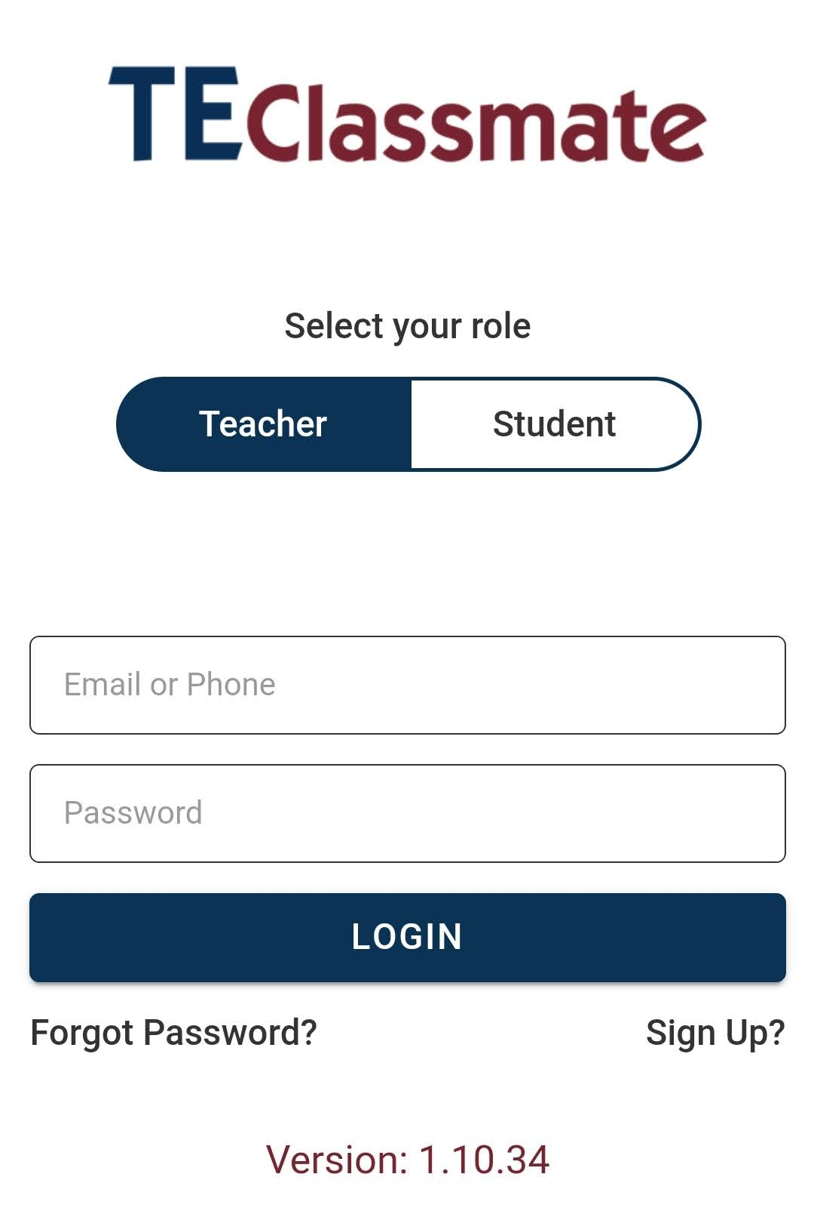
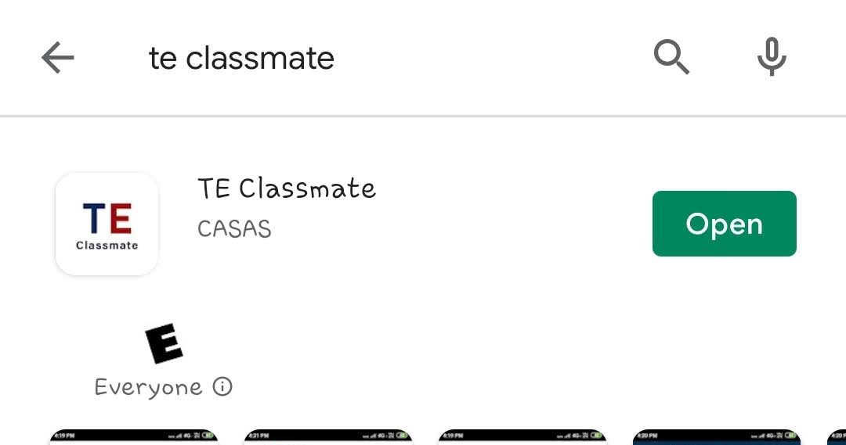
TE Classmate
Free and easily downloaded from Apple and Google Play stores.
Quick Sign Up
Quick Login
Notes:
TE Classmate is free and easy to download from either the Apple or Google Play stores. Sign up and login is quick and easy. I do want to make to say teachers do have to be assigned to classes in TE in order for them to have access to the classes in TE Classmate.

Slide 13
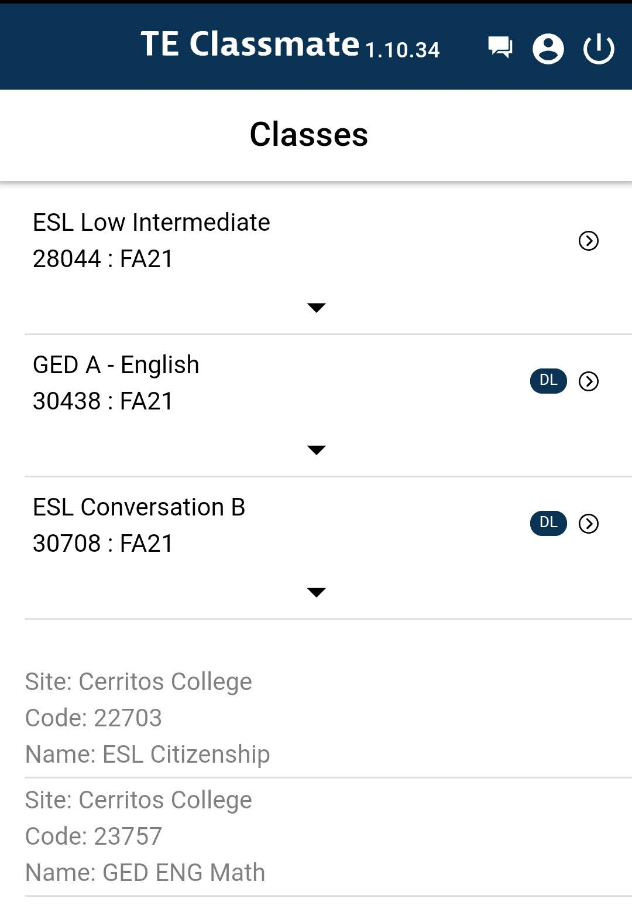
TE Classmate
Lists of all active classes on top
Old classes grayed out below
Distance Learning Designation immediately visible
Notes:
Once logged in, teachers will see a listing of their current classes on the top. Any completed classes for the program year will show at the bottom and greyed out. In order to enter attendance, you click on the arrow on the right of the class.

Slide 14
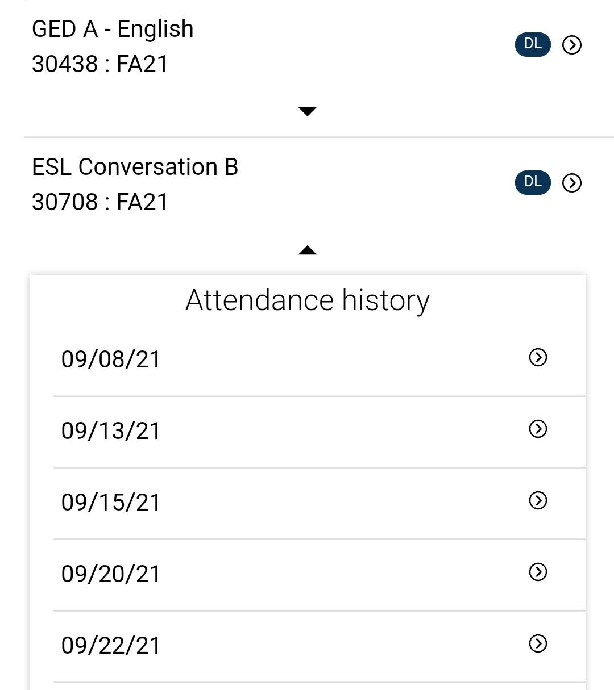
TE Classmate
You can view previously submitted attendance from the class screen as well!
Notes:
Clicking on the arrow below the class will show you a history of entered attendance for up to three weeks. Here is where’d you go in case you need to update submitted attendance.

Slide 15
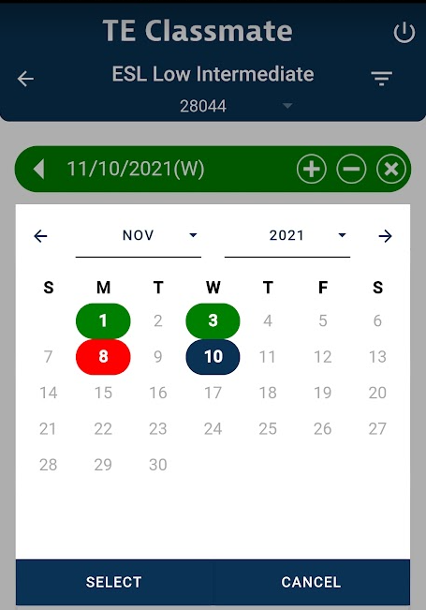
TE Classmate
By clicking on the date on top you get an at-a-glance view of the entered (or missing) attendance.
Green has been submitted
Red is missing
Dark Blue is today’s date
Notes:
In addition to the attendance history, once inside the class, you can click on the date and get an at-a-glance view of entered (or missing) attendance. Color coded for ease of use.

Slide 16
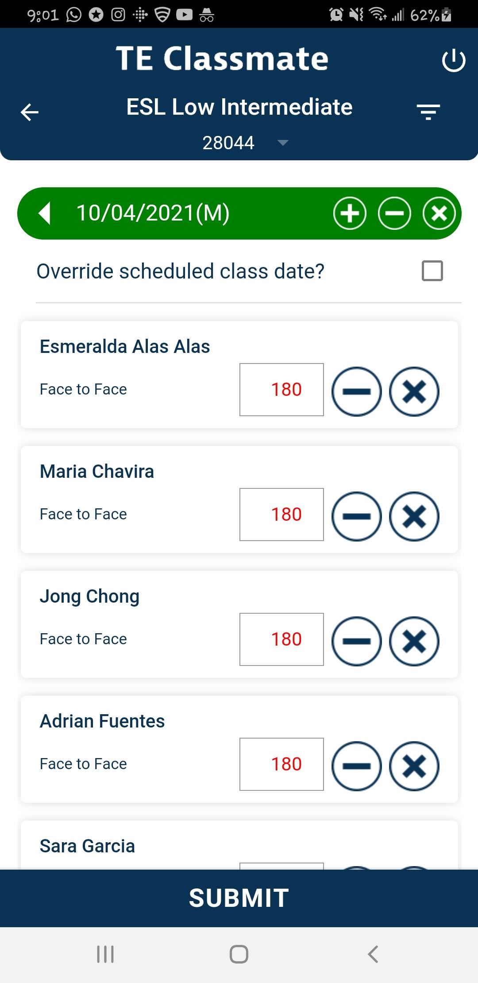
TE Classmate
You can view different teaching modalities in TE classmate:
In Person
Notes:
The screen will present differently based on teaching modality and the setup in TE. This class is a strictly in-person course so the attendance is denoted as Face to Face. The set max time is setup in TE. All students are defaulted as attending for the full time of the class. If a student is absent, hit the X next to their name. If a student was late, you can reduce their time individually.

Slide 17
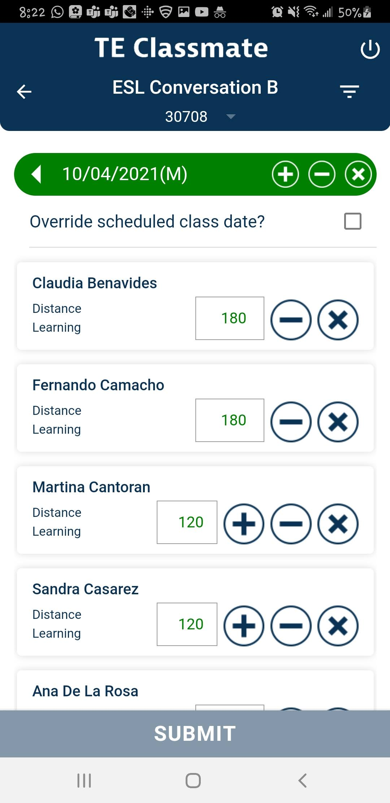
TE Classmate
You can view different teaching modalities in TE classmate:
Distance Learning
Notes:
Here we see a class that is set up as distance learning only.

Slide 18
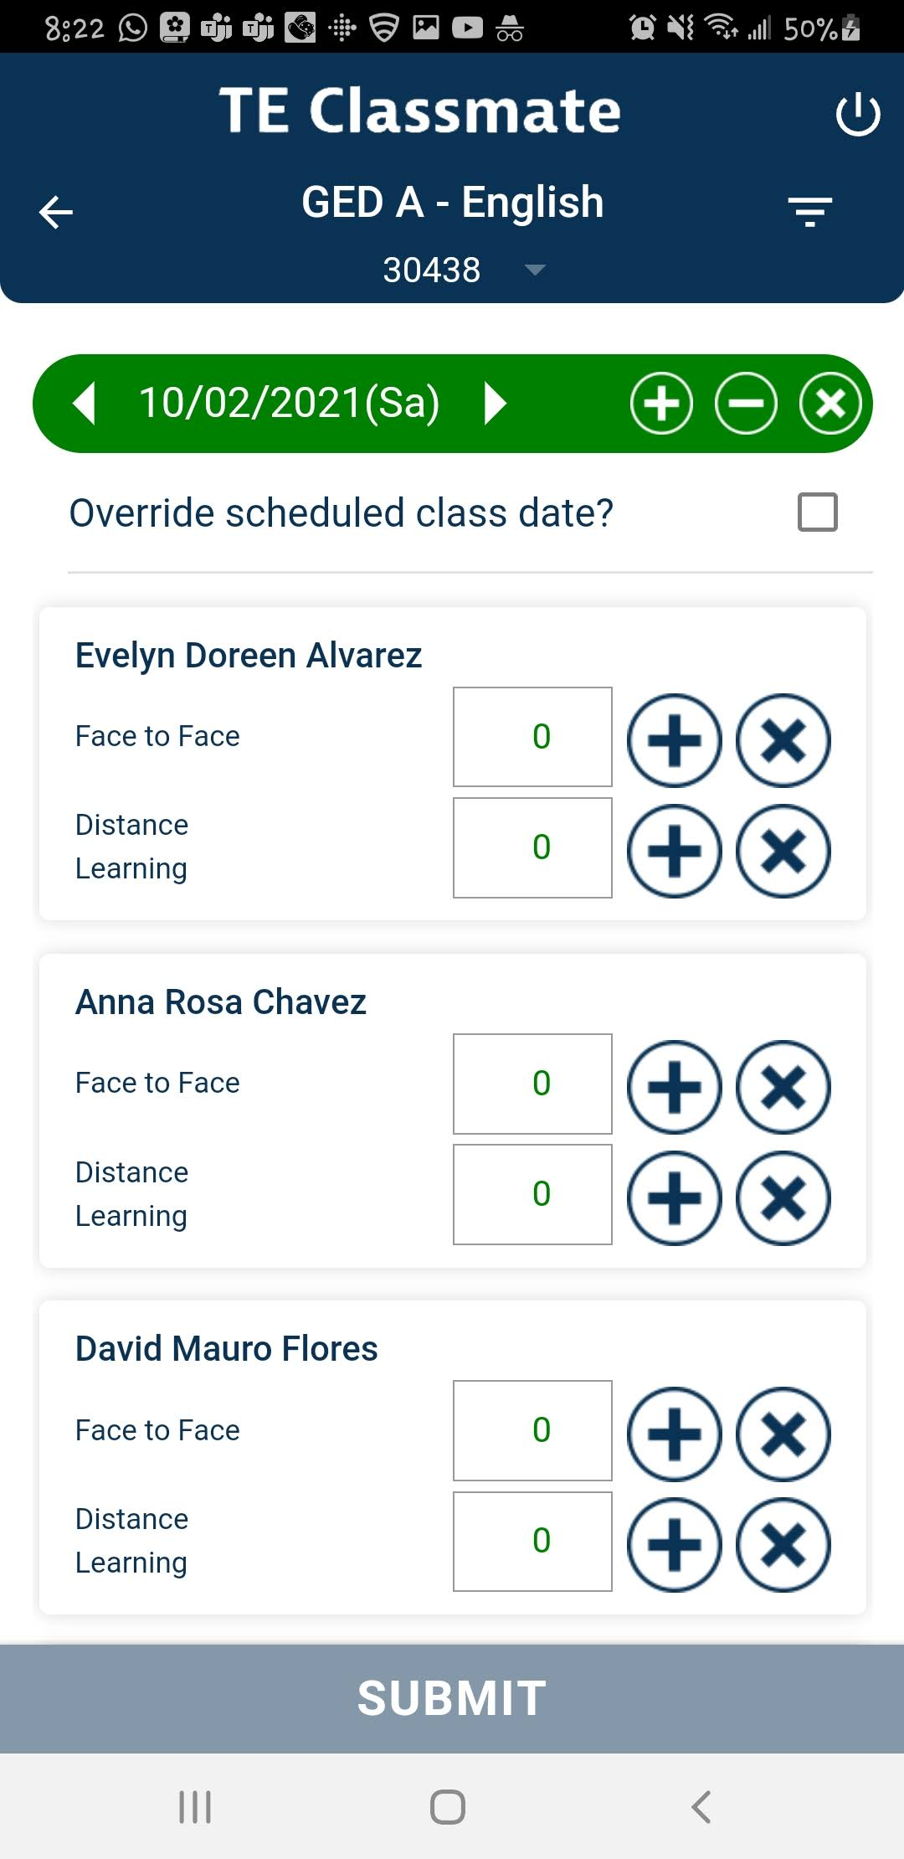
TE Classmate
You can view different teaching modalities in TE classmate:
Hybrid
Notes:
This is a sample of a mixed modality class that has both an in person AND Distance Learning component.

Slide 19
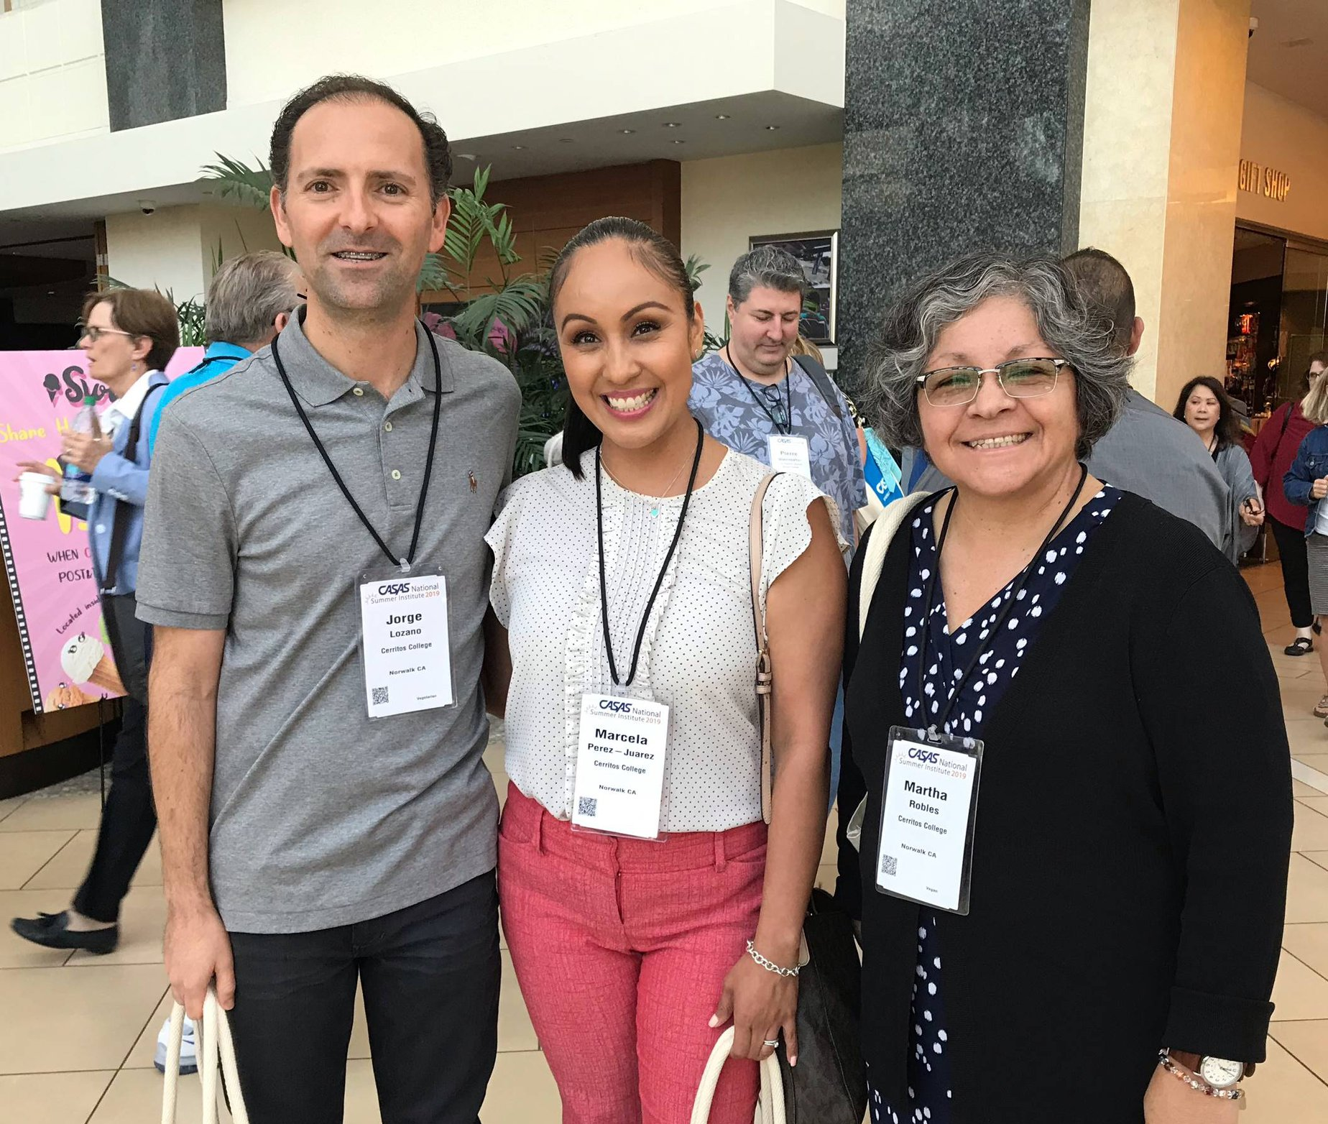
Faculty Testimonials
Adult Education and Diversity Programs
Notes:
I am a believer that if you want to know whether a product works well or not, you have to go to the end user. I went directly to my faculty and asked for their impressions and thoughts regarding their use of TE Classmate.

Slide 20
Faculty Testimonials
Instructor Samel, Adjunct Faculty, Basic Skills Math/HSE Preparation
“So far, I love the app. It is quick and easy to use. I really like that they change the colors to green when someone is marked present.”
Adult Education and Diversity Programs
Notes:
Instructor Samel, Adjunct Faculty, Basic Skills Math/HSE Preparation had this to say: “So far, I love the app. It is quick and easy to use. I really like that they change the colors to green when someone is marked present.”

Slide 21
Faculty Testimonials
Instructor Zugschwerdt, Adjunct Faculty, English as Second Language
“When I'm in the classroom at an off-site location, I am dependent upon the location's computers and IT department. If I need to leave right after class, or if we unexpectedly need to change classrooms, I don't have to worry about going back just to do attendance.
As a Mac user, it is also great to have easy access to attendance for my online classes without having to use a school computer. Anytime we can eliminate extra steps, it just makes a lot more room for keeping students the priority. That's why I love this TE app!”
Adult Education and Diversity Programs
Notes:
Instructor Zugschwerdt, Adjunct Faculty, English as Second Language “When I'm in the classroom at an off-site location, I am dependent upon the location's computers and IT department. If I need to leave right after class, or if we unexpectedly need to change classrooms, I don't have to worry about going back just to do attendance.
As a Mac user, it is also great to have easy access to attendance for my online classes without having to use a school computer. Anytime we can eliminate extra steps, it just makes a lot more room for keeping students the priority. That's why I love this TE app!”

Slide 22
Faculty Testimonials
Instructor Kouznetsova, Adjunct Faculty, English as Second Language
“I like using the TE Classmate application on my iPhone. Using it for entering the attendance is truly convenient. It is just like sending an email or text.”
Adult Education and Diversity Programs
Notes:
Instructor Kouznetsova, another adjunct Faculty member teaching English as Second Language stated: “I like using the TE Classmate application on my iPhone. Using it for entering the attendance is truly convenient. It is just like sending an email or text.”

Slide 23
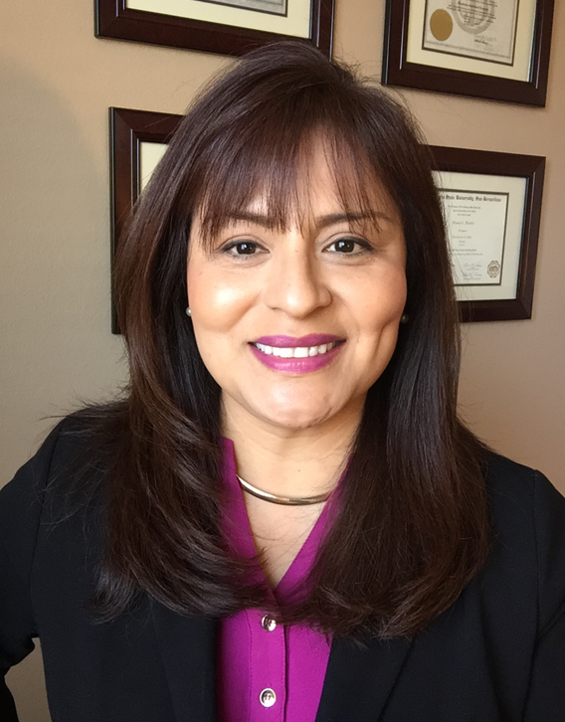
Faculty Testimonials
Instructor Ramos, Adjunct Faculty, HSE Preparation/Vocational ESL
“The TE Classmate app is very convenient... I can have the Canvas Attendance open on my main computer and input the minutes attendance into TE from my phone.”
Adult Education and Diversity Programs
Notes:
Next, we have Instructor Ramos, Adjunct Faculty, HSE Preparation/Vocational ESL “The TE Classmate app is very convenient... I can have the Canvas Attendance open on my main computer and input the minutes attendance into TE from my phone.”

Slide 24
Faculty Testimonials
Instructor Oviedo, Adjunct Faculty, HSE Preparation/Basic Skills
“This app allows me to input attendance quickly in real-time, as easily as sending a text. Convenience in the palm of your hand.”
Adult Education and Diversity Programs
Notes:
Last, but not least, Instructor Oviedo, Adjunct Faculty, HSE Preparation/Basic Skills states: “This app allows me to input attendance quickly in real-time, as easily as sending a text. Convenience in the palm of your hand.”

Slide 25
TE Classmate
Download it
Use it
Love it
Notes:
What has been great about taking part in the TE classmate pilot is how responsive CASAS has been. Our teachers make a suggestion on what would make the experience better, and within days, if possible, it has been implemented. Being at the ground level of making an app for teachers and influenced by the experience of teachers has been a wonderful experience. So, my recommendation for the field? TE Classmate…Download it, Use it, Love it. Thank you.

