Slide 1
Computer Skills
Zoom
Objectives
Google
Google Classroom
Student Email
Write an email

Slide 2
Computer Skills Objectives
At the end of this training, students will be able to
Use Zoom-open a Zoom invite, connect audio and video, mute and unmute, chat, annotate and go into breakout rooms.
Use their student email-log on, open, send and receive.
Enter Google Classroom and open assignments, submit google forms and turn in assignments.
HOME

Slide 3
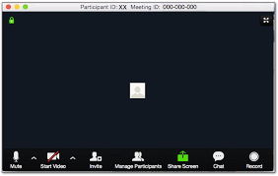
Zoom
Toolbar

Slide 4
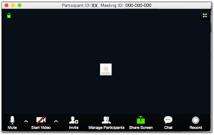
Audio and Video

Slide 5
Chat
Notes:
Assignment: All students need to send a chat to everyone. Introduction: Name, Country, Language

Slide 6
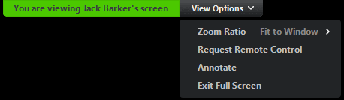
Where is annotate?
click View Options then Annotate located at the top of the screen
Notes:
Teachers must share their screens in order for annotate to appear in the drop down menu under View Options.

Slide 7
How to Annotate
Annotation Tools:

Slide 8
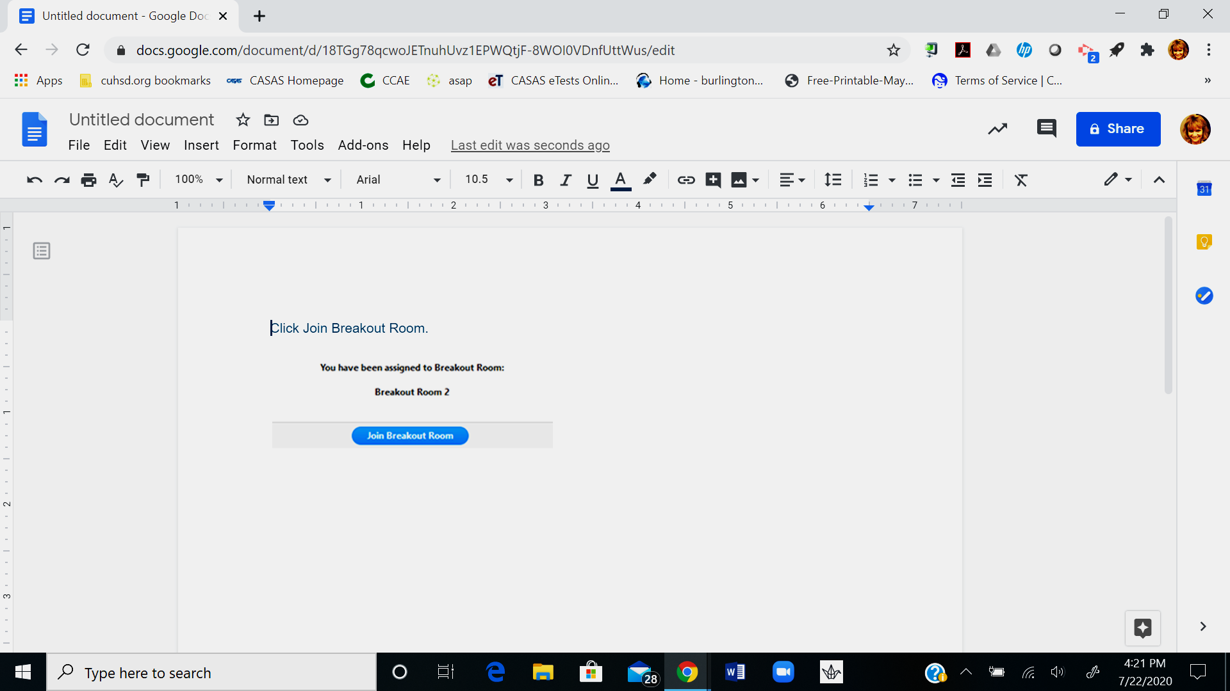
Breakout Rooms
When you see this message click on the
blue Join Breakout Room message

Slide 9

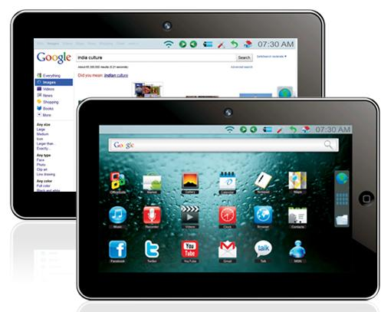
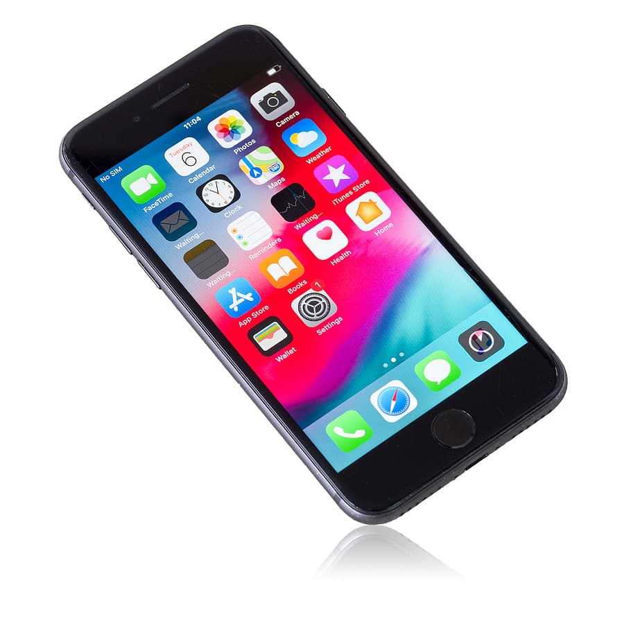
Student Email
CACE Gmail account
Works on any device
HOME

Slide 10
User Name
Example:
First Name: Robert
Use the first 4 letters of first name
Last Name: Ochoa
Use first 4 letters of last name
Student ID: 7334452
Use last 4 numbers of student ID
robeocho4452@mycace.cuhsd.org

Slide 11
Password
Example
Student ID: 7334452
The last two numbers of the student ID need to be spelled out
Five Two (must be capital letters)
Your birthday-Month and Day
For example: May 15
0515
Password: FiveTwo-0515

Slide 12
User Name and Password
For Robert Ochoa
Student ID: 7334452
Birthday: May 15
User Name: robeocho4452@mycace.cushd.org
Password: FiveTwo-0515

Slide 13

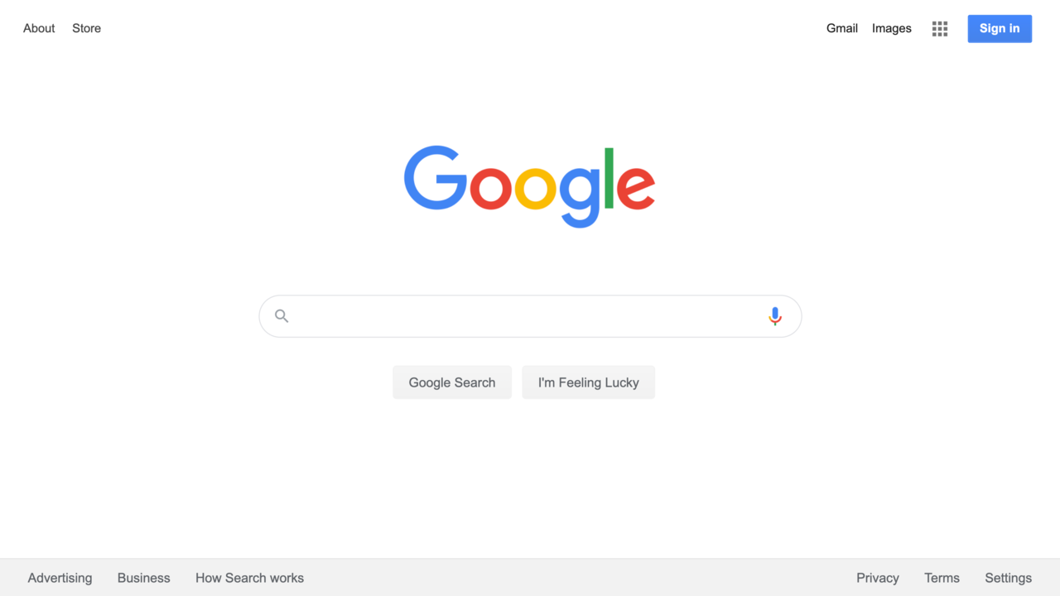
Google
Find the Chrome Icon

Slide 14

All things Google
Sometimes known as the waffle

Slide 15
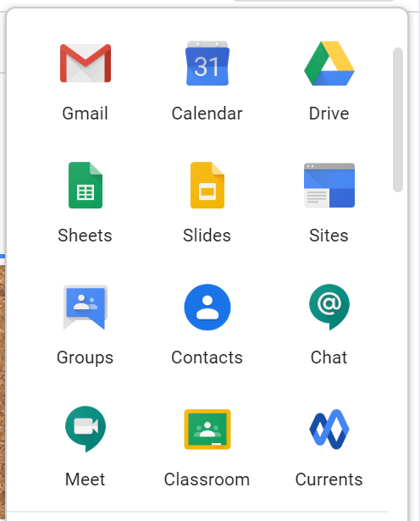
Google Icons

Slide 16
Open Gmail
Compose an email
Log into your student gmail
How to open email
Email directions
Compose
To: Teacher’s email address
Subject: Introduction
Greeting
Body of email: Name, Country, Length of time in US
Closing

Slide 17
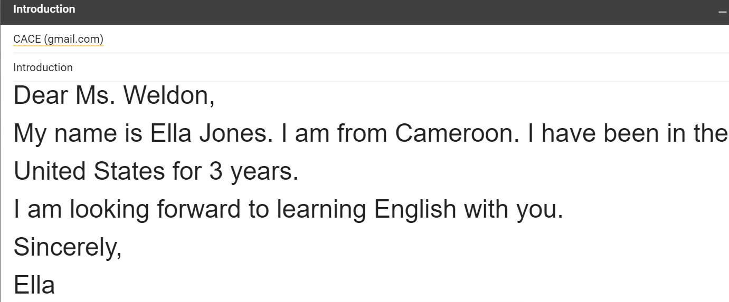
Sample Email

Slide 18
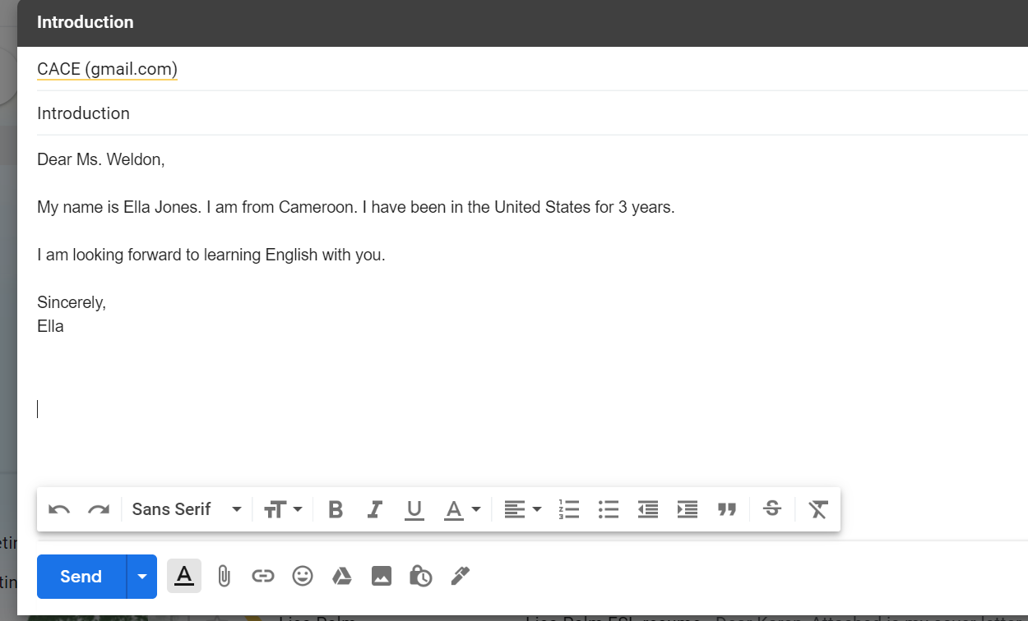
Send email

Slide 19
Google Classroom
HOME

Slide 20
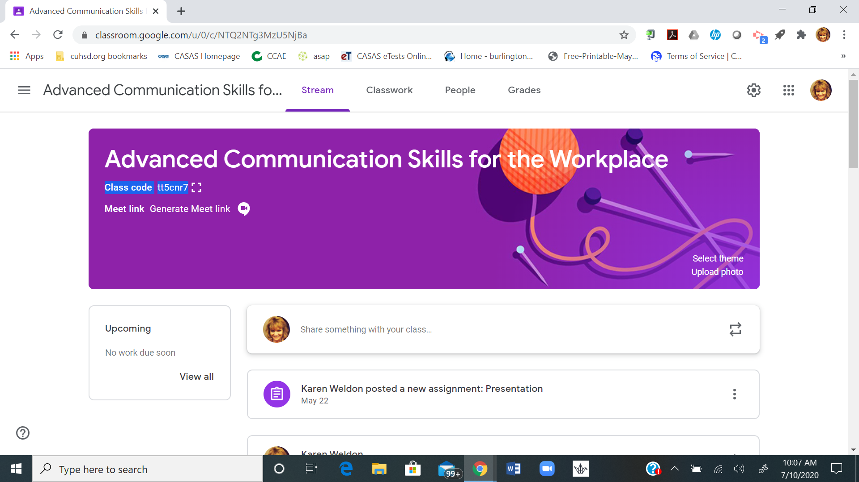
Teacher’s Class
Your teacher will send you a code to JOIN his/her Google classroom

Slide 21
Join
You can join a class in 2 ways:
1. Sign into Classroom and Enter the class code ________________
OR
2. Accept an invite—
Your teacher will send you an invite. You can accept the invite in your email.
Note: After you join a class on one device, you're enrolled in that class for all devices.

Slide 22
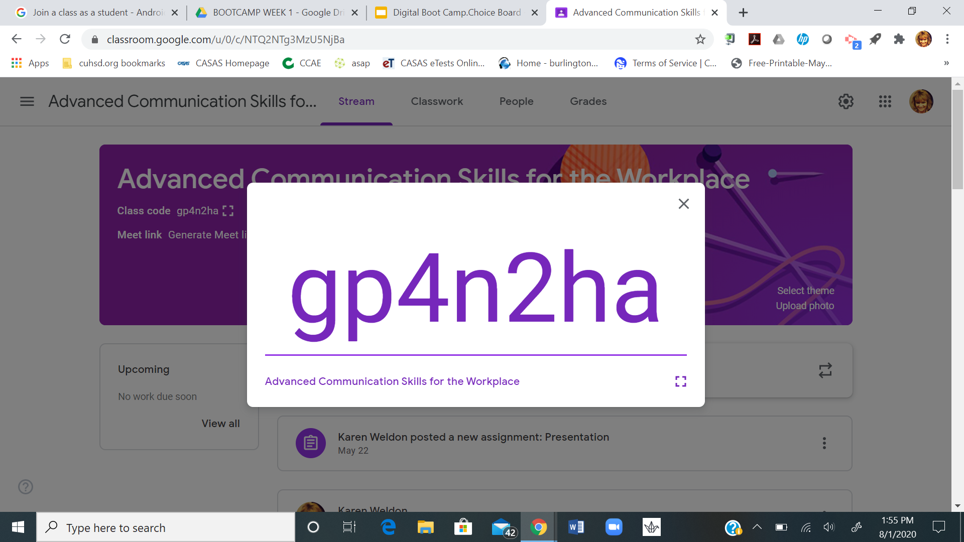

Slide 23
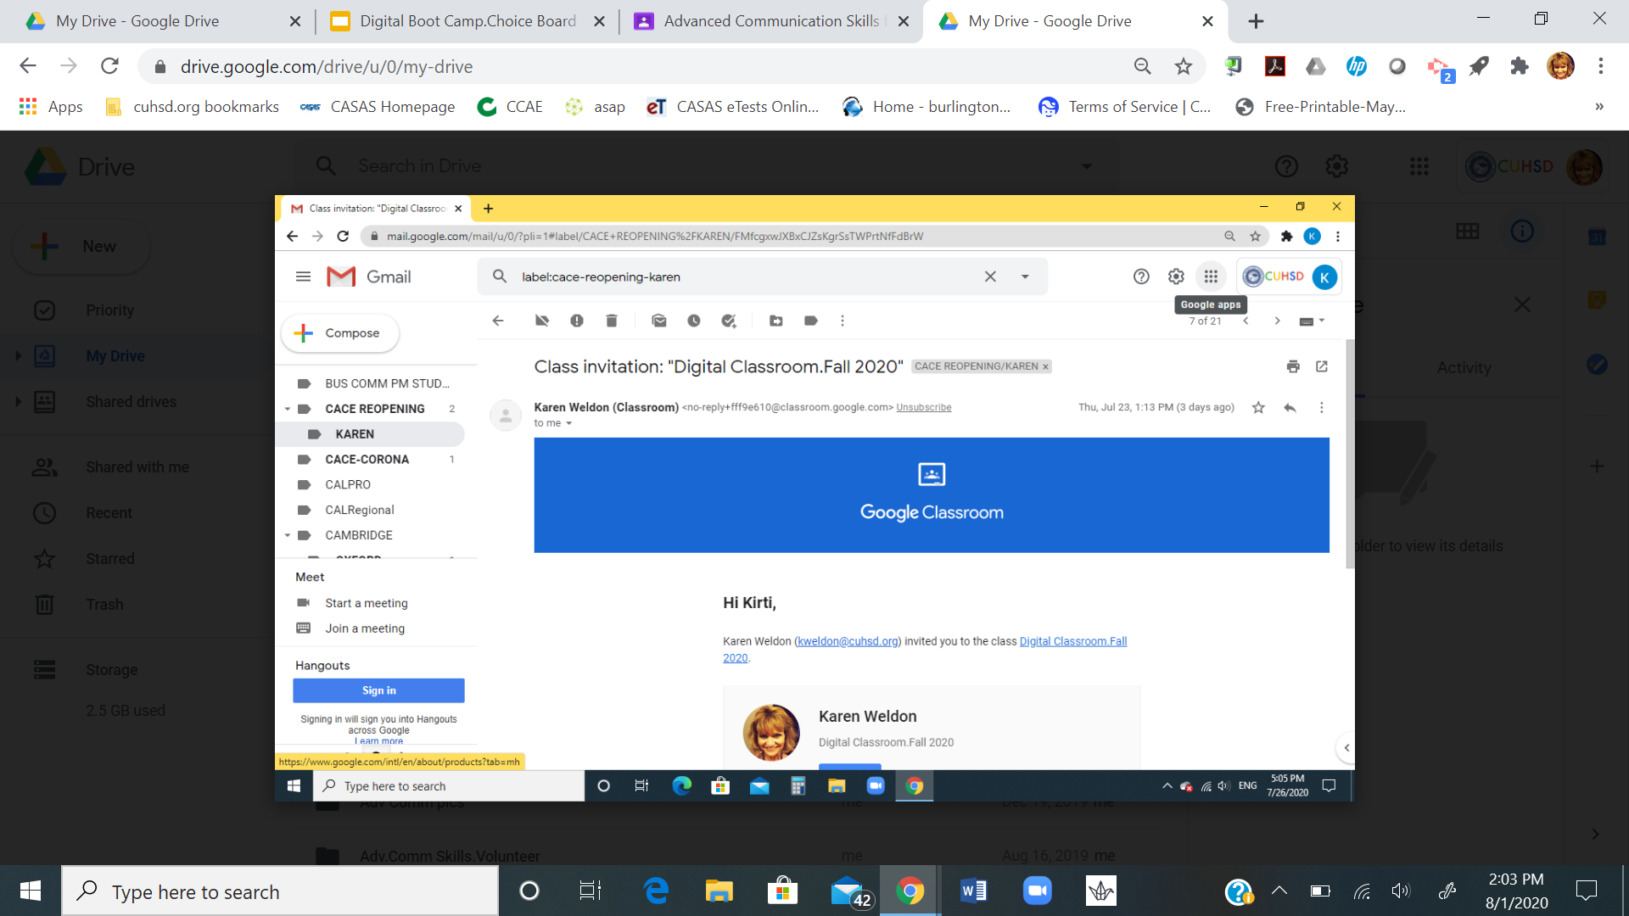
Invite to Join

Slide 24
Join my Class
What are the steps?
Go to the waffle
Click on Google Classroom waffle
Enter the code!

Slide 25
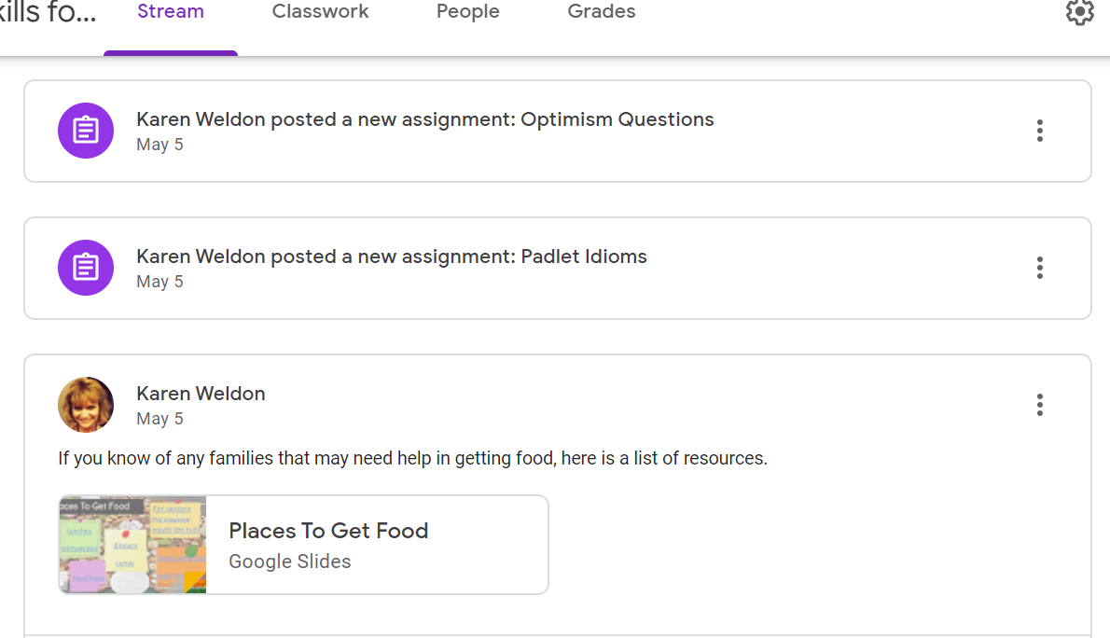
Stream
All class messages and assignments will show up in the Stream.

Slide 26
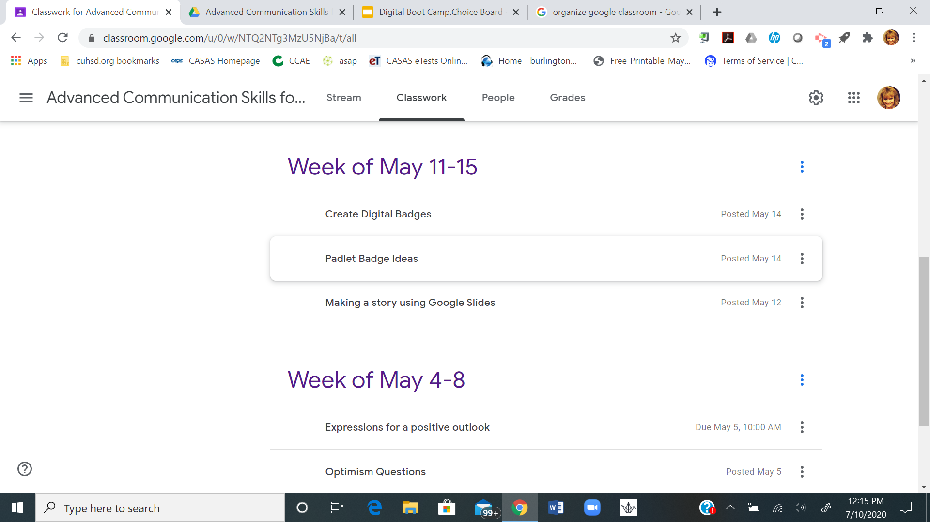
Assignments

Slide 27
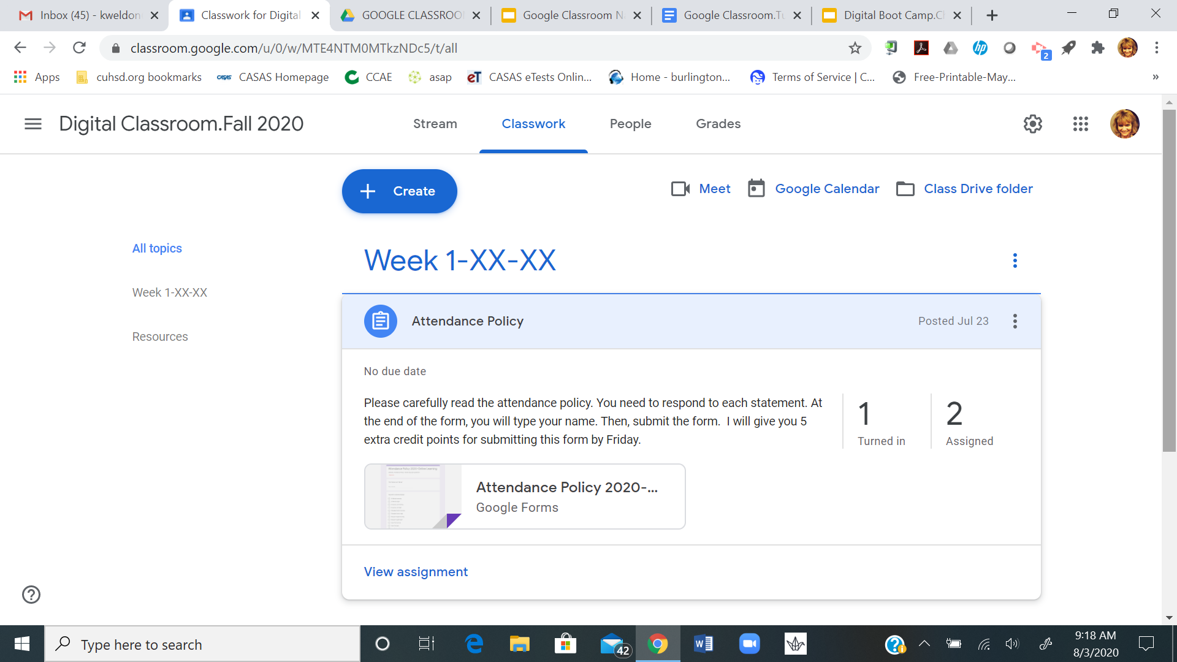
View assignments
Go to Classwork. Then, view assignment.
HOME

Slide 28
Practice Submit Form
Go to assignments and click on Attendance Policy.
Complete the form and submit.

Slide 29
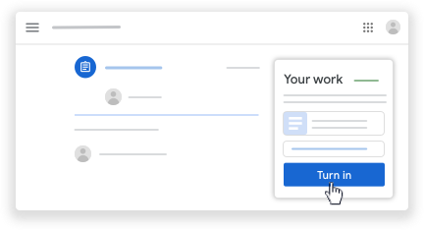
Complete and Turn In
Click the image with your name to open the assigned file.
Enter your work.
On the document or in Classroom, click Turn in and confirm.
HOME

Slide 30
Assignment
Go to Classwork and look for your assignment that is due today!
What is the name of the assignment?
When is it due?
How many points is it worth?
HOME
Notes:
Attendance Policy is on a Google Form. When the students click on submit, it automatically turns in the assignment. The google doc assignments require turn it in. Practice with both types of assignments.

Slide 31
Turn it in!
Practice: Turn it in!

