Slide 1
Oregon Adult Basic Skills –
Online Assessment Hub Partnership
CASAS Presentation
Fall 2023
Donna Lewelling, State Director
Oregon Adult Basic Skills
Curtis Buell, Local ABS Director
Southwestern Oregon Community College

Slide 2
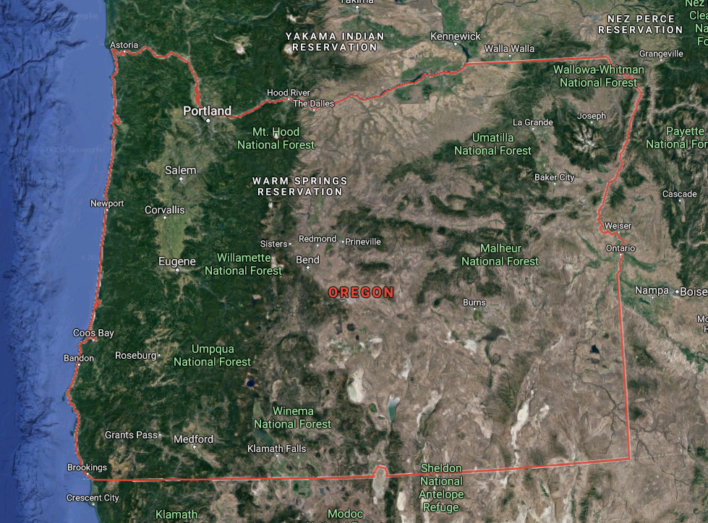
Overview of Oregon: 9th largest state 27th most populous state
Source: Google Maps
Notes:
Economy:
-Nike World Headquarters,
-Intel and other computer chip manufacturers
-Also agriculture and food: Wine, Beer, Cheese, Cattle,
-Pendleton wool…

Slide 3
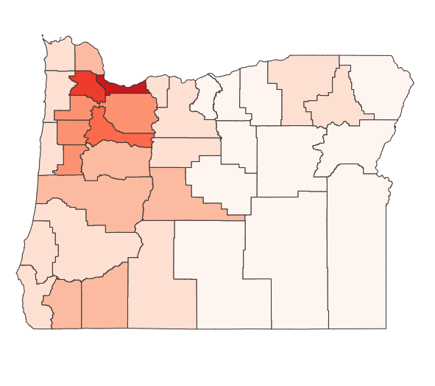
Oregon: Population Density by County Highest (red): 1873 people per sq. km in Multnomah County Lowest (pale tan): 0.72 people per sq. km in Harney County
Source: www.worldpopulationreview.com
Notes:
As you can see from the map, our population is really located in what we call the I-5 Corridor. And we have a big difference in density by county.

Slide 4
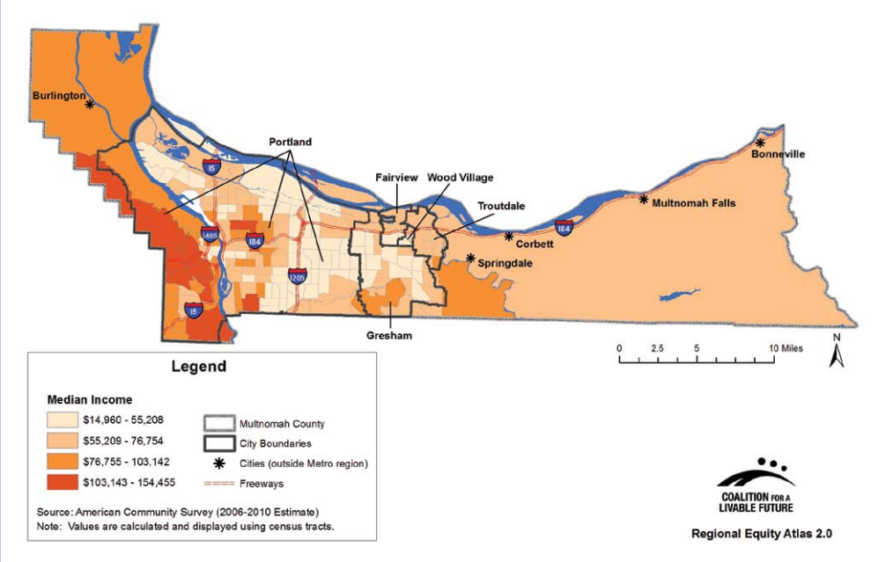
Multnomah: A Tale of Two Counties If you were to split Oregon’s most populous county, Multnomah, into two counties, the western half would be the wealthiest county in Oregon, and the eastern half would be the poorest county in Oregon.
Source: www.worldpopulationreview.com
Notes:
And the big difference doesn’t just end there…

Slide 5
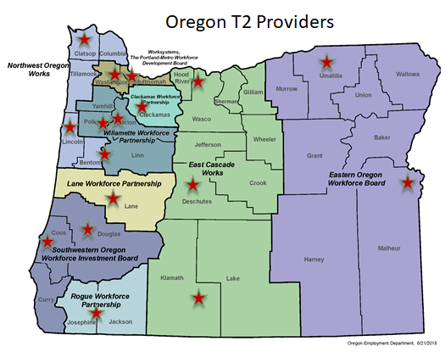
Snapshot of Oregon Providers
16 providers statewide.
Notes:
Donna:
Here is a map of the beautiful state of Oregon.
Most of our population is centered on the west side of the cascade mountains.
We have 9 local workforce boards and one state board.
We have 17 providers which include 16 of our 17 cc and the Dept. Of Corrections.

Slide 6
Oregon Title II Total Enrollment
Source: CASAS TOPSpro NRS Table 1
Notes:
(Although it will not be consistent with other data slides, I wanted to include 2017 and 2018 enrollment to tell a more complete story)
Note that, while Oregon Title II total enrollment has essentially recovered from the pandemic (only a few hundred shy of 2018-19 total enrollment), it’s still significantly less than 2017-18 enrollment.
The need for Title II services has not diminished in Oregon: more than 100,000 Oregonians aged 18-64 lack a high school diploma and are unemployed/out of the workforce
Some local programs have seen record enrollment in 2022-23, but the Oregon ABS Team is still pursuing work on a marketing campaign to promote Title II services to those who qualify (concurrent with rebranding discussions)
Some local programs are facing capacity issues (e.g. teacher recruitment and retention)

Slide 7
Oregon Title II Enrollment by Race/Ethnicity
Source: CASAS TOPSpro NRS Table 1
Notes:
Note that for the last 2 years, Oregon Title II has served more Hispanic/Latino participants (light brown line) than White participants (HECC green line)
Data retrieved from NRS Table 1, which dictates the Race/Ethnicity categories and naming conventions

Slide 8
Oregon Title II Enrollment by Gender
Source: CASAS TOPSpro NRS Table 1
Notes:
Note that for the last 3 years, Oregon Title II has served more females (blue line) than males (green line)
Data retrieved from NRS Table 1, which does not include non-binary gender categories (only male/female)

Slide 9
Oregon Title II Enrollment by Age
Source: CASAS TOPSpro NRS Table 2
Notes:
Data retrieved from NRS Table 2, which dictates the Age categories and, as such, the largest group served are those 25-44 (because it’s the widest age range)

Slide 10
Oregon Title II Percent with a Pre-/Post-Test Pair
Source: CASAS TOPSpro NRS Tables 4 and 4B
Notes:
This chart includes the percentage of those who have a pre-/post-test pair
ABE includes Levels 1 thru 5
ESL includes Levels 1 thru 6
Overall includes total of ABE and ESL
Formula is:
(total pre-/post-tested from Table 4B) divided by (total enrolled from Table 4) = percent who have been pre-/post-tested

Slide 11
Oregon Title II Percent EFL Gain via Pre-/Post-Test
Source: CASAS TOPSpro NRS Table 4
Notes:
This shows performance for EFL gain via pre-/post-test ONLY (does not include MSG gains via HSE, etc.)
ABE includes Levels 1 thru 6
ESL includes Levels 1 thru 6
Overall includes total of ABE and ESL

Slide 12
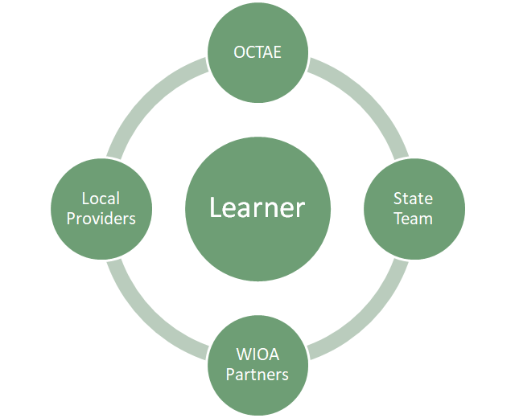
The Learner is at the Center of Partnerships
Notes:
Donna-
Philosophical Approach
We recognize that we have to partner with OCTAE, our WIOA partners and local provers to wrap around our learners.

Slide 13
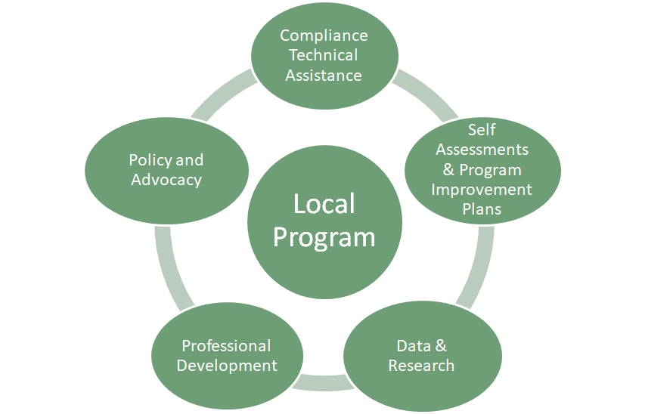
Partnerships – State Support for Local Programs
A philosophical approach to Title II Program Delivery in Oregon
Notes:
Donna: We also recognize that in order for our local programs to fully support our learners, we at the state level must wrap around them with a variety of supports.
This foundational approach is a theme you will recognize throughout today's presentation. Both before, during, and beyond.

Slide 14
“The Hub”

Slide 15
5 Remote Testing Stations
2 Part Time Test Proctors (one for mornings, one for evenings)
Testing Sessions are available:
Day | Morning | Evenings
Monday | 9:00 - 3:00 | 4:30 - 8:30
Tuesday | 9:00 - 2:00 | 4:30 - 7:30
Wednesday | 9:00 - 12:00 | 4:30 - 7:30
Thursday | 9:00 - 2:00 | 4:30 - 7:30
Friday | 9:00 - 3:00 | 4:30 - 8:30
Notes:
Each proctor will have up to 5 test sessions running at all times.
Sessions were setup for both morning/early afternoon and evening so that we had test available for students with different schedules

Slide 16
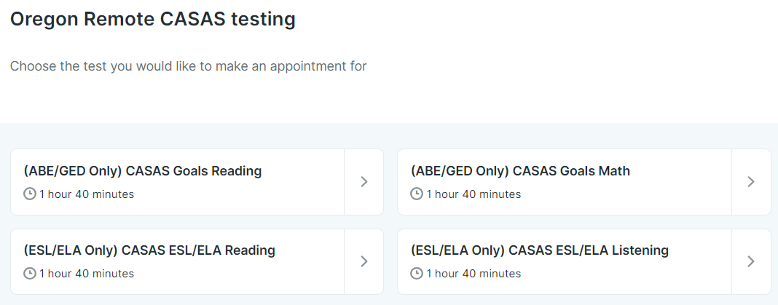
The Hub is for proctoring tests only
All Part A: Preparation for Remote Testing activates are the responsibility of local programs
Students sign up for appointments online through youcanbook.me
Bookings are made with assistance from local program to ensure students book the correct test
Notes:
Students are prepared for the remote proctoring appointment by their local programs
Student appointments are scheduled online and local programs are assisting students to make the correct appointment with the correct data
Youcanbook.me sends an immediate appointment confirmation with the Zoom link for the meeting to the student’s email
Youcanbook.me also sends an appointment reminder 1 hour before the appointment with the Zoom links as well

Slide 17
Testing Session Usage
A snapshot from Quarter 2 of 2022-2023
Month | Percent of Morning Testing Slots Used | Precent of Evening Testing Slots Used
October | 66% | 81%
November | 78% | 94%
December | 93% | 94%
Notes:
We believe we have the right amount of testing sessions available for our state needs
Testing usage tends to be highest near the beginning and end of each term (as expected)
Night testing usually has a higher usage percentage due in part to programs not having as much availability for night testing

