Slide 1
Remote Proctor Training
https://www.casas.org/product-overviews/remote-testing

Slide 2
Before meeting with the student...

Slide 3
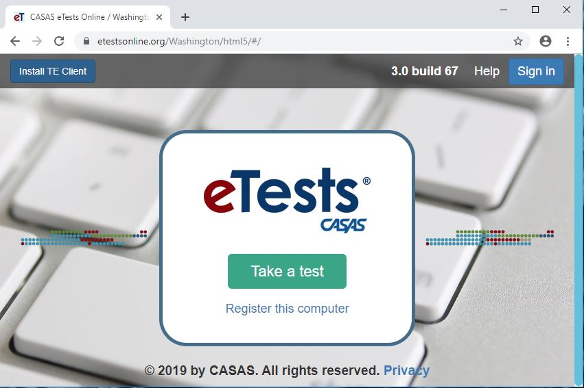
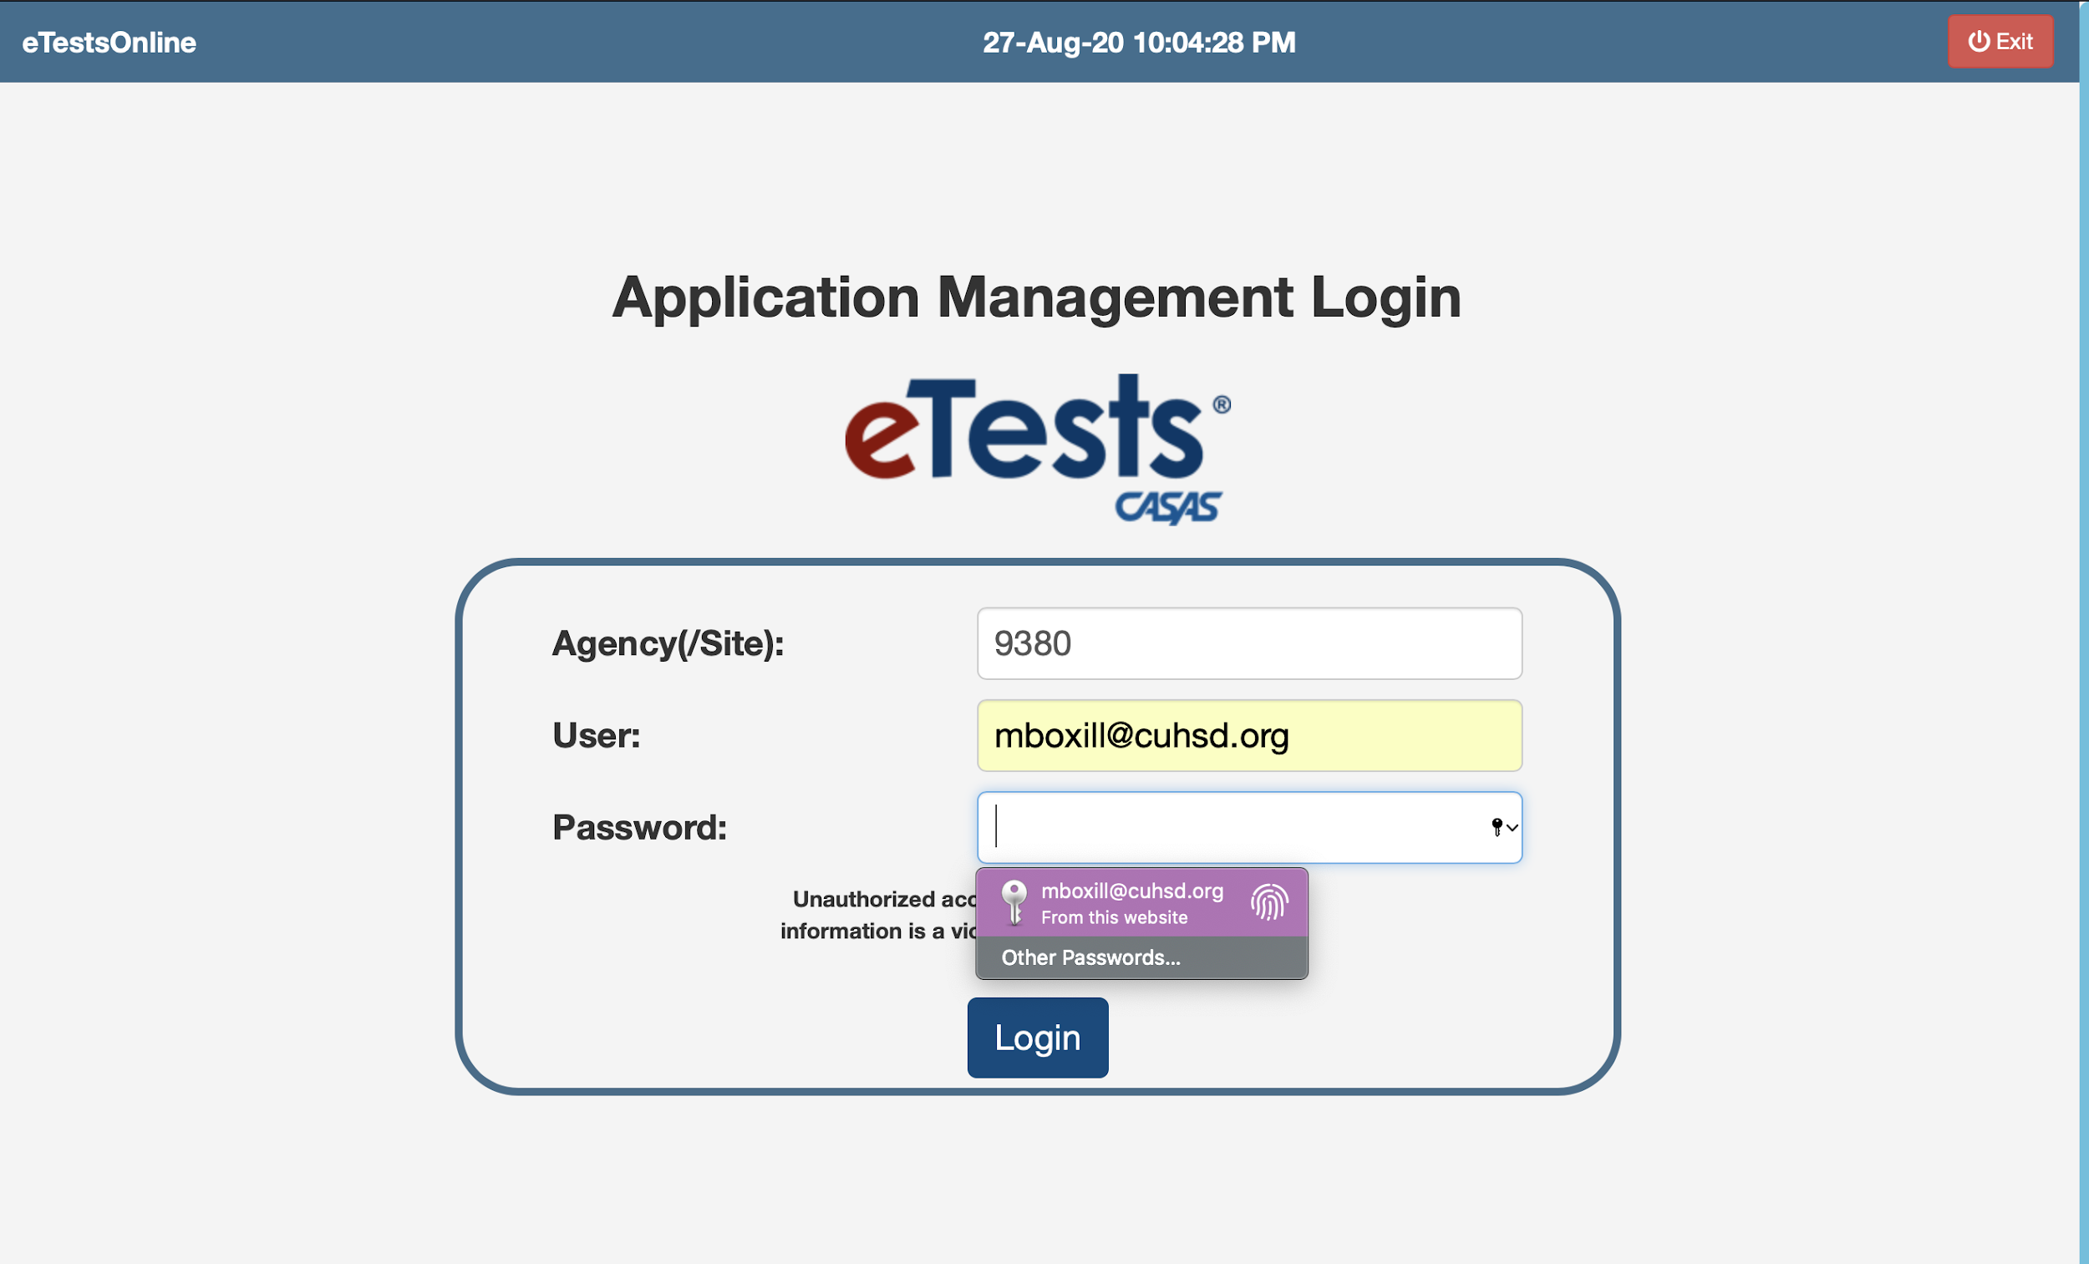
Setting up eTests
Testing Link: https://ca.etestsonline.org/html5/#/
Sign in at the top right corner
Agency/Site Code: 9380
Needed:
PC with Windows 10
Google Chrome

Slide 4
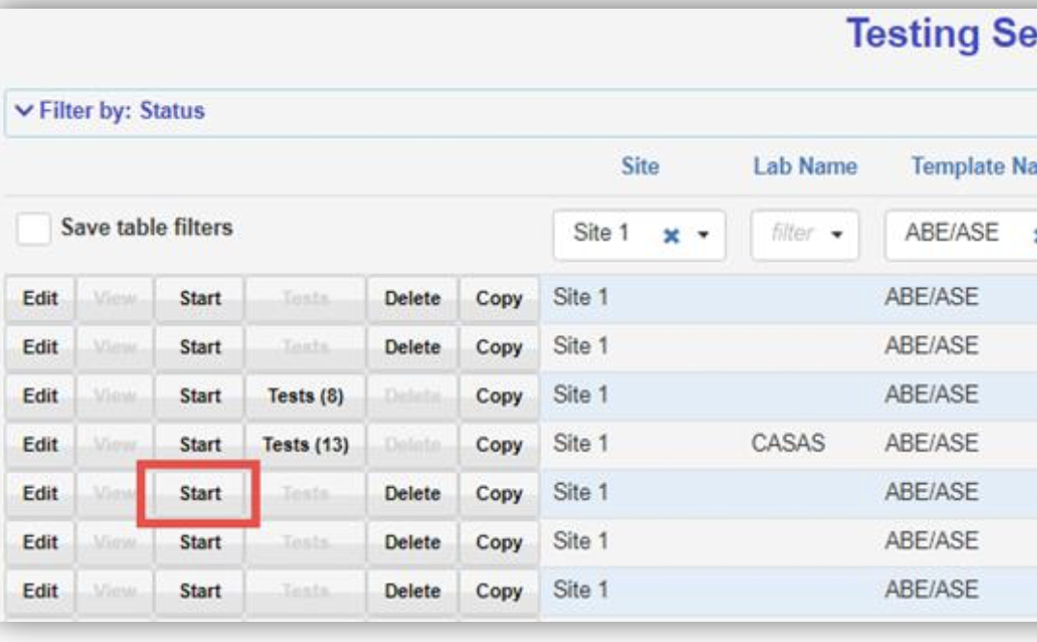
Start the testing session
ESL: Del Mar ESL Reading (2020-2021) Remote Testing
ABE/HSD: ABE/ASE Assessment Reading Goals (2020-2021) Remote Testing
HSE/Span HSE: HSE Math Goals (2020-2021) Remote Testing

Slide 5
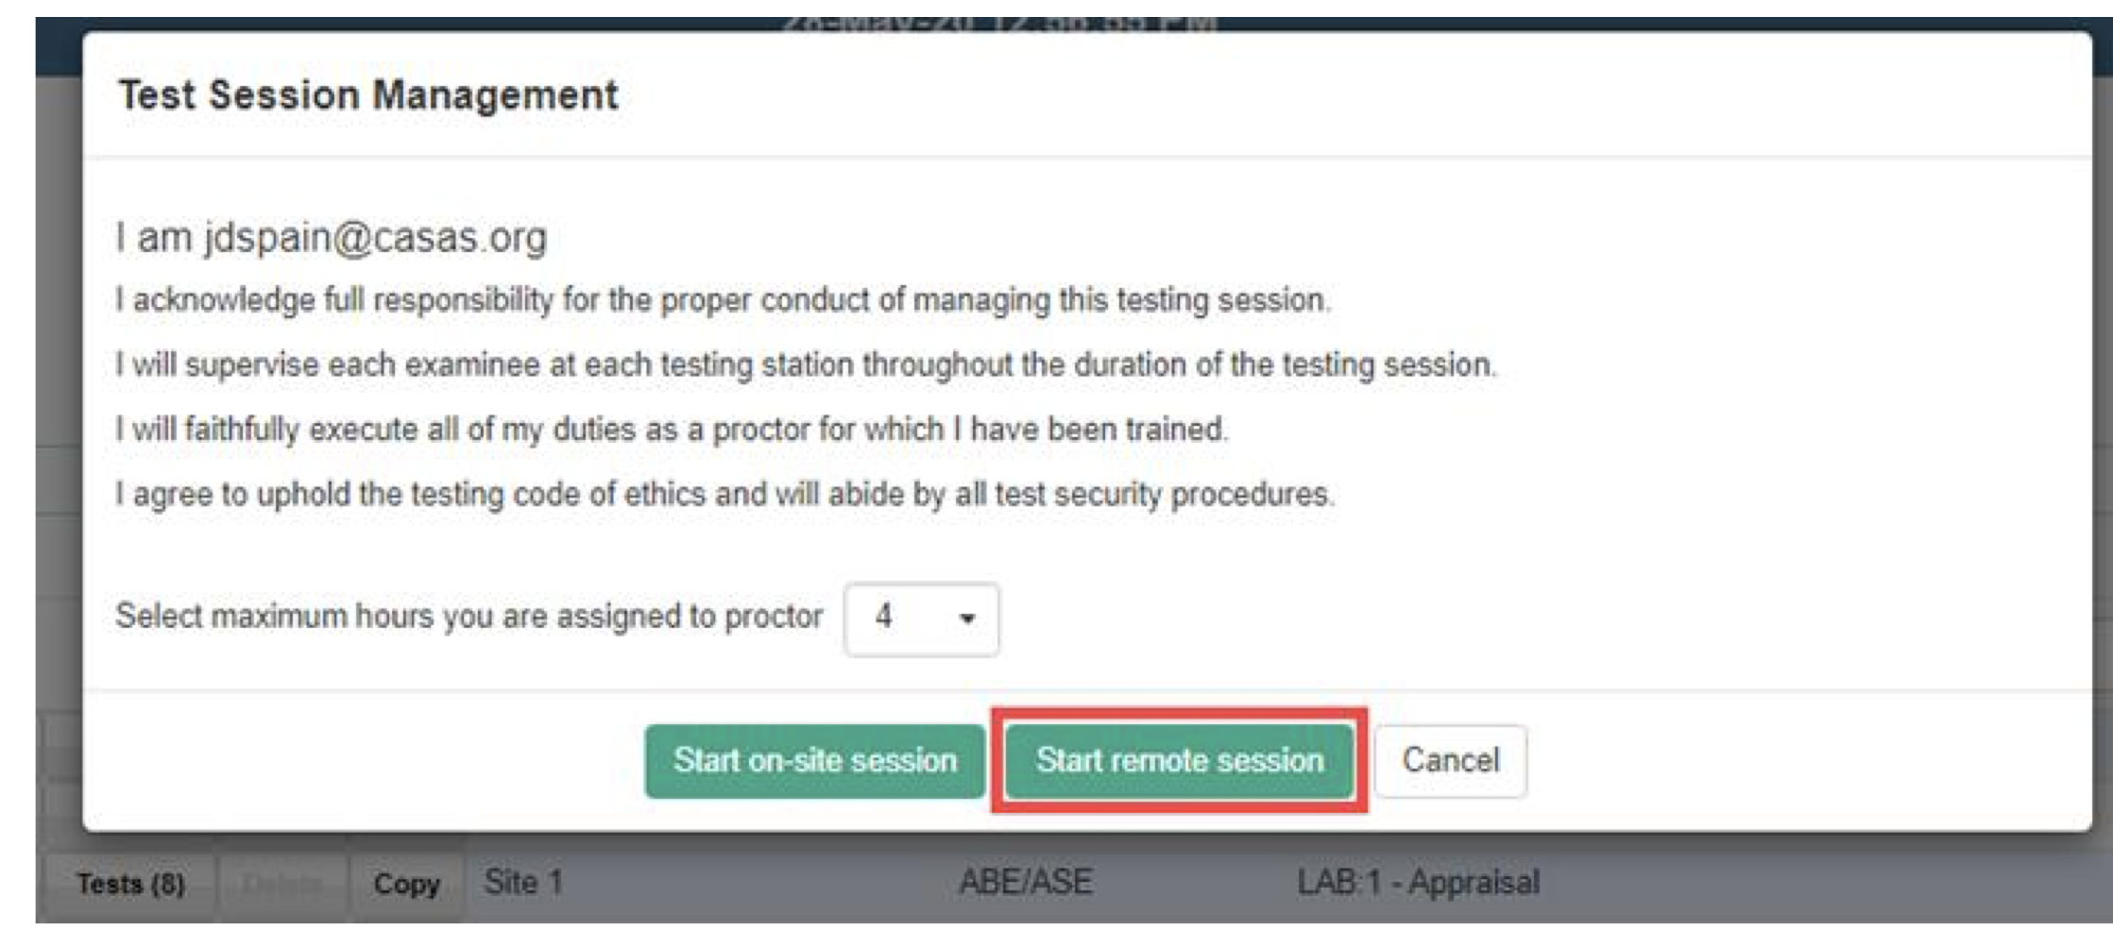
Select Start Remote Session
This step is important because you can not add a computer remotely if you select “On-Site”.

Slide 6
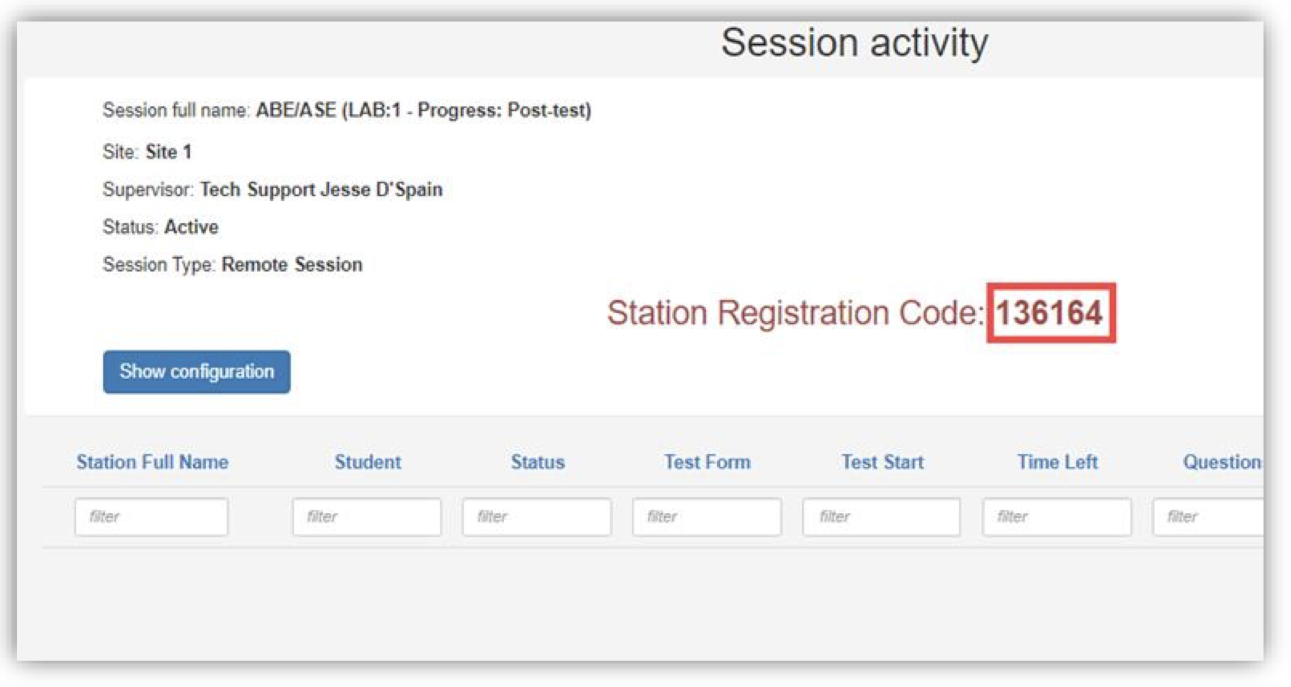
Registration Code
This is a one time code that changes every time a new testing session is started.
This code is used to register the computer that will be used for testing.

Slide 7
Registering your computer
Log out of eTests
Exit the login screen
Click on “Register this Computer” (your computer)
Download the test

Slide 8
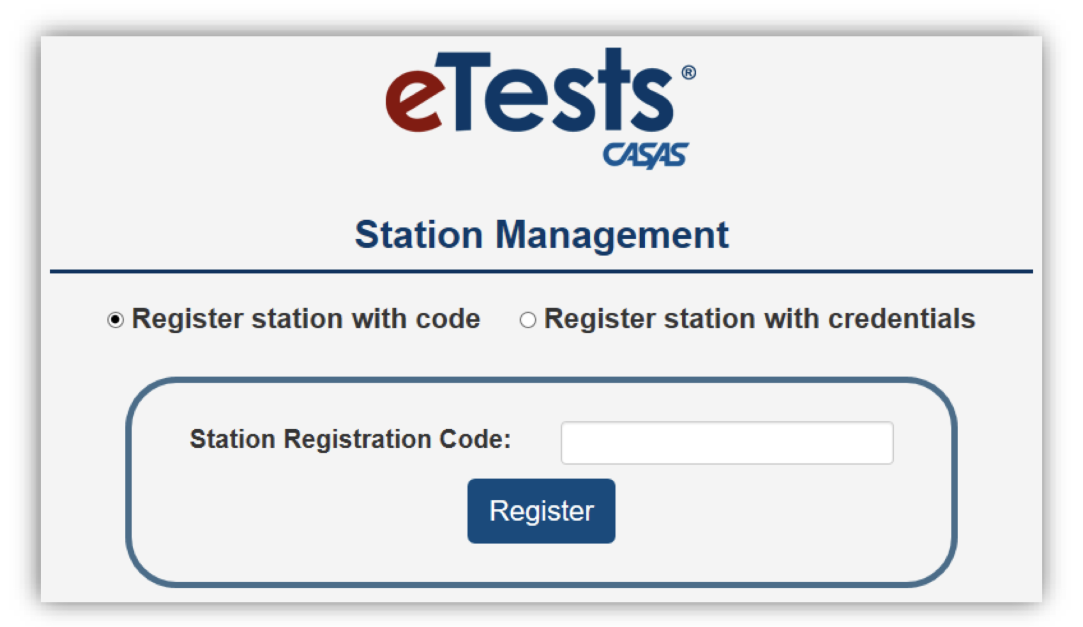
Enter the Registration Code
Enter the station code
After the station code is entered, it will go to the test page
You need to exit until you and the student are ready to begin the test

Slide 9
Enable the test
Before the test can be taken, the proctor has to log back into the testing session.
Next to the station name, “Enable Test” needs to be selected.
Log out again
I like to have an extra computer or Tablet incase I forget

Slide 10
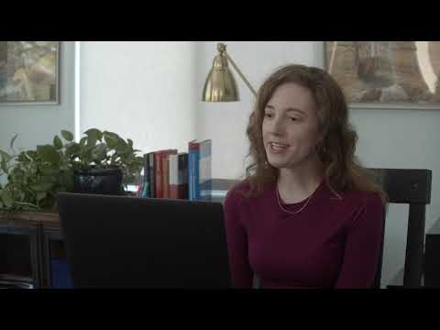
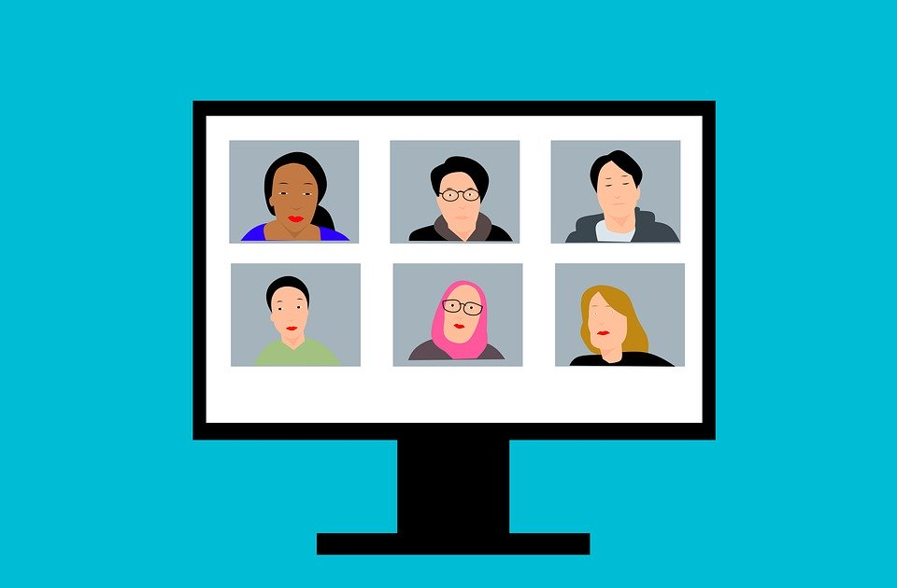
Meeting with the student...

Slide 11
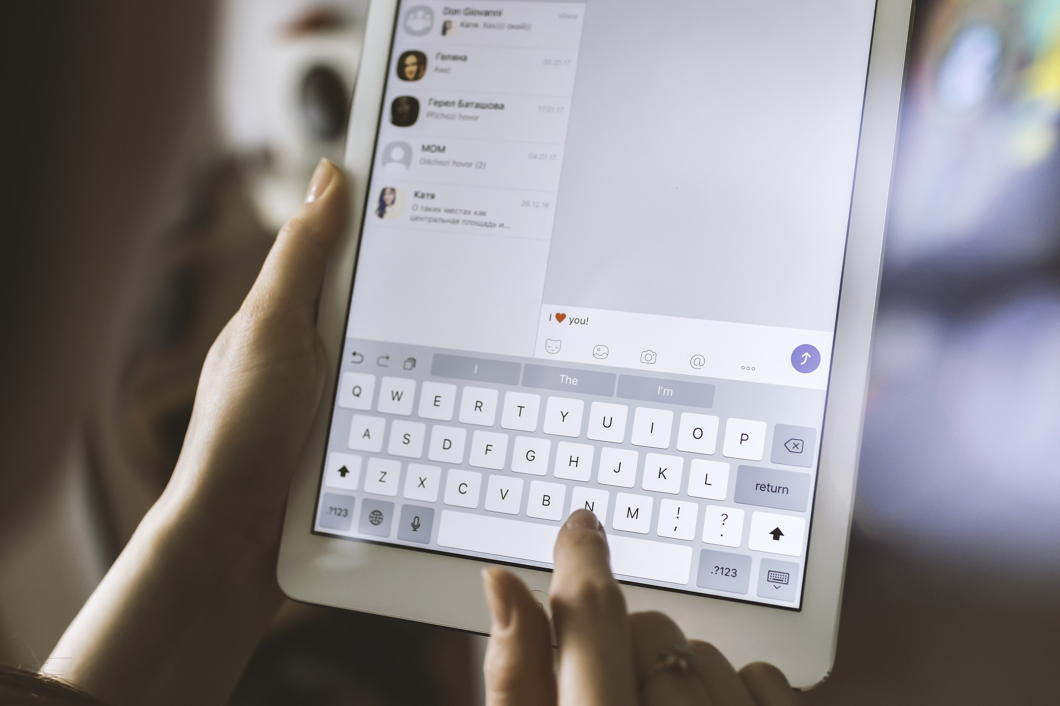
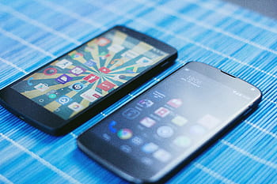
Student Devices
Take the test on:
PC - Download
Mac - Download
iPad - App
Tablet - App
Chromebook - Oral Responses Only
If there is no camera on the device:
Student needs to sign into Zoom twice: Phone and Computer
Ask them to Mute and turn off the volume for the computer
It creates an awful echo

Slide 12
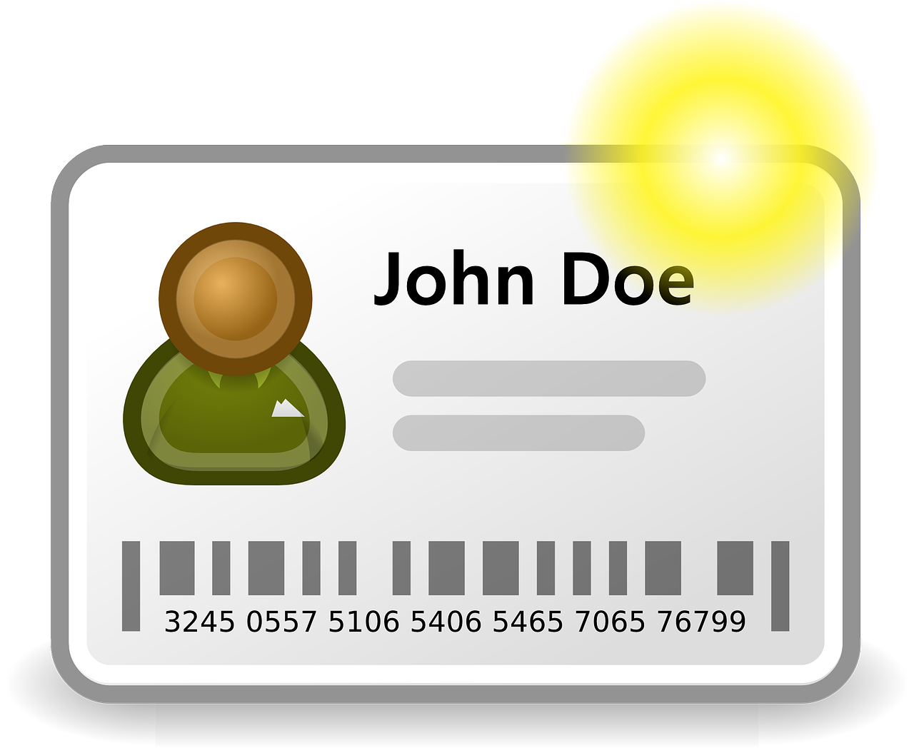
Introduce yourself
Ask for the student’s ID
It can be:
CACE ID
Driver’s License
Passport
Green Card
Etc…

Slide 13
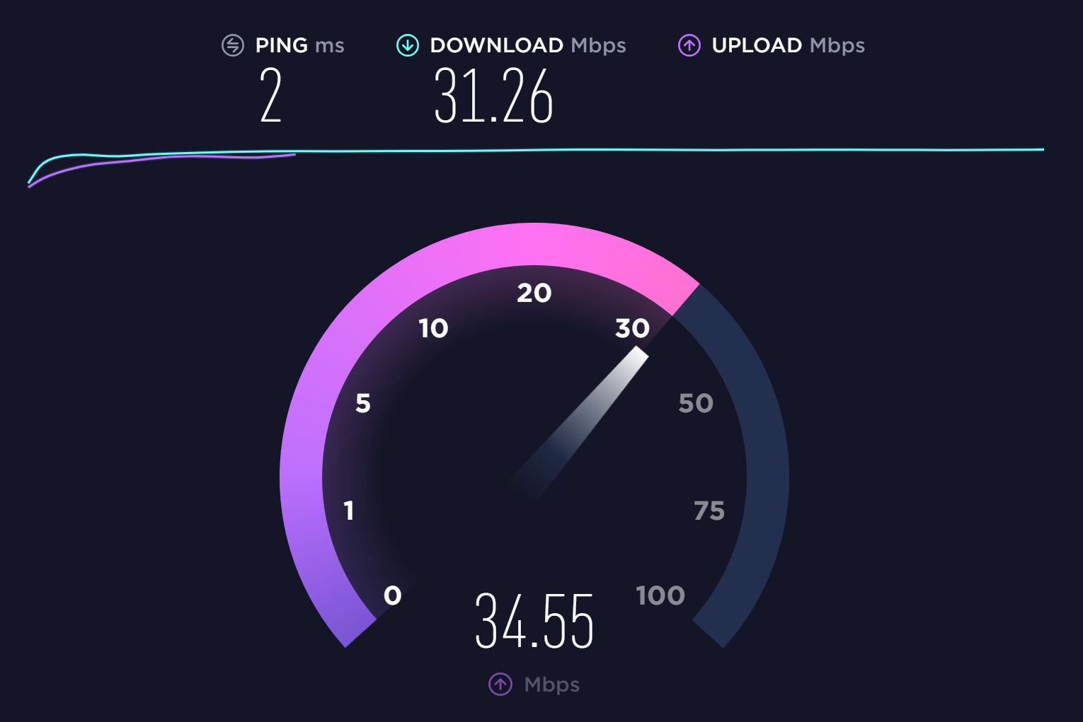
Speedtest
The internet speed needs to be at least 2 mbps for Download
https://www.speedtest.net
Have student share their screen so that you can see the Speedtest score and make sure Zoom is the only thing open

Slide 14
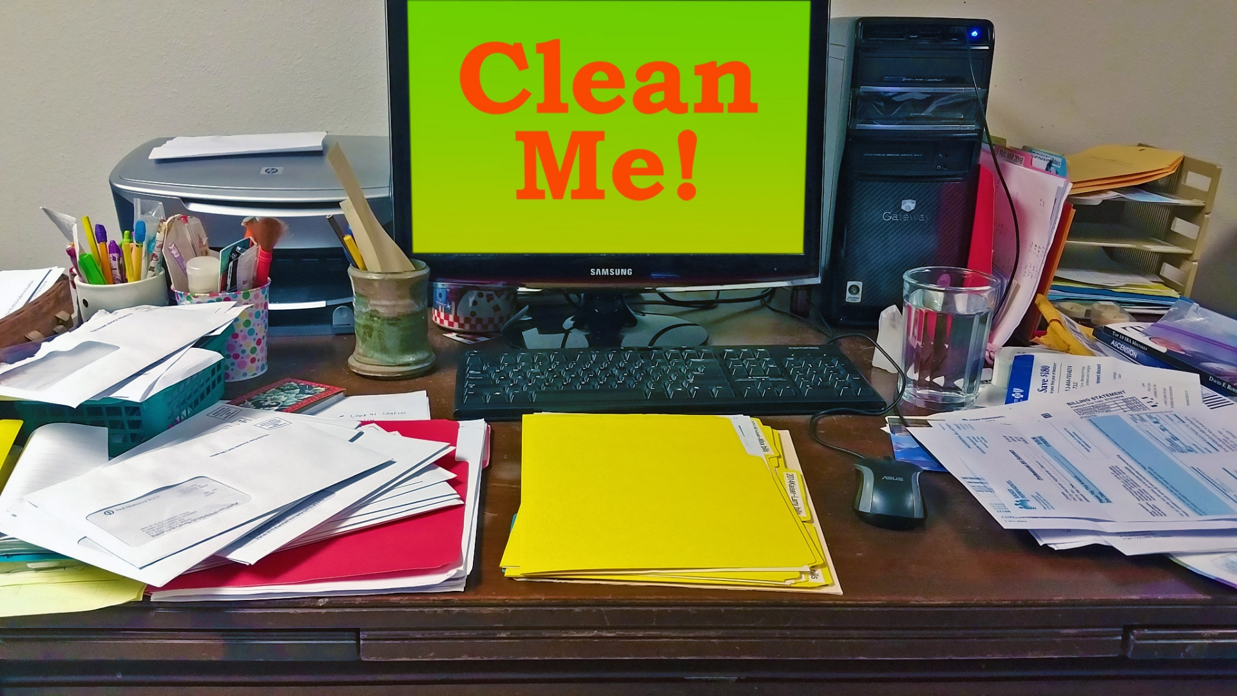
Environment
Ask the student to move the device so that you can view the room
There can not be any of these things close by:
Notes/Paper
Pens/Pencils
Books
Dictionaries
Translators
Phone
Other People

Slide 15
Agreement:
Next I need to ask you five questions in which you will answer Yes or No:
I need you to keep the camera and audio on at all times during the test. Do you understand?
Is there anyone else in the room with you?
Will you take the test by yourself?
You cannot use any dictionaries, cell phones, books or notes during the test. Do you understand?
You cannot take any pictures or write down any notes during the test. Do you understand?
Ask to turn off cell phones
After confirming that the student understands, you can share your screen.

Slide 16
Start the Test:
Repeat the process of downloading the test.
Enter the student’s ID number.
Student confirms name

Slide 17
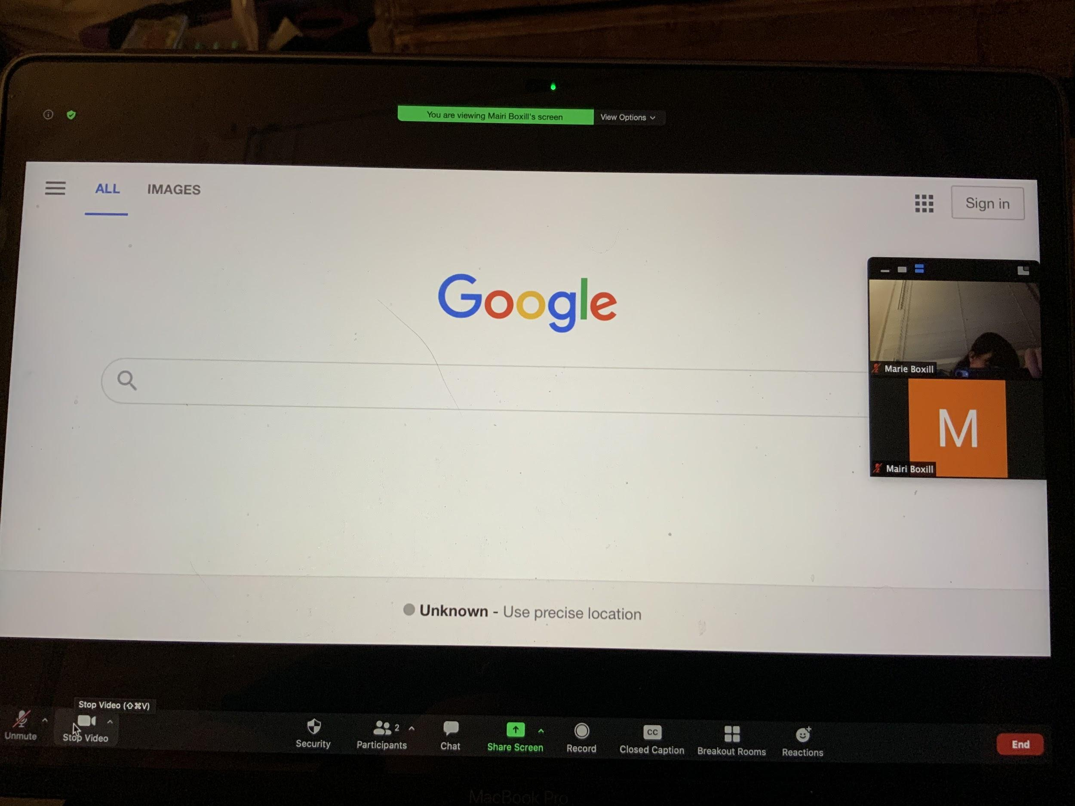
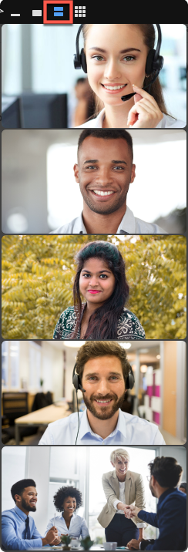
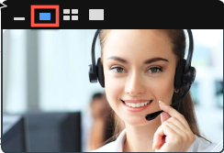
Where are the video icons?
I ask this because the questions are on the right side of the screen

Slide 18
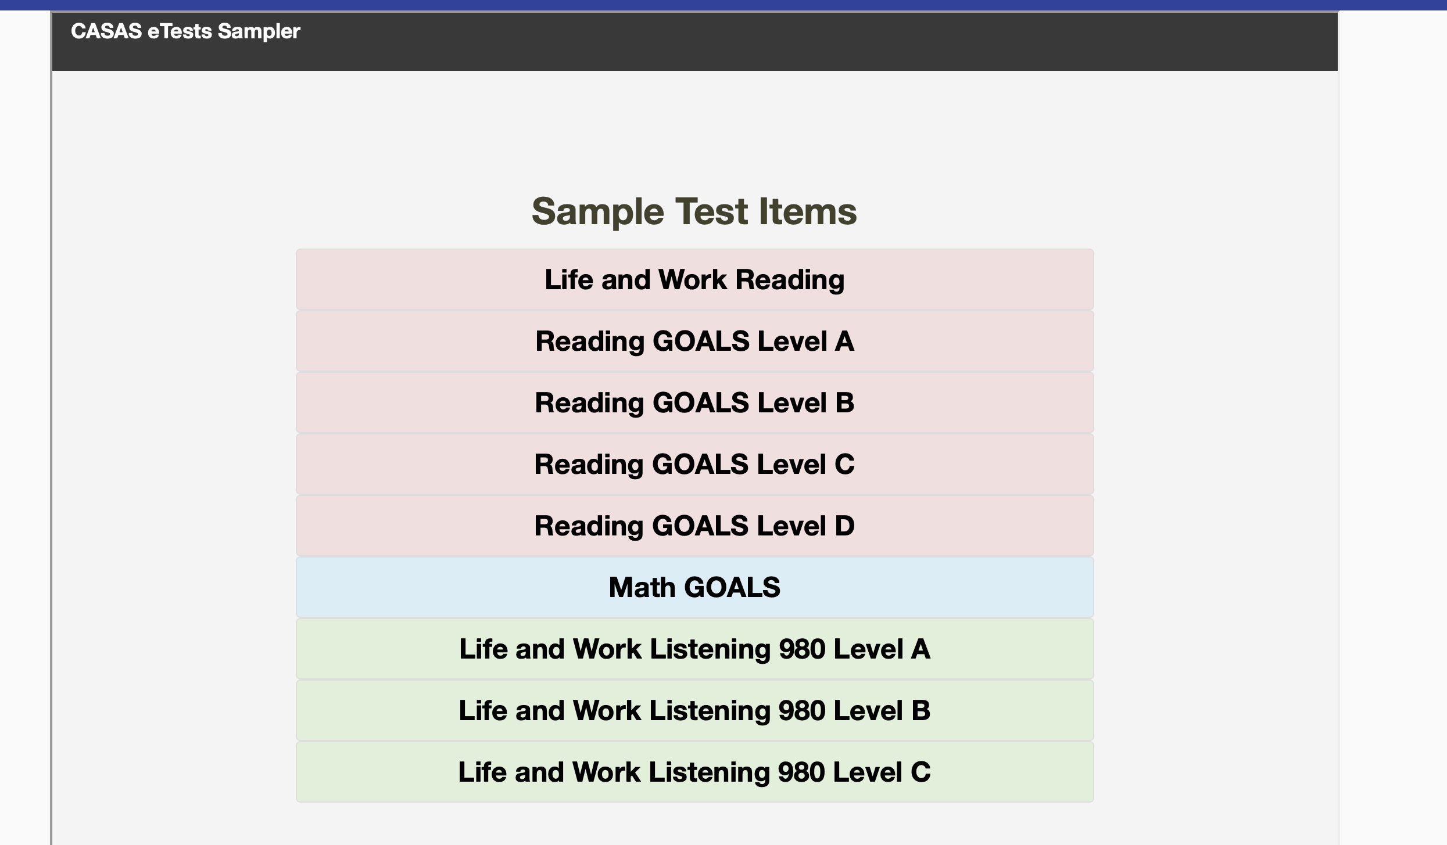
Ready to test
Student Camera and Audio are on
Proctor Camera and Audio are turned off

Slide 19
Give student remote control
The student can click on View Options at the top and then Request Remote Control
Or
You can give the student Remote Control by clicking on the icon at the top of the screen
*This step for iPads
Click on the name you want to give control to

Slide 20
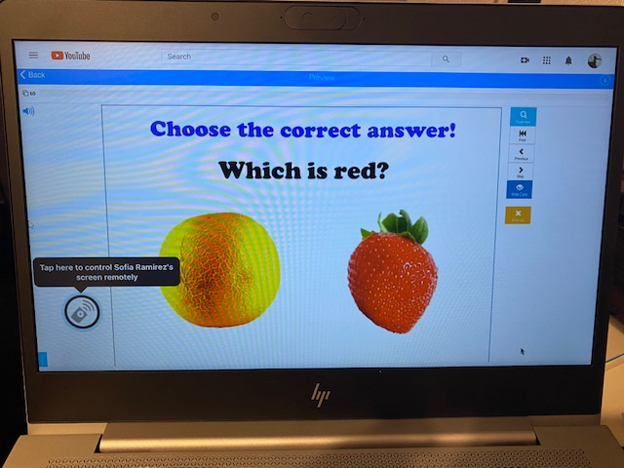
Students testing on an iPad
Students can not request Remote Control access. You need to give them access via the host toolbar.
When the student is given access, they will see a circle at the bottom. Tapping on the circle gives them Remote Control.

Slide 22
Practice
https://casasportal.org/eTests

