Slide 1
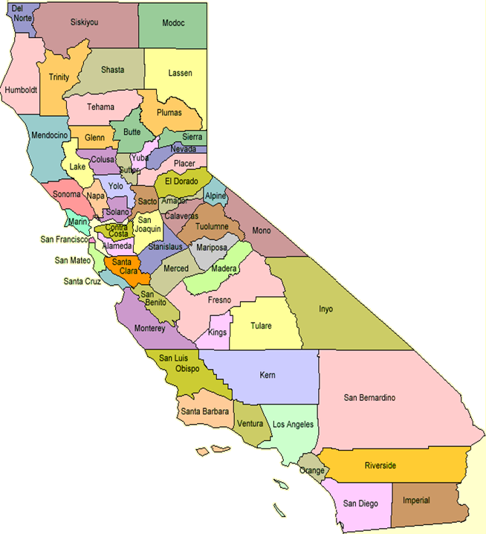
CASAS Technical Assistance for California WIA Title II Funded Agencies
New Staff
2010-11

Slide 2
California Accountability for New Users
At the end of this session, participants will be able to:
Describe WIA and NRS requirements
Identify the data submission timeline and deliverables
Implement basic data collection requirements
Implement appropriate pre- and post-testing
Identify funding sources and payment points
Locate resources and technical assistance
Notes:
How long have participants been involved?

Slide 3
National Reporting System
The National Reporting System (NRS) is the accountability system for federally funded WIA Title II adult education programs.
The NRS is important to states, programs, teachers, and students because it provides a means of regular evaluation.
In August 1998 the voluntary nature of the NRS changed when the Adult Education and Family Literacy Act within the Workforce Investment Act (WIA - P.L. 105-220) became law.

Slide 4
NRS Resources
To learn more information about the National Reporting System:
  http://www.nrsweb.org
  http://www.nrsonline.org

Slide 5
WIA Title II Data Deliverables
Quarterly TOPSpro data submission
  Updated TOPSpro export to CASAS via Internet/disk
  Data Integrity Report
Quarterly Core Performance Survey
  Run TOPSpro Core Performance Reports
  Disseminate surveys to students and enter results on CASAS Web site
  Separate results for distance learning students
California WIA Title II Instructional Questionnaire
  CASAS sends questionnaires to agencies mid-October
  Agencies complete and return to CASAS by mail
WIA Title II Program Implementation Survey
  Complete online on CASAS Web site
End of Year Data Submission
  Submit TOPSpro export to CASAS via Internet/disk
  Data Integrity Report
  Certification Letter
  Payment Points Summary Report
  AE Personnel Wizard
Notes:
Probe for familiarity with Core Perf, Inst Questionnaire, WIA Survey

Slide 6
WIA Title II Data Collection Timeline
Data Submission | Core Performance | Date Due
1st Quarter Data Submission | 09-10 4th Quarter Sept 30, 2009 | October 31, 2010
2nd Qtr Data Submission | 1st Quarter Follow-Up Survey | January 31, 2011
3rd Quarter Data Submission | 2nd Quarter Follow-Up Survey | April 30, 2011
Year End Data Submission | 3rd Quarter Follow-Up Survey | August 15, 2011
None | 4th Quarter Follow-Up Survey | September 30, 2011

Slide 7
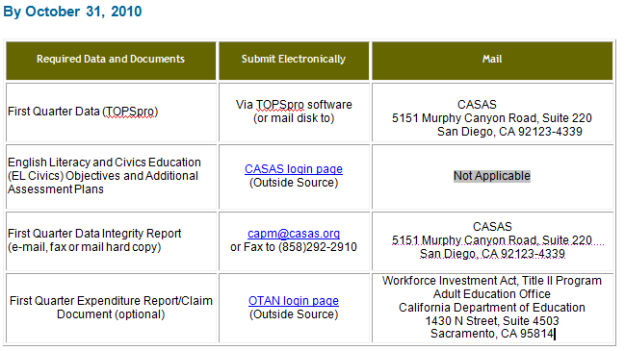
First Quarter Data Submission

Slide 8
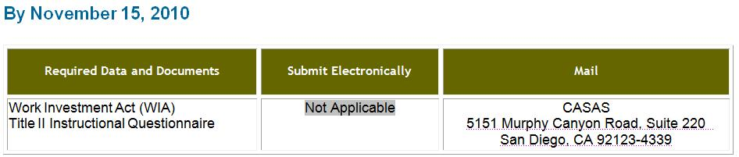
WIA Title II Instructional Questionnaire Submission

Slide 9
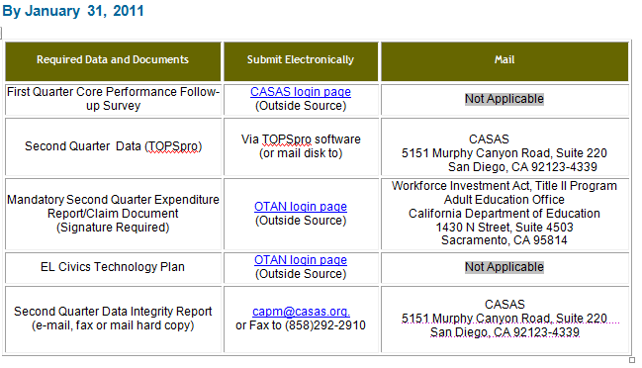
Second Quarter Data Submission

Slide 10
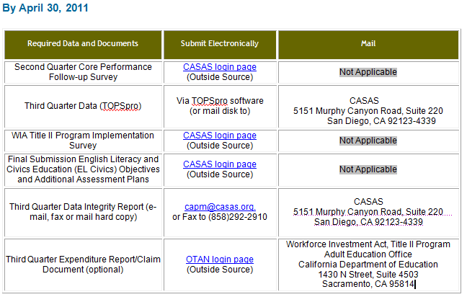
Third Quarter Data Submission

Slide 11
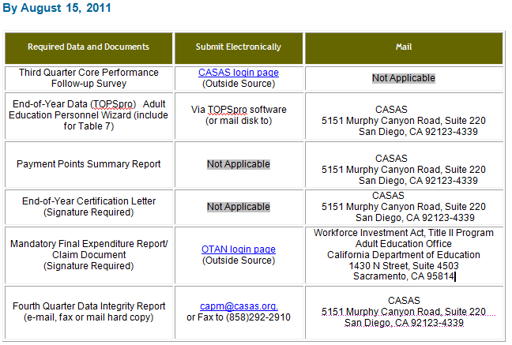
Fourth Quarter Data Submission

Slide 12
Follow-Up Quarter Data Submission
By September 30, 2011
Required Data and Documents | Submit online/Electronically | Mail hard copy
Fourth Quarter Core Performance Follow-up Survey | http://www.casas.org | Not Applicable (Online Only)

Slide 13
Summary of Required Surveys
WIA Title II Requirement | Frequency of Submission | Submission Method
Core Performance Survey | Quarterly | Online
WIA Survey | Annually | Online
Class Questionnaire | Annually | Paper

Slide 14
Data Collection Overview
Entry Record for all WIA II learners upon entry into class
Update Record for all WIA II learners who attend 12 or more hours of instruction
Test all WIA Title II learners (ABE, ESL, ASE)
Hours of instruction on Update Record
Entries and Updates for concurrent learners (K-12) enrolled in WIA funded programs
Enter aggregated personnel information (Federal Table 7) for staff assigned to WIA funded programs into TOPSpro

Slide 15
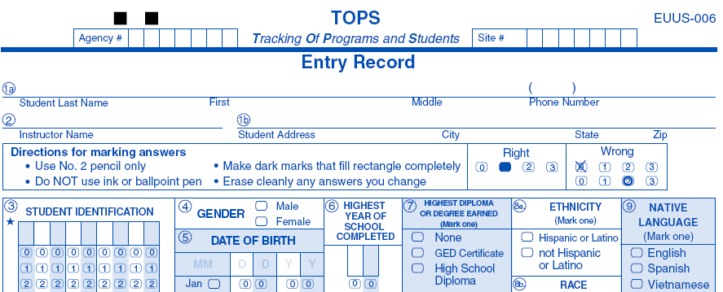
Entry Record
Includes fields to collect demographics, such as learner gender and date of birth
Includes program-related information, such as instructional program or date of entry into a class
Notes:
Note starred fields

Slide 16
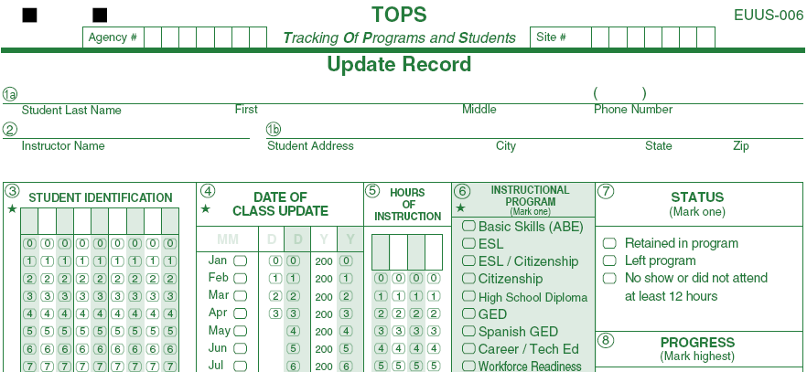
Update Record
Tracks learner progress and indicates results of instruction the learner received at your school or program.

Slide 17
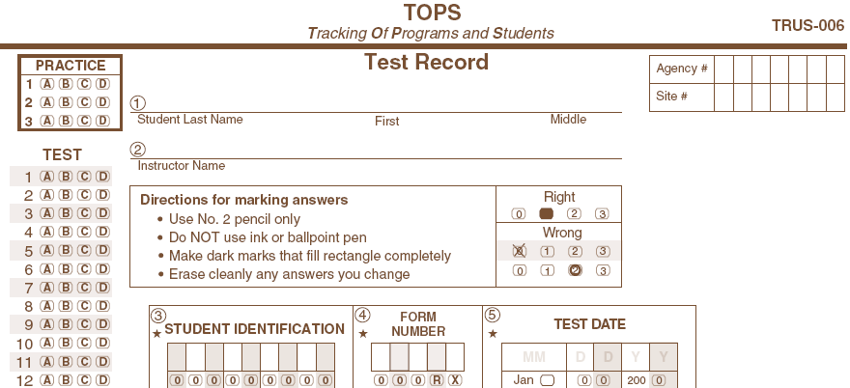
Test Record
Records answers to a single CASAS test and includes information about the test, such as test date and form number

Slide 18
Data Collection Requirements
Entry Records
For Each WIA Title II Learner:
Collect Gender (Field 4) and Date of Birth (Field 5)
Assist the learner in selecting primary and secondary goals, labor force status, and Distance Learning, if applicable
Learners with a goal of attaining a high school diploma or GED (Field 12) must have a CASAS test at or above 236

Slide 19
Data Collection Requirements
Update Records
Must be completed after a substantial block of instruction or at the end of the instructional period (semester, quarter, term)
Must be completed when a learner exits a program
Mark the appropriate learner status, progress, instructional level and reason for exiting

Slide 20
Data Collection Requirements
Entry and Update Records
Complete one Entry and one Update Record on a student for each class (strongly recommended)
If your agency uses only one Entry and Update Record for multiple classes, the Update Record must accurately report the learner’s total hours of instruction and outcomes for the year within an instructional program.

Slide 21
Hours of Instruction
On an Update Record — should accurately reflect the learner’s total hours of instruction
On a Test Record — should accurately reflect the hours of instruction the learner received since the previous test

Slide 22
California Assessment Policy
The CDE requires WIA Title II funded local agencies to test all students enrolled in ABE, ESL, and ASE instructional programs.
Pretests are recommended as soon as the student enrolls in the program
Post-tests are recommended at the end of each quarter, semester, or term to document continuous learner improvement – after approximately 70-100 hours of instruction.
Document is available for download on the CDE and CASAS Web sites

Slide 23
California Assessment Policy
Highlights of 2010-11 CDE Assessment Policy
Lists appropriate CASAS assessment instruments authorized for use for WIA II accountability reporting.
Details policies for appropriate test administration, scoring, and use of test results.
Includes updated instructions for hours between pre-/post-testing and distance learning programs
Documents CDE training attendance policy for WIA II agencies
Includes Guidelines for Local Assessment

Slide 24
Guidelines for Local Assessment
WIA Title II agencies must develop and implement a Local Agency Assessment Policy, and update it annually.
Local agencies may develop their own assessment policy guidelines, but must address, at a minimum, all CDE assessment policy guidelines and those included in the Guidelines for Local Assessment template.
Download the template at the California Accountability page, at www.casas.org
CDE will review local policy and implementation during program monitoring.

Slide 25

Valid Paired Test Records
Accurate Pretest
  Test score is within the accurate range or conservative estimate range (high end or  score)
Appropriate Post-Test
  Scored within the accurate or conservative estimate range
  Post-test form of equal or higher level, but not administered consecutively
Notes:
Define * scores and ◊ scores

Slide 26


Pre- and Post-test Examples
Can I administer the same test form more than once?
  Yes, but not consecutively.
81 R
“A” test
82 R
“A” test
81 R
“A” test

Slide 27

Pre- and Post-test Examples
All tests within a level are interchangeable.
82 R
“A” test
81 R
“A” test
82X R*
“A” test

Slide 28

Pre- and Post-test Examples
Can I administer a lower level test as
a post-test?
NO.
84 R
“B” test
82 R
“A” test

Slide 29
Pre- and Post-test Examples
Can I administer a higher level test as
a post-test? YES.
82 R
“A” test
84 R
“B” test

Slide 30

Appropriate Pre- and Post-Test Selection
Appropriate
81R-82R-81R
81R-82R-81RX
82R-82RX-84R
Inappropriate
81R-81R-81R
81R-87R
85R-83R

Slide 31

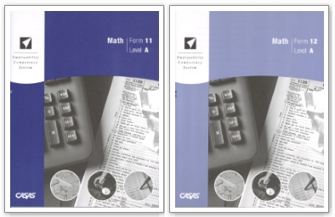
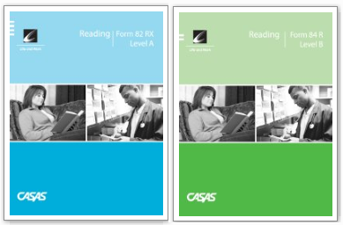

Use of Assessment Modalities
ABE/ASE: Use Reading and/or Math
ESL: Use Reading and/or Listening
Pre- and post-test pairs must always be from the same test modality.

Slide 32
Multiple Modalities Paired Tests
For students with two sets of pretest and post-test scores, such as one in reading and one in listening, which determines benchmark attainment?
  The pretest and post-test pair with the lowest accurate pretest score determines benchmark attainment
Notes:
Discuss Reading Math
Reading Listening combination

Slide 33
ABE/ESL CASAS Pretest 236 or Higher
Payment Points Drop Reason #10
Enroll learner in GED or high school diploma instructional program with goal of GED or high school diploma
Test in another modality
Do nothing and student will not be included in federal reporting for WIA Title II.

Slide 34
Appropriate Goal Setting and Program Placement for ASE/GED Learners
All adult learners with a goal on the TOPSpro Entry Record of attaining a high school diploma or GED must have a CASAS test at or above the following thresholds:
Test Benchmark — CASAS Scale Scores (Reading or Math)
Low ASE | 236 – 245
High ASE | 246 and above
Notes:
This new policy shown here will be effective immediately. It states that for a learner to have a primary or secondary goal of GED/High School Diploma, the learner must have a CASAS pretest score at or above specific thresholds. For ASE Low learners, their CASAS Reading pretest score must be 236 to 245. For ASE High learners, the CASAS Reading score must be 246 or above.
We will send a message to all agencies explaining and including a copy of the policy. The policy will be included in the CASAS Administration Manual and an error check incorporated into TOPSpro. We are also encouraging agencies to focus on goal setting for instruction and WIA Title II reporting purposes this year and will be working through the State Leadership Projects to help agencies with this.

Slide 35
Data Collection: WIA Title II
Sections 225/231 & EL Civics
Designate the funding source(s) of your own agency using the Agency Lister in TOPSpro.

Slide 36
225 Funded Agencies
Entities | Instructional Programs | Required TOPSpro Forms
State Departments Corrections and Rehabilitation Mental Health Developmental Services Jail Programs | ABE ESL ASE (GED/HSD) | Entry Record Create upon entry into program Update Record Create after ≥12 hours of instruction Pretest/Post-Test All students, all programs

Slide 37
231 Funded Agencies
Entities | Instructional Programs | Required TOPSpro Forms
Local Agencies Adult Schools CBOs Community Colleges Library Literacy | ABE ESL HSD/GED Special Programs Family Literacy VABE & VESL ESL-Cit (Citizenship Preparation) | Entry Record Create upon entry into program Update Record Create after ≥12 hours of instruction Pretest/Post-Test All students, all programs

Slide 38
225 and 231 Funded
If your agency receives funding for both 225 and 231:
  Each program must have a unique CASAS agency ID number
  Separate data submissions required
Notes:
225 + 231 refer to two paragraphs in WIA

Slide 39
EL Civics Funded Agencies
Entities | Instructional Programs | Required TOPSpro Forms
State/Local Agencies Adult Schools CBOs Community Colleges Library Literacy | ESL Special Program EL Civics | Entry Record Create upon entry into program Update Record Create after ≥12 hours of instruction Pretest/Post-Test All students, all programs Additional Assessments* Citizenship Interview Test* Gov’t. and History Test* *(optional)

Slide 40

EL Civics Focus Areas
Civic Participation – connects literacy to the lives of learners and reflects their experiences as community members, parents, and participants in the workforce.
Citizenship Preparation – prepares learners to take and pass the U.S. Citizenship and Immigration Services (CIS) written and oral citizenship test.

Slide 41
EL Civics Class Designation
Designate the appropriate focus area for each EL Civics class in the TOPSpro Class Lister.
Notes:
Note Additional Assessment Import Wizard
Reminder re: no ESL Citizenship

Slide 42
EL Civics Guidelines
Entry Record for each EL Civics focus area a student attends — must be for an EL Civics designated class
Update Record— follow the same guidelines as ESL
CASAS pre- and post-tests—use reading or listening tests
EL Civics students must have instructional program of ESL (not ESL-Citizenship)
Agencies that are funded for EL Civics must designate Citizenship Preparation under EL Civics

Slide 43
Section 231 ESL-Citizenship
Effective 2010-11, 231 funded agencies who are not funded for EL Civics may implement ESL-Citizenship under section 231 if they have applied and been approved for ESL Citizenship.

Slide 44
Non WIA II Data Collection Guidelines
Local agency determines data collection requirements for non WIA II programs
Agencies that choose to continue this data collection refer to Appendix E in 2010-11 Administration Manual for California
Adult schools with CALWORKS eligible students should continue to collect data following guidelines in Section 3 of manual
Performance-based Accountability (PBA) is no longer required

Slide 45
Payment Point Structure
Payment Points
Includes all achievements that can result in a payment under the grant and focus area
Two types:
  1. Benchmarks
  2. SODS (Student Outcome Datasets
Payment Points
Benchmarks
SODS

Slide 46
Payment Point Structure
Benchmarks
Significant gain (on CASAS scores)
Two-level advancement
Completion of GED or high school diploma

Slide 47
Significant Gain Benchmark
5 points gain or greater for pretest scores of 210 or below
3 points gain or greater from pretest scores of 211 and above
Earned in only one modality
Earned only once for each learner per program year

Slide 48
Significant Gain Benchmark Calculation
Significant Gain
Calculated by first accurate pretest to highest appropriate post-test
Highest
210
206
203
First Accurate
200

Slide 49
Significant Gain Benchmark Calculation
Significant Gain
Pretest = 206
Post-test = 210
4 point gain
Highest
210
206
First Accurate
203

Slide 50
Significant Gain Benchmark Calculation
Significant Gain
Pretest = 200
Post-test = 206
6 point gain
Highest
206
203
First Accurate
200

Slide 51
Two Level Advancement Benchmark
Refers to CASAS levels within the NRS adjusted levels of performance
Gain resulting in two-level movement on California Benchmark Levels
See 2010-11 California Administration Manual, Section 6
Earned in only one modality
Earned only once for each learner per program year

Slide 52
Payment Points for Basic Skills (ABE)
NRS (National Reporting System) Level Names for BS | CASAS Score Ranges for NRS Levels | CASAS Level Names for ABE | CASAS pretest scaled score range for California Payment Point | Minimum scaled score gain in order to earn a significant learning gain | Minimum post-test scaled score to achieve a two level gain
Beginning Adult Basic Education Literacy | 200 and below | Beginning Literacy/Pre-Beginning | • 180 and below | 5 or more points (3 or more points for learners using POWER) | 191
 |  |  | • 181 – 190 |  | 201
 |  |  | • 191 – 200 |  | 211
Beginning Basic Education | 201 – 210 | Beginning Basic Skills | • 201 – 210 |  | 221
Low Intermediate ABE | 211 – 220 | Intermediate Basic Skills | • 211 – 220 | 3 or more points | 236
High Intermediate ABE | 221 – 235 | Advanced Basic Skills | • 221 – 235 |  | 246
Low Adult Secondary Education | 236 – 245 | Adult Secondary | • 236 – 245 |  | N/A
High Adult Secondary Education | 246 and above | Advanced Adult Secondary | • 246 + |  | N/A

Slide 53
Payment Points for ESL
NRS (National Reporting System) Level Names for ESL | CASAS Score Ranges for NRS Levels | CASAS Level Names for ESL | CASAS pretest scaled score range for California Payment Point | Minimum scaled score gain in order to earn a significant learning gain | Minimum post-test scaled score to achieve a two level gain
Beginning ESL Literacy | 180 and below | Beginning Literacy/ Pre-Beginning ESL | • 180 and below | 5 or more points | 191
Low Beginning ESL | 181 – 190 | Low Beginning ESL | • 181 – 190 |  | 201
High Beginning ESL | 191 – 200 | High Beginning ESL | • 191 – 200 |  | 211
Low Intermediate ESL | 201 – 210 | Low Intermediate ESL | • 201 – 210 |  | 221
High Intermediate ESL | 211 – 220 | High Intermediate ESL | • 211 – 220 | 3 or more points | 236
Low Advanced ESL | 221 – 235 | Advanced ESL | • 221 – 235 |  | 246
Notes:
Note changes to NRS Levels upcoming in 2006-07

Slide 54
GED and High School Diploma Benchmarks
GED Benchmarks
GED students must pass all five sections
Must mark “Passed GED” on Update Record
Passing the Spanish GED is acceptable for GED benchmark attainment
GED students must use their Social Security number (SSN) or GED ID
CDE will perform a data match for GED students to determine benchmark payments
Notes:
GED – more info needed for these individuals because of CDE data match
HSD – student must pass CAHSEE to earn HSD

Slide 55
High School Diploma Benchmarks
HSD Benchmarks
High school diploma students must pass the California High School Exit Exam (CAHSEE)
Must mark “Earned HS diploma” on Update Record
Maintain certified list of high school diploma students

Slide 56
EL Civics Student Outcome Dataset (SODS)
Civic Participation
Pass one or more CDE-approved Additional Assessments (COAAPs)
Completion of Entry, Update, Pretest, and Post-test

Slide 57
EL Civics Student Outcome Dataset (SODS)
Citizenship Preparation
Pass Citizenship Interview Test (Score = 206 or above
Pass Government and History for Citizenship Test (Score = 206 or above)
Also requires presence of Entry, Update, Pretest, Post-test

Slide 58
225/231 Funded Only
Significant Gain
Two-Level Advancement
GED/HSD
The maximum number of Payment Points a student may earn for 225/231 funded only is three (3).
If an agency is 231 funded only and has been approved for ESL-Citizenship, a student can earn two additional payment points:
  Pass Citizenship Interview Test
  Pass Government and History for Citizenship Test

Slide 59
EL Civics Civic Participation Only
Significant Gain
Two-Level Advancement
Additional Assessments (up to 3)
The maximum number of Payment Points a student may earn for Civic Participation only is five (5).

Slide 60
EL Civics Citizenship Preparation Only
Significant Gain
Two-Level Advancement
Citizenship Interview Test
Government and History for Citizenship
The maximum number of Payment Points a student may earn for Citizenship Preparation only is four (4).

Slide 61
Section 231 and EL Civics Funded
The maximum number of Payment Points a student may earn from multiple focus areas is five (5), from a combination of benchmarks and SODS.
  231 and Civic Participation
  231 and Citizenship Preparation
  Civic Participation and Citizenship Preparation
  231, Civic Participation, and Citizenship Preparation

Slide 62

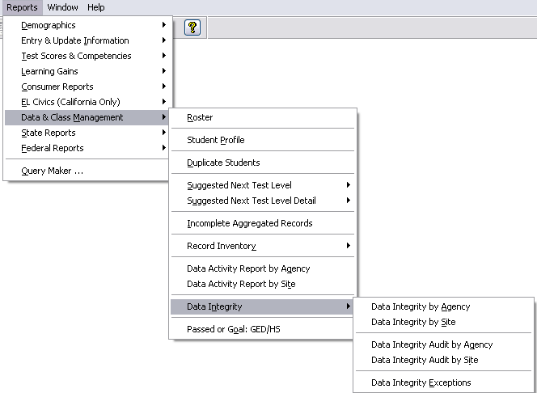
Resources
Reports: Data Management
Data Integrity Report — summarizes 28 essential student data elements by agency or site
Data Integrity Audit — lists potentially missing required data elements by student
Data Integrity Exceptions — lists potential issues by Data Integrity item number

Slide 63

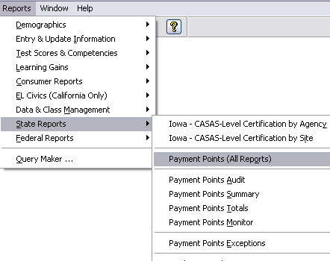
Resources
Reports: Payment Points
Payment Points Summary
Payment Points Totals —displays quantity and totals for each instructional program and focus area
Payment Points Monitor —provides special options to include/exclude certain criteria in the report
Payment Points Exceptions —identifies those dropped from the Payment Points reports

Slide 64

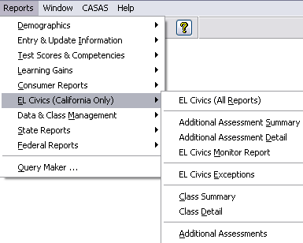
Resources
Reports: EL Civics
Additional Assessment Summary
Additional Assessment Detail
EL Civics Monitor
EL Civics Exceptions

Slide 65

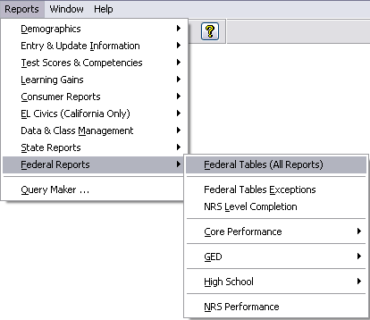
Resources
Reports: NRS Reports
Federal Tables (esp. FT 4, 4B, 5A)
NRS Performance Report
NRS Level Completion Report
Persister Report
Federal Table Audit Reports

Slide 66
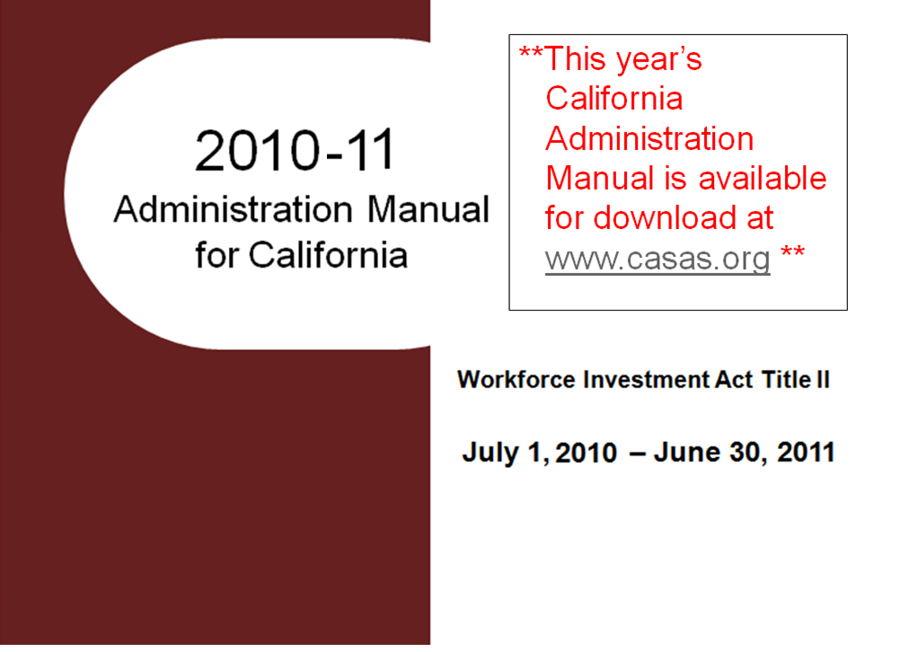
**This year’s California Administration Manual is available for download at www.casas.org **

Slide 67

2010-11 Ordering Guide for WIA II Agencies
WIA Title II agencies can order select CASAS materials free of charge using the 2010-11 Ordering Guide.
Access the Ordering Guide in your California Administration Manual or download it separately at www.casas.org.

Slide 68
Technical Assistance
CDE Consultants
Program assistance
Resources
Policy
Compliance
Legal and fiscal
Regional meetings
CASAS Staff
Provide assessment and curriculum support
Support California accountability
Provide TOPSpro and other technical assistance
Regionally assigned Program Specialists
Coordinate with CDE consultants

Slide 69
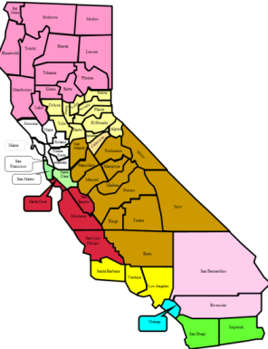
Resources
Regional Network Meetings
Each region in California holds network meetings where participants can address concerns and discuss ways to better meet accountability requirements.
  TOPSpro Network Meetings
  WIA II Network Meetings
  EL Civics Network Meetings
Network groups meet monthly, quarterly, or whatever is best for each region.
Meetings held face to face and online.
Register for network meetings at www.casas.org.

Slide 70
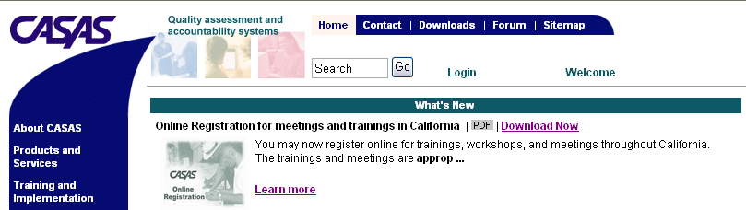
Resources
CASAS Web Site
What’s New
Online Registration
California Accountability Page
EL Civics Page
CASAS Forums
Download Centers
www.casas.org

Slide 71
Resources
CASAS Technical Support:
1-800-255-1036
CASAS Fax #:
1-858-292-2910
E-mail:
capm@casas.org
topspro@casas.org

Slide 72
Contact Information for New Personnel
Update WIA II Contact Information
  Agencies are required to periodically update their contact info on the OTAN Web site:
  www.otan.us/adulted/
  Include name, phone #, email and title: such as Primary WIA II contact, EL Civics contact, TOPSpro contact, district administrator, etc.
  If unable to access the OTAN Web site, then FAX on District Letterhead to:
    Rich Berry @ CDE, Fax #916-327-7089
    Martha Perez @ CASAS, Fax #858-292-2910
Notes:
It is important that contact information be updated in a timely manner. If there are new people or jobs have changed please immediately update the contact information.

Slide 73
Thanks for your participation!

